Slide 1

Automation Testing
Presented by: cuongtm8

Slide 2
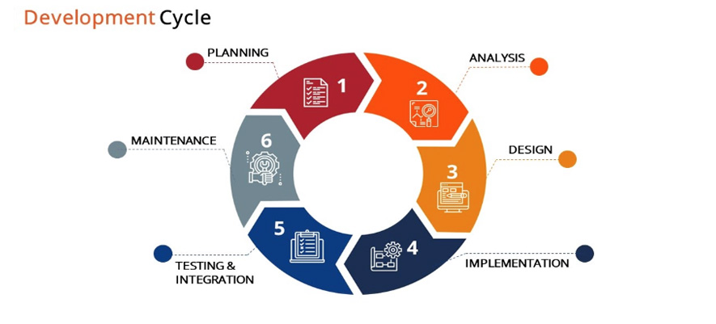
Development Cycle

Slide 3
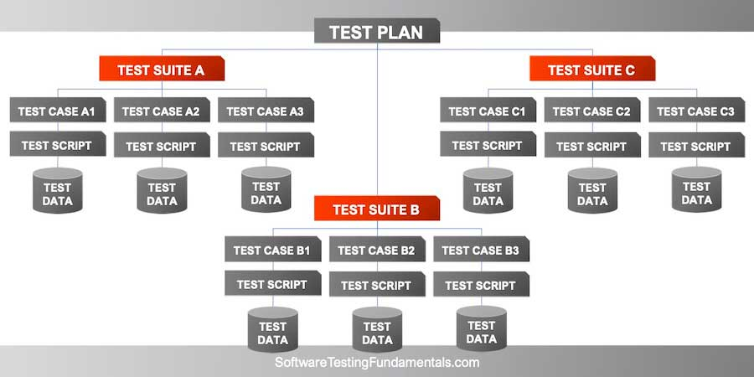
Test Case, Test Suite & Test Plan

Slide 4
Test Suites and Their Test Cases: The Hierarchy Explained
https://www.testim.io/blog/test-suites-test-cases-hierarchy-explained/

Slide 5
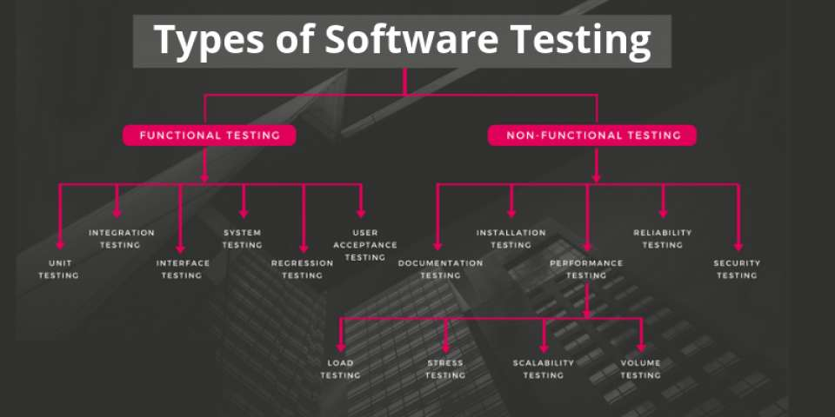
Types of Software Testing

Slide 6
Types of Software Testing
Read this article for more details about Types of Testing Framework:
https://hackr.io/blog/types-of-software-testing

Slide 7
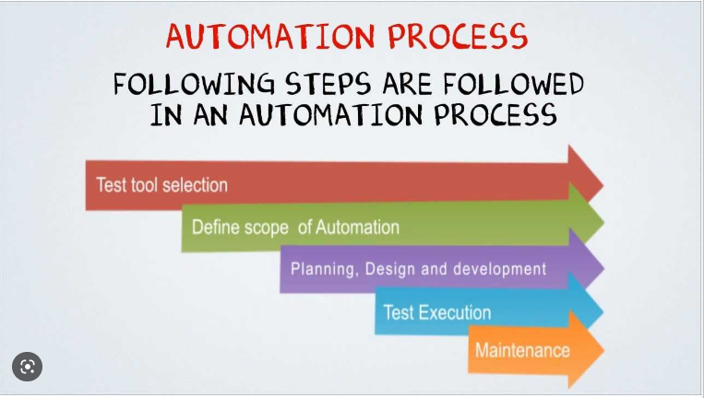
Automation Testing

Slide 8
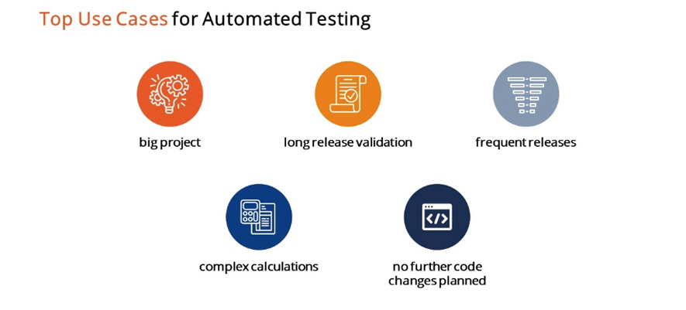
Top Use Cases for Automated Testing

Slide 9
More about Automation Testing
A very detailed PDF slide: https://home.cs.colorado.edu/~kena/classes/5828/s12/presentation-materials/ghanakotagayatri.pdf
Automation Testing for Beginner: https://www.guru99.com/automation-testing.html

Slide 10
What is a Test Framework?
Before diving into the most common types of frameworks and their benefits, let’s clarify what a test automation framework actually is. A testing framework is a set of guidelines or rules used for creating and designing test cases. A framework is comprised of a combination of practices and tools that are designed to help QA professionals test more efficiently.

Slide 11
Benefits of a Test Automation Framework
Utilizing a framework for automated testing will increase a team’s test speed and efficiency, improve test accuracy, and will reduce test maintenance costs as well as lower risks. They are essential to an efficient automated testing process for a few key reasons:
Improved test efficiency
Lower maintenance costs
Minimal manual intervention
Maximum test coverage
Reusability of code

Slide 12

Types of Automated Testing Framework

Slide 13

Linear Framework

Slide 14

Modular Framework

Slide 15
Library-based Framework
Library Architecture Testing framework aka “Structured Scripting” or “Functional Decomposition”
It is based on the modular framework with some additional advantages.
In the modular testing framework, we divide the application under test into modules whereas here we identify the common tasks and grouped them into functions. Once the functions are grouped then these groups will be kept in a library. The test scripts reuse these libraries to create new test cases.
Advantages | Disadvantages
Script maintenance is simple Easy to scalable Functions library is reusable and it can be reusable | Coding skills are required It takes more time to prepare test scripts A fixed set of test data is hardcoded within the scripts

Slide 16

Data-Driven Framework

Slide 17
Keyword Driven Framework
It is also known as table-driven testing or action word based testing.
In Keyword-driven testing, we use a table format to define keywords or action words for each function or method that we would execute. It performs automation test scripts based on the keywords specified in the excel sheet.
By using this Framework, testers can work with keywords to develop any test automation script, testers with less programming knowledge would also be able to work on the test scripts.
For more details, please visit this page: https://www.guru99.com/keyword-driven-testing.html

Slide 18
Hybrid Framework
As with most testing processes today, automated testing frameworks have started to become integrated and overlap with one another. As the name suggests, a hybrid framework is a combination of any of the previously mentioned frameworks set up to leverage the advantages of some and mitigate the weaknesses of others.
Every application is different, and so should the processes used to test them. As more teams move to an agile model, setting up a flexible framework for automated testing is crucial. A hybrid framework can be more easily adapted to get the best test results.

Slide 19

Behavior Driven Development Framework

Slide 20
More about Automated Testing Framework
https://smartbear.com/learn/automated-testing/test-automation-frameworks/
https://www.testim.io/blog/test-automation-frameworks/

Slide 21
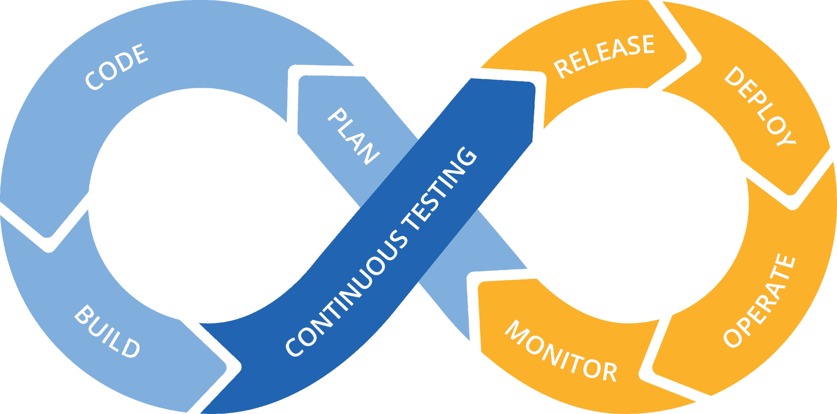
What is Continuous Testing?
Continuous Testing is the process of executing automated tests as part of the software delivery pipeline in order to obtain feedback on the business risks associated with a software release candidate as rapidly as possible. It evolves and extends test automation to address the increased complexity and pace of modern application development and delivery.

Slide 22
Continuous Testing Definition: 14 Key Points
1. Continuous Testing’s primary goal is assessing business risk coverage
2. Continuous Testing provides instant insight on whether a release candidate is too risky to proceed through the delivery pipeline
3. Continuous Testing establishes a safety net that helps the team protect the user experience in accelerated development processes and avoid software failure headlines
4. Continuous Testing expects testing to be embedded within the development process, not tacked on at the end
5. Continuous Testing is seamlessly integrated into the software delivery pipeline and DevOps toolchain
6. Continuous Testing expects a stable test environment with valid test data to be available for each and every test run
7. Continuous Testing embraces everything from “shift left” (unit, component, coverage…) to “shift right” (monitoring/ APM, Testing in Production)

Slide 23
Continuous Testing Definition: 14 Key Points
8. Continuous Testing involves executing the right set of tests at the right stage of the delivery pipeline—without creating a bottleneck
9. Continuous Testing delivers actionable feedback appropriate for each stage of the delivery pipeline
10. Continuous Testing evaluates each layer of a modern architecture at the appropriate stage of the delivery pipeline
11. Continuous Testing includes end-to-end tests that realistically assess the end-user experience across all associated technologies (front-end and back-end)
12. Continuous Testing’s tests must be broad enough to detect when an application change inadvertently impacts functionality that users have come to rely on
13. Continuous Testing reduces false positives by prioritizing robust, flexible modern test frameworks over brittle scripts
14. Continuous Testing involves continuously reviewing and optimizing the test suite to eliminate redundancy and maximize business risk coverage

Slide 24
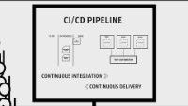
Continuous Integration/Continuous Delivery (CI/CD)

Slide 25

DevOps

Slide 26
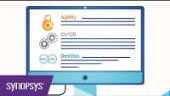
CI/CD .vs DevOps .vs Agility

Slide 27
Thanks for watching

