Slide 1

V-MODEL EXAMPLE
Hai Nguyen

Slide 2
Overview V Model
Requirement
Analysis
Acceptance
Testing
V-Model is also known as Verification and Validation Model. It is based on the association of a testing phase for each corresponding development stage.
System
Design
System
Testing
Architecture
Design
Integration
Testing
Validation Phase
Verification Phase
Module
Design
Unit
Testing
Coding

Slide 3

New job from customer
Customer wants to build a software which allows to insert/sort/delete any integer number.

Slide 4
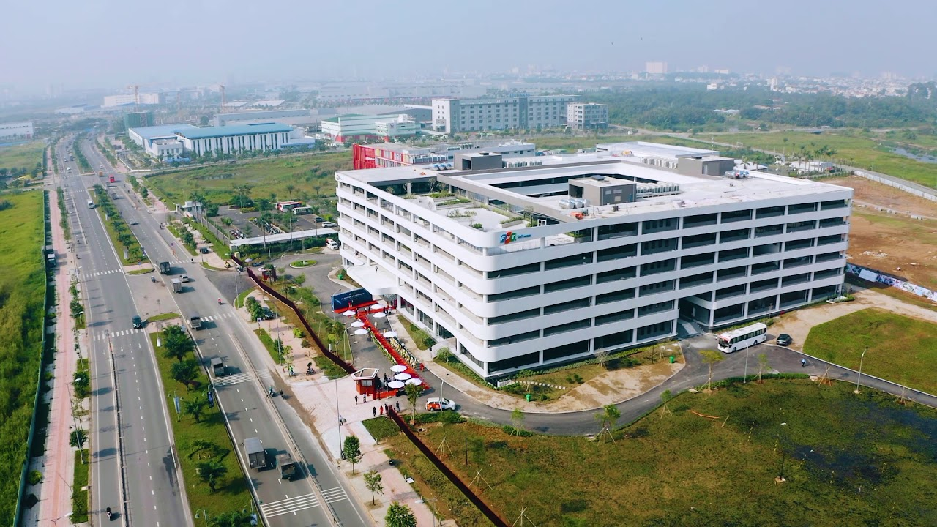

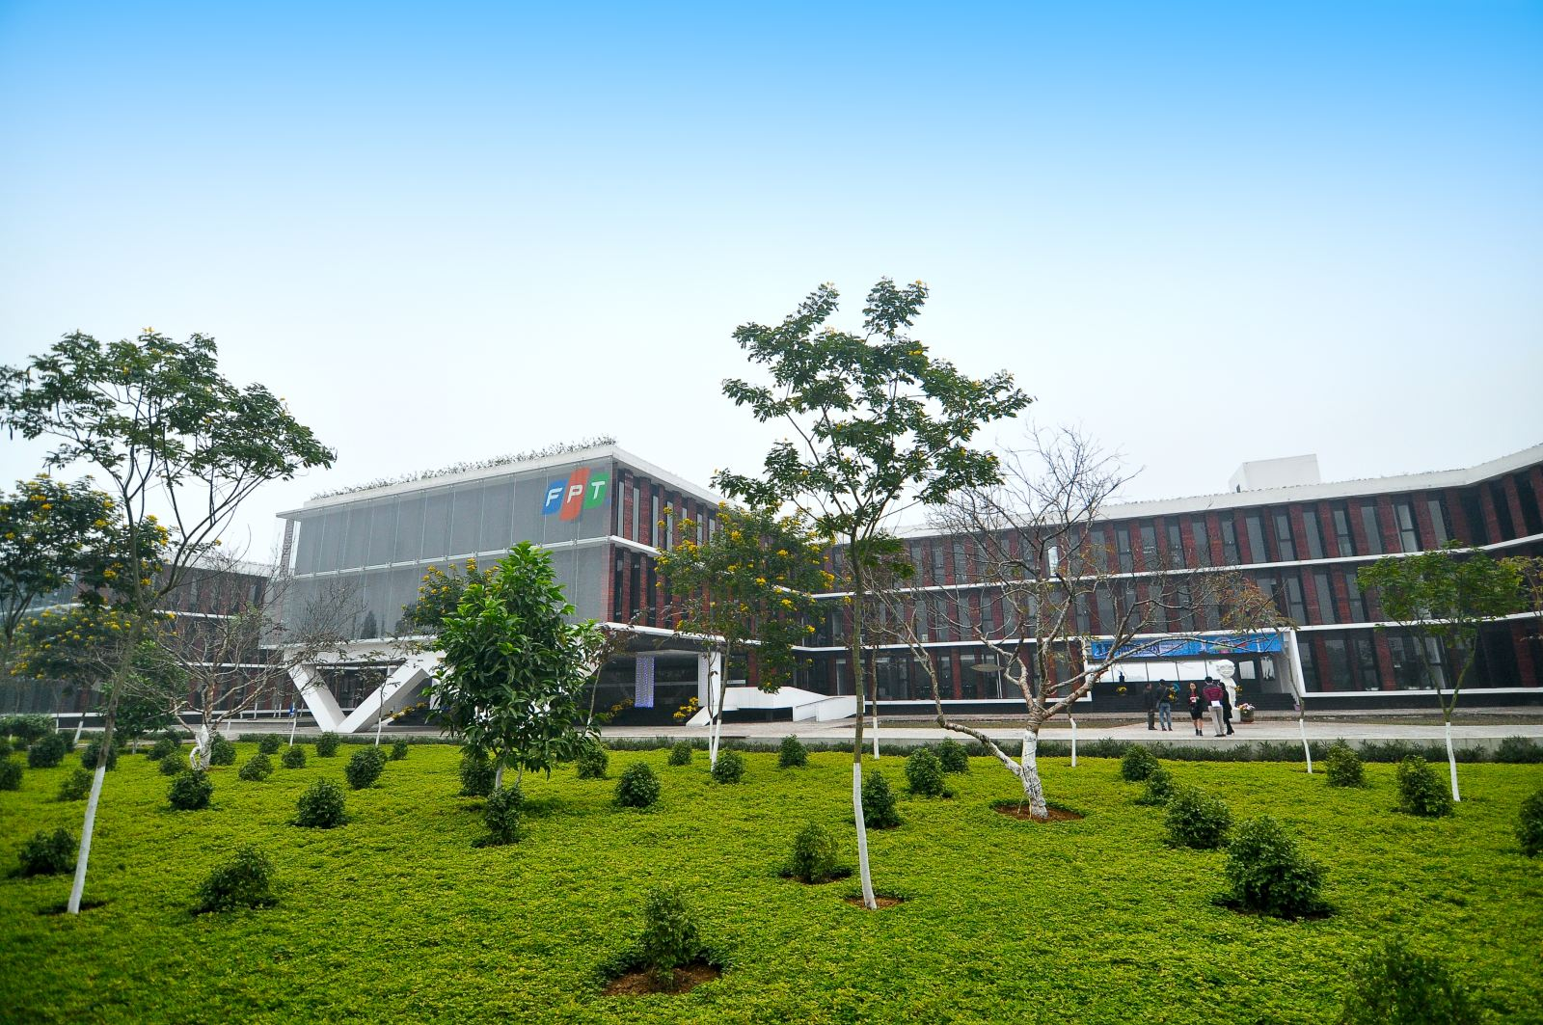
Requirement analysis
Range of value?
→ I want to manage numbers which are in range from 0 to 100.
Number of value to be managed?
→ I want to manage up to 20 numbers.
Allow to have the same number.
→ Number is unique.
Increase or decrease
→ Increase.
Print the sort of number list.
→ I want to print out all inserted numbers as sorted.

Slide 5
Requirement analysis
Req01: Software must allow to insert an integer number in range from 0 to 100.
Req02: Software must allow to insert up to 20 integer numbers.
Req03: Software must allow to delete an inserted integer number.
Req04: Software must allow to sort the inserted integer numbers from low to high, and print out the sorted list.
→ DOORNG

Slide 6



System design
Insert
Delete
Display/Print
Check if input number is in range or not.
Check if input number is existed or not.
Insert input number to list.
Check if input number is existed in list or not.
Delete the number from list.
Check if the list is empty or not.
Print out the sorted list.

Slide 7


System design
Software
Insert
Delete
Display/Print
Console
UML

Slide 8
Architecture design
Application
Utilities
App
Event
Insert
Delete
Display
Lib
Print
Linked List
Data container
4 View + 1

Slide 9
Architecture design
Menu
Insert
Linked
List
User
Delete
Data
Container
Display

Slide 10
Module design
In Range
Existed
Empty
Existed
Delete
Display
Insert

Slide 11
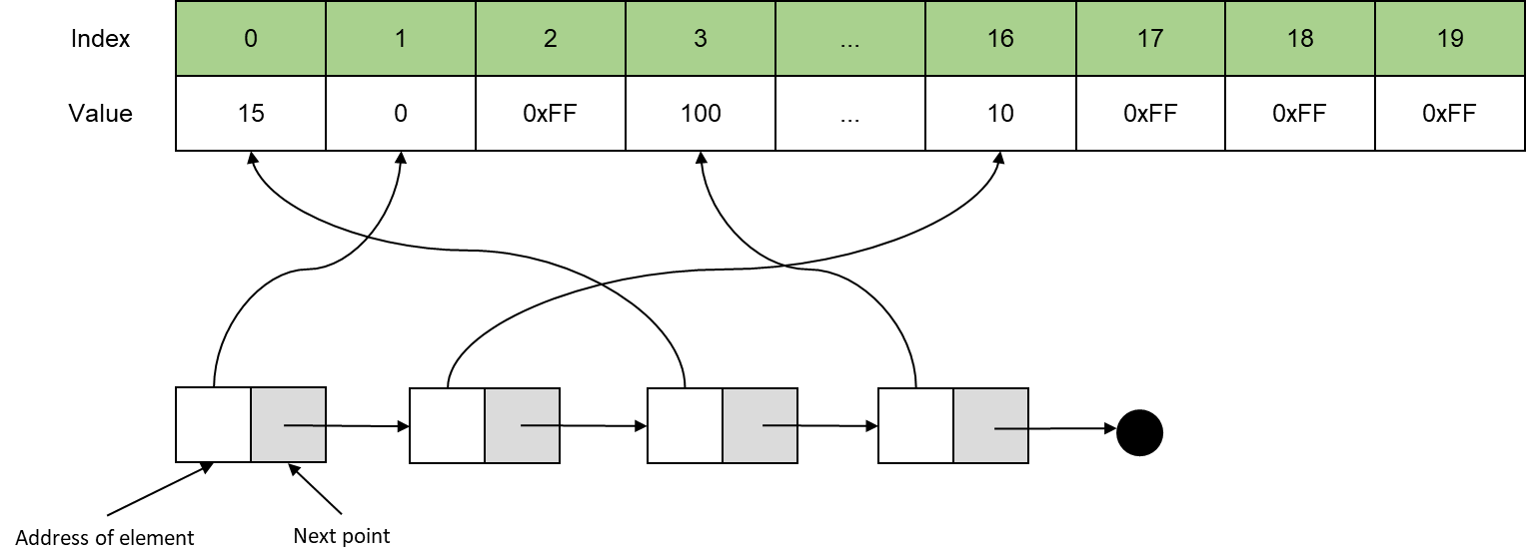
Module design

Slide 12
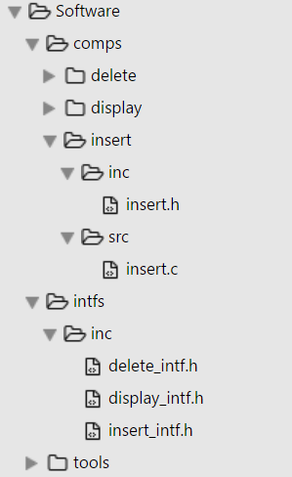
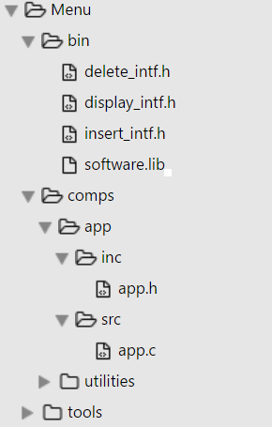
Coding
Lib
App

Slide 13
Test case specification
Req01: Software must allow to insert an integer number in range from 0 to 100.
TC01_001: Insert in range integer number.
TC01_002: Insert out range integer number.
Req02: Software must allow to insert up to 20 integer numbers.
TC02_001: Insert an integer number when data container is not full.
TC02_002: Insert an integer number when data container is full.
Req03: Software must allow to delete an inserted integer number.
TC03_001: Delete an existed integer number in data container.
TC03_002: Delete an integer number not existed in data container.
Req04: Software must allow to sort the inserted integer numbers from low to high, and print out the sorted list.
TC04_001: Print info when the data container is empty.
TC04_002: Print info when the data container is not empty.

Slide 14
Unit testing
UT Test Suite
Insert source code
Delete source code
Display source code
Insert test code
Delete test code
Display test code
Insert mock
Delete mock
Display mock
Unit test framework
Test utilities
Test dispatch
Test Execute
Test report
Test statistics
Google test

Slide 15
Integration testing
Integration Test Application
Test utilities
Test cases
Test Execute
Test report
Test statistics
Software lib
Insert
Delete
Display
Notes:
Different from UT to IT
UT: Used mocked function to isolate an unit for testing.
IT: Do not use mocked function to test the interaction between module in lib.

Slide 16
System testing
System test framework
Product
Test cases
Keyboard
emulator
Menu
Test script
Test core
Lib
Test statistics
Test execution
Notes:
Different from IT to ST
ST will combine serial of IT test to accomplish a function of system. Not only test the interaction between modules of system.

Slide 17
Acceptance testing
Customer environment
Product
Menu
UT test
Framework
IT test
Framework
System test Framework
Manual
Test
Lib
Notes:
Different from IT to ST
ST will combine serial of IT test to accomplish a function of system. Not only test the interaction between modules of system.

Slide 18
Pros and cons
This is a highly-disciplined model and Phases are completed one at a time
Works well for smaller projects where requirements are very well understood
Simple and easy to understand and use
Easy to manage due to the rigidity of the model. Each phase has specific deliverables and a review process.
High risk and uncertainty.
Not a good model for complex and object-oriented projects.
Poor model for long and ongoing projects.
Not suitable for the projects where requirements are at a moderate to high risk of changing.
Once an application is in the testing stage, it is difficult to go back and change a functionality.
No working software is produced until late during the life cycle.

Slide 19
Thank You !

