Slide 1

FILM PRODUCTION VENTURE
Profitability Analysis and Future Venture Strategy

Slide 2
CONTENTS
T
Overview
Business Problem
Methods Used
Results
Project Findings
Analysis
Conclusion
1
2
3
4
5
6
7

Slide 3
OVERVIEW
T
I analyzed the highest grossing movies and the most popular actors and directors of the past decade to help you make the best movie. Either during the holiday season in November or December or during the summer months with the hire of a popular actor and director that enjoy filming action/crime/thiller or action/adventure/sci-fi genres.

Slide 4
BUSINESS PROBLEM
You want to break into the movie business, but you don’t know where to start.
Let’s look at a four factors to keep in mind:
Release Month
Popular Director
Popular Actor
Top Worldwide Grossing Movie Genre

Slide 5
METHODS USED
Data Sets
Reformat
Combine
Data Visualizations
Used two different sources of data to extract key indicators of successful movies.
Cleaned up and reformatted data sources to perform mathematical operations.
Extracted and combined data to depict further analysis of genre.
Created data visualizations to present findings.

Slide 6
RESULTS
T
Top Grossing Month
Most Popular Director
Since 2010, November is the highest worldwide grossing month with $30,219,577,526
Christopher Nolan leads all directors since 2010 with 4,994,749 votes
Most Popular Actor
Top Grossing Genre
Leonardo DiCaprio leads all actors since 2010 with 6,264,072 votes
Action/adventure/sci-fi and action/crime/thriller are the top grossing genres with $2,753,569,061 and $16,027,425,657

Slide 7
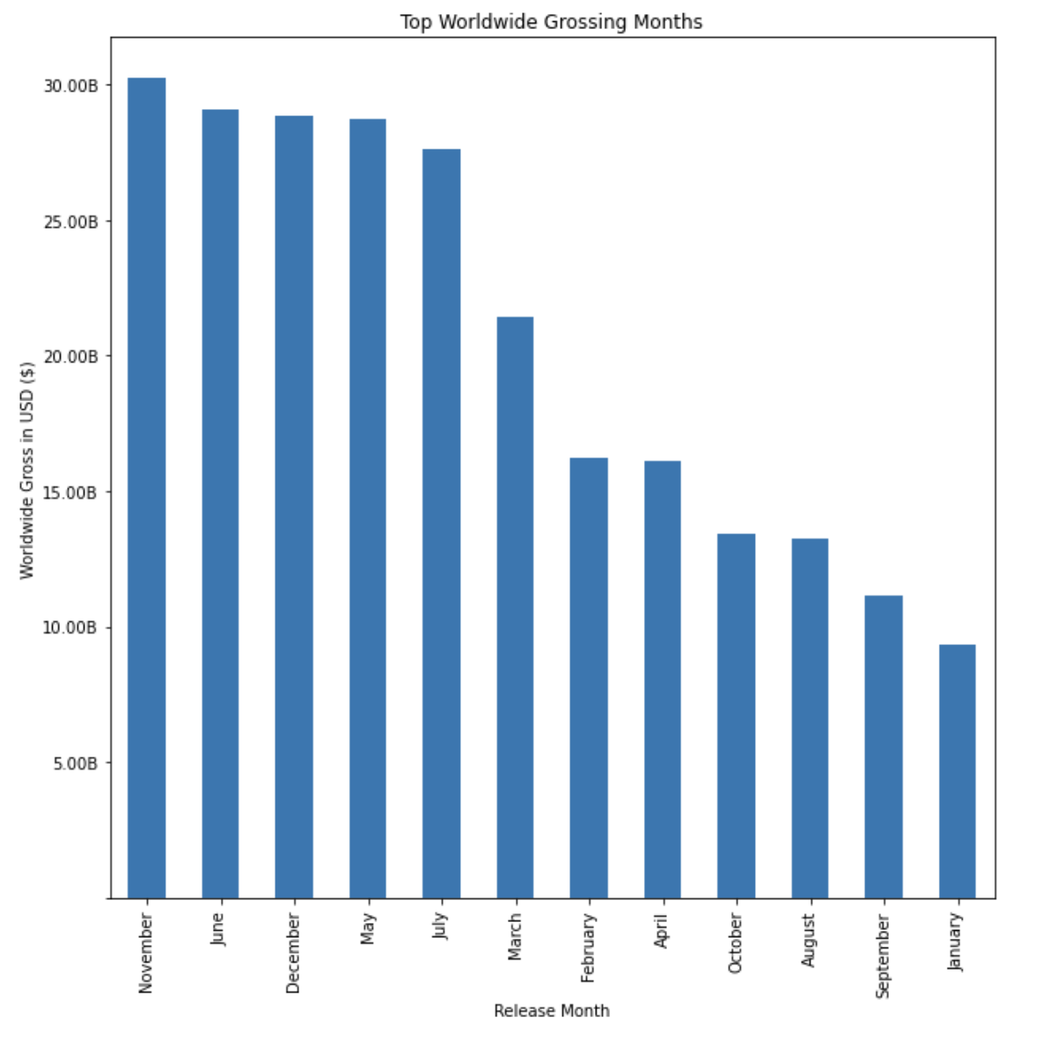
FINDINGS
T
Result
Since 2010, November is the highest grossing month for movies. However the summer season is a profitable time to release a film as well.

Slide 8
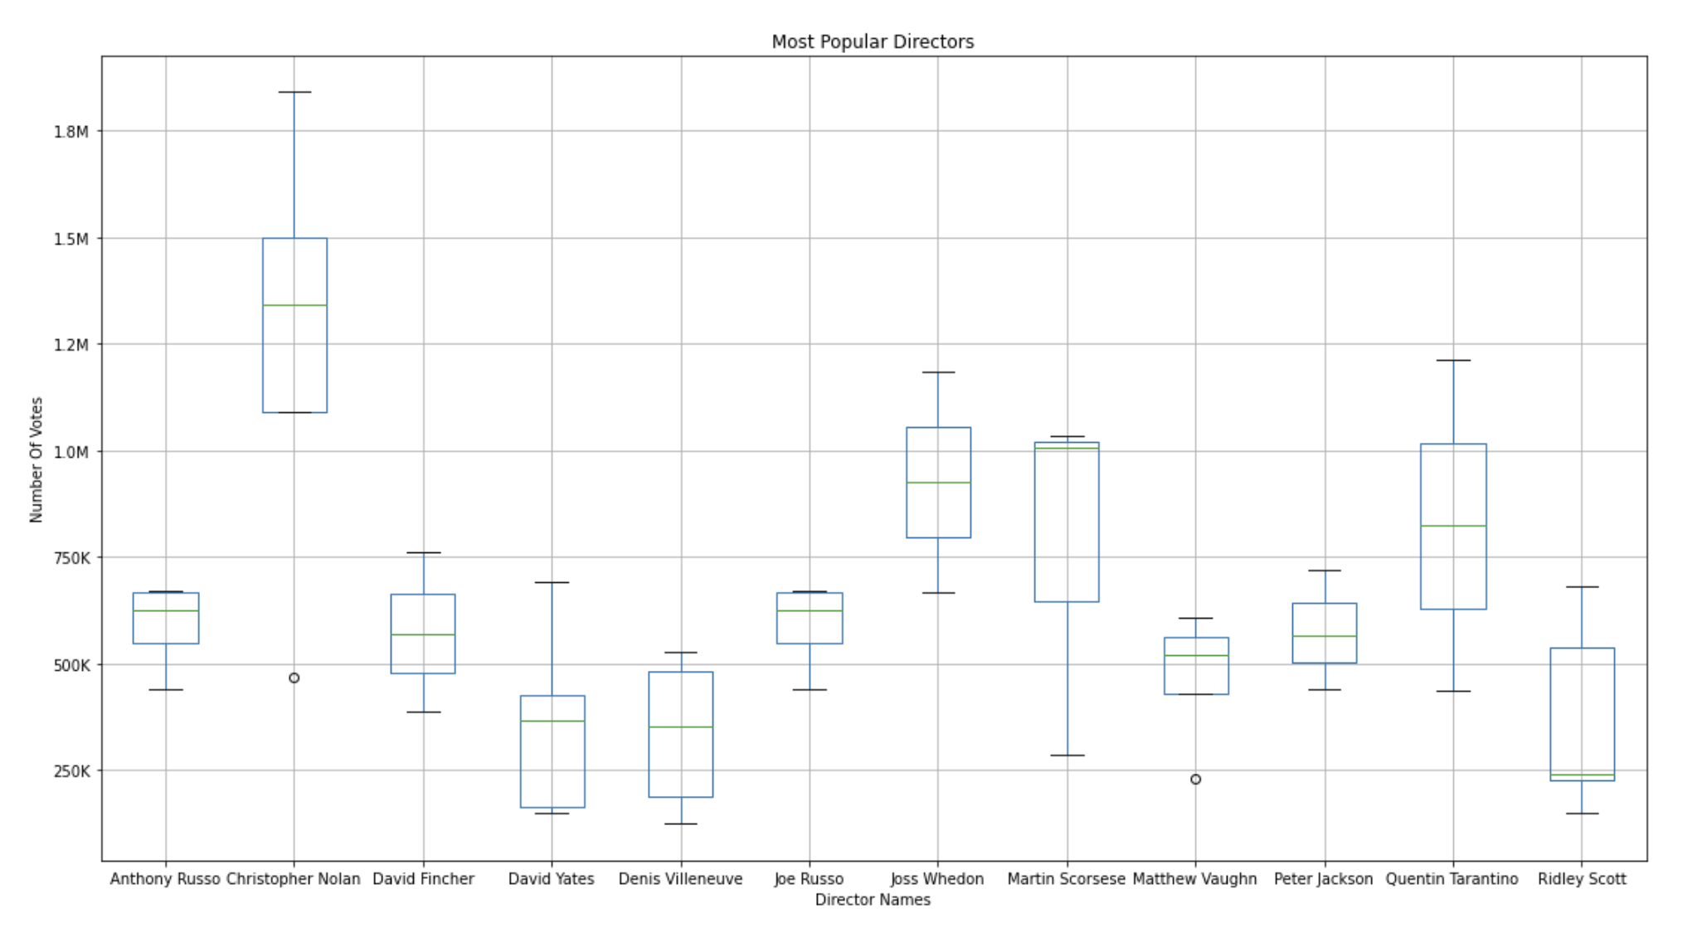
FINDINGS
T
Since, 2010 Christopher Nolan is the most popular director ranking the highest with the most votes from the general public.

Slide 9
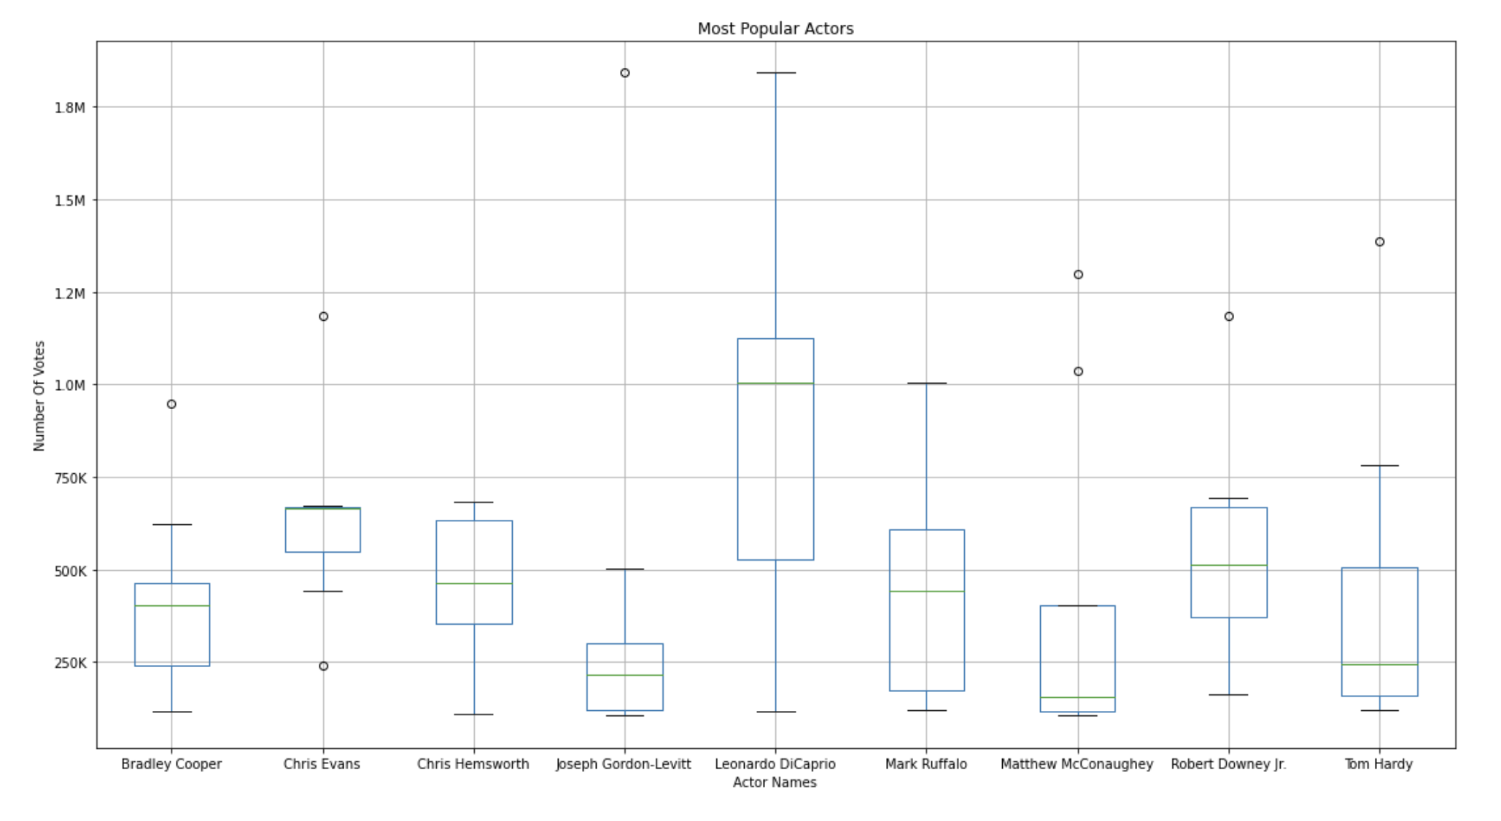
FINDINGS
Since 2010, Leonardo DiCaprio was the leading actor in terms of total votes, making him the most popular.

Slide 10
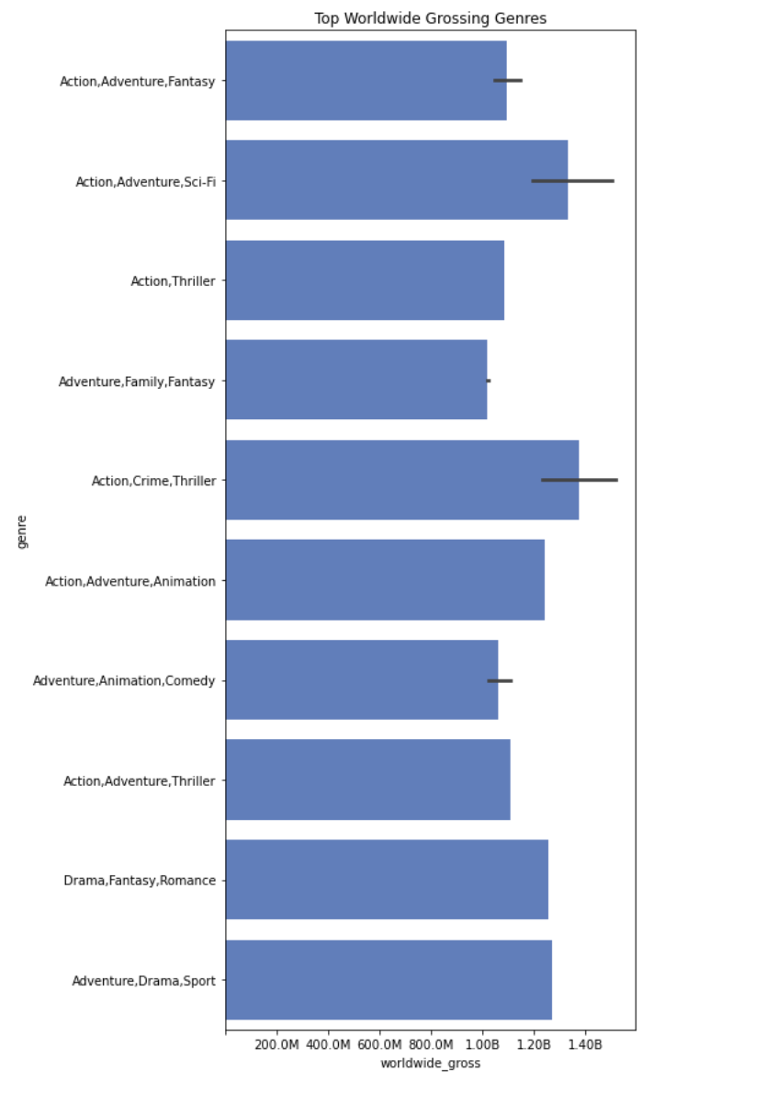
FINDINGS
T
Result
In terms of worldwide gross, action/crime/thriller and action/adventure/sci-fi were the top money making genres since 2010.

Slide 11
ANALYSIS
T
From the data, the hiring of a well known director and actor are very important to creating a successful movie. The data shows that Nolan and DiCaprio are the most popular actors in the past decade, but to look at other actors and directors that have done well in the action/crime/thriller and action/adventure/sci-fi would be beneficial for this new movie company venture.

Slide 12
CONCLUSION
T
Key Findings
In conclusion, I would recommend that Microsoft create movies of either the action/crime/thriller genre or the action/adventure/sci-fi genre. From the data provided, hiring well known directors and actors is proven to positively impact the worldwide gross for a film. To promote the highest box office sales, I recommend a release date during the summer season or during the holidays in November and December. Movie genre, the hiring of a director and lead actor, and release month are all factors critical to creating a successful film.

Slide 13
Next Steps
Analyze data dating back to the year 2000 to see if the findings change.
Try Different Data Analysis Metrics
Determine popular directors and actors by using worldwide gross as the determining factor.
Preferred Genres of Actors/Directors
What genres do top actors and directors on our list prefer to do and are the best at making.
Further analyze past data

Slide 14


THANK YOU
Michael Holthouser
Mholthouser.co@gmail.com
https://github.com/MHolthouser1024/Microsoft-Movie-Analysis.git
linkedin.com/in/michael-holthouser-9aa54195

