Slide 1

FILM PRODUCTION VENTURE
Profitability Analysis and Future Venture Strategy

Slide 2
CONTENTS
T
Overview
Business Problem
Methods Used
Results
Project Findings
Analysis
Conclusion
1
2
3
4
5
6
7

Slide 3
OVERVIEW
T
Analysis of the best time of the year to release a film.
Using number of votes by the public audience as the determine most popular directors and actors.
Analysis of the top worldwide grossing genres.

Slide 4
BUSINESS PROBLEM
You want to break into the movie business, but you don’t know where to start.
Let’s look at a four factors to keep in mind:
Release Month
Popular Director
Popular Actor
Top Worldwide Grossing Movie Genre

Slide 5
METHODS USED
Data Sets
Reformat
Combine
Data Visualizations
Used two different sources of data to extract key indicators of successful movies.
Cleaned up and reformatted data sources to perform mathematical operations.
Extracted and combined data to depict further analysis of genre.
Created data visualizations to present findings.

Slide 6
RESULTS
T
Top Grossing Month
Most Popular Director
Since 2010, November is the highest worldwide grossing month with $30,219,577,526
Christopher Nolan leads all directors since 2010 with 4,994,749 votes
Most Popular Actor
Top Grossing Genre
Leonardo DiCaprio leads all actors since 2010 with 6,264,072 votes
Action/adventure/sci-fi and action/crime/thriller are the top grossing genres with $2,753,569,061 and $16,027,425,657

Slide 7
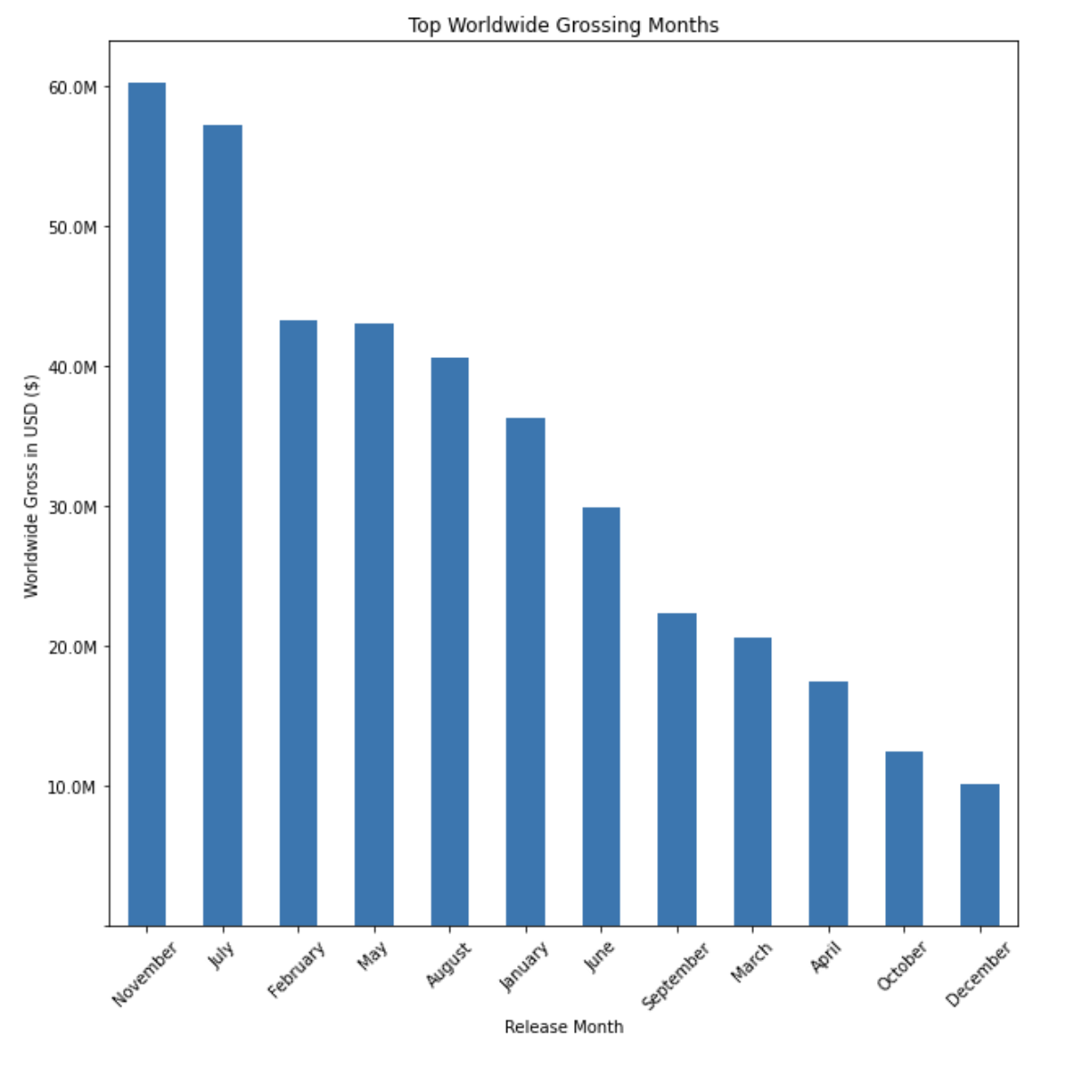
FINDINGS
T
Result
November and July best months to release a film.
Releasing a film in December or October is not recommended.

Slide 8
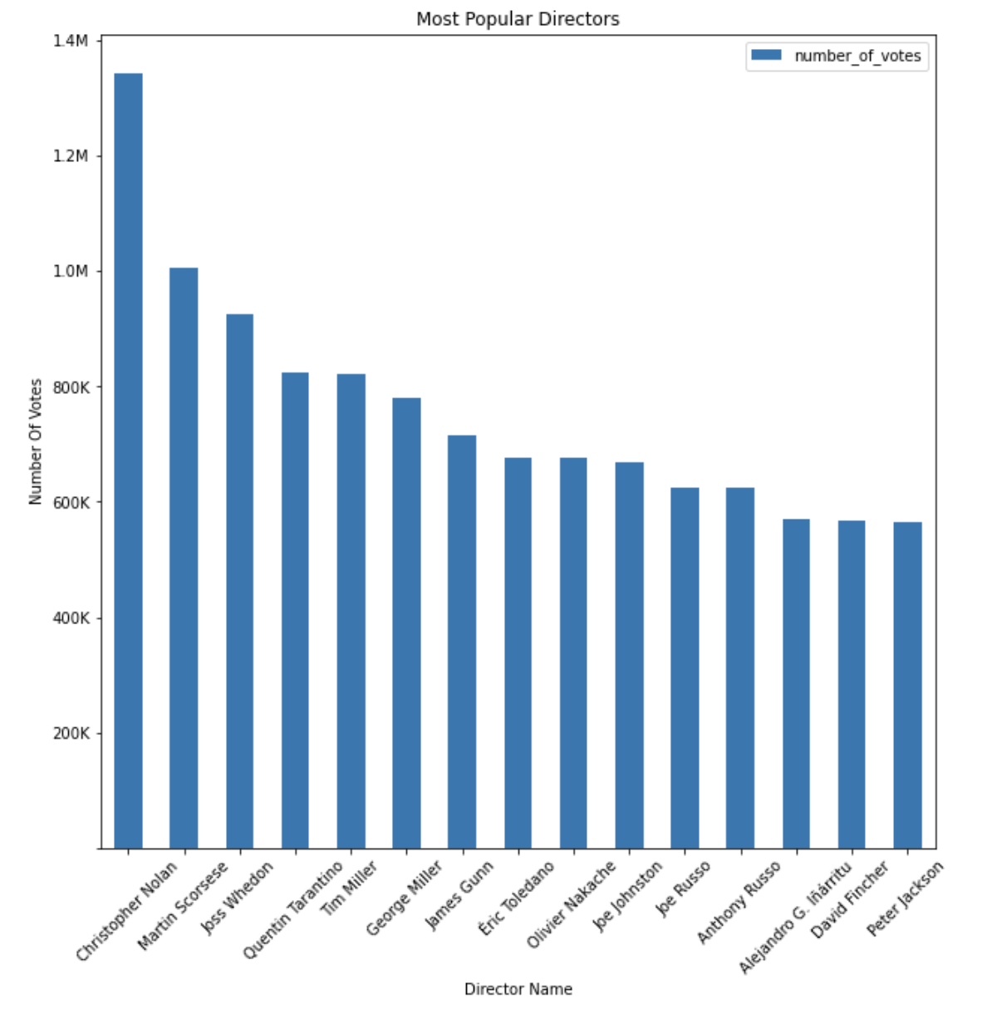
FINDINGS
T
Since, 2010 Christopher Nolan is the most popular director ranking the highest with the most votes from the general public.

Slide 9
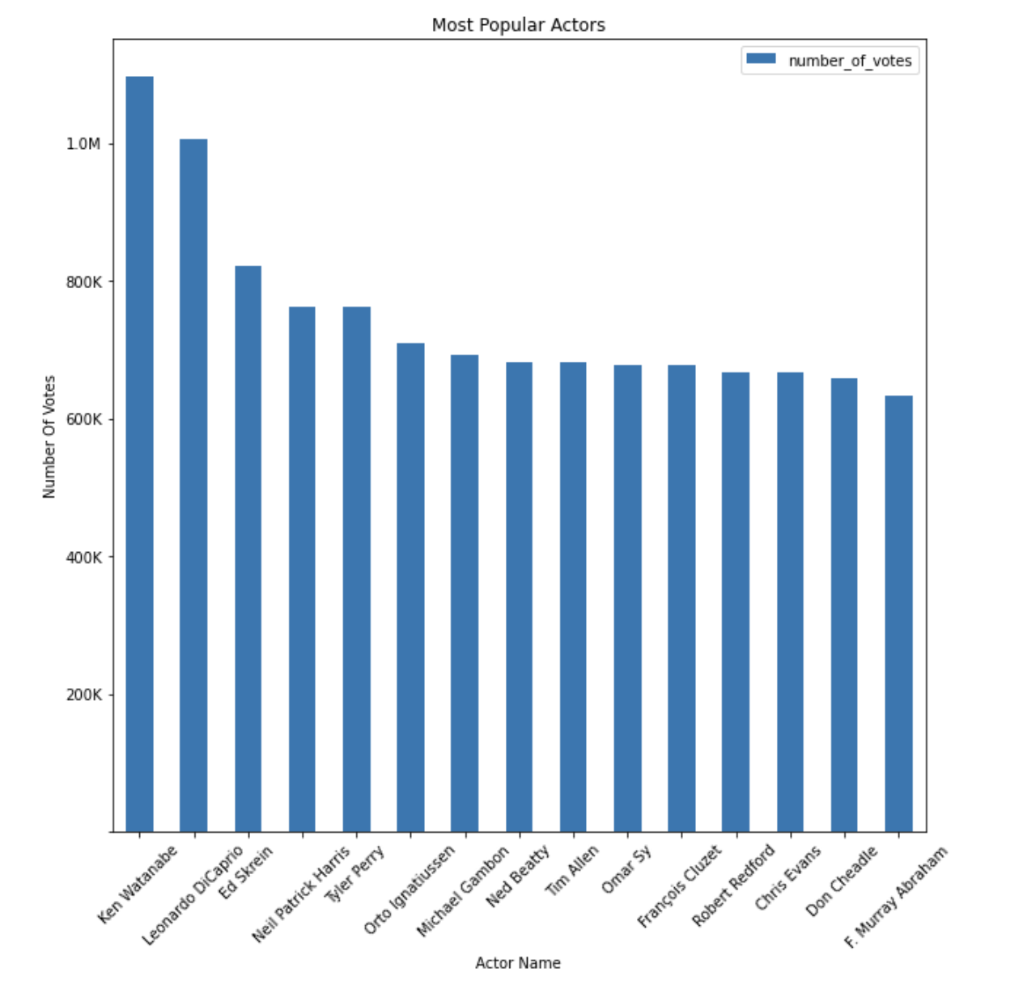
FINDINGS
Since 2010, Ken Watanabe and Leonardo DiCaprio were the most popular actors, voted by the general audience.

Slide 10
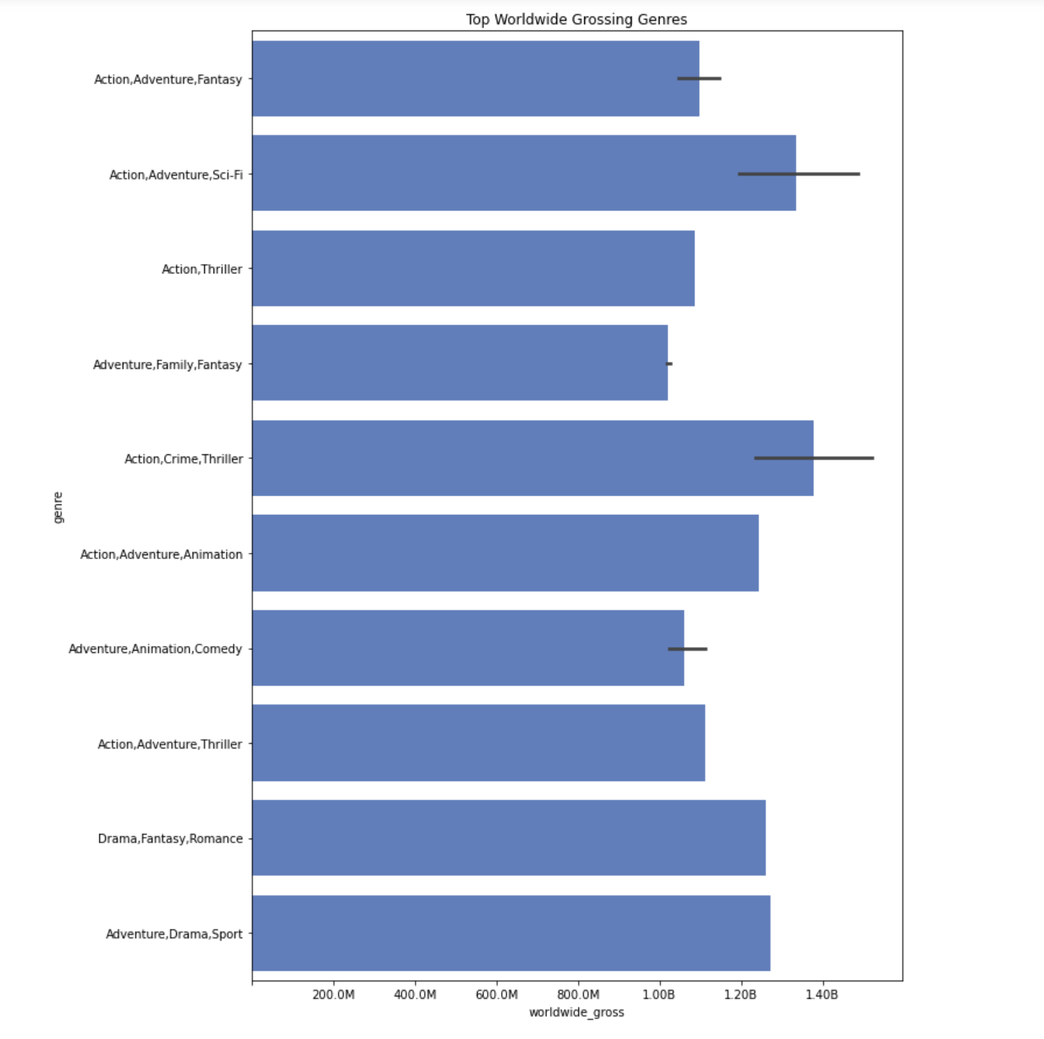
FINDINGS
T
Result
In terms of worldwide gross, action/crime/thriller and action/adventure/sci-fi were the top money making genres since 2010.

Slide 11
ANALYSIS
T
hiring of a well known director and actor are very important to creating a successful movie.
The data shows that Nolan and Watanabe are the most popular actors in the past decade.
Action movies do the best in the box office.

Slide 12
CONCLUSION
T
Key Findings
I recommend Microsoft film action films.
Hiring a well know director and actor duo is proven to positively impact the worldwide gross and exposure of a film.
Releasing a film in November or July is the best time to release to film to promote the highest box office sales.

Slide 13
Next Steps
Analyze data dating back to the year 2000 to see if the findings change.
Try Different Data Analysis Metrics
Determine popular directors and actors by using worldwide gross as the determining factor.
Preferred Genres of Actors/Directors
What genres do top actors and directors on our list prefer to do and are the best at making.
Further analyze past data

Slide 14


THANK YOU
Michael Holthouser
Mholthouser.co@gmail.com
https://github.com/MHolthouser1024/Microsoft-Movie-Analysis.git

