Slide 1
King County, WA Housing Sale Price Analysis
Michael Holthouser

Slide 2
CONTENTS
T
1
Overview
Data Understanding
Exploring the Data
Modeling
Regression Results
Recommendations
Limitations
Next Steps
2
3
4
5
6
7
8

Slide 3
OVERVIEW
Business Problem: King County Realtors need to provide their clients with guidance on to improve the value of their homes prior to listing.
Business Question: Which home renovations might increase the estimated value of their homes, and by what amount?

Slide 4
BUSINESS AND DATA UNDERSTANDING
Stakeholder: King County Realtors
Data: King County House Sales dataset. The data includes data of single-family home sales from 2014-2015, with 20 different features related to each home.

Slide 5
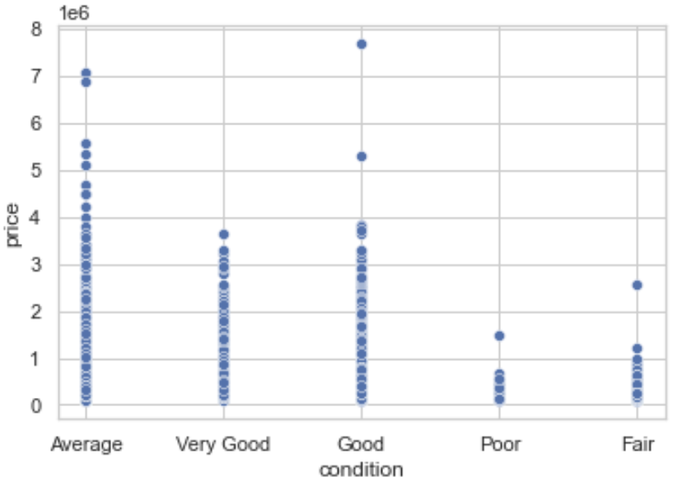
EXPLORING THE DATA

Slide 6
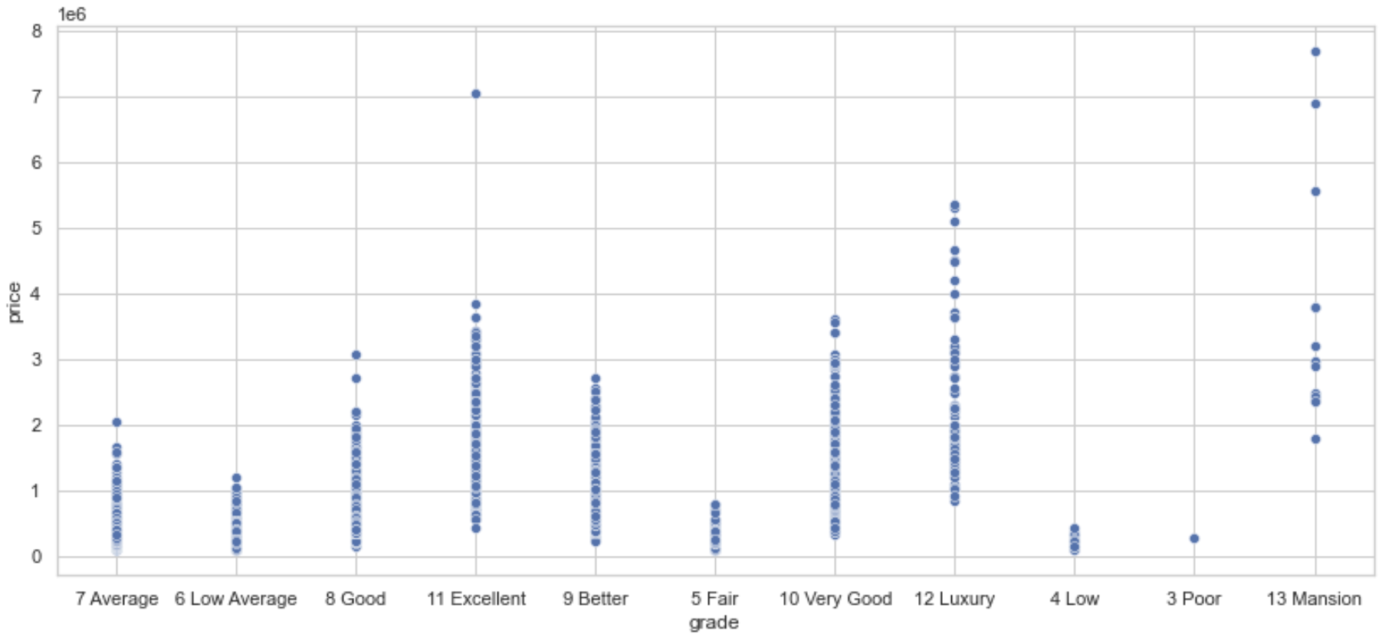
EXPLORING THE DATA

Slide 7



MODELING
T
Linear regression allows us to see if there is a relationship between the renovations and the selling price of a home. Such that a 1 unit increase in X results in a 1 unit increase in Y.
In a business perspective, we are able to see how the selling price of homes are impacted by the different renovations.
Using coefficients is an effective method for this project, because we are able to see how each individual feature impacts the sale price of a home.

Slide 8
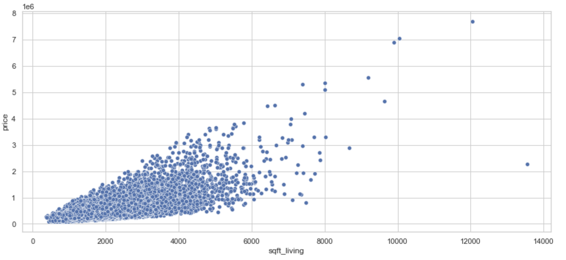
For Example

Slide 9
REGRESSION RESULTS
Coefficient Interpretations:
For every bedroom added to a home, it decreases the price of the home by 2.3%
For every square foot of living added to a home, it increases the price of a home by 0.02%
For every floor added to a home, it increases the price of a home by 1.7%
For every increase in condition to a home, it increases the price of a home by 10.4%
For every increase in the grade of a home, it increases the price of a home by 19.3%

Slide 10


Recommendations
T
Use high quality materials when renovating to maximize the grade of the home.
creating another floor is a great option to increase the price of a home. For a 500,000 dollar home, adding one floor would increase the price by $8,500.
Improving the condition of your home to a minimum, average condition, will increase your home's value by 10%.

Slide 11
LIMITATIONS
Our final model only explains 58% of the variance of the data.
Not every feature of a home was included in the model, such as location, or school districts.

Slide 12
NEXT STEPS
Collect more recent data to obtain more accurate figures with the current market of King County, WA.
Add more features into our model to see how the model’s accuracy is affected.

Slide 13


THANK YOU
Michael Holthouser
Mholthouser.co@gmail.com
https://github.com/MHolthouser1024/Phase-2-housing-project

