Slide 1
King County, WA Housing Sale Price Analysis
Michael Holthouser

Slide 2
CONTENTS
T
1
Overview
Data Understanding
Exploring the Data
Modeling
Regression Results
Recommendations
Limitations
Next Steps
2
3
4
5
6
7
8

Slide 3

OVERVIEW
Business Problem: King County Realtors need to provide their clients with guidance on how to improve the value of their homes prior to listing.
Business Question: Which home renovations might increase the estimated value of their homes, and by what amount?

Slide 4
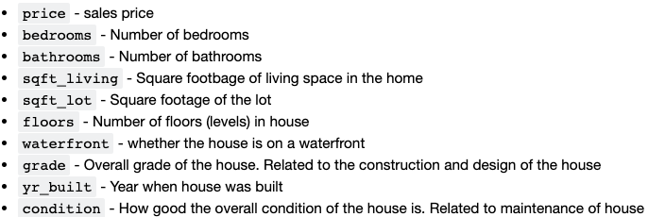
BUSINESS AND DATA UNDERSTANDING
Stakeholder: King County Realtors
2014-2015 King County Housing Dataset

Slide 5
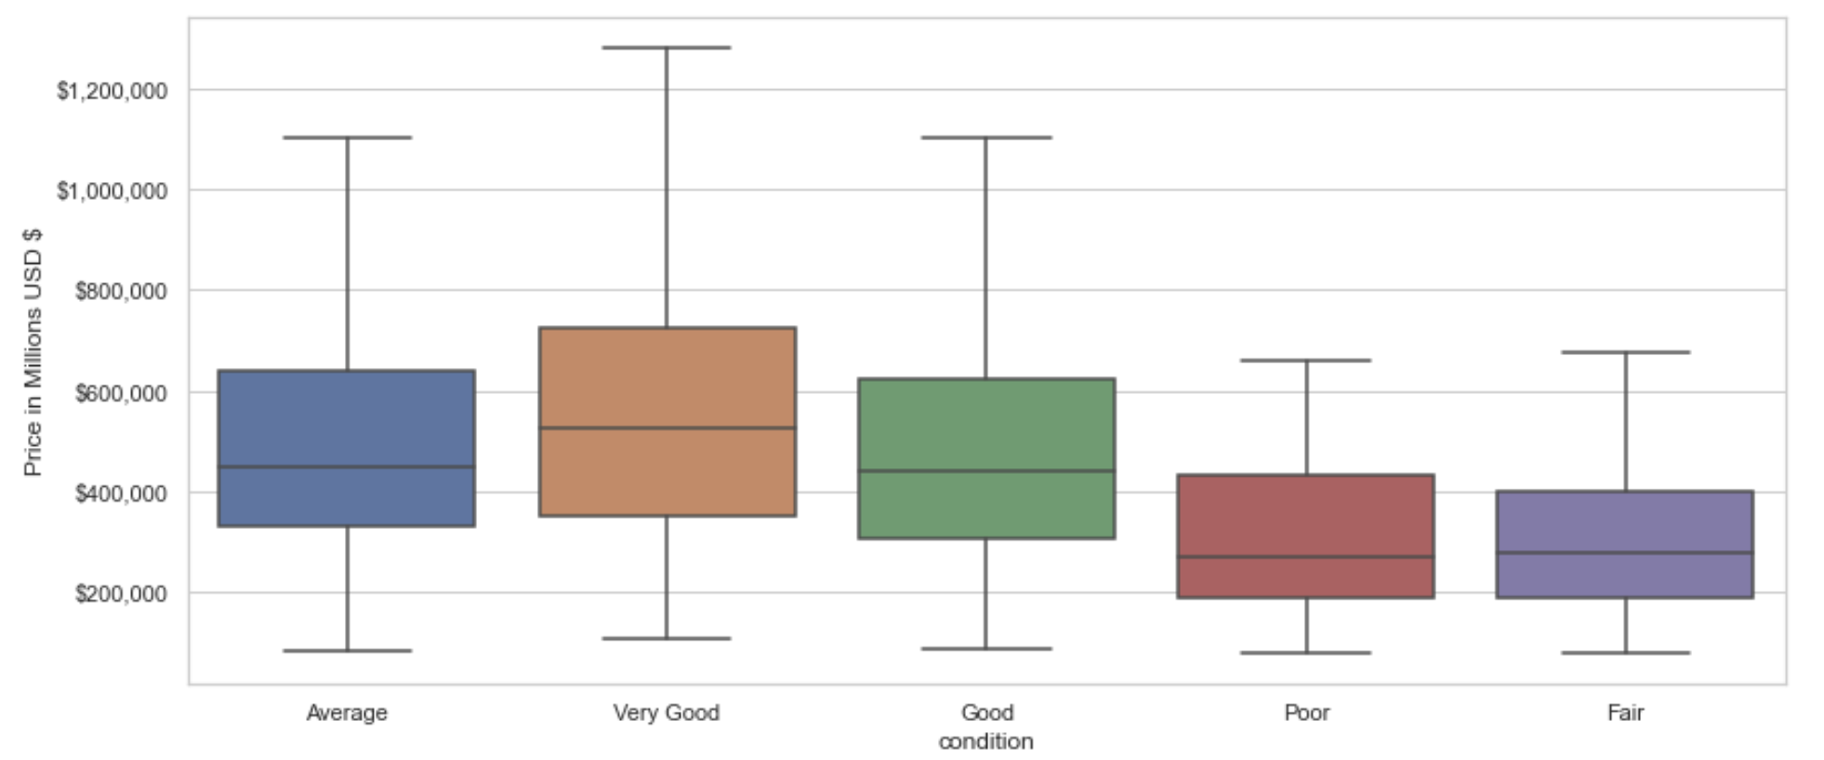
FEATURE: CONDITON
Better maintained homes result in a higher selling price
Want to ask for my money? Maintenance is IMPORTANT

Slide 6
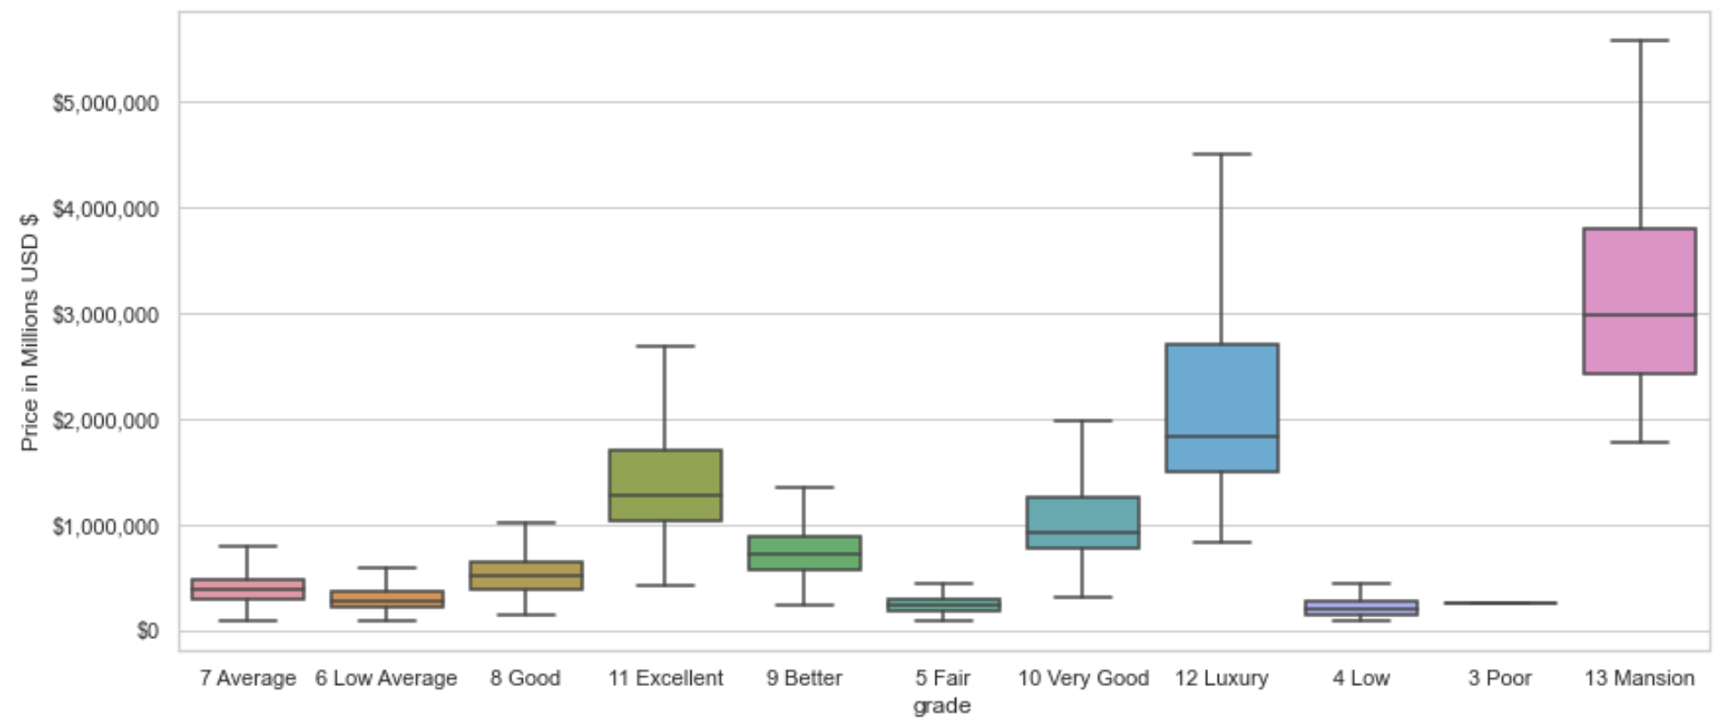
FEATURE: GRADE
HIGH QUALITY MATERIALS = HIGHER SELLING PRICE

Slide 7
MODELING PROCESS
IMPORT THE DATA
CLEAN THE DATA
EVALUATED RESULTS
MODELED

Slide 8
RESULTS AND RECOMMENDATIONS
FEATURE | ADDING 1 UNIT | COEFFICIENT INTERPRETATION
Grade | For every grade level increase | Price increases 19.3%
Condition | For every condition rating increase | Price increases 10.4%
Floor | For ever additional floor | Price increases 1.7%

Slide 9
LIMITATIONS
Our final model only explains 58% of the variance of the data.
Not every feature of a home was included in the model, such as location, or school districts.

Slide 10
NEXT STEPS
Collect more recent data to obtain more accurate figures with the current market of King County, WA.
Add more features into our model to see how the model’s accuracy is affected.

Slide 11


THANK YOU
Michael Holthouser
Mholthouser.co@gmail.com
https://github.com/MHolthouser1024/Phase-2-housing-project

