Slide 1
Predicting Customer Churn: SyriaTel Telecommunications
Author: Michael Holthouser

Slide 2

Contents
Overview
Business Problem
Business Question
Data Understanding
Stakeholder
The data
Modeling
Winning Model
Evaluation Metric
Feature Visualizations
International_plan
Customer_service_calls
Total_day_charge
Recommendations

Slide 3

Overview
Business Problem: SyriaTel Communications has tasked me to provide prediction analysis on which of their customers are likely to churn.
Churn - “A measure of the number of individuals or items moving out of a collective group over a specific period”
Business Question: What features in the dataset are weighed the most in predicting which customers will churn?

Slide 4
Data Understanding
Stakeholder: SyriaTel Communications
Churn in Telecom’s dataset from Kaggle.com
state - US state of customer residence
account_length - Number of months the customer has been with the current telco provider.
international_plan - (yes/no). The customer has international plan.
voice_mail_plan - (yes/no). The customer has voice mail plan.
number_vmail_messages - numerical. Number of voice mail messages.
breakdown of call minutes, charges, and number of calls for day, evening, night, and international.
total_day_charge
number_customer_service_calls – Number of calls to customer service.
churn - (yes/no). Customer churn – target variable.

Slide 5
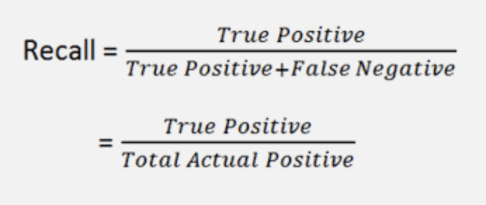
Modeling
Highest scoring method: Decision Tree Classifier
66 % Recall Score
Evaluation Metric:
False negatives are costly
Optimize for Recall
Recall is a measure of the correct positive predictions
Important Features:
International plan
Customer service calls
Total day charge

Slide 6
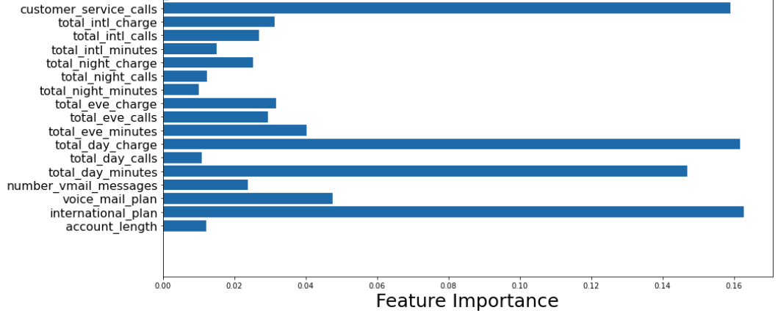
Important Features
Top 3 weighted features:
International plan
Customer service calls
Total day charge

Slide 7
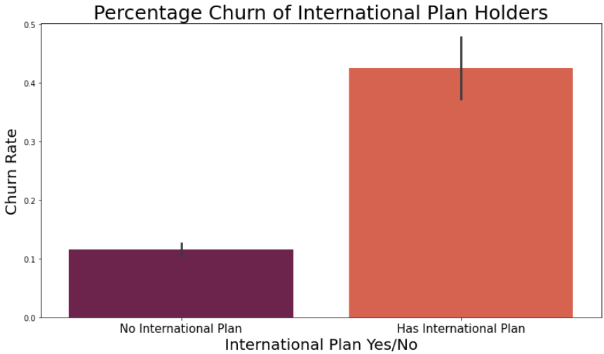
International Plan
42% churn rate for international
plan holders.
11% churn rate for customers with
no international plan.

Slide 8
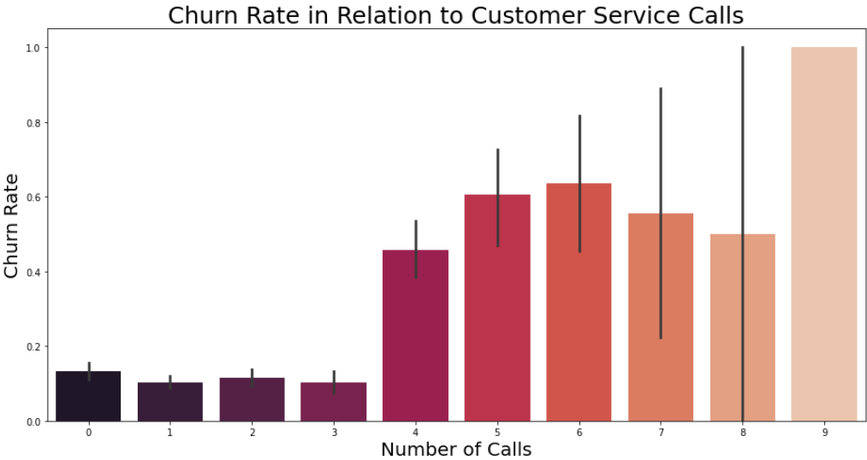
Customer Service Calls
Churn rate significantly increases
when customers call customer
service 4 times.

Slide 9
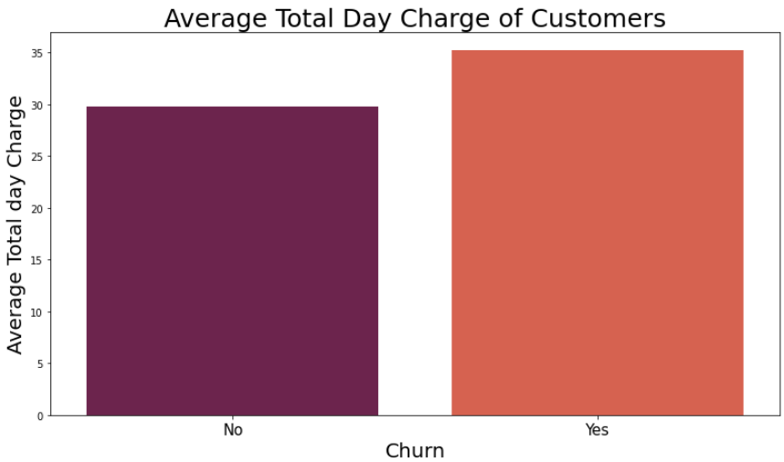
Total Day Charge
Average total day charge for a
customer who has churned is
$35.18
Average total day charge for a
current active customer who has
not churned is $29.78

Slide 10

Recommendations
Determine if international plans are meeting the customers needs.
Implement new plan features or cost reduction to retain international plan holders.
Managers of the customer service department must strategize and train their teams to better
assist customers with the goal of reducing the number of times a customer has to call in
regards to their service.
Explore ways to retain customers that have an average total day charge of $35.
possibly with creating new incentives to their phone plans.

Slide 11


THANK YOU
Michael Holthouser
Mholthouser.co@gmail.com
https://github.com/MHolthouser1024/dsc-phase-3-project-v2-3

