Slide 1


The Impact of Cloud-Based Device Management on Security and Operational Efficiency in Organisations
Mustafa Hussein
Research Methods and Professional Practice October 2025 B
Unit 10 – Research Proposal Presentation

Slide 2
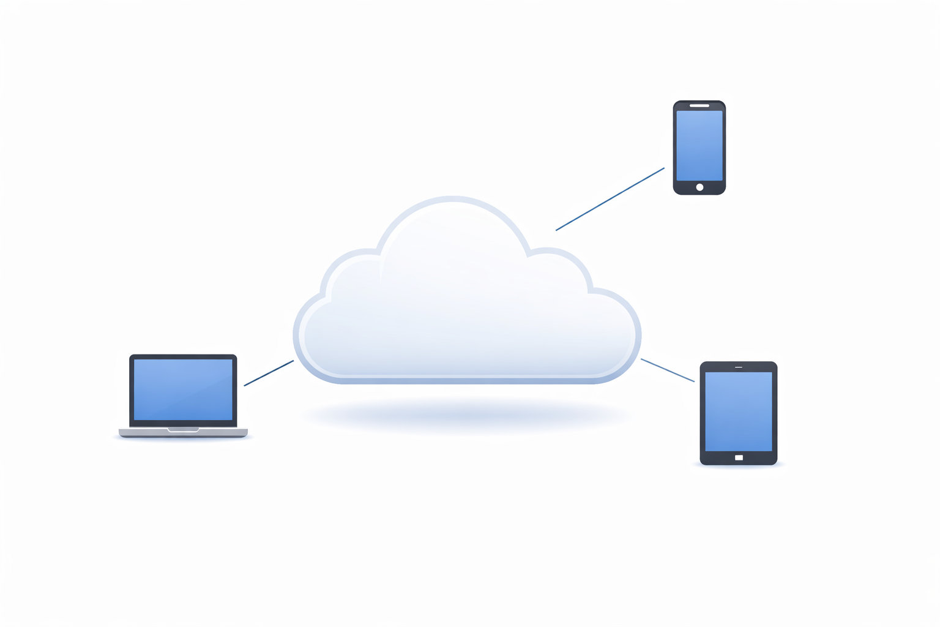
Introduction & Context
Growth of cloud computing & remote work
Increase in managed endpoints
Security & management challenges

Slide 3

Research Problem
Vendor-led evidence dominates
Limited independent academic evaluation
Unclear real-world organisational impact

Slide 4

Significance & Contribution
Cloud computing
Cybersecurity
Enterprise IT management
Evidence-based insight

Slide 5
Research Question
To what extent does cloud-based device management improve security and operational efficiency in organisations?

Slide 6

Aim
Evaluate security impact
Evaluate operational efficiency impact

Slide 7
Objectives
Review literature
Examine security outcomes
Analyse operational efficiency
Identify challenges

Slide 8
Key Literature (Overview)
Cloud computing foundations
Unified Endpoint Management
Zero Trust security
(Optional visual: layered model)

Slide 9
Key Literature (Critical)
Strengths
Centralised control
Visibility & compliance
Limitations
Vendor bias
Governance & readiness issues

Slide 10

Research Design
Qualitative
Exploratory
Interpretivist

Slide 11
Data Collection
Semi-structured interviews
IT professionals
8–12 participants
Diverse roles & organisations

Slide 12
Data Analysis
Thematic analysis
Coding → themes
Security & efficiency themes

Slide 13
Ethics & Risk
Informed consent
Anonymity
UK GDPR
BCS standards

Slide 14
Artefacts & Timeline
Interview guide
Transcripts
Thematic framework
Timeline (simple):
Literature → Ethics → Data → Analysis → Presentation

Slide 15
Conclusion
Research gap addressed
Feasible methodology
Contribution to computing

