Slide 1
The Impact of Artificial Intelligence on Enterprise IT
A Reflective Analysis of the Most Influential Technology Trends in the Next Five Years
By Mustafa Hussein

Slide 2
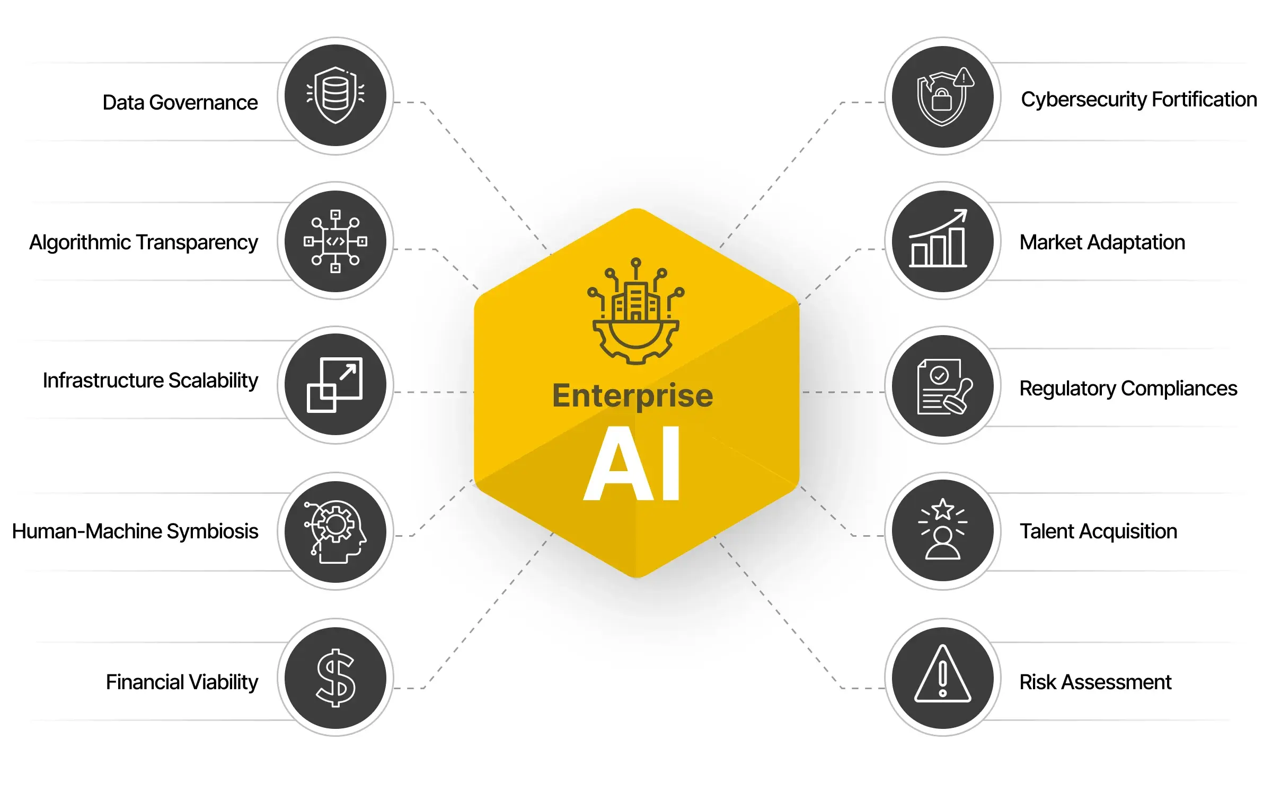
Introduction to AI in Enterprise IT
“Enterprise AI entails leveraging advances machine and cognitive capabilities to discover and deliver organizational knowledge, data, and information in a way that closely aligns with how humans look for and process information (Tesfaye, 2022)”

Slide 3
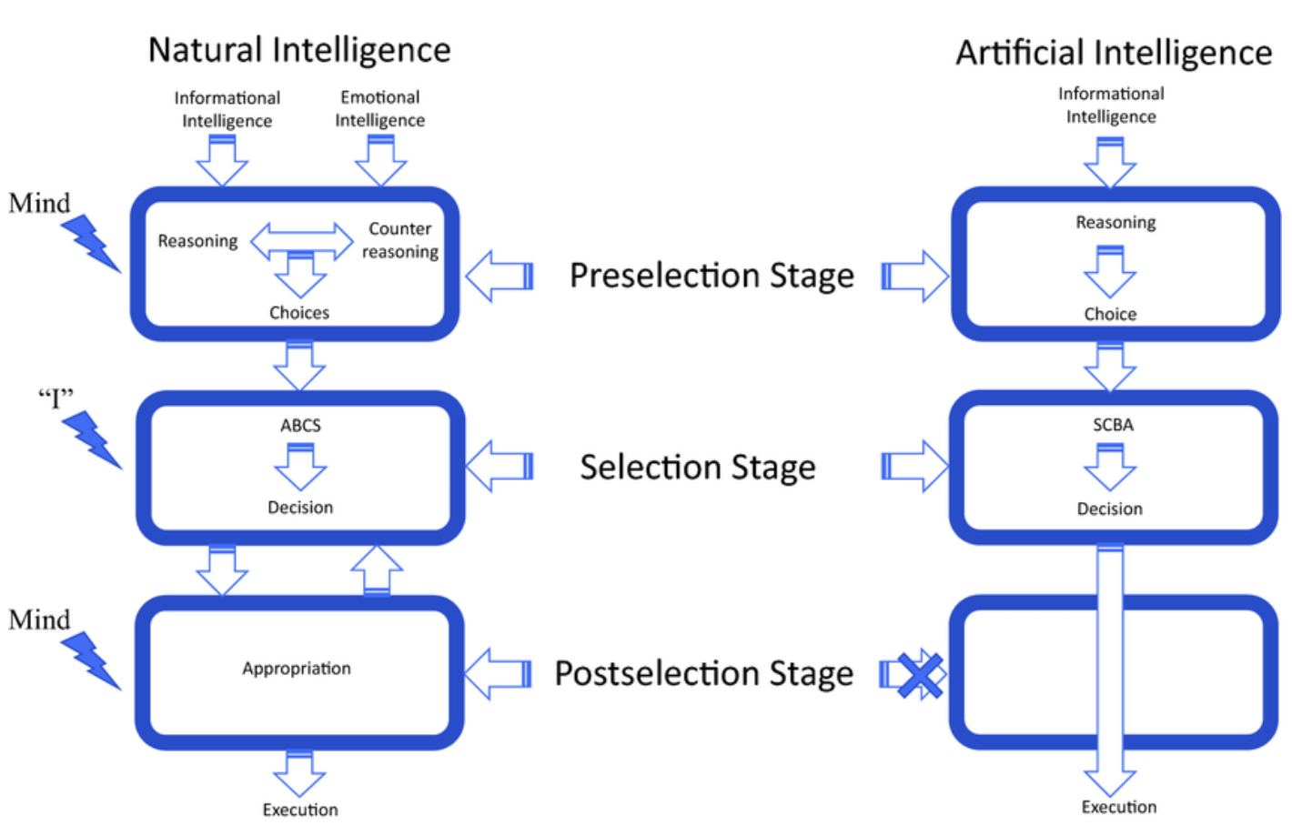
Why AI Will Have the Most Impact

Slide 4
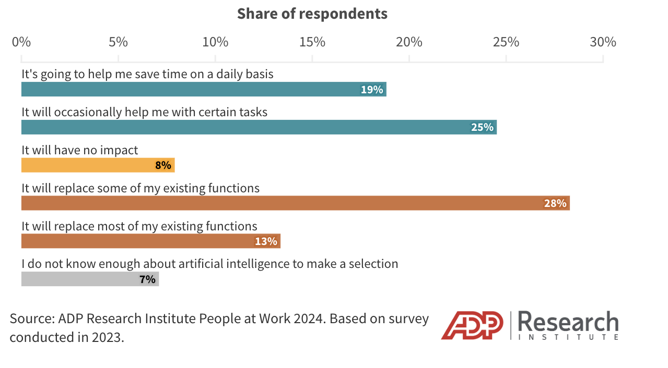
Industry Impact of AI
What role do you believe artificial intelligence will have in your work during the next 2-3 years?

Slide 5
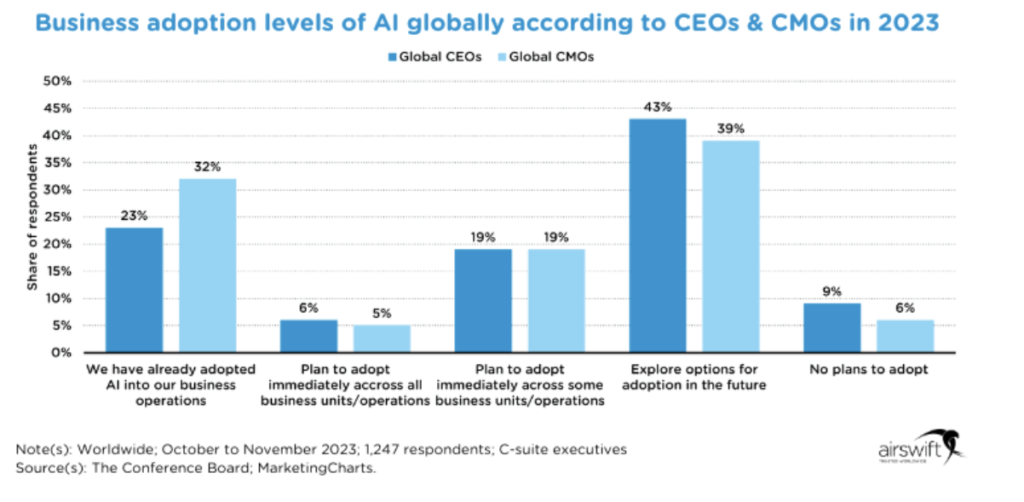
Impact on Working Life
The comparison between global CEOs and CMOs regarding AI adoption levels as of 2023

Slide 6
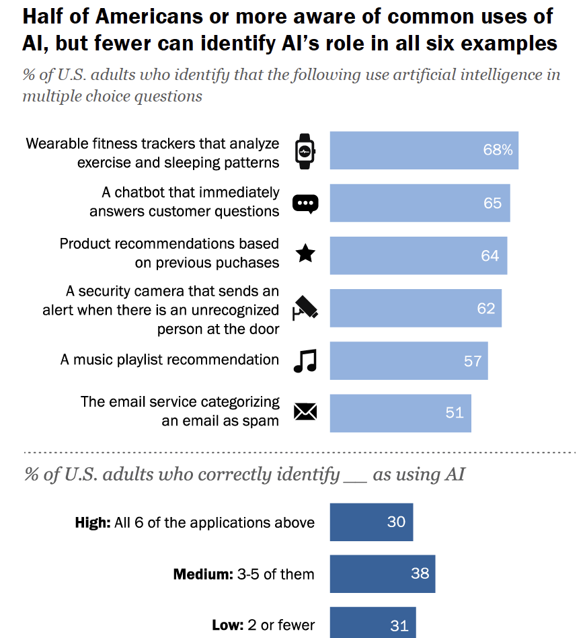
Reflective Analysis: Personal Experience
The Pew Research Centre survey reveals that while many Americans are aware of common applications of artificial intelligence (AI) in daily life, such as customer service chatbots and personalised product recommendations, there are significant gaps in understanding its broader implications.

Slide 7
Reflective Analysis: Reviewing Others and Self
Literature review broadened perspectives on AI impacts.
Enhanced critical thinking on tech changes and strategies.
Recognised AI's role in improving operational efficiency.
Explored AI's impact on decision-making and analytics.
Real-world cases illustrated AI's transformative potential.

Slide 8
Conclusion
AI transforms Enterprise IT through automation and enhanced decision-making.
AI fosters innovation in product development and customer engagement.
Preparation for future challenges with AI ensures competitive edge.
Insights gained underscore AI's transformative impact on strategy and workforce.
AI's ongoing evolution shapes the future of Enterprise IT and business success.

Slide 9
Bibliography
Farhadi, A. (2021) Similarities and differences of the decision-making process ..., There is no “I” in “AI”. Available at: https://www.researchgate.net/figure/Similarities-and-differences-of-the-decision-making-process-in-natural-intelligence-NI_fig2_348520668 (Accessed: 16 July 2024).
Hanowell, B. (2024) Most workers think AI will affect their jobs. they disagree on how., ADP Research Institute (ADPRI). Available at: https://www.adpri.org/worker-sentiment-ai-impact/ (Accessed: 16 July 2024).
Kennedy, B. (2023) Public awareness of artificial intelligence in Everyday Activities, Pew Research Center. Available at: https://www.pewresearch.org/science/2023/02/15/public-awareness-of-artificial-intelligence-in-everyday-activities/ (Accessed: 16 July 2024).
Kostrz, A. (2024) The future of ai in your business, NTT DATA Business Solutions (UK) Ltd. Available at: https://nttdata-solutions.com/uk/blog/the-future-of-ai-in-your-business/#:~:text=AI’s%20ability%20to%20analyze%20and,on%20business%20will%20be%20enormous. (Accessed: 16 July 2024).
L, T. (2024) Knowledge Graphs & Data modeling, Enterprise Knowledge. Available at: https://enterprise-knowledge.com/services/knowledge-graphs-data-modeling/ (Accessed: 16 July 2024).
Santos, R. (2024) AI adoption: 9 industries that are setting the gold standard, Technology and Engineering Workforce Solutions: Global STEM Jobs. Available at: https://www.airswift.com/blog/ai-in-business (Accessed: 16 July 2024).
SHARMA, R. (2024) Enterprise AI development company - markovate, Scaling Up: How Enterprise AI Drives Business Growth. Available at: https://markovate.com/enterprise-ai-development-company/ (Accessed: 16 July 2024).

