Slide 1
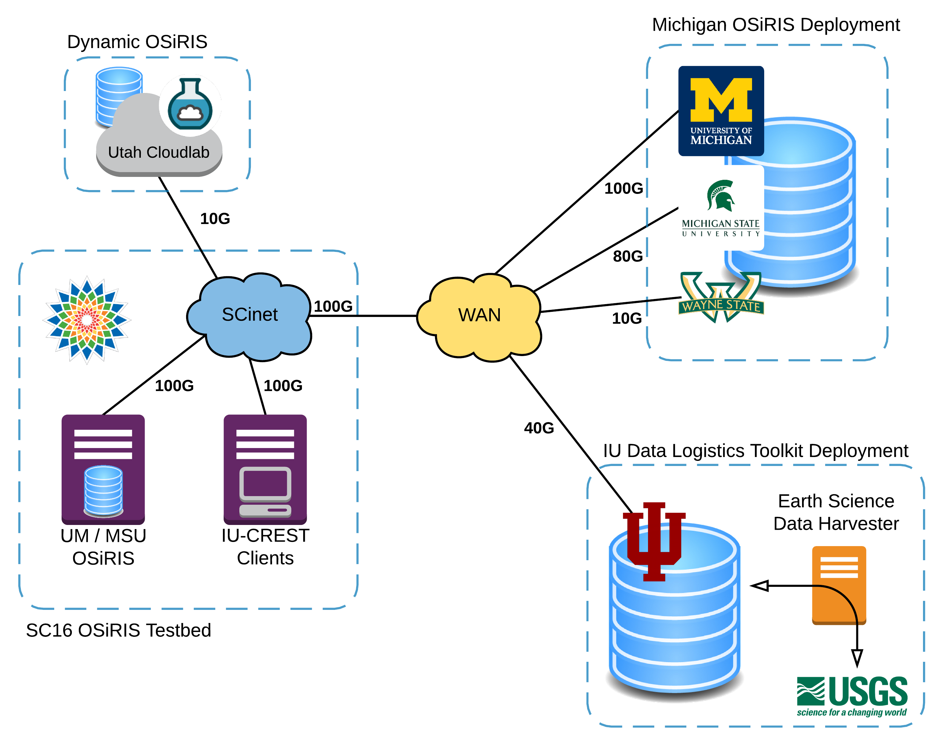

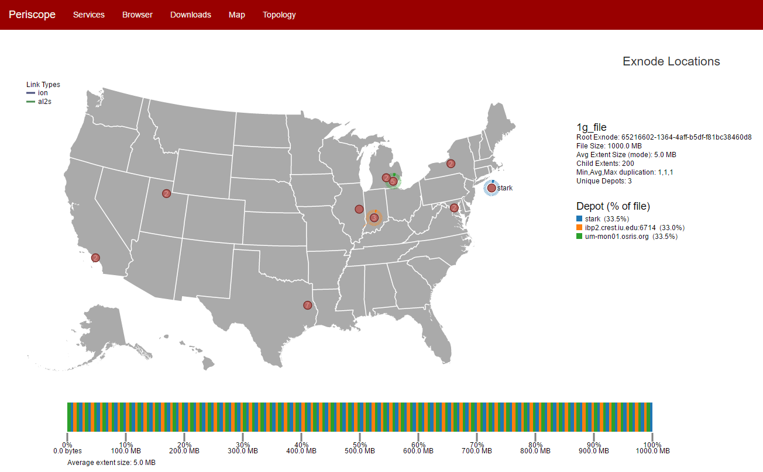
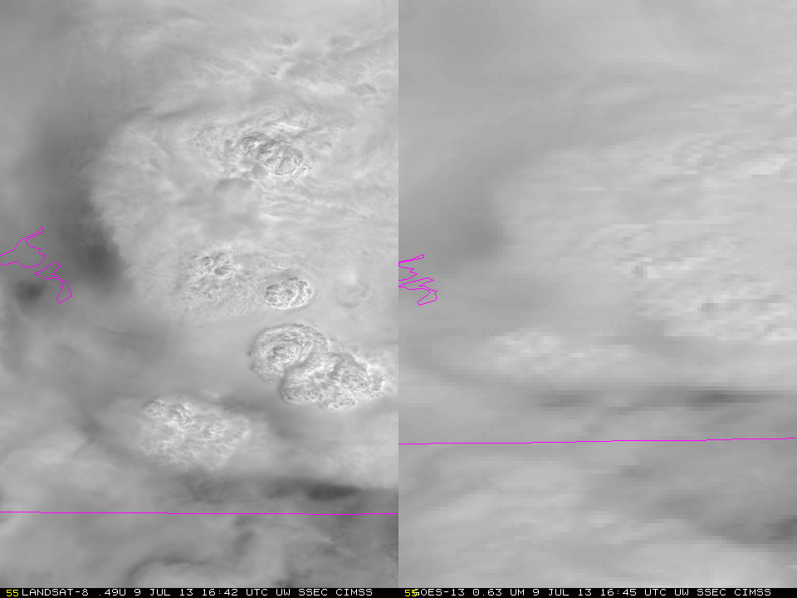
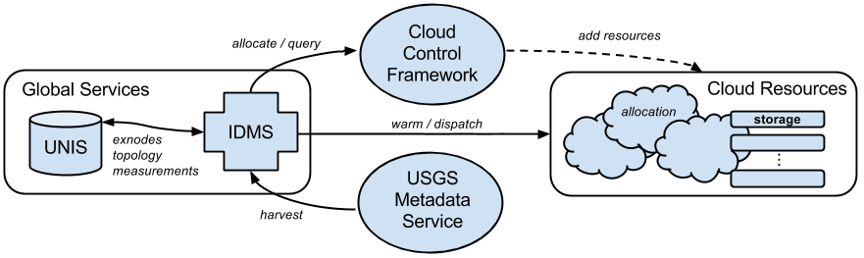
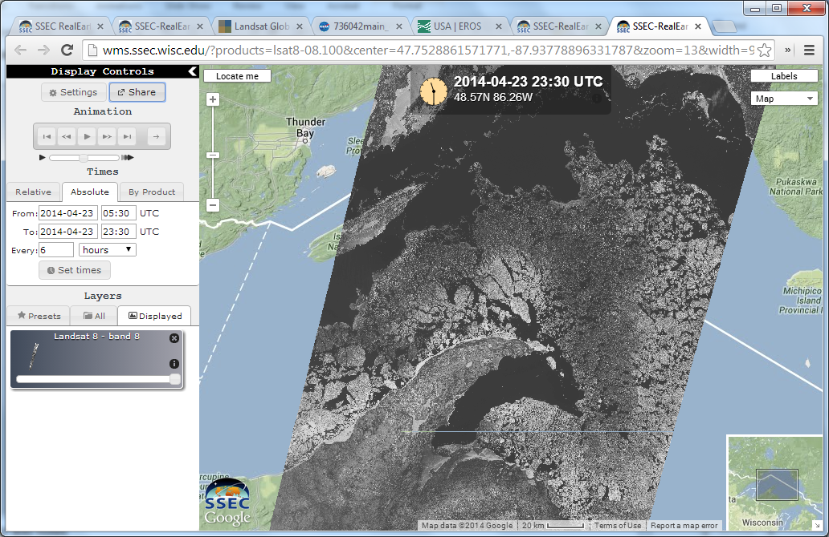

Rapid Earth Science Data Movement on OSiRIS with the Data Logistics Toolkit
Jeremy Musser, Miao Zhang, Joseph Cottam, Jayashree Candadai, Supreeth Shivanand, Ashwin Dev, Sirshak Das, Paventhan Vivekanandan, Ezra Kissel, Martin Swany
Indiana University – Center for Research in Extreme Scale Computing (CREST)
Motivation and Goals
Landsat Remote Sensing Workflow
OSiRIS+DLT @SC16
The Multi-Institutional Open Storage Research Infrastructure (MI-OSiRIS) project provides a distributed, storage deployment that lets researchers write, manage, and share data from their own computing facility locations. The Data Logistics Toolkit (DLT) is a software package that enables filesystem, measurement, and data movement services across heterogeneous storage and network infrastructures. We are using OSIRIS and DLT to extend a remote sensing data “depot network” with the goal of enabling open access, reduced latency, and fast downloads of valuable Earth science information collected from satellites and other sensors. At SC16, we are evaluating the combined OSiRIS+DLT deployments in this context to explore a number of questions, including:
How quickly can we respond to changing network conditions and dynamically adjust the flow of data?
What are the impacts of WAN latencies on real-world Ceph cluster operation?
To what extent can we fully automate workflows?
How effective are our locality and replication policies?
NASA’s Landsat satellites provide very high spatial resolution imagery that may benefit meteorological studies and forecasting if the data can be made quickly available. However, the relatively large, multi-spectrum scene bundles have low temporal resolution and complex associated metadata making file acquisition for analysis difficult. The OSiRIS+DLT effort addresses these challenges through a number of innovations:
Persistent scene harvesting mechanism to stage data within the distributed storage network
Policies to control placement and replication of data based on locality and network availability constraints
Hierarchical network topology and filesystem metadata services with publish/subscribe mechanisms to provide new data notifications
Active and passive network measurement components integrated with data movement logic
Data sharing, archiving, security and life-cycle management as part of a single distributed service
Active Monitoring and Measurement
Toolkit Software
Dynamic Deployments
Landsat > GOES
libdlt – DLT filesystem middleware. Provides an abstraction at the object store level for interchangeable use of Ceph or IBP with core data movement routines.
IDMS – The Intelligent Data Movement Service enforces any global and user-specific data distribution policies.
UNIS-RT and Flange – Runtime for the Unified Network Information Service. Flange directly uses the runtime to operate programmatically on a UNIS topology representation (network graph) for dynamic updates.
Periscope – Measurement collection/analysis framework.
The DLT enables dynamic resource deployments based on observed demand and prevailing network state. The GENI and CloudLab infrastructure are currently supported.
A set of best-practices is being developed for rapid OSiRIS site instantiations.
More Information
= Ceph Storage Cluster
http://www.osris.org
http://data-logistics.org
Supported by OSiRIS (Univ. of Michigan) 3003646554,
NSF OCI-1246282, and
CNS-1320659
RealEarth Landsat Visualization

