Slide 1

MACHINE LEARNING
MACHINE LEARNING STUDY 2022 WINTER

Slide 2
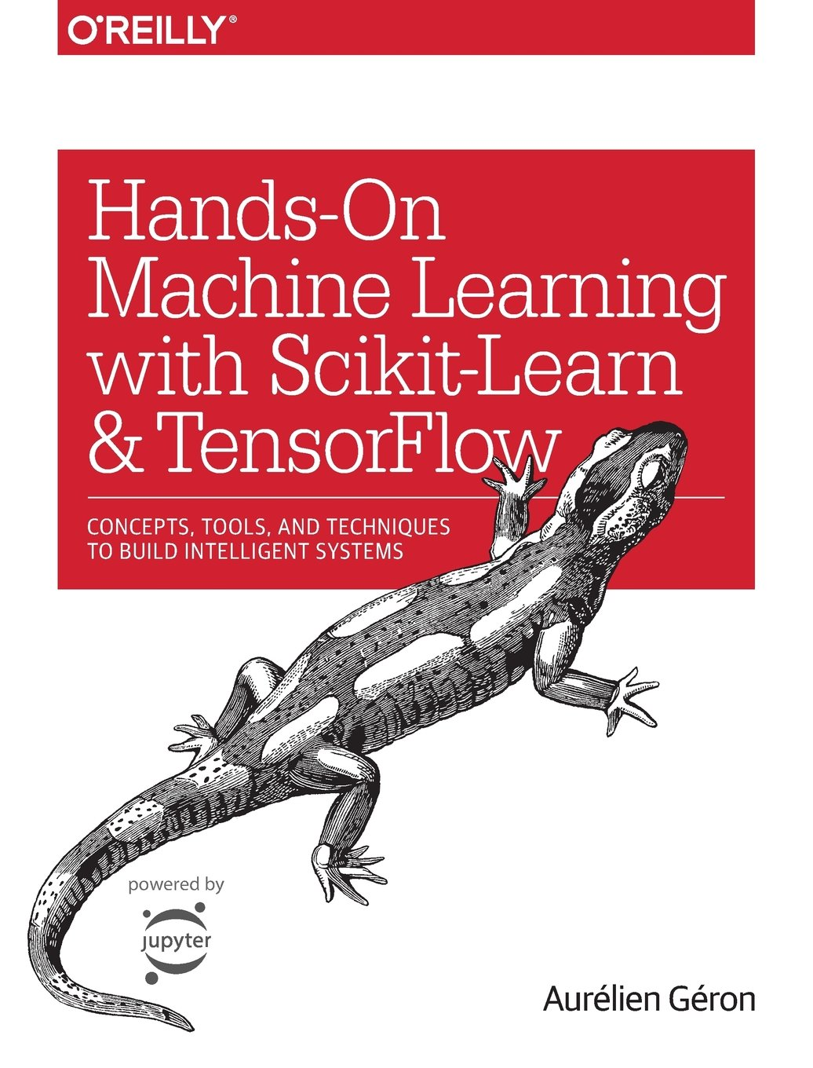
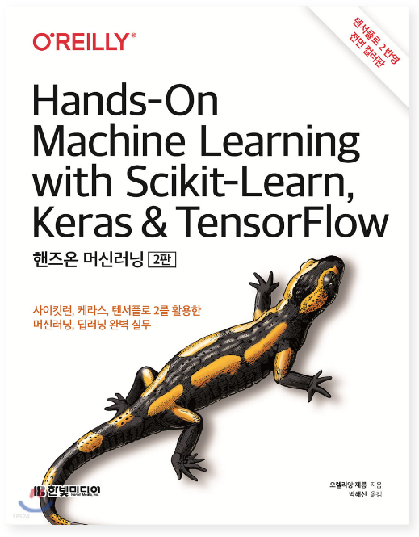
TEXTBOOK
Optional

Slide 3

PROCESS
Session 0
I ntroduce
- STUDY GOALS
- STUDY KEYPOINTS
P lan & Details
- STUDY DETAILS
- WEEKLY TASKS
- STUDY PLANS
Q nA & Team Building
- TEAM BUILDING
- FIX TOPIC
- Q&A & NETWORKING TIME

Slide 4
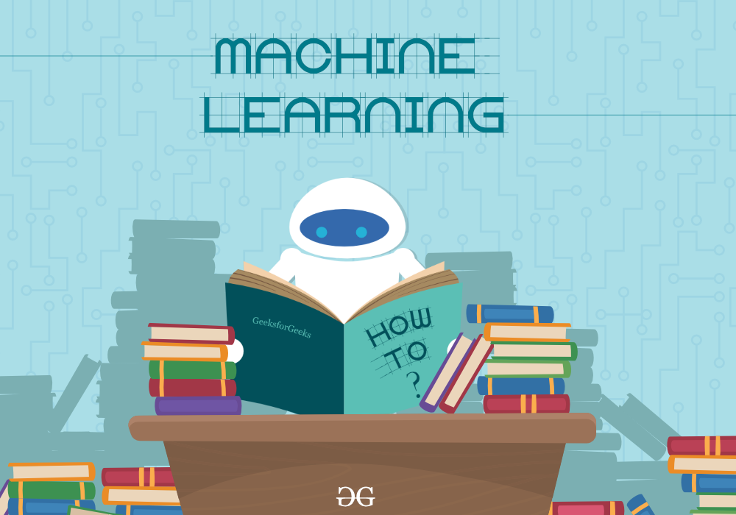
INTRODUCE
STUDY GOALS
MACHINE LEARNING STUDY 2022 WINTER
Machine Learning Basics and Utilization Study
Learn about the basic algorithms of Machine Learning
Acquire implementation capability based on theory or formula
Learning quickly through project experience with understood Machine Learning algorithms
BASIC
Overall Level
Basic
Intermediate
Hard
Theory
Project

Slide 5



INTRODUCE
STUDY KEYPOINTS
GROUP STUDY
TERM PROJECT
WEEKLY MEETING
Group-based
Projects and Presentations
Toy projects using
ML algorithms
Weekly meeting on
Every Tuesday 6:00 PM

Slide 6


PLAN
WEEKLY TASKS
PERSONAL TASK
GROUP TASK
Term Project
Prepare a presentation slide
※ Presentations should be written in English
※ Presenter will be assigned randomly
Submit Preliminary research about topic of the next presentation
‘Warning’ to all team member
If presentation is not prepared
3 warnings == expulsion

Slide 7
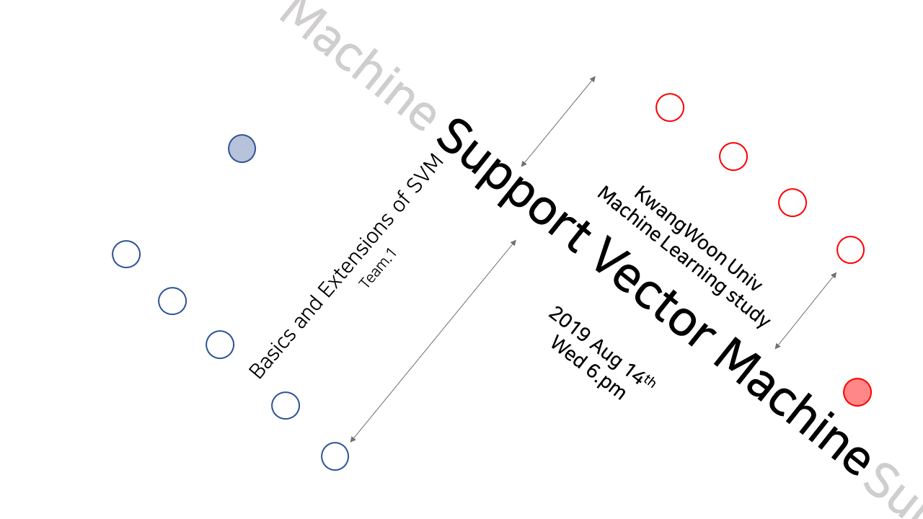
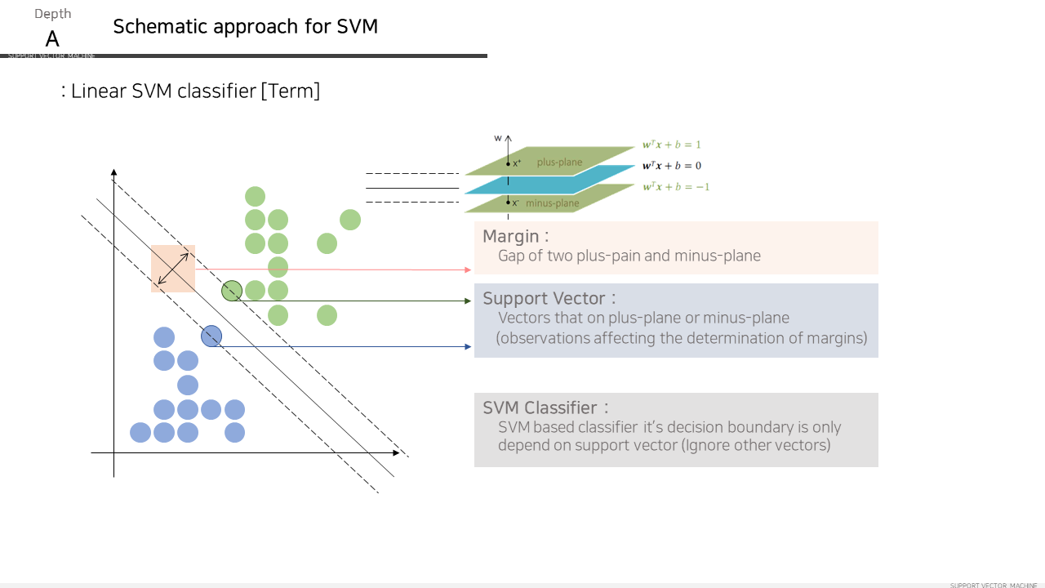
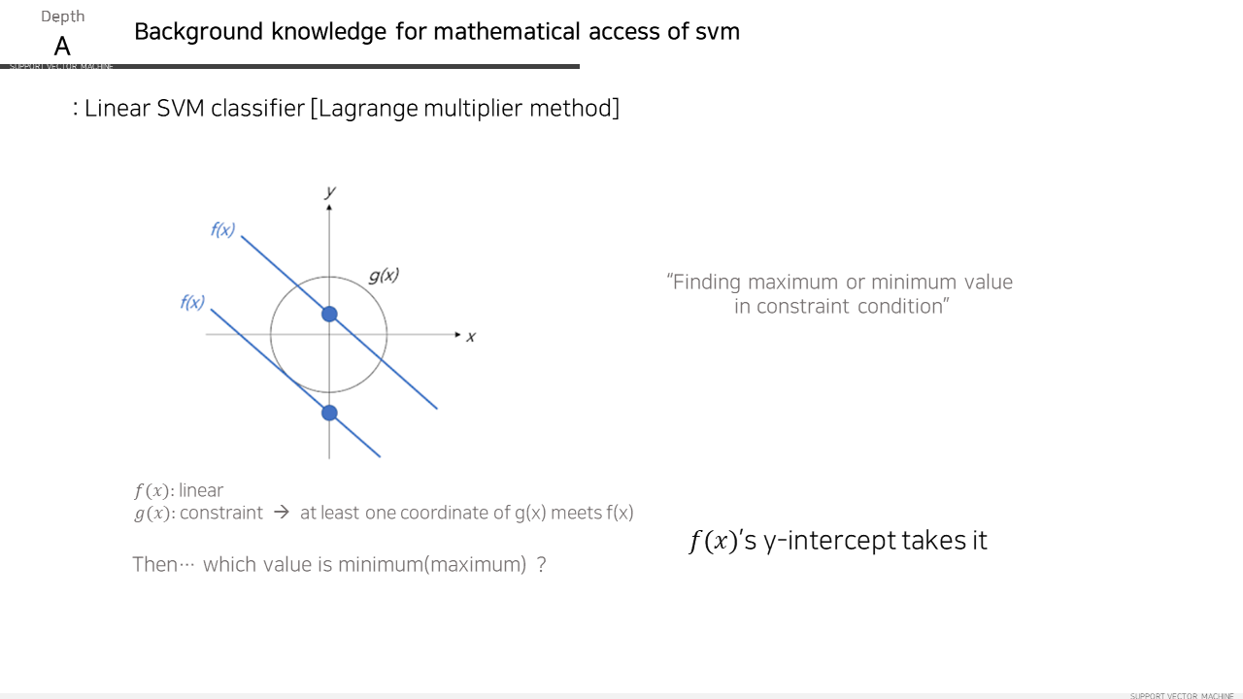
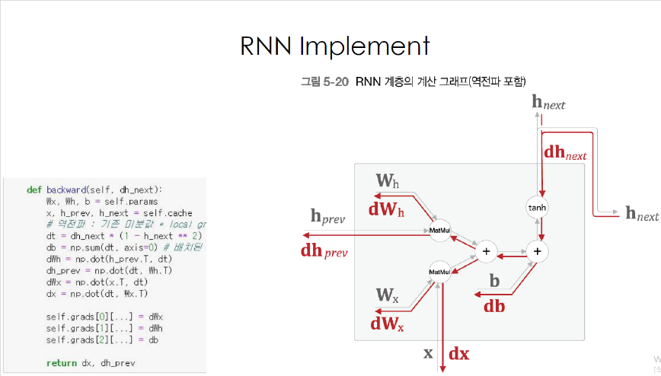
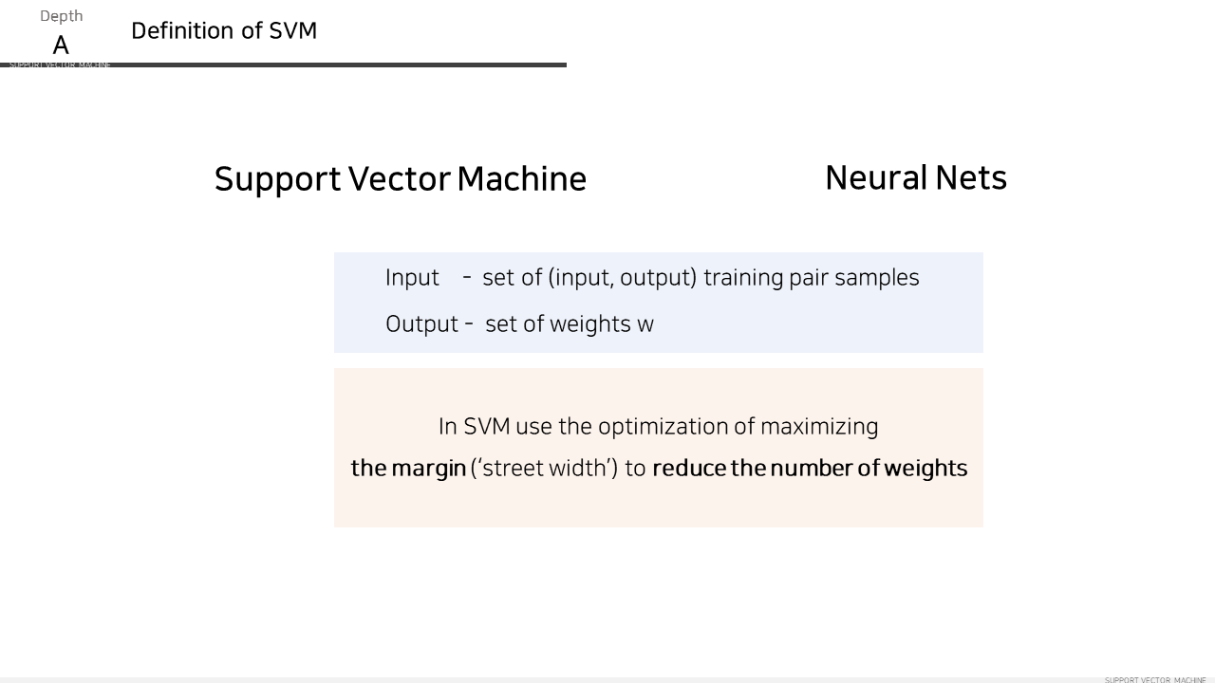
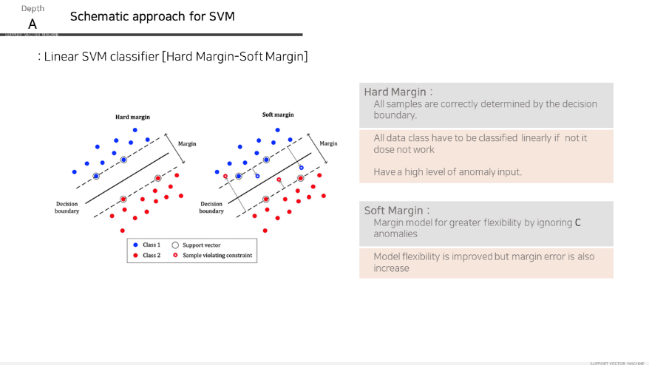
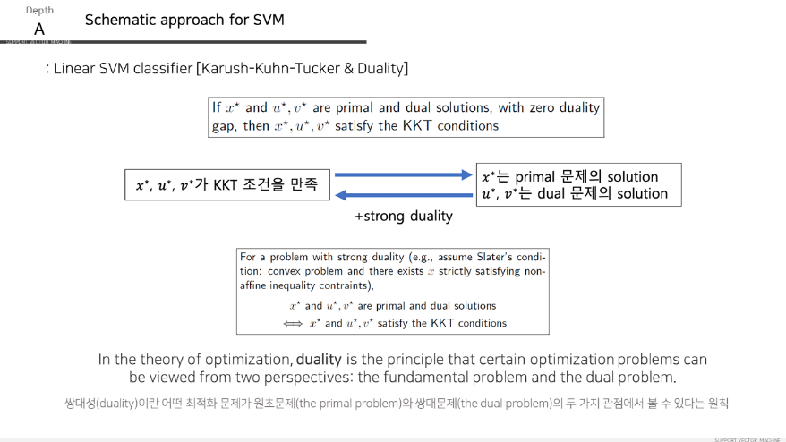
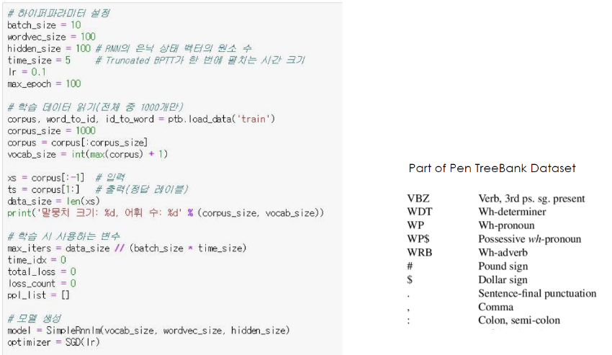
EXAMPLE
Section PPT
< Intro >
< Graphical Inst >
< Mathematical Inst >
< Implement >

Slide 8
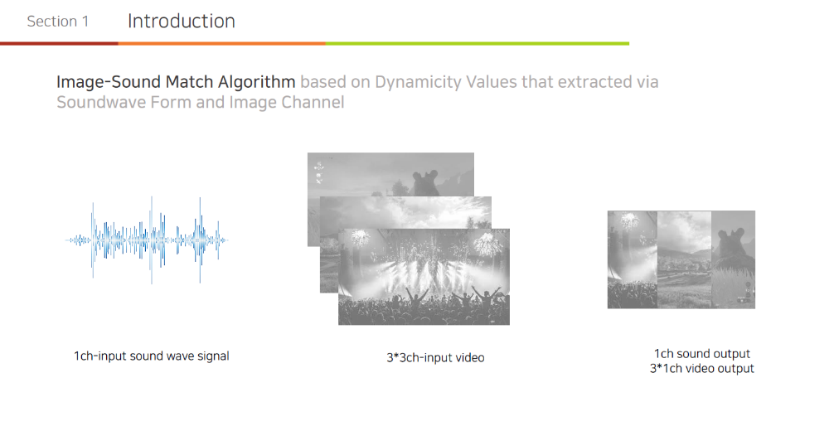
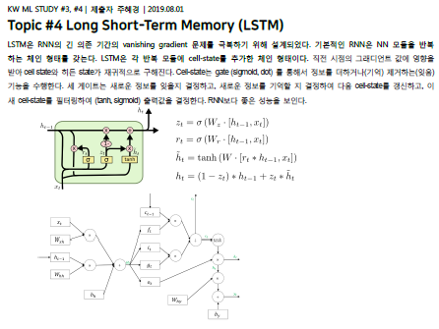
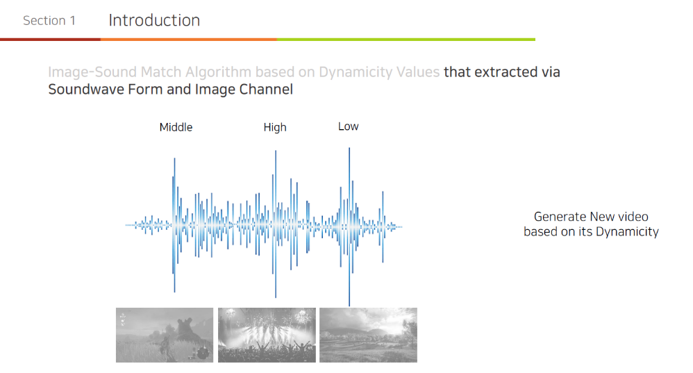
EXAMPLE
Progress PPT & Weekly Assignment
< Project Progress >
<Preliminary research>

Slide 9
PLAN
STUDY PLANS
Sun | Mon | Tue | Wed | Thu | Fri | Sat
1 | 2 | 3 Meetup #0 | 4 | 5 | 6 | 7
8 | 9 | 10 Meetup #1 | 11 | 12 | 13 | 14
15 | 16 | 17 Meetup #2 | 18 | 19 | 20 | 21
22 | 23 | 24 | 25 | 26 | 27 | 28
29 | 30 | 31 Meetup #3 | 1 | 2 | 3 | 4
Jan
Meetup #0
→ Introduce Study
→ Team-Building & Set Topic
Meetup #1
→ Basic of Machine Learning (1)
→ Topic Presentation #1 – Basic Probability Theorems and Metrics for ML
Meetup #2
→ Basic of Machine Learning (2)
→ Topic Presentation #2 → k-means and k-Nearest Neighbor algorithm
→ Pre-conference: Project presentation
Meetup #3
→ Topic Presentation #3 –– Linear Regression and Logistic Regression
→ Project Progress sharing (1/3)

Slide 10
PLAN
STUDY PLANS
Sun | Mon | Tue | Wed | Thu | Fri | Sat
29 | 30 | 31 Meetup #3 | 1 | 2 | 3 | 4
5 | 6 | 7 Meetup #4 | 8 | 9 | 10 | 11
12 | 13 | 14 Meetup #5 | 15 | 16 | 17 | 18
19 | 20 | 21 Meetup #6 | 22 | 23 | 24 | 25
26 | 27 | 28 | 9 | 10 | 11 | 12
Feb
Meetup#4
→ Topic Presentation #4 – Decision Tree and Random Forest
→ Project Progress sharing (2/3)
Meetup#5
→ Topic Presentation #5 – Dimensionality Reduction
→ Project Progress sharing (3/3)
Meetup#6
→ Final Project Presentation

Slide 11
Team-Building
TOPICS
List of Topic
Topic Presentation #1 - Basic Probability Theorems and Metrics for ML
Topic Presentation #2 - K-means and K-Nearest Neighbors
Topic Presentation #3 - Linear Regression and Logistic Regression
Topic Presentation #4 - Decision Tree and Random Forest
Topic Presentation #5 - Dimensionality Reduction
Easy
Hard
TOPIC | TOPIC 1 | TOPIC 2 | TOPIC 3 | TOPIC 4 | TOPIC 5
Team | Jiwoon | B, F | C, D | A, G | E

Slide 12
Team-Building
Team Build
TEAM A | 김민지 | 정현기 | 윤태호 | 양지석
TEAM B | 이지홍 | 정성현 | 오민성
TEAM C | 이정훈 | 김효민 | 김준혁
TEAM D | 김기수 | 황정원 | 류한웅
TEAM E | 심재윤 | 이혜미 | 박정원 | 장우현
Team F | 졸업작품팀1
Team G | 졸업작품팀2
TOPIC | TOPIC 1 | TOPIC 2 | TOPIC 3 | TOPIC 4 | TOPIC 5
Team | Jiwoon | B, F | C, D | A, G | E

Slide 13

Q&A
Jiwoon Lee(이지운)
Email. metr0jw@outlook.com
Phone. +82-10-3326-2914
Kwangwoon University
School of Computer Information and Engineering
Member of BCML Lab.

