Slide 1
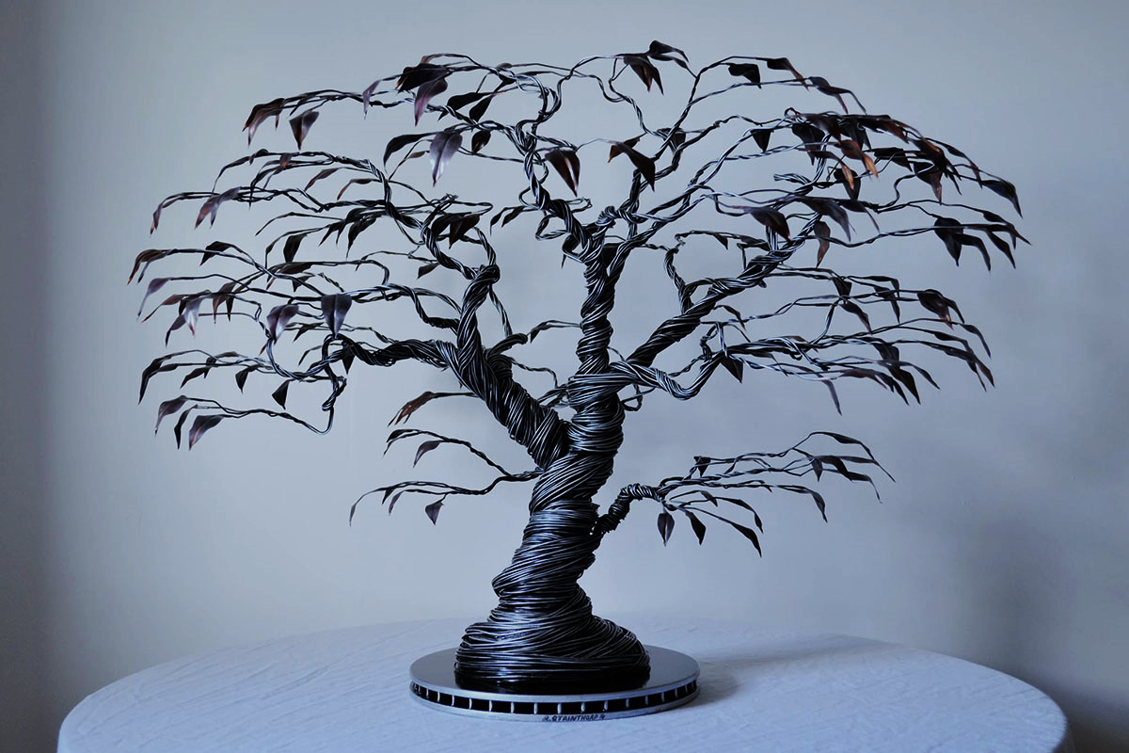
Workshop on phenotyping standards
Anne-Françoise Adam-Blondon
& Célia Michotey
29-30 April - Lund

Slide 2
Agenda
Day 1
Presentation of the standards for phenotyping studies (9:30 - 12:00)
General overview
MIAPPE: description of trial studies
CropOntology: ontologies to define observations made in trials
An ontology for forest trees: the “Woody Plant Ontology”
Lunch (12:00 – 13h00)
Hands-on session (13:00 – 16h00)
Each participant try to use the presented standards to describe its dataset
Wrap-up
Workshop dinner (18:30)
Day 2 (9:00 - 12:00)
Examples of data management, advantages of using standards
Conclusions of the workshop

Slide 3
General overview

Slide 4
MIAPPE
https://www.miappe.org/
E. Papoutsoglou, D. Faria, C. Pommier, C. Miguel, P. Kersey, A-F. Adam-Blondon et al.

Slide 5
CropOntology
www.cropontology.org
Elizabeth Arnaud et al.

Slide 6
Woody Plant Ontology
https://doi.org/10.15454/JB2WCE
Célia Michotey, Inês Chaves et al.

Slide 7
Hands-on session

Slide 8
Instructions
FILES
Phenotyping data
Your dataset
Test dataset: POP2_dataset.xlsx
MIAPPE template
https://github.com/MIAPPE/MIAPPE/tree/master/MIAPPE_Checklist-Data-Model-v1.1
MIAPPE_Checklist-Data-Model-v1.1.xlsx
CropOntology template
http://www.cropontology.org/ (Trait Dictionary template v5, Guidelines)
WoodyPlantOntology_template.xls
TODO
Describe the dataset using MIAPPE v1.1 template
Describe the observed variables using the CropOntology’s TD v5 template

Slide 9
MIAPPE Example Project / Investigation
Identification
Institution Name | Project | Trial Code | Trial Name
INRA-URFM | PlantaComp | 0148000204 | Valcros
INRA-URFM | PlantaComp | 0148000205 | La Nerthe
General
Trial Status | Trial Type | Plantation Date | Ending Date | Comments | Publications | Trial Design
CLOSED | Provenance | 05/04/1995 |  |  |  | Randomized complete blocks
CLOSED | Provenance | 21/04/1995 |  |  |  | Randomized complete blocks
Management
Manager | Manager Email | Scientific | Scientific Email | Landowner | Site Status
Denis Vauthier | denis.vauthier@inra.fr | Bruno Fady | bruno.fady@inra.fr | SA Domaine Valcros | private
Denis Vauthier | denis.vauthier@inra.fr | Bruno Fady | bruno.fady@inra.fr | Ciments Lafarge | private
Location
Country | County | Municipality | Site Name | Latitude | Longitude | Elevation | Exposure | Slope | Comments
France | PACA | Marseille | La Nerthe | 43,37675 | 5,286256 | 204 | Flat
France | PACA | La Londe-les-Maures | Valcros | 43,17583 | 6,280556 | 80 | NO
Investigation | Investigation unique ID | Investigation title | Investigation description | Submission date | Public release date | License | MIAPPE version | Associated publication
 | INRA:PlantaComp | French common garden |  |  |  | CC BY-SA | 1.1

Slide 10
MIAPPE Example Trial / Study
Identification
InstitutionName | Project | Trial Code | Trial Name
INRA-URFM | PlantaComp | 0148000204 | Valcros
INRA-URFM | PlantaComp | 0148000205 | La Nerthe
General
Trial Status | Trial Type | Plantation Date | Ending Date | Comments | Publications | Trial Design
CLOSED | Provenance | 05/04/1995 |  |  |  | Randomized complete blocks
CLOSED | Provenance | 21/04/1995 |  |  |  | Randomized complete blocks
Management
Manager | Manager Email | Scientific | Scientific Email | Landowner | Site Status
Denis Vauthier | denis.vauthier@inra.fr | Bruno Fady | bruno.fady@inra.fr | SA Domaine Valcros | private
Denis Vauthier | denis.vauthier@inra.fr | Bruno Fady | bruno.fady@inra.fr | Ciments Lafarge | private
Location
Country | County | Municipality | Site Name | Latitude | Longitude | Elevation | Exposure | Slope | Comments
France | PACA | Marseille | La Nerthe | 43,37675 | 5,286256 | 204 | Flat
France | PACA | La Londe-les-Maures | Valcros | 43,17583 | 6,280556 | 80 | NO
Study | Study unique ID | Study title | Study description | Start date of study | End date of study | Contact institution | Geographic location (country) | Experimental site name | Geographic location (latitude) | Geographic location (longitude) | Geographic location (altitude)
 | 0148000204 | Domaine de Valcros |  | 05/04/1995 |  | INRA-URFM
Description of the experimental design | Type of experimental design | Observation unit level hierarchy | Observation unit description | Description of growth facility | Type of growth facility | Cultural practices | Map of experimental design
Randomized complete blocks |  | Block>Prov>SeqID
Person | Person name | Person email | Person ID | Person role | Person affiliation

Slide 11
MIAPPE Example Trial / Study
Identification
InstitutionName | Project | Trial Code | Trial Name
INRA-URFM | PlantaComp | 0148000204 | Valcros
INRA-URFM | PlantaComp | 0148000205 | La Nerthe
General
Trial Status | Trial Type | Plantation Date | Ending Date | Comments | Publications | Trial Design
CLOSED | Provenance | 05/04/1995 |  |  |  | Randomized complete blocks
CLOSED | Provenance | 21/04/1995 |  |  |  | Randomized complete blocks
Management
Manager | Manager Email | Scientific | Scientific Email | Landowner | Site Status
Denis Vauthier | denis.vauthier@inra.fr | Bruno Fady | bruno.fady@inra.fr | SA Domaine Valcros | private
Denis Vauthier | denis.vauthier@inra.fr | Bruno Fady | bruno.fady@inra.fr | Ciments Lafarge | private
Location
Country | County | Municipality | Site Name | Latitude | Longitude | Elevation | Exposure | Slope | Comments
France | PACA | Marseille | La Nerthe | 43,37675 | 5,286256 | 204 | Flat
France | PACA | La Londe-les-Maures | Valcros | 43,17583 | 6,280556 | 80 | NO
Study | Study unique ID | Study title | Study description | Start date of study | End date of study | Contact institution | Geographic location (country) | Experimental site name | Geographic location (latitude) | Geographic location (longitude) | Geographic location (altitude)
 | 0148000204 | Domaine de Valcros |  | 05/04/1995 |  | INRA-URFM | FR | La Nerthe | +43,37675 | +5,286256 | 204
Description of the experimental design | Type of experimental design | Observation unit level hierarchy | Observation unit description | Description of growth facility | Type of growth facility | Cultural practices | Map of experimental design
Randomized complete blocks |  | Block>Prov>SeqId
Person | Person name | Person email | Person ID | Person role | Person affiliation

Slide 12
MIAPPE Example Trial / Study
Identification
InstitutionName | Project | Trial Code | Trial Name
INRA-URFM | PlantaComp | 0148000204 | Valcros
INRA-URFM | PlantaComp | 0148000205 | La Nerthe
General
Trial Status | Trial Type | Plantation Date | Ending Date | Comments | Publications | Trial Design
CLOSED | Provenance | 05/04/1995 |  |  |  | Randomized complete blocks
CLOSED | Provenance | 21/04/1995 |  |  |  | Randomized complete blocks
Management
Manager | Manager Email | Scientific | Scientific Email | Landowner | Site Status
Denis Vauthier | denis.vauthier@inra.fr | Bruno Fady | bruno.fady@inra.fr | SA Domaine Valcros | private
Denis Vauthier | denis.vauthier@inra.fr | Bruno Fady | bruno.fady@inra.fr | Ciments Lafarge | private
Location
Country | County | Municipality | Site Name | Latitude | Longitude | Elevation | Exposure | Slope | Comments
France | PACA | Marseille | La Nerthe | 43,37675 | 5,286256 | 204 | Flat
France | PACA | La Londe-les-Maures | Valcros | 43,17583 | 6,280556 | 80 | NO
Study | Study unique ID | Study title | Study description | Start date of study | End date of study | Contact institution | Geographic location (country) | Experimental site name | Geographic location (latitude) | Geographic location (longitude) | Geographic location (altitude)
 | 0148000204 | Domaine de Valcros |  | 05/04/1995 |  | INRA-URFM | FR | La Nerthe | +43,37675 | +5,286256 | 204
Description of the experimental design | Type of experimental design | Observation unit level hierarchy | Observation unit description | Description of growth facility | Type of growth facility | Cultural practices | Map of experimental design
Randomized complete blocks |  | Block>Prov>SeqId
Person | Person name | Person email | Person ID | Person role | Person affiliation
 | Denis Vauthier | denis.vauthier@inra.fr |  | Manager | INRA

Slide 13
MIAPPE Example Genetic Unit / Material
Trial | Identification
Trial Code | Accession Number | Taxon Scientific Name | Holding Institution
0148000204 | 6581 | Pinus pinea | INRA
0148000204 | 6584 | Pinus pinea | INRA
0148000205 | 6581 | Pinus pinea | INRA
0148000205 | 6584 | Pinus pinea | INRA
Biological Material | Biological material ID | Organism | Genus | Species | Infraspecific name
 | 6581 | NCBI:3346 | Pinus | pinea
Biological material latitude | Biological material longitude | Biological material altitude | Biological material coordinates uncertainty | Biological material preprocessing
Material source ID (Holding institute, accession) | Material source DOI | Material source latitude | Material source longitude | Material source altitude | Material source coordinates uncertainty | Material source description
INRA:pinus_pinea:6581 | https://doi.org/10.15454/RVGGF8

Slide 14
MIAPPE Example Environment, Factor, Event
Environment | Environment parameter | Environment parameter value
 | Initial spacing | 3x2m
Experimental Factor | Experimental Factor type | Experimental Factor description | Experimental Factor values
 | Watering | Daily watering 1L per plant | Watered; Unwatered
Event | Event type | Event accession number | Event description | Event date
 | Fertilizing | CO_715:0000011 | Fertilizer application: Ammonium nitrate at 3 kg/m2 | 2006-10-27; 2006-11-13; 2016-11-21

Slide 15
MIAPPE Example Observation Unit
Id UG | Block | Prov | SeqID | X | Y | SUR-28031996
6581 | 1 | 1 | 11 | 1 | 11 | -9
6581 | 1 | 1 | 17 | 1 | 17 | 0
6584 | 1 | 2 | 43 | 2 | 29 | 0
6584 | 1 | 2 | 63 | 2 | 9 | -9
Observation Unit | Observation unit ID | Observation unit type | External ID | Spatial distribution | Observation Unit factor value
 | SeqID:11 | SeqID (Sequential ID) |  | X:1 ; Y:11
Sample | Sample ID | Plant structure development stage | Plant anatomical entity | Sample description | Collection date | External ID

Slide 16
MIAPPE Example Observed variable
Id UG | Block | Prov | SeqID | X | Y | SUR-28031996
6581 | 1 | 1 | 11 | 1 | 11 | -9
6581 | 1 | 1 | 17 | 1 | 17 | 0
6584 | 1 | 2 | 43 | 2 | 29 | 0
6584 | 1 | 2 | 63 | 2 | 9 | -9
Observed Variable | Variable ID | Variable name | Variable accession number | Trait | Trait accession number
 | SUR-28031996 | SUR | CO_357:0000082 | Survival | CO_357:1000070
Method | Method accession number | Method description | Reference associated to the method | Scale | Scale accession number | Time scale
Visual scoring | CO_357:2000003 |  |  | Survival scale | CO_357:3000036 | Date

Slide 17
CropOntology TD v5 Example
Variable ID | Variable name | Variable synonyms | Context of use | Variable status | Institution | Language | Crop
CO_357:0000082 | SUR | Survival, Health status, ES, S, MOR | Trial evaluation | Standard for INRA | INRA/IBET | EN | WoodyPlant
Trait ID | Trait name | Trait class | Trait description | Trait synonyms
CO_357:1000070 | Survival | Stress | Assessment of the survival state of the tree | Health status
Main trait abbreviation | Alternative trait abbreviations | Entity | Attribute | Trait status
SUR | S, SR, ES, MOR | tree | survival | Standard for INRA
Method ID | Method name | Method class | Method description | Method reference
CO_357:2000003 | Visual scoring | Estimation | Visual assessment with a reference scoring scale
Scale ID | Scale name | Scale class | Decimal places | Lower limit | Upper limit | Scale Xref | Category 1 | Category 2 | Category 3
CO_357:3000036 | Survival scoring scale | Nominal | 0 | 0 | 2 |  | 0 = Alive | 1 = Dead | 2 = Doubtful

Slide 18
Wrap-up

Slide 19
Examples of data management advantages of using standards
Data discovery (beta): https://urgi.versailles.inra.fr/data-discovery-beta/
BrAPI: https://brapi.org/
FAIDARE (beta): https://urgi.versailles.inra.fr/gpds/

Slide 20
Conclusions

Slide 21
What about NordPlant ?
Data management
Usage of the presented standards ?
Data storage ecosystem: files, databases or other ?
Joining of other federations
Interested by BrAPI ?
Need help to join federations ?

Slide 22


