Slide 1
Standardizing data on phenotyping experiments using MIAPPE
A-F Adam-Blondon and C Pommier (INRA, Fr), D Faria (IGC, Pt), C Miguel (IBET, Pt), E Papoutsoglou (WUR, NL), P. Kersey (EBI, UK)
PhenoHarmonIS 2018

Slide 2
Why should we standardize phenotyping experimental data?
To enable anyone (including yourself) to reuse it: metadata about the experiment (who did it, for what purpose, where and how)
To enable the (automatic) integration of the experimental data with other types of data: unique identification of the concepts used to link different data sets
Phenotype 1 = measurement on a cultivar in an environment-GPS1-time1
Phenotype 2 = measurement on a cultivar in an environment-GPS2-time2
Genotype = observed marker’s alleles on a cultivar
Climate 1 = climatic data at GPS1-time1
To enable knowledge discovery: metadata about the experiment, controlled vocabularies, ontologies

Slide 3
Different steps to standardize data
Check list of fields required to describe the data set : metadata recommendations
-> e.g. MIAPPE
Use controlled vocabularies/scales/ontologies: e.g. Crop Ontology, Gene Ontology, BBCH scales…
Use Persistent Uniques Identifiers: e.g. gene ID, accessions ID, Trait ID, pubmed ID, DOI,…
Use standard file formats: e.g. VCF, IsaTab, …

Slide 4
Metadata : Data about the data
In the context of phenotyping experiment:
The objective of the experiment
Who contributed to the experiment
What were the experimental procedures
What was the biological material experimented
...

Slide 5
MIAPPE: Minimum Information About Phenotyping Experiment
Developed and maintained by an international community interested in plant phenotyping: large community of breeders and biologists, European infrastructure for Plant Phenotyping (EPPN/EMPHASIS), European infrastructure of Bioinformatics (ELIXIR), Planteome, Excellence in Breeding Platform…
www.miappe.org
Implemented in a growing number of database and repositories storing data from phenotyping experiments (should be visible at https://fairsharing.org/FAIRsharing.nd9ce9 but not yet really)

Slide 6
MIAPPE - Improvements
EU FP7. TransPlant : MIAPPE v1.0
EU H2020 ELIXIR Excelerate: MIAPPE v1.1 revised by the international community -> MIAPPE v1.1 (in progress) proposed here:
Detailed specifications for each field and examples
Checks with crops and forest trees communities
Work on the data model: alignment with ISA-Tab model, BrAPI

Slide 7
Capturing important information about phenotyping experiments using the MIAPPE standard
Two examples to illustrate how to capture important information about the phenotyping experiments:
[1] Bouchet et al. 2013 (http://doi.org/10.1371/journal.pone.0071377): Adaptation of Maize to Temperate Climates: Mid-Density Genome-Wide Association Genetics and Diversity Patterns Reveal Key Genomic Regions, with a Major Contribution of the Vgt2 (ZCN8) Locus.
[2] Monclus et al. 2012 (http://dx.doi.org/10.1186/1471-2229-12-173): Integrating genome annotation and QTL position to identify candidate genes for productivity, architecture and water-use efficiency in Populus spp

Slide 8
Bouchet et al 2013 [1] - Material&methods section on phenotyping experiments
375 inbred line collection defined to represent the European and American diversity and to cover a wide range of flowering times
The whole panel was tested at three different locations:
Einbeck, Germany
Gif-sur-Yvette, France
Saint-Martin-de-Hinx, France
French locations were evaluated over 3 years (2002–2004) and the German location over 1 year (2005).
Evaluations were repeated twice at each location using a complete block design. In order to limit competition effects, each block was organized into four sub-blocks corresponding to earliness groups based on a priori information. Each individual plot consisted of a row of 15 plants at a density of approximately six plants per square meter.
Days to anthesis for male flowering (MFLW) and days to silking for female flowering (FFLW) and anthesis to silking interval (ASI) were measured in thermal time.

Slide 9
Monclus et al 2012 [2] - Material&methods section on phenotyping experiments
Field trial established in April 2003 located in Central France (Ardon, 47°49’41''N, 1°54’39''E, 110 m)
The biological material consisted of a cloned 336 F1 progeny from an interspecific cross between the female Populus deltoides (Bartr. Ex Marsh.) ‘73028-62’ from Illinois and the male P. trichocarpa (Torr. and Gray) ’101-74’ from Washington State.
The trial was established from 25 cm- homogenous hardwood cuttings planted at a plant density of 6670 trees per ha. The trial was and consisted in 6 randomized complete blocks where each F1 genotype and each parent was represented by one replicate.
Circumference and stem height were measured at the end of the first (winter 2003–2004) and second (winter 2004–2005) as described in Dillen et al. Forest Ecol Manag. 2007, 252 (1–3): 12-23). Growth increment in height and circumference during the second growing season were calculated.
Leaf traits where measured in 2003: one fully illuminated mature leaf was collected on each tree according to Monclus et al. http://doi.org/10.1111/j.1469-8137.2005.01407.x ). Six calibrated discs of lamina were cut from this leaf, dried at 50 °C during 48 °C and weighed, and specific leaf area (SLA, cm² g⁻¹) was computed. Leaf discs were ground to fine powder for analysis of leaf carbon isotope composition (δ¹³C), carbon (C_{M}) and nitrogen (N_{M}) contents. One-milligram subsamples of ground material were used for measuring the CO₂ produced by combustion and its ¹³CO₂/¹²CO₂ ratio by a continuous flux isotope ratio mass spectrometer. The discrimination between atmospheric CO₂ and plant material was calculated.

Slide 10
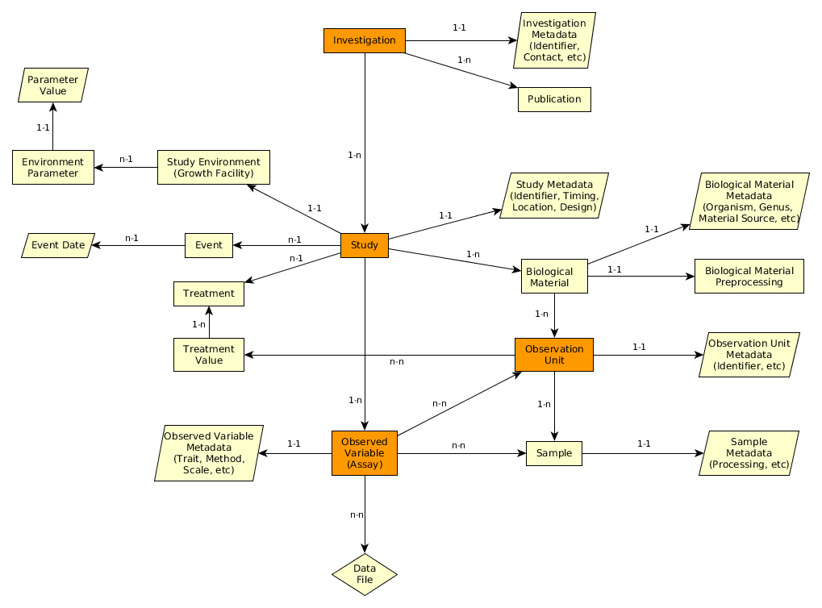
MIAPPE V1.1 (in progress) data model – the (ISA) backbone
Investigation
Study
Assay
(Observed variable)

Slide 11
MIAPPE main sections – Investigation
Investigations are research programmes with defined aims. They can exist at various scales: e.g. grant-funded programme of work with various published components; a single experiment.
One investigation holds one to many studies.
Metadata are similar to the information required for the deposition of a data set in an archive attached to a DOI: title, description, associated publications/people, ...
Examples:
Bouchet et al. [1]: the whole set of multilocal and pluriannual phenotyping experiments constitute the investigation.
Monclus et al. [2]: the whole set of measurements over three years constitute the investigation.

Slide 12
MIAPPE main sections – Study
A "study" (or experiment) comprises a series of assays (or measurements) undertaken to answer a particular biological question.
One study = one location
Metadata: all the informations describing the experiment as a whole -> timing, location, statistical design, cultural pratices, etc...
Examples:
Bouchet et al. [1] : sets of measurements conducted for each combination of year x location is a study (Einbeck_2005, Mauguio_2002, Mauguio_2003, Mauguio 2004, …)
Monclus et al. [2] : One study can group all the measurements made on detached leaves in 2003 (Ardon_2003) and the growth measurements from two seasons data in another one (Ardon_2003-2005).

Slide 13
MIAPPE main sections – Observed Variable (Assay)
An Observed Variable (assay) corresponds to a specific measurement. The assay targets a trait of interest and the measurement conducted is associated with a method and a scale.
Metadata are the mandatory metadata of the Crop Ontology Trait Dictionary: trait, method and scale
Example:
In each study of Bouchet et al. [1] three measurements are made:
Daily temperature (environment)
Female flowering developmental stage date
Male flowering developmental stage date
This allows the authors to generate three observed variables expressed in Growing Degree days (unit/scale) according to a defined method associated to the data published: the male and female flowering dates and the interval between the two.

Slide 14
MIAPPE V1.1 (in progress) data model – The biological material assayed
Investigation
Study
Biological material
Observation Unit
Assay
(Observed variable)
Sample

Slide 15
MIAPPE main sections – Biological material
Biological material section: identification of the biological material being studied and of its source (if provided originally by a stock center for instance). This section is crucial for integrating phenotyping data with genomic or genetic data.
Metadata include mandatory information and identifiers from the Multicrop Passport Descriptor (MCPD) standard + the possibility to use GPS location for forest tree / in situ material provenance
Source of the material used: accession, cultivar/variety, region of provenance, ...
MCPD identification system:
Genebank/Lab + Species + accession number (mandatory)
DOI
(Biological) material used in the study: seed lot, cuttings…
Lab + internal accession number (mandatory)
URI
Lab + internal accession number (mandatory)
BioSample ID
Plant Samples used in the study: detached leaves, ...

Slide 16
MIAPPE main sections – Observation Unit, Samples
Observation units are the objects in the study about which observations are made, and which may take different treatment values. They typically correspond to one or more individual plants. They can also be used for environmental variables.
Metadata are specific to MIAPPE: identifiers, location, replication, treatments, …
A sample is a portion of plant tissue extracted from an observation unit for the purpose of sub-plant observations and/or molecular studies.
Metadata are aligned with the BioSample DB generic model: identifiers, information about processing, …

Slide 17
MIAPPE main sections – Observation Unit, Samples
Populus deltoïdes
INRA:73028-62
doi:10.15454/1.4921786081024297E12
Example: Monclus et al., 2012, [2]
6 randomized blocks
1 observation unit = one tree
No treatment
6 replicates defined by their position in each block: row and column

Slide 18
MIAPPE main sections – Observation Unit, Samples
Example: Monclus et al., 2012, [2]
Populus deltoïdes
INRA:73028-62
doi:10.15454/1.4921786081024297E12
[observation unit] : Block1-Row4-Col4
Set of samples
One leaf
For each tree of each block
= for each observation unit
6 leaf disks
Different types of processing of the leaf disks depending on the measurement: can be captured by different sets of samples (e.g. if subsampling generates repetitions) or in the method of the observed variable.
Notes:
Leaf traits where measured in 2003: one fully illuminated mature leaf was collected on each tree according to Monclus et al. http://doi.org/10.1111/j.1469-8137.2005.01407.x ). Six calibrated discs of lamina were cut from this leaf, dried at 50 °C during 48 °C and weighed, and specific leaf area (SLA, cm² g⁻¹) was computed. Leaf discs were ground to fine powder for analysis of leaf carbon isotope composition (δ¹³C), carbon (C_{M}) and nitrogen (N_{M}) contents. One-milligram subsamples of ground material were used for measuring the CO₂ produced by combustion and its ¹³CO₂/¹²CO₂ ratio by a continuous flux isotope ratio mass spectrometer. The discrimination between atmospheric CO₂ and plant material was calculated.

Slide 19
MIAPPE V1.1 (in progress) data model – Other Important sections of information
Investigation
Files: data,…
Environment
Events
Study
Biological material
Treatment
Observation Unit
Assay
(Observed variable)
Sample

Slide 20
MIAPPE main sections – Treatment
A treatment is a biotic or abiotic experimental factor the effects of which are being ascertained in the study. It should take different values among the various observation units of the study.
Metadata include a name, a description and a value of the treatment
Example (fiction): In Monclus et al 2012 [2] we could imagine 3 blocks watered and 3 blocks unwatered. The purpose of the experiment could then be to study the genetic adaptation to water deficit through its impact on plant growth.
Observation unit | Value[Watering]
Blocks 1-3 | Watered
Blocks 4-6 | Unwatered

Slide 21
MIAPPE main sections – Event
An event is discrete occurrence at a particular time in the experiment (which can be natural, such as rain, or unnatural, such as planting, watering, etc). Can be applied at the whole study level or at the observation unit level but in the latter case, it is not the factor being studied but an additional information on the course of the experiment (e.g. unwanted pathogen attack).
Metadata include a name, a description and a time/date
Examples: In Monclus et al., 2012, [2]
the field establishment date, 2003.
the orchard was subjected to 15mm of rain on March 15, 2012 (fiction).
Study | Event
 | Name | Description | Date
Monclus et al., 2012 | Rain | 15mm of rain on the orchard | 2012-03-15

Slide 22
MIAPPE main sections – Environment
Environment: Environmental parameters and other experimental conditions that are controlled throughout the study and that are not a direct subject/factor of the experimentation. If the environmental variables are measured (recorded), they are described in the observed variable section.
Metadata include the description and the value of the environmental variable
Example:
Environment parameter | Environment parameter Value
Air temperature | 22°C
Rooting medium composition | Ca (XEO:00058): 5 mg/L; ...

Slide 23
Let’s work on your examples
Documents for the session (both in progress):
MIAPPE V1.1 current version
MIAPPE V1.1 compliant metadata excel file

