Slide 1
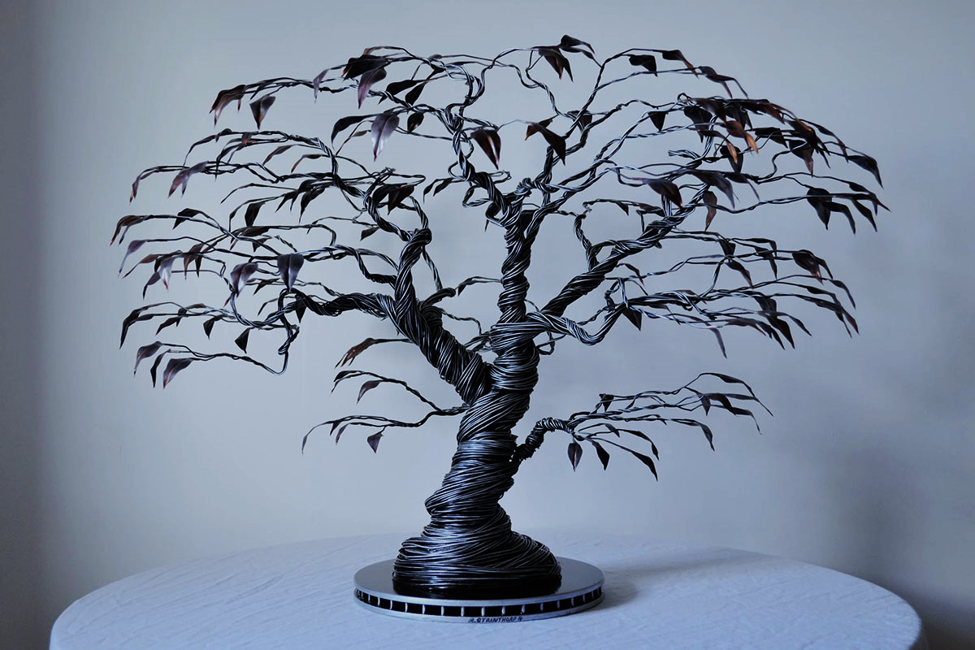
Workshop on phenotyping standards Ontology
Célia Michotey
29-30 April - Lund

Slide 2
CropOntology
www.cropontology.org
Elizabeth Arnaud et al.

Slide 3




Context
Need
Importance of controlled vocabularies and ontologies for data annotation and FAIRness
Must respect crop specificities
Answer
Development of a standard to build ontologies to annotate phenotypes: “Crop Ontology”
Crop-specific vocabulary established by its community
31 ontologies crop-specific available (including woody plants): www.cropontology.org
Trial | Genotype | CIR | HT | SUR
Domaine de Valcros | 6579 | 600 | 17 | 1
Domaine de Valcros | 6580 | 482 | 14 | 1
Trial | Genotype | H | CIR
La Nerthe | 6579 | 23 | 650
La Nerthe | 6580 | 28 | 514

Slide 4
Standard model
Variable = trait + method + scale
The phenotypic observation
Trial | Genotype | CIR | HT | SUR
Domaine de Valcros | 6579 | 600 | 17 | 1
Domaine de Valcros | 6580 | 482 | 14 | 1
Variable | Variable ID
 | Variable name
 | Variable synonyms
 | Context of use
 | Growth stage
 | Variable status
 | Variable Xref
 | Institution
 | Scientist
 | Date
 | Language
 | Crop

Slide 5
Standard model
Variable = trait + method + scale
What is the studied character?
Trial | Genotype | CIR | HT | SUR
Domaine de Valcros | 6579 | 600 | 17 | 1
Domaine de Valcros | 6580 | 482 | 14 | 1
Trait | Trait ID
 | Trait
 | Trait class
 | Trait description
 | Trait synonyms
 | Main trait abbreviation
 | Alternative trait abbreviations
 | Entity
 | Attribute
 | Trait status
 | Trait Xref
Circumference of the tree
Total height of the tree
Survival state of the tree

Slide 6
Standard model
Variable = trait + method + scale
How is it observed?
Trial | Genotype | CIR | HT | SUR
Domaine de Valcros | 6579 | 600 | 17 | 1
Domaine de Valcros | 6580 | 482 | 14 | 1
Method | Method ID
 | Method
 | Method class
 | Method description
 | Formula
 | Method reference
Measured at breast height with a graduated ribbon
Measured from soil to crown with a pole or a clinometer
Visual assessment with a reference scoring scale

Slide 7
Standard model
Variable = trait + method + scale
How is it expressed (unit or scale)?
Trial | Genotype | CIR | HT | SUR
Domaine de Valcros | 6579 | 600 | 17 | 1
Domaine de Valcros | 6580 | 482 | 14 | 1
Scale | Scale ID
 | Scale name
 | Scale class
 | Decimal places
 | Lower limit
 | Upper limit
 | Scale Xref
 | Category 1
 | Category 2
 | …
 | Category n
cm
mm
0 = Alive
1 = Dead
2 = Doubtful

Slide 8







CropOntology workflow
Trait Dictionary Template v5

Slide 9
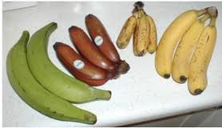
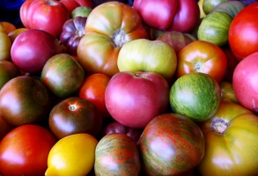
Ontologies mapping
Finger color
Banana Traits
Berry color
Fruit Color
Reference
Trait Ontology
Tomato Traits

Slide 10
Woody Plant Ontology
https://doi.org/10.15454/JB2WCE
Célia Michotey, Inês Chaves et al.

Slide 11
An ontology for Woody Plants
Description
Lists reference variables used for experimentations and observations on woody plants (forest trees and shrubs, possibly fruit trees) organized following the Crop Ontology standard
International initiative based on various communities (French, Portuguese and European)
DOI : https://doi.org/10.15454/JB2WCE
Access
Versioned in different formats in an INRA GitLab
Available on GnpIS ontology portal, CropOntology, Ontology Lookup Service (EBI’s OLS), AgroPortal, FAIRsharing
=> 468 variables at this time (386 FR and 460 EN)

Slide 12
CropOntology Trait template
Variable | Variable ID
 | Variable name
 | Variable synonyms
 | Context of use
 | Growth stage
 | Variable status
 | Variable Xref
 | Institution
 | Scientist
 | Date
 | Language
 | Crop
Trait | Trait ID
 | Trait
 | Trait class
 | Trait description
 | Trait synonyms
 | Main trait abbreviation
 | Alternative trait abbreviations
 | Entity
 | Attribute
 | Trait status
 | Trait Xref
Scale | Scale ID
 | Scale name
 | Scale class
 | Decimal places
 | Lower limit
 | Upper limit
 | Scale Xref
 | Category 1
 | Category 2
 | …
 | Category n
Method | Method ID
 | Method
 | Method class
 | Method description
 | Formula
 | Method reference
Mandatory - Highly recommented - Optional

Slide 13
Variable creation
Trial | Genotype | CIR | HT | SUR
Domaine de Valcros | 6579 | 600 | 17 | 1
Domaine de Valcros | 6580 | 482 | 14 | 1
Trial | Genotype | H | CIR
La Nerthe | 6579 | 23 | 650
La Nerthe | 6580 | 28 | 514
Trait ID | Trait name | Trait class | Trait description | Trait synonyms
CO_357:1000070 | Survival | Stress | Assessment of the survival state of the tree | Health status
CO_357:1000012 | Tree circumference | Morphological | Circumference of the tree main stem | Tree girth
Main trait abbreviation | Alternative trait abbreviations | Entity | Attribute | Trait status
SUR | S, SR, ES, MOR | tree | survival | Standard for INRA
CIR | CIRC, Circ, CI, Girth | trunk | circumference | Standard for INRA

Slide 14
Variable creation
Trial | Genotype | CIR | HT | SUR
Domaine de Valcros | 6579 | 600 | 17 | 1
Domaine de Valcros | 6580 | 482 | 14 | 1
Trial | Genotype | H | CIR
La Nerthe | 6579 | 23 | 650
La Nerthe | 6580 | 28 | 514
Method ID | Method name | Method class | Method description | Method reference
CO_357:2000003 | Visual scoring | Estimation | Visual assessment with a reference scoring scale
CO_357:2000017 | Ribbon 130cm protocol | Measurement | Measured at 130cm from the ground (approximately breast height) with a graduated ribbon
CO_357:2000018 | Ribbon 1m protocol | Measurement | Measured at 1m from the ground with a graduated ribbon | http://www.csdhub.com/national-plant-specification/conifers/nps-conifers-girth/

Slide 15
Variable creation
Trial | Genotype | CIR | HT | SUR
Domaine de Valcros | 6579 | 600 | 17 | 1
Domaine de Valcros | 6580 | 482 | 14 | 1
Trial | Genotype | H | CIR
La Nerthe | 6579 | 23 | 650
La Nerthe | 6580 | 28 | 514
Scale ID | Scale name | Scale class | Decimal places | Lower limit | Upper limit | Scale Xref | Category 1 | Category 2 | Category 3
CO_357:3000036 | Survival scoring scale | Nominal | 0 | 0 | 2 |  | 0 = Alive | 1 = Dead | 2 = Doubtful
UO:0000016 | mm | Numerical |  |  |  | http://purl.obolibrary.org/obo/UO_0000016

Slide 16
Variable creation
Trial | Genotype | CIR | HT | SUR
Domaine de Valcros | 6579 | 600 | 17 | 1
Domaine de Valcros | 6580 | 482 | 14 | 1
Trial | Genotype | H | CIR
La Nerthe | 6579 | 23 | 650
La Nerthe | 6580 | 28 | 514
Variable ID | Variable name | Variable synonyms | Context of use | Variable status | Institution | Language | Crop
CO_357:0000082 | SUR | Survival, Health status, ES, S, MOR | Trial evaluation | Standard for INRA | INRA/IBET | EN | WoodyPlant
CO_357:0000019 | CIR | Tree circumference, Tree girth, C130, Ci130 | Trial evaluation, Breeding criterion | Standard for INRA | INRA | EN | WoodyPlant
CO_357:0000020 | CIR1 | Tree circumference at 1m, Girth at 1m, Circum | Trial evaluation, Breeding criterion | Standard for INRA | IBET/INRA | EN | WoodyPlant

Slide 17
Variable creation
Trial | Genotype | CIR | HT | SUR
Domaine de Valcros | 6579 | 600 | 17 | 1
Domaine de Valcros | 6580 | 482 | 14 | 1
Trial | Genotype | H | CIR
La Nerthe | 6579 | 23 | 650
La Nerthe | 6580 | 28 | 514
Variable ID | Variable name
CO_357:0000082 | SUR
CO_357:0000019 | CIR
CO_357:0000020 | CIR1
Trait ID | Trait name
CO_357:1000070 | Survival
CO_357:1000012 | Tree circumference
CO_357:1000012 | Tree circumference
Method ID | Method name
CO_357:2000003 | Visual scoring
CO_357:2000017 | Ribbon 130cm protocol
CO_357:2000018 | Ribbon 1m protocol
Scale ID | Scale name
CO_357:3000036 | Survival scale
UO:0000016 | mm
UO:0000016 | mm

Slide 18
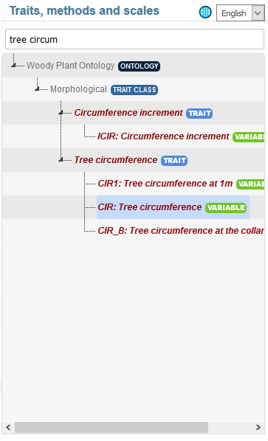
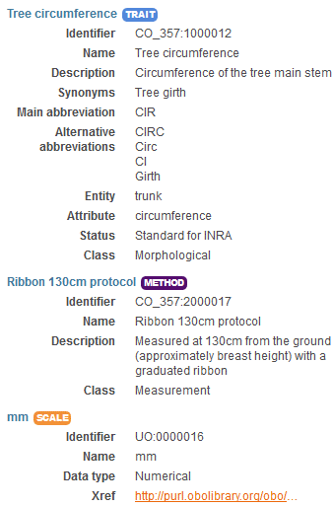
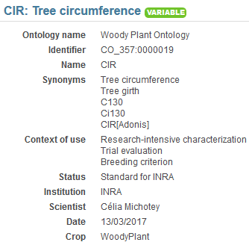
Variable viewer https://urgi.versailles.inra.fr/ephesis/ephesis/ontologyportal.do#termIdentifier=CO_357

Slide 19
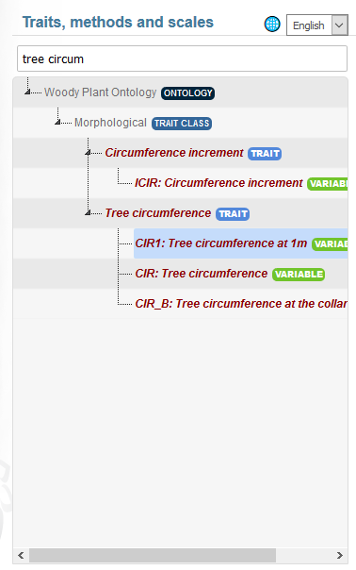
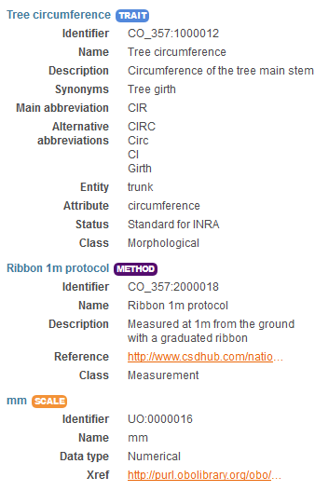
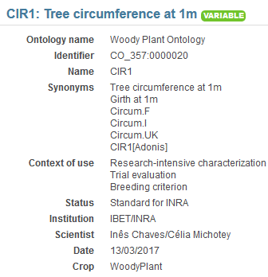
Variable viewer https://urgi.versailles.inra.fr/ephesis/ephesis/ontologyportal.do#termIdentifier=CO_357

Slide 20
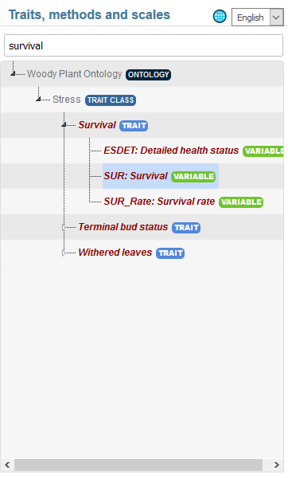
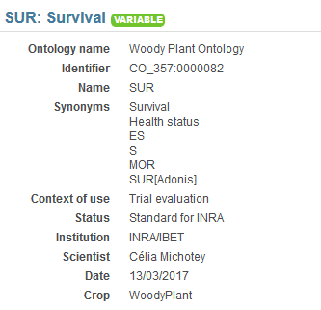
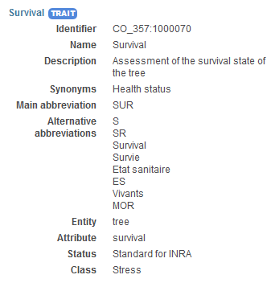
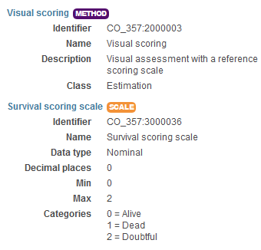
Variable viewer https://urgi.versailles.inra.fr/ephesis/ephesis/ontologyportal.do#termIdentifier=CO_357

Slide 21
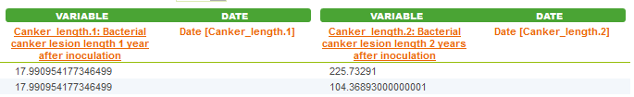

Variable annotation
Study | QTL | Trait | Trait description
POPYOMICS | Pop2_qtl1 | L98AR1 | Latent Period for strain 98AR1
POPYOMICS | Pop2_qtl2 | L93CV1 | Latent Period for strain 93CV1
POPYOMICS | Pop2_qtl3 | Canker_LL | Canker lesion length

Slide 22
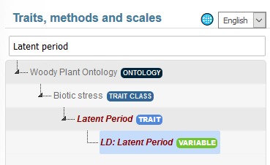
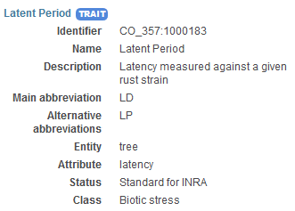
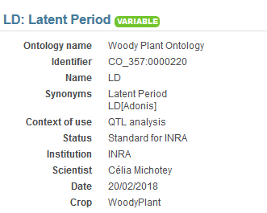
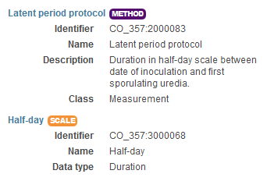
Variable annotation
Trait | Trait description
L98AR1 | Latent Period for strain 98AR1
L93CV1 | Latent Period for strain 93CV1
Canker_LL | Canker lesion length

Slide 23
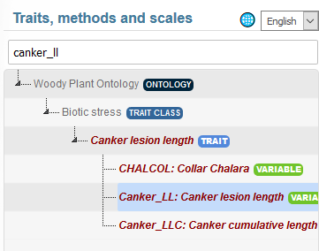
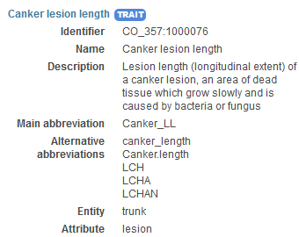
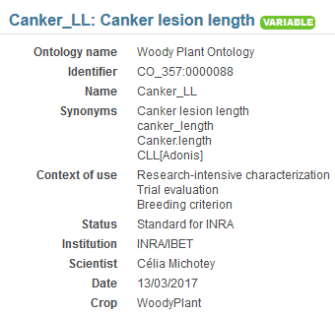
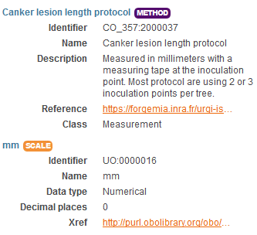


Variable annotation
Trait | Trait description
L98AR1 | Latent Period for strain 98AR1
L93CV1 | Latent Period for strain 93CV1
Canker_LL | Canker lesion length

Slide 24
BBCH scale for Woody Plant
Scale used to identify the phenological development stages of plants
Bud development
Leaf development
Stem development and elongation
Flowering
Fruit development
Senescence
Uses a decimal code system, which is divided into principal and secondary growth stages
Woody BBCH
Development of a BBCH scale for Forest Plants by the project TEMPO (French network of observatories dedicated to phenology for the entire living kingdom) => homogenize variables and facilitate data links
BBCH-scale available in the Woody Plant Ontology

Slide 25
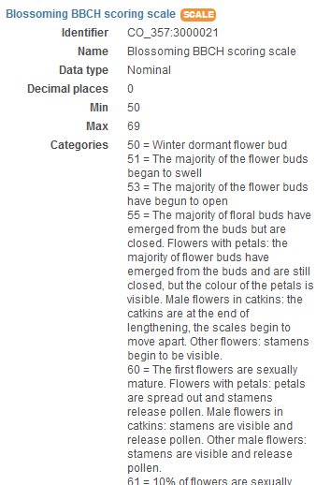
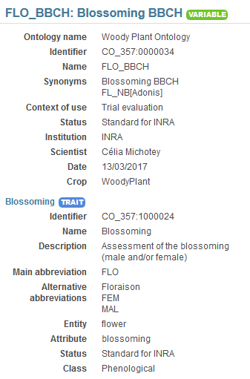
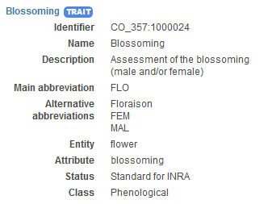
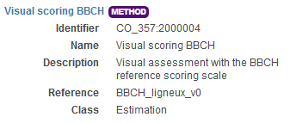
BBCH scale for Woody Plant

Slide 26
How to contribute?
Create your variables
In an empty CropOntology template (Trait Dictionary template v5)
Or complete the last version of the Woody Plant Ontology
Send your file to celia.michotey@inra.fr
I will
Validate your variables
Add them to the last version of the Woody Plant Ontology
Publish this new version on all sites referencing the Woody plant Ontology

Slide 27






Acknowledgments

Slide 28


