Slide 1
Medical Cyber Physical Systems
Overview

Slide 2
Challenges
Despite the availability of this large volume of data, the amount of time it takes to process it —to make practical inferences— is not a trivial task either for computers or healthcare professionals.
Data and time
Algorithms and tools thus far enable the identification of correlations between input and output.
Pattern / trend identification for analytic relationships
Focus:
to improve disease diagnosis accuracy,
determining the cause and course of disease, and
Formulating and effective treatment of disease
Reference: ML in Healthcare and Medical Cyber Physical Systems: A Survey

Slide 3
Example applications
Training an algorithm on multiple images of a certain medical condition from a set of prior patients, the existence of that same medical condition can be detected in a new patient by using the new patient’s image as the input to the algorithm.
A remote health monitoring system consisting of body-worn sensors that acquire data from a patient, transmit to the cloud, and process it using machine intelligence can improve diagnostic accuracy, reduce healthcare costs due to the reduction in the time for in-patient care

Slide 4
ML Challenges / barriers
Training Data: Majority of the algorithms, the prediction accuracy depends on an initial ‘‘training’’ phase, where the algorithm learns how to predict the output based on a set of training data, which includes known input-output pairs.
Because the priority for medical applications is typically algorithmic accuracy, it is reasonable to expect that future healthcare applications that incorporate machine intelligence will utilize large datacenters, potentially rented from cloud operators such as Amazon EC2

Slide 5
ML Challenges / barriers
Choice of Model: Before selecting a machine intelligence algorithm, the first step is generally the design of a model in which the form of the input and output values are specified, as well as a tolerable accuracy.
The choice of algorithm depends largely on the:
type of data,
complexity of the model, and
the goal.
the decision process of the model is sometimes of interest, interpretability of the model for humans is another issue. Hence, the models should show the relation between the variables and how each variable affect the decision process with ease.

Slide 6
Assistive Technologies
The aim is to utilize machine intelligence to provide assistance directly to a patient, rather than being used by the doctor.
Typically, the input to an underlying machine intelligence algorithm in this category comes from one or more physiological bio–markers of the patient and the output of the algorithm is used to energize multiple actuators (e.g. a robotic or haptic device) or make suggestions to the user.
Eg. iSTRETCH system(stroke), and COACH system (dementia)

Slide 7
Personal Health Monitoring
Personal health monitoring applications differ from assistive technologies in that the intended recipient of the machine intelligence-generated suggestions is a person who is capable of performing daily activities and the goal of using these suggestions is to improve and monitor personal health.
Following studies use machine intelligence to make critical suggestions to patients who are suffering from an existing medical condition.
[26] M. Rabbi, M. H. Aung, M. Zhang, and T. Choudhury, ‘‘MyBehavior: Automatic personalized health feedback from user behaviors and preferences using smartphones,’’ in Proc. ACM Int. Joint Conf. Pervasive Ubiquitous Comput., 2015, pp. 707–718.
[27] D. S. Zois, M. Levorato, and U. Mitra, ‘‘Active classification for POMDPs: A Kalman-like state estimator,’’ IEEE Trans. Signal Process., vol. 62, no. 23, pp. 6209–6224, Dec. 2014.
[28] D. Zhou et al., ‘‘Tackling mental health by integrating unobtrusive multimodal sensing,’’ in Proc. AAAI, 2015, pp. 1401–1409.
[29] J. Wijsman, B. Grundlehner, H. Liu, H. Hermens, and J. Penders, ‘‘Towards mental stress detection using wearable physiological sensors,’’ in Proc. Annu. Int. Conf. IEEE Eng. Med. Biol. Soc., Aug. 2011, pp. 1798–1801.

Slide 8
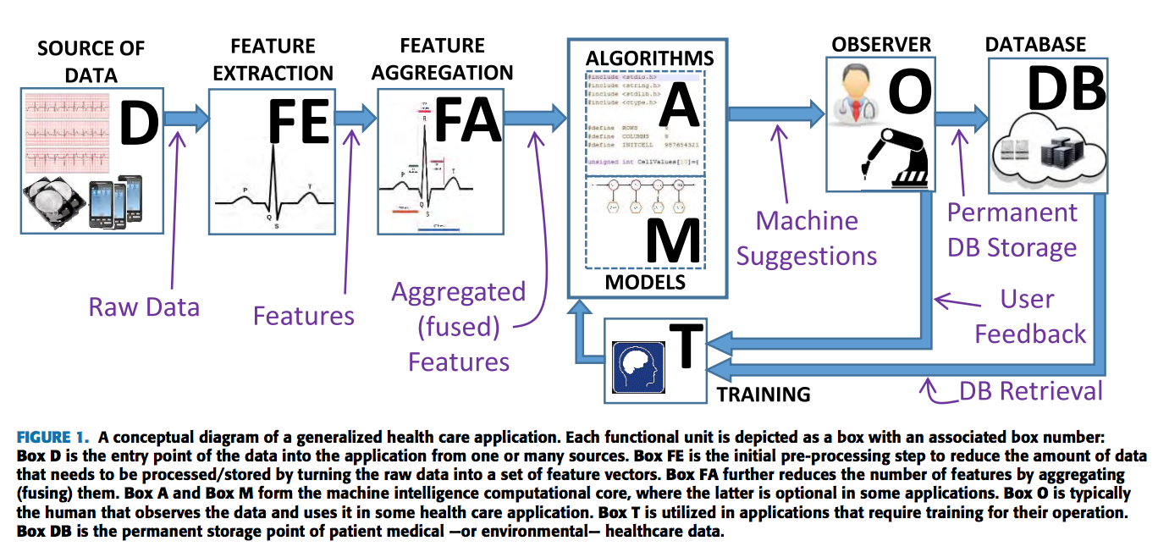
Conceptual Diagram

Slide 9
The MyBehavior system [26] does not include Box DB (Database), because the underlying machine intelligence algorithm only requires instantaneous patient data instead of stored data.
In another example, Tatonetti et al. [30] describe data mining techniques to detect drug interactions that increase blood glucose levels; because their algorithms assume no previously known drug interactions, the concept of training —and consequently Box T (Training)— is not applicable in this case.

Slide 10
IBD
Machine Intelligence in Big Data
Laboratory

