Slide 1
FASHION MNIST
CLOTHING CLASSIFICATION

Slide 2
OVERVIEW
Fashion-MNIST dataset is a collection of photos from fashion-related articles. It can be used for learning and applying deep convolutional neural network development, evaluation, and application for image classification. This code proposes a deep learning model using the tensorflow framework to handle the problem. We create a classification model.

Slide 3
PROBLEM STATEMENT
The market for online fashion is always growing. To boost sales or comprehend consumers better, an artificial intelligence system that recognizes and categorizes human clothes is needed. Businesses in the clothes sales industry can benefit from an algorithm that can recognize apparel by using it to determine the profile of potential customers and concentrate on sales that are aimed at specific niches.

Slide 4
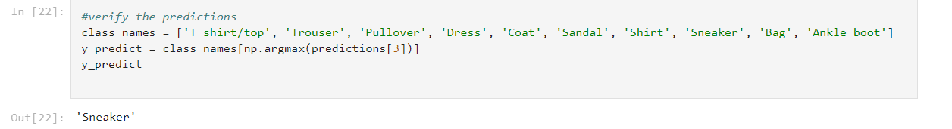
RESULT
We predict the class of image it belongs to.
EXAMPLE:

Slide 5
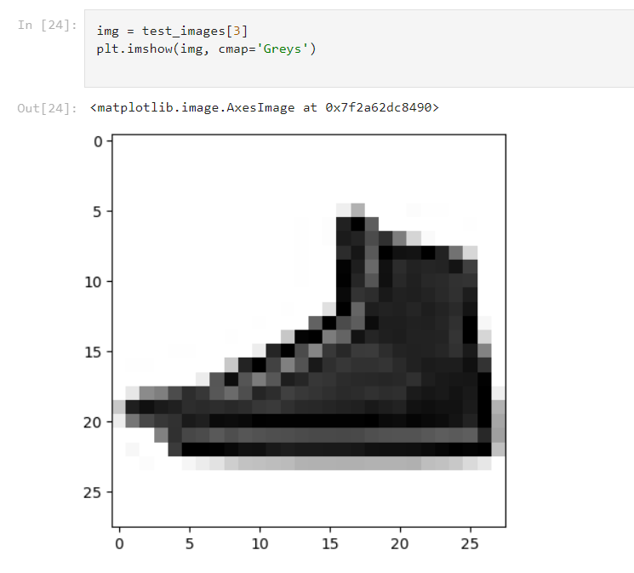

Slide 6
MODEL USED
We build a deep learning model with feedforward and backpropagation techniques using different layers.
A straightforward neural network model is built.
We first define the model, compile and fit it, and then evaluate the model.

Slide 7
MODEL ARCHITECTURE
In the top layer of this network, The format of the photos was changed from a two-dimensional array (28 by 28 pixels) to a one-dimensional array (28 * 28 = 784 pixels) when layers flattened them. This layer restructures the fashion MNIST data. There are no parameters to learn. Consider this layer lining up and unstacking rows of pixels in the image. A series of two tf.keras.layers make up the network when the pixels are flattened.
These layers are fully or densely linked. There are 128 nodes in the dense top layer (or neurons). A 10-element array is returned by the second (and final) layer. Each node has a score that indicates which of the ten classes the current image belongs to.

Slide 8
Thus, the model is evaluated and the accuracy obtained is 86.33%.

Slide 9
THANK YOU

