Slide 1

Designing the web with HTML and CSS and JavaScript
Sujay Patil
Vatsal Joshi
School of Information Technology &
Engineering

Slide 2
Overview of JavaScript

Slide 3
A brief history of JavaScript and how it came to exist
Knowing why and how JavaScript was created helps us understand why it is the way it is.
In 1993, NCSA’s Mosaic was the first widely popular web browser.
In 1994, a company called Netscape was founded to exploit the potential of the nascent World Wide Web. Netscape created the proprietary web browser Netscape Navigator, which was dominant throughout the 1990s.
Netscape quickly realized that the Web needed to become more dynamic.

Slide 4
In 1995, Netscape hired Brendan Eich, who is the creator of JavaScript and also the co-founder of the Mozilla Project, Mozilla Foundation and the Mozilla Corporation.
Before he could get started, Netscape collaborated with hardware and software company Sun (before it was acquired by Oracle) to include its more static programming language, Java, in Navigator.
As a consequence, Java was combined with a scripting language. The reason was that Java was to be the “component language” and a scripting language was necessary to automate their interactions.

Slide 5
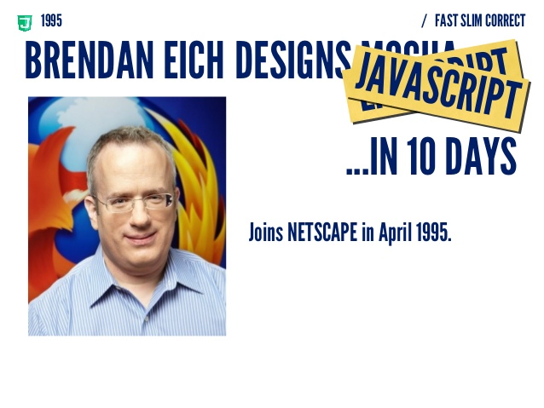

Slide 6
Current views on the language
JavaScript has become the de-facto standard programming language of the Web. Why, you ask? Because it is:
Open
Standardized (hosted by the standards organization ECMA)
And, most importantly a very good language; well-suited to the Web with its dynamic nature and tight integration with the DOM.

Slide 7
Why JavaScript ?
While, generally speaking, HTML is for content and CSS is for presentation, JavaScript is for interactivity.
Originally designed for adding small amounts of interactivity to a page (like hovers and animations - you know the kind of thing), JavaScript is now used for almost anything up to large applications and games, and can even be found in servers.

Slide 8

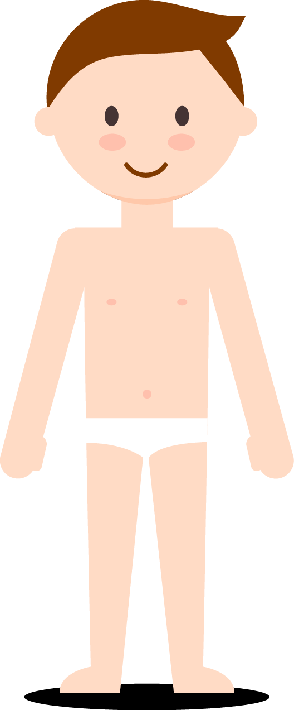
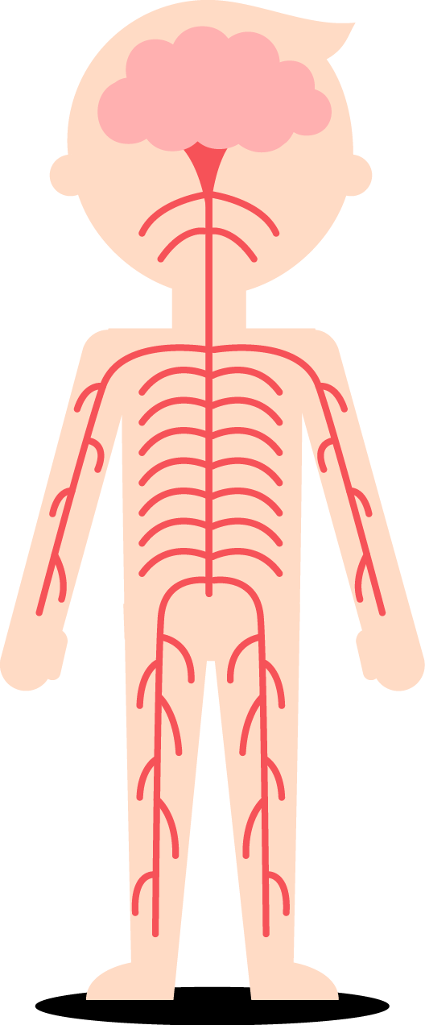
HTML
CSS
JavaScript

Slide 9
HTML – Used to structure your web page.
CSS – Used to style your web page.
JavaScript – Used to add behavior and dynamicity.

Slide 10
Making Stuff Happen - HTML, CSS and JavaScript
There’s a few ways to try out JavaScript, and when learning it’s best to try them out to see what works for you. But first, how does JavaScript relate to HTML and CSS?
Mostly, JavaScript runs in your web browser alongside HTML and CSS, and can be directly added to any webpage using a script tag. The <script> element can either contain JavaScript directly (internal) or link to an external resource via a src attribute.
A browser then runs JavaScript line-by-line, starting at the top of the file or script element and finishing at the bottom (unless you tell it to go elsewhere).

Slide 11
Internal
You can just put the JavaScript inside a script element.
External
An external JavaScript resource is a text file with a .js extension, just like an external CSS resource with a .css extension.
To add a JavaScript file to your page, you just need to use a script tag with a src attribute pointing to the file. So, if your file was called script.js and sat in the same directory as your HTML file.

Slide 12
Console
The last way is great for getting instant feedback, and it’s recommend if you just want to try a line out quickly.
In a modern browser you’ll find some developer tools - often you can right click on a page, then click “inspect element” to bring them up. Find the console and you’ll be able to type JavaScript, hit enter and have it run immediately.
Search the net if you can’t find your dev tools or console - they’re changing in browsers all the time.

Slide 13
Let’s go!
To get started, the best way is the internal method. You can modify the contents of the script element and refresh the page just like you’re used to - quick and easy.
Now it’s time to learn some JavaScript.

Slide 14
Variables and Data
Storing data so we can use it later is one of the most important things when writing code. Fortunately, JavaScript can do this! If it couldn’t, it’d be pretty darn useless.
Run in scratchpad:
var surname = prompt('Greetings friend, may I enquire as to your surname?');

Slide 15
A little box will pop-up, asking (very courteously if I may say) for your surname. Type your surname in and hit ‘OK’.
The surname you entered is now saved, and it can be referred to as surname. You can get what you entered back out again by typing surname into the console. You should see your surname appearing back to you underneath! Exciting!
You’ve created a variable.
Think, if you will, of a variable as a shelf with a name so it’s easy to get back to. You’ve named a shelf surname.

Slide 16
When you type a variable name into the console you are asking the browser, which looks after the shelves, to go find the shelf and give what’s on it to you. This is also known as the variable’s value. The value can be almost anything - in surname, you’ve stored some letters, known as a string. You can also store numbers and a myriad other kinds of data.
So, a variable has a name and a value.
They are the way we store data, and you’ll be using them a lot.
There are two parts to creating a variable; declaration and initialization. Once it’s created, you can assign (or set) its value.

Slide 17
Declaration
Declaration is declaring a variable to exist. To return to the shelf metaphor, it’s like picking an empty shelf in a massive warehouse and putting a name on it.
var surname; var age;

Slide 18
Initialization
Initialization is giving a variable its value for the first time. The value can change later, but it is only initialized once.
You initialize a variable using the equals sign (=). You can read it as “the value of the variable on the left should be the data on the right”:
var name = "Tom";
var age = 20;

Slide 19
Logic
A really important part of programming is being able to compare values in order to make decisions in code. When a comparison is made the outcome is either true or false; a special kind a of data called a boolean. This is logic.
Equality
To find out when two values are equal, use the triple equals operator (“===”).
We can also determine if two values are not equal using the triple not equal operator (“!==”).

Slide 20
Greater than and less than
Comparing two numbers is useful, for example, to determine which of two is larger or smaller. This first example is a comparison of 10 and 5 to see if 10 is larger, using the greater than operator (“>”).
Next we use the less than operator (“<”) to determine if the left value is smaller.
Combined comparisons
Combining a comparison of equality and size can be done with the greater than or equal to and less than or equal to operators (“>=” and “<=” respectively).

Slide 21
Conditional
Logic is used to make decisions in code; choosing to run one piece of code or another depending on the comparisons made. This requires use of something called a conditional. There are a few different conditionals that you might want to use, but we’ll just focus the ones used most commonly:
If
If-else

Slide 22
If statement
It’s very simple: if some logic (the condition) is true, run a block of code.
You can also supply more code to be run if the condition is not true, and supply additional conditions and blocks of code to optionally be run. These forms are called if-else.
The code between the braces - “{” and “}” - is called a block.

Slide 23
If-else
The if-else form of an if statement is used to run an alternative piece of code if the conditional is not true. The code in the if block below will be ignored, for example - only the code in the else block will be run.

Slide 24
Looping
Loops are a way of repeating the same block of code over and over. They’re incredibly useful, and are used, for example, to carry out an action on every item in an array (we will come to arrays later) or in searching.
Two of the most common loops are while loops and for loops. They combine a conditional and a block, running the block over and over until the logic of the conditional is no longer true, or until you force them to stop.

Slide 25
While
A while loop repeats a block of code while a condition is true.
Like an if statement, the condition is found in parentheses.

Slide 26
For
A for loop is similar to an if statement, but it combines three semicolon-separated pieces information between the parentheses: initialization, condition and a final expression.
The initialization part is for creating a variable to let you track how far through the loop you are - like i in the while example; the condition is where the looping logic goes - the same as the condition in the while example; and the final expression is run at the end of every loop.

Slide 27
Functions
Functions are reusable blocks of code that carry out a specific task. To execute the code in a function you call it. A function can be passed arguments to use, and a function may return a value to whatever called it.
You can save functions as the value of a variable, and you call a function using this variable and a pair of parentheses. This is also called invoking the function.
To create a function use the function keyword. You list the arguments in parantheses, and then supply a block that supplies the function’s code.

Slide 28
Objects
JavaScript objects are like a real life objects; they have properties and abilities. A JavaScript object is, in that sense, a collection of named properties and methods - a function. An object can be stored in a variable, and the properties and methods accessed using the dot syntax.
You can get data back out of an object using the dot syntax.
Properties can be any kind of data including objects and arrays. Adding an object as a property of another object creates a nested object.
Creating an empty object and adding properties and methods to it is possible too.

Slide 29
Arrays
Arrays are lists of any kind of data, including other arrays. Each item in the array has an index — a number — which can be used to retrieve an element from the array.
The indices start at 0; that is, the first element in the array has the index 0, and subsequent elements have incrementally increasing indices, so the last element in the array has an index one less than the length of the array.
In JavaScript, you create an array using the array-literal syntax.
You retrieve a specific element from an array using square bracket syntax.
It’s also possible to set the value at a particular index, again using the square bracket syntax.

Slide 30
Note:
You can find the number of elements in the array using its length property.
You can use push and pop methods to add and remove elements from the end of the array.

Slide 31
DOM
The Document Object Model is a way to manipulate the structure and style of an HTML page. It represents the internals of the page as the browser sees it, and allows the developer to alter it with JavaScript.

Slide 32
Trees and Branches
HTML is an XML-like structure in that the elements form a structure of parents’ nodes with children, like the branches of a tree. There is one root element (html) with branches like head and body, each with their own branches. For this reason, the DOM is also called the DOM tree.
Modifying the DOM, by picking an element and changing something about it, is something done often in JavaScript. To access the DOM from JavaScript, the document object is used. It’s provided by the browser and allows code on the page to interact with the content.

Slide 33
Getting an Element
The first thing to know is how to get an element. There are a number of ways of doing it, and browsers support different ones. Starting with the best supported we’ll move through to the latest, and most useful, versions.
By ID
document.getElementById is a method for getting hold of an element – unsurprisingly - by its ID.
By Class Name
document.getElementsByClassName returns the same kind of NodeList as getElementsByTagName, except that you pass a class name to be matched, not a tag name.
By CSS Selector
A couple of new methods are available in modern browsers that make selecting elements easier by allowing the use of CSS selectors. They are document.querySelector and document.querySelectorAll.

Slide 34
Events and Callbacks
In the browser most code is event-driven and writing interactive applications in JavaScript is often about waiting for and reacting to events, to alter the behavior of the browser in some way. Events occur when the page loads, when user interacts (clicks, hovers, changes) and myriad other times, and can be triggered manually too.
To react to an event you listen for it and supply a function which will be called by the browser when the event occurs. This function is known as a callback.

Slide 35
THANK YOU!

