Slide 1
Mnemonic Similarity
Objects

Slide 2
Now, I am going to test your memory for those items that you just viewed. For each item, you need to indicate if the item is OLD (V), SIMILAR (B), or NEW (N).
OLD refers to an item that you just saw, NEW refers to an item that you have not seen within the context of the experiment, and SIMILAR refers to an item that is similar to one that you just saw, but not exactly the same.
Before you begin, I am going to show you a brief demonstration to give you a feel for the task.

Slide 3
First, let’s view some items as if they were in the
INDOOR/OUTDOOR task.

Slide 5
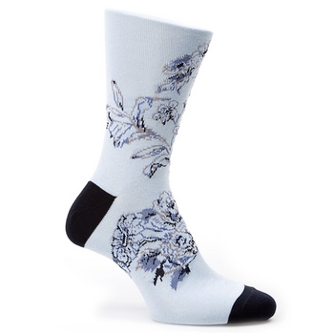

Slide 6
Indoor

Slide 8
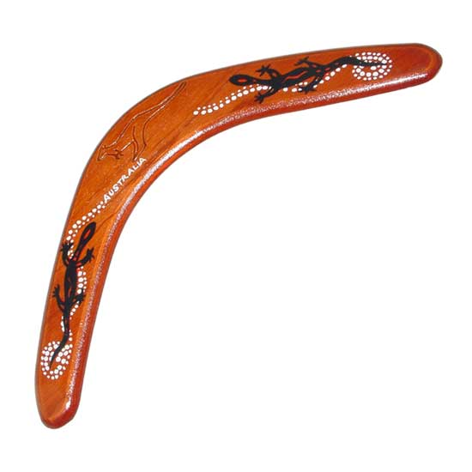

Slide 9
Outdoor

Slide 11
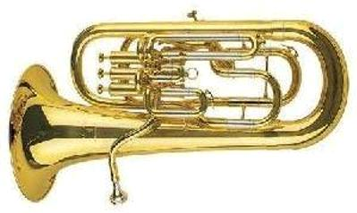

Slide 12
Indoor

Slide 14
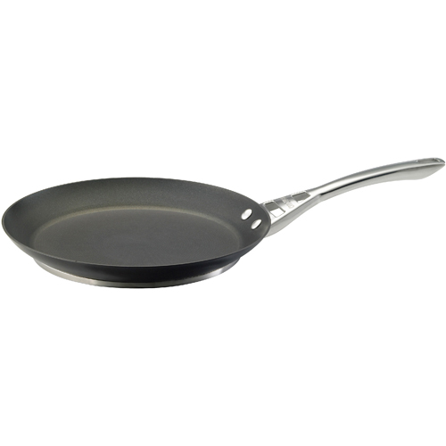

Slide 15
Indoor

Slide 17
Now for the OLD, SIMILAR, NEW task....

Slide 20
Old (v)

Slide 22


Slide 23
New (n)

Slide 25
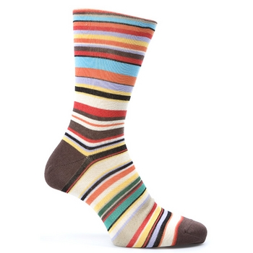

Slide 26
Similar (b)

Slide 29
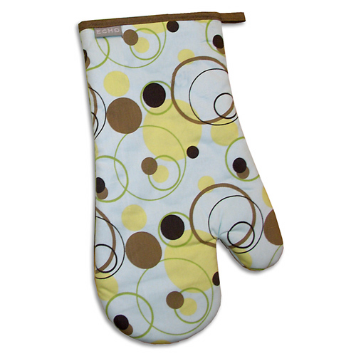

Slide 30
New (n)

Slide 33
Old (v)

Slide 35
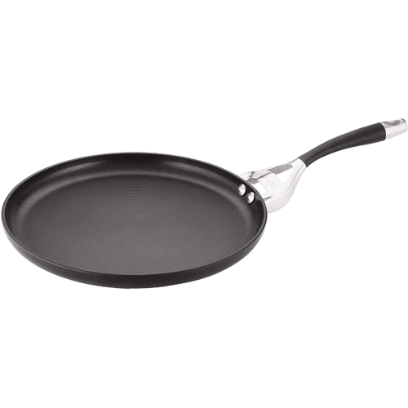

Slide 36
Similar (b)

Slide 39
Now it’s your turn.
For each item, you need to indicate if the item is
OLD (V), SIMILAR (B), or NEW (N).

