Slide 1
Mnemonic Similarity
Objects

Slide 2
Now, I am going to test your memory for those items that you just viewed. For each item, you need to indicate if you are SURE that the item is OLD (C), if the item is PROBABLY OLD (V), if the item is PROBABLY NEW (B), or if you are SURE that the item is NEW (N).
OLD refers to an item that you just saw, NEW refers to an item that you have not seen within the context of the experiment, even if it’s SIMILAR to an item that you just saw but not exactly the same.
Before you begin, I am going to show you a brief demonstration to give you a feel for the task.

Slide 3
First, let’s view some items as if they were in the
INDOOR/OUTDOOR task.

Slide 5
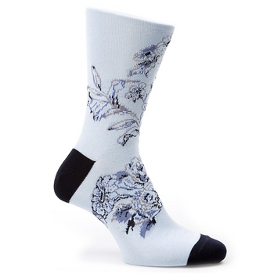

Slide 6
Indoor

Slide 8
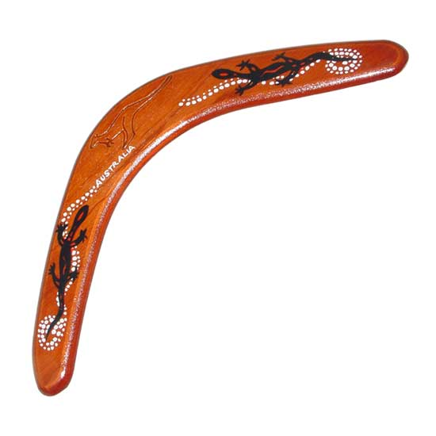

Slide 9
Outdoor

Slide 11
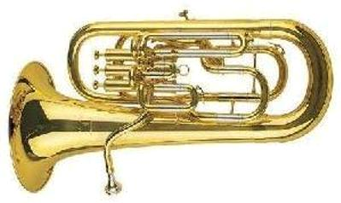

Slide 12
Indoor

Slide 14
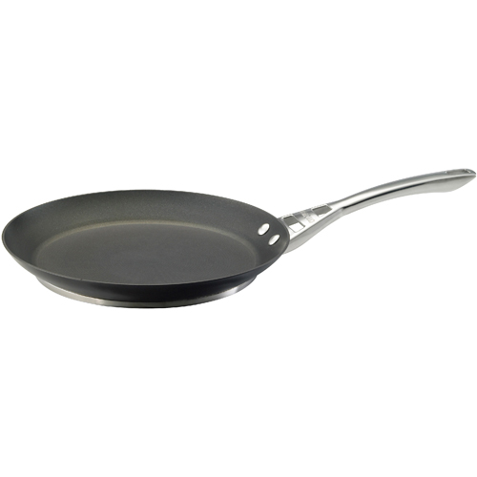

Slide 15
Indoor

Slide 17
Now for the SURE OLD, PROBABLY OLD,
PROBABLY NEW, SURE NEW task....

Slide 20
Sure Old (c)

Slide 22
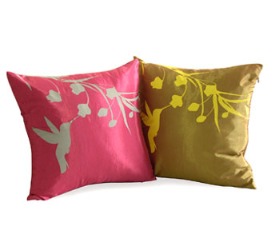

Slide 23
Probably New (b)

Slide 25
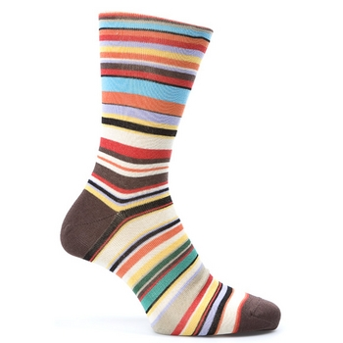

Slide 26
Sure New (n)

Slide 29
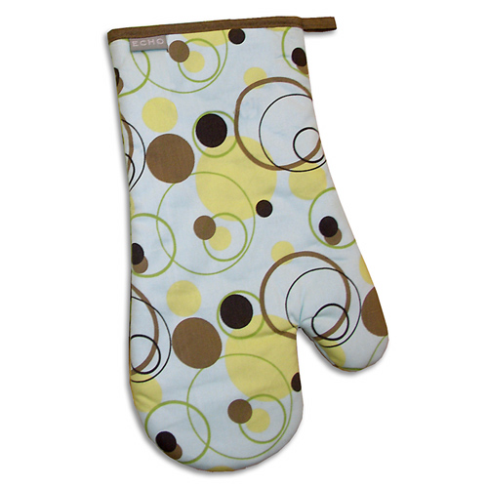

Slide 30
Sure New (n)

Slide 33
Probably Old (v)

Slide 35
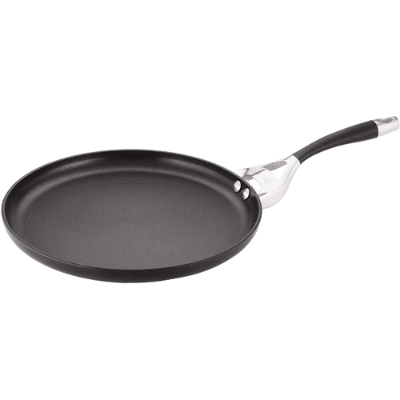

Slide 36
Probably New (b)

Slide 39
Now it’s your turn.
For each item, you need to indicate if you are SURE the item is OLD (C), if the item is PROBABLY OLD (V), if the item is PROBABLY NEW (B), or if you are SURE the item is NEW (N).

