Slide 1


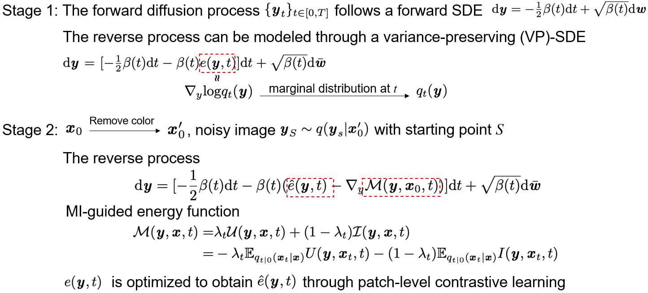
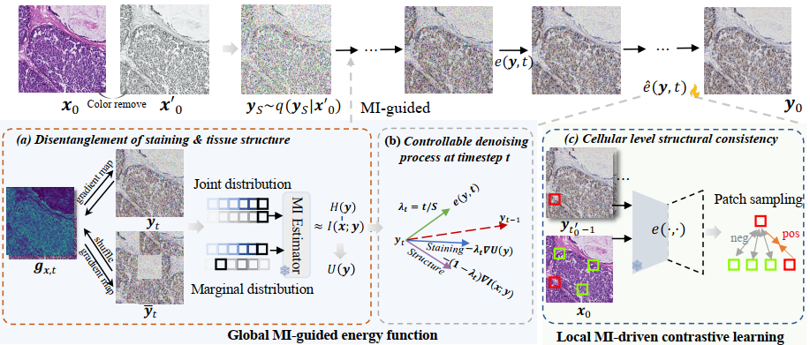
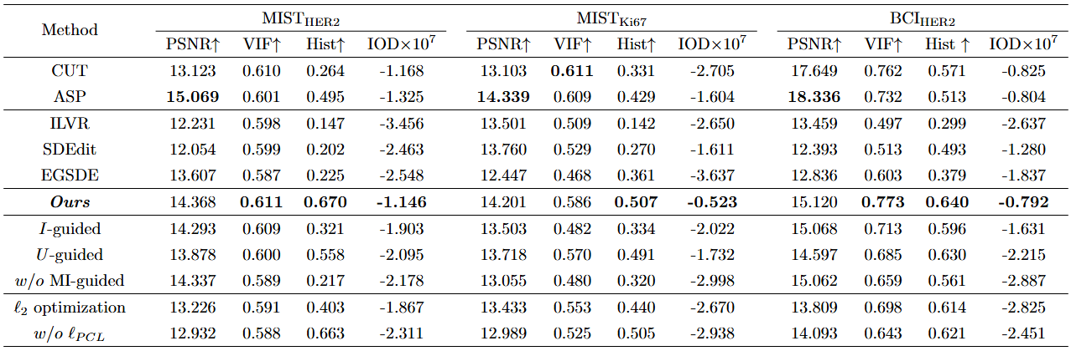
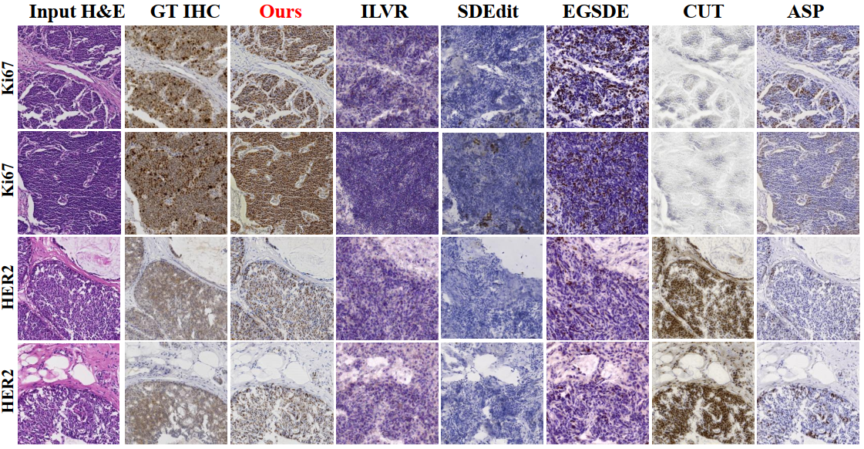
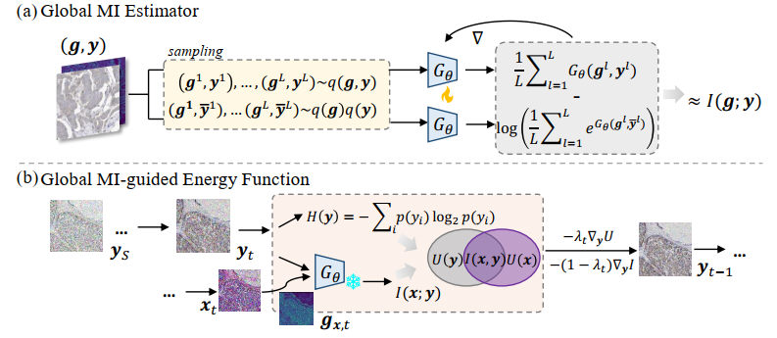
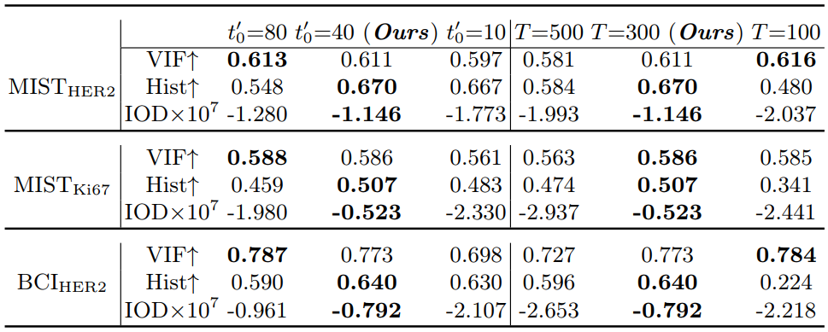
Score-based Diffusion Model for Unpaired Virtual Histology Staining
Anran Liu ^{1*}, Xiaofei Wang ^{2*}, Jing Cai ^{1✉}, Chao Li ^{2,3,4✉}
1. Department of Health Technology and Informatics, Hong Kong Polytechnic University, China
2. Department of Clinical Neurosciences, University of Cambridge, UK
3. School of Science and Engineering, University of Dundee, UK
4. Department of Applied Mathematics and Theoretical Physics, University of Cambridge, UK
*Equal contribution
Introduction
Background
H&E staining is the most common diagnostic practice for histology evaluation but lacks specificity for diagnostic markers. IHC staining provides protein-targeted staining with diagnostic markers but is restricted by tissue availability and antibody specificity.
Challenges
Effective decomposition of staining style and tissue structure across H&E and IHC modalities. Controllable staining process adaptable to diverse tissue and proteins with rigorous structural consistency for non-pixel-aligned image pairs.
Related works
Traditional pixel-wise color mapping methods struggle with complex staining relationships. GAN-based methods face mode collapse and training instability, with entanglement of shared structural and specific staining information complicating generation control.
Contributions
Experimental Results
First energy-guided diffusion model for unpaired virtual histology staining: (1) Novel score-based diffusion framework with global MI-guided energy function for dynamic disentanglement of staining and structure across modalities; (2) Timestep-adaptive reverse-time SDE for precise staining intensity and structural reconstruction control; (3) Local MI-driven contrastive learning for cellular-level structural consistency.
Dataset
We evaluate our method on two public datasets: the Breast Cancer Immunohistochemical (BCI) challenge dataset and the Multi-IHC Stain Translation (MIST) dataset. In BCI, we split the dataset into 3498, 437 and 438 H&E-IHC (of gene HER2) pairs for training, validation and test. For the MIST dataset, we include H&E-IHC pairs of two genes, i.e., HER2 (4,513, 564 and 563 pairs for training, validation and test) and Ki67 (4,288, 536, 537 pairs for training, validation and test). All patches are cropped in size of 1024×1024. All H&E-IHC pairs are from consecutive slices, but not strictly pixel-aligned.
Method
Two-stage score-based diffusion framework
Comparison with Other Methods
We assess generated IHC image quality using four complementary metrics: PSNR for objective image quality assessment, VIF for measuring information preservation between source and generated images, and histogram correlation for evaluating color matching performance. Additionally, we use IOD (Integrated Optical Density) deviation to quantify clinical relevance by measuring consistency of positive staining signals in cellular regions. These metrics collectively evaluate both technical image quality and diagnostic utility for virtual staining applications.
Table 1. Performance of virtual IHC staining. Bold numbers indicate the best results.
Fig.1 The overall workflow of MIU-Diff.
We establish a two-stage score-based diffusion framework that first pretrains an unconditional IHC diffusion model, then learns the conditional distribution for H&E-to-IHC translation. The MI-guided energy function M(y,x,t) dynamically disentangles staining style U(y) and shared structural information I(x;y) through mutual information estimation. Given the severe challenge of unpaired training data where H&E and IHC images are from different tissue sections, we propose a timestep-adaptive reverse SDE that precisely controls the balance between staining restoration and structure preservation. Additionally, local MI-driven contrastive learning ensures cellular-level consistency by maximizing mutual information between corresponding patches while minimizing it for non-corresponding regions.
MI-guided energy function to disentangle staining & structure
The method employs a global mutual information estimator to quantify shared structural characteristics between H&E and generated IHC images, trained within the IHC domain using gradient maps as structural proxies. The energy function dynamically balances unique staining information U(y) and shared structural information I(x;y), with the timestep-adaptive parameter λₜ = t/S controlling this trade-off throughout the reverse diffusion process. This approach enables the model to prioritize staining detail restoration in early timesteps while emphasizing structural consistency preservation in later stages, effectively disentangling style and content without requiring pixel-aligned training pairs.
Fig.3 Visual comparisons on MIST_{Ki67} and MIST_{HER2}.
Ablation Study
Table 2. Ablation experiments with different optimization and denoising steps.
Fig.2 Illustration of (a) the construction and training process of the global MI estimator, and (b) the MI-guided energy function in the reverse diffusion, which is formulated by I(x; y) approximated using the MI estimator and U(y).
Conclusion
Reference
The H&E-IHC virtual staining task faces challenges in structural consistency preservation and staining conversion. In this study, we proposed an MI-guided score-based diffusion model, MIU-Diff, for unpaired virtual staining. MIU-Diff effectively disentangles staining style from tissue structure through a dynamic global MI-guided energy function. Additionally, the timestep-customized reverse diffusion process allows precise modulation of staining and structure. To further ensure cellular-level structural consistency, we also introduced a local MI-driven contrastive learning strategy. Experimental results on two public datasets showed superior performance of MIU-Diff over advanced methods, making it a valuable technique for clinical diagnosis.
[1] He, Y., Liu, Z., Qi, M., et al.: PST-Diff: achieving high-consistency stain transfer by diffusion models with pathological and structural constraints. IEEE Transactions on Medical Imaging (2024)
[2] Kataria, T., Knudsen, B., Elhabian, S.Y.: StainDiffuser: Multitask dual diffusion model for virtual staining. arXiv preprint arXiv:2403.11340 (2024)
[3] Chen, F., Zhang, R., Zheng, B., et al.: Pathological semantics-preserving learning for H&E-to-IHC virtual staining. In: International Conference on Medical Image Computing and Computer-Assisted Intervention, pp. 384–394. Springer (2024)
For more information, please contact: xw405@cam.ac.uk
Paper ID: #5

