Slide 1
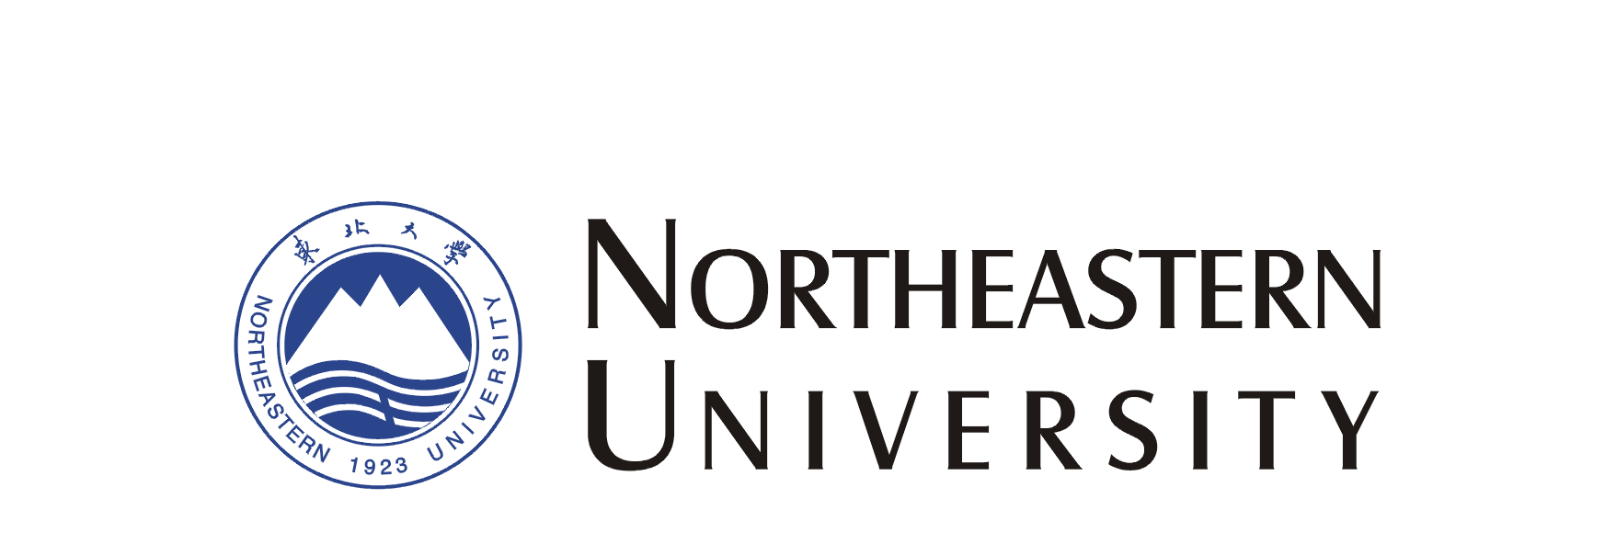


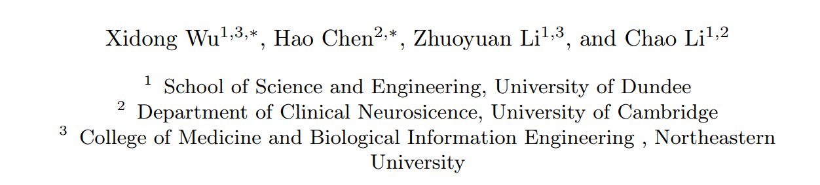
OG-SAM: Enhancing Multi-Organ Segmentation with Organogenesis-Based Adaptive Modeling

Slide 2
Overview
· Reviewing
· Motivation
· Method
· Results
· Our thinking

Slide 3
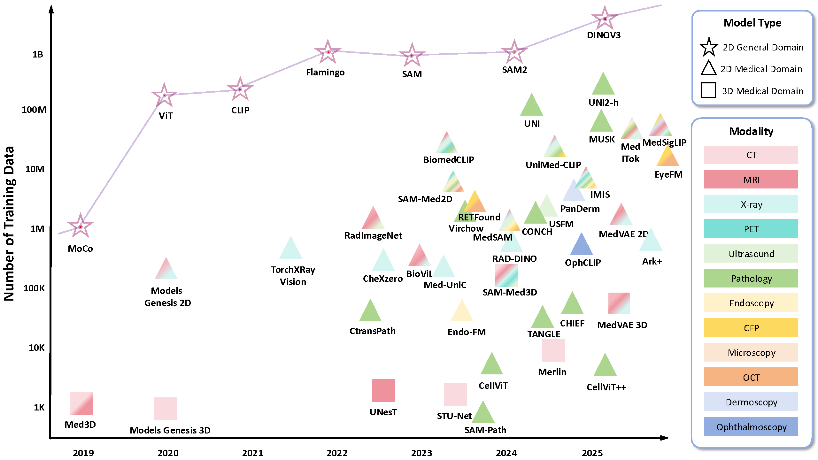
Reviewing
Project Imaging-X Contributors. Arxiv(2025)

Slide 4
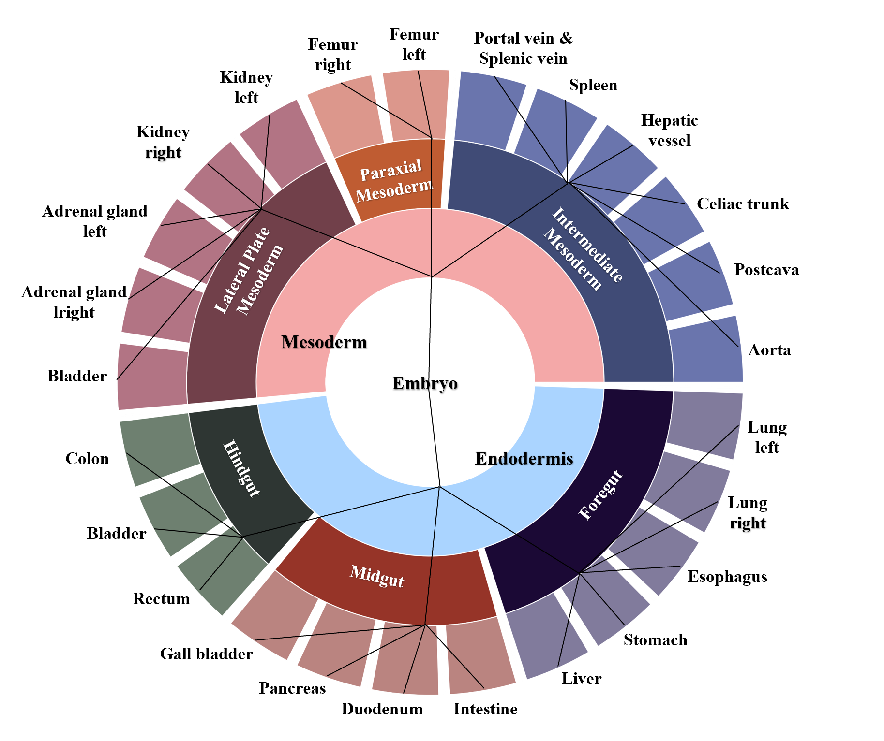
Motivation
1. Nuanced Relationships Between Organs
2. Distinctive Morphological Characteristics

Slide 5
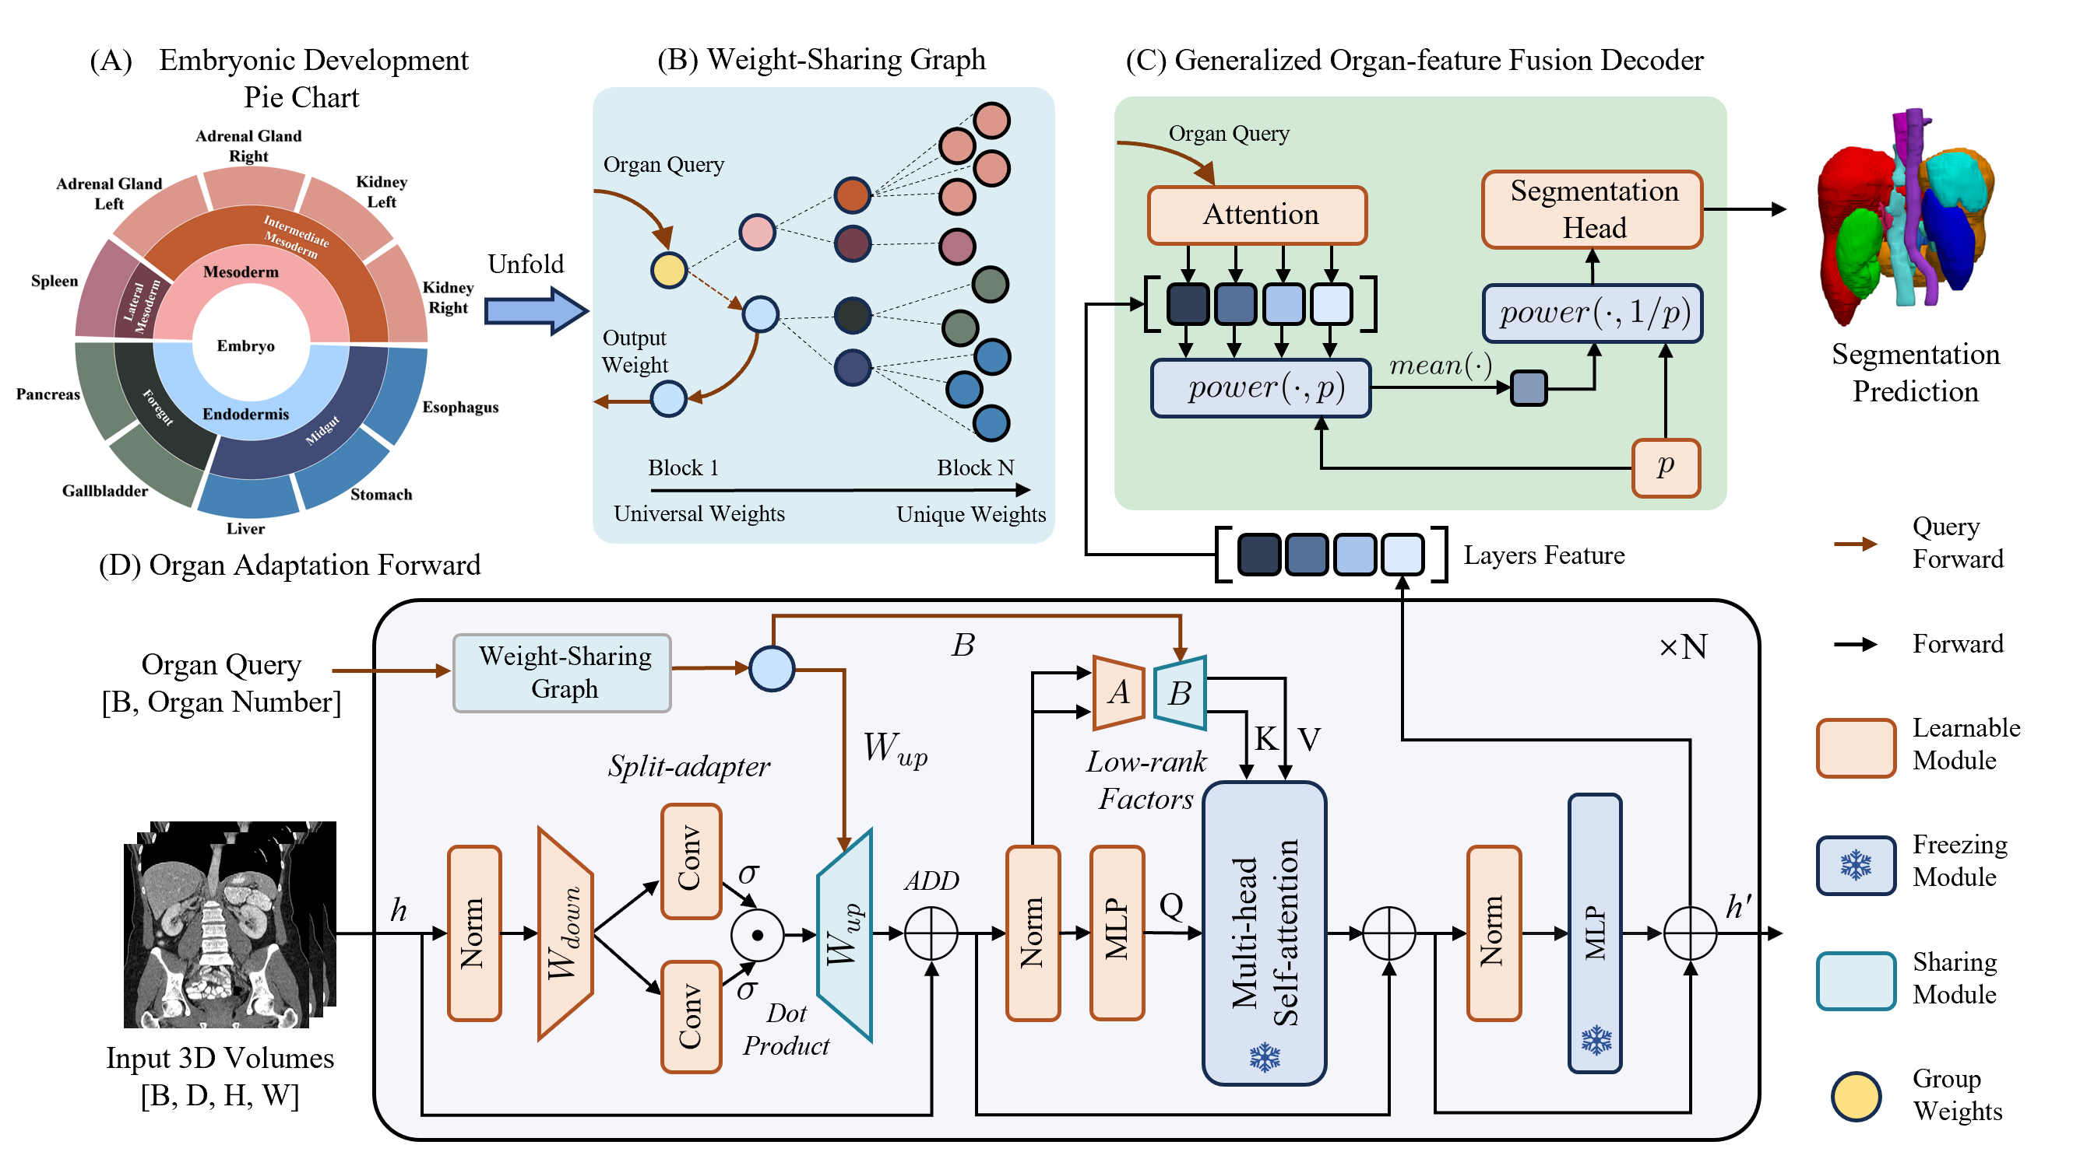
Method

Slide 6
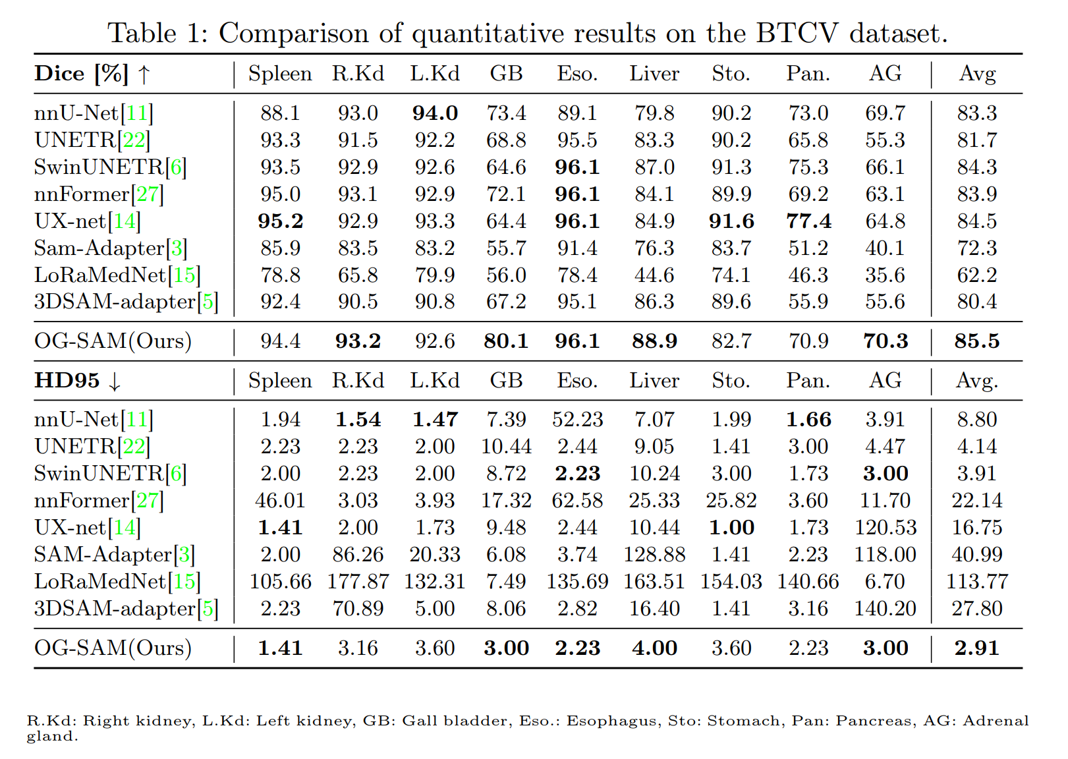
Results

Slide 7
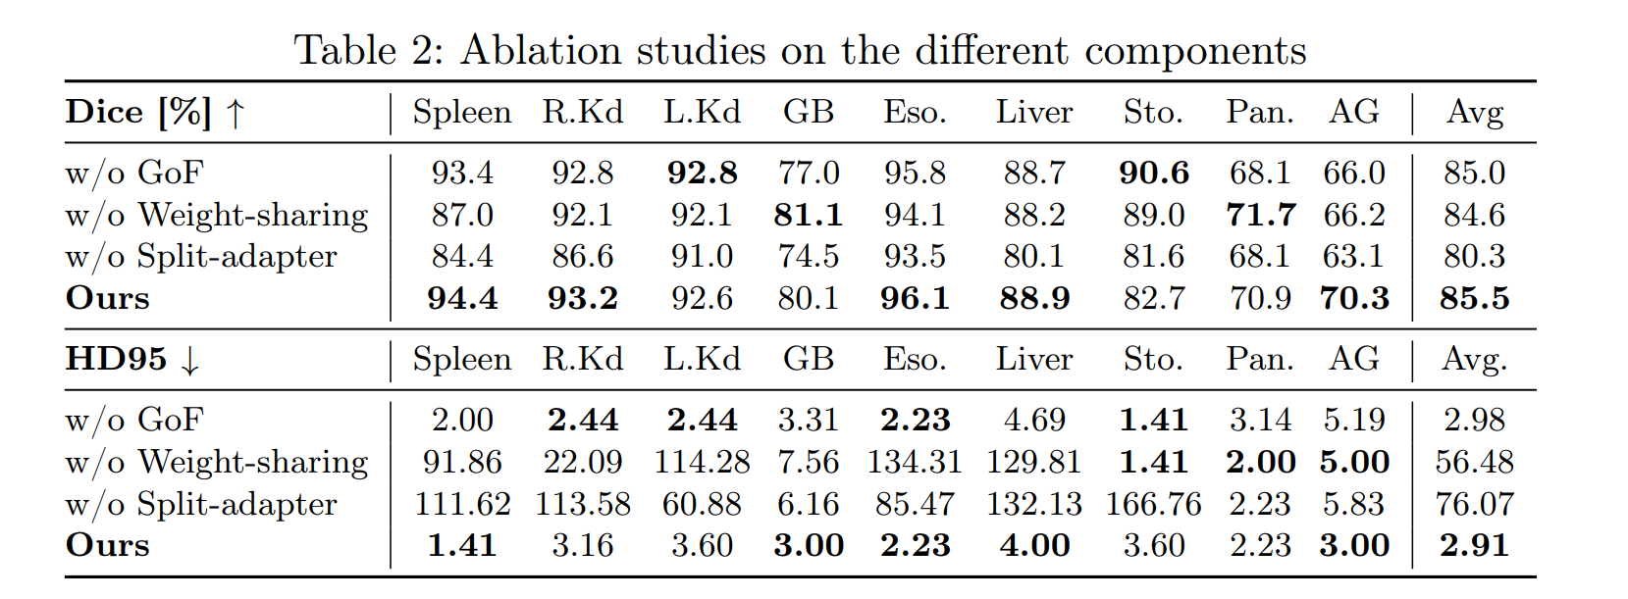
Results

Slide 8
Our thinking
1.Bridging Foundation Models & Medicine
2.Biological Inspiration → Computational Design
Notes:
To conclude, our thinking is that biological development principles, such as organogenesis, are not only relevant to medicine, but can also inspire how we design adaptive AI models.
With OG-SAM, we show that by combining shared-to-specialized learning and multi-scale adaptation, segmentation becomes more accurate and robust.
More importantly, this paradigm is scalable—new organs can be added without retraining from scratch.
We believe this approach is a step toward bridging large foundation models with domain-specific medical knowledge, opening possibilities for future multi-task and personalized clinical applications.”

