Slide 1


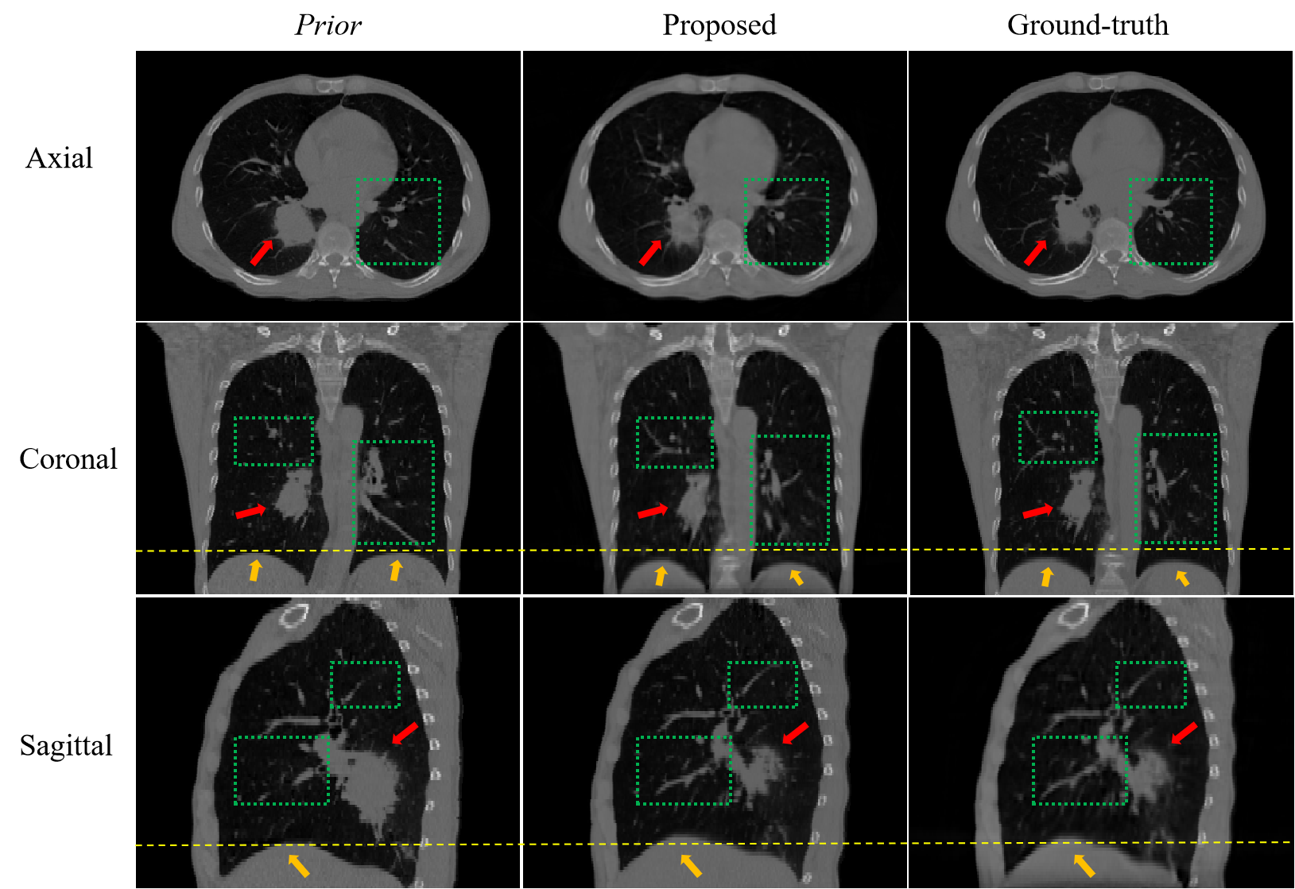
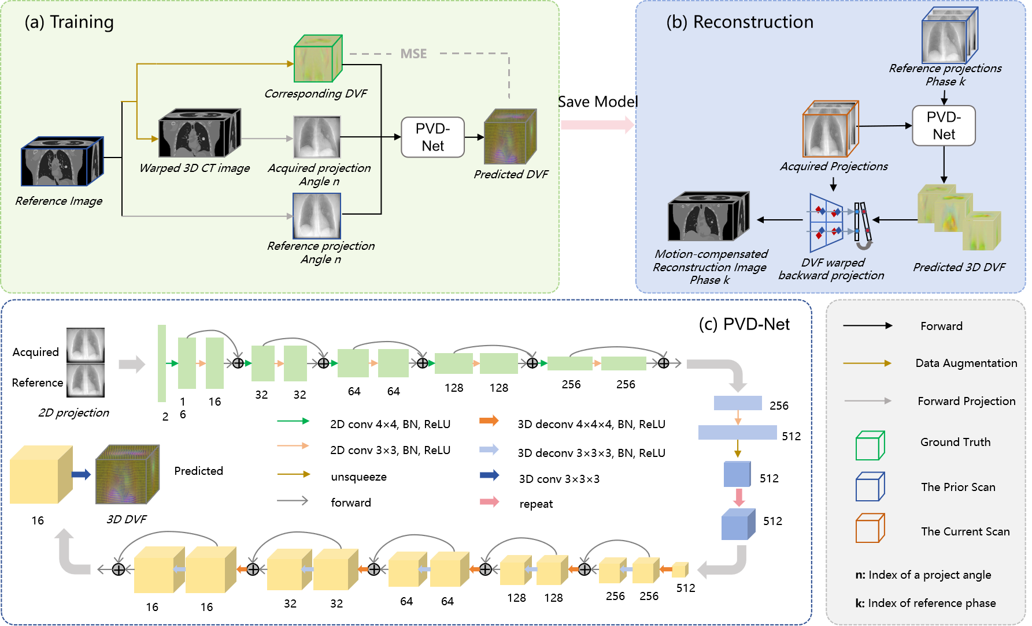
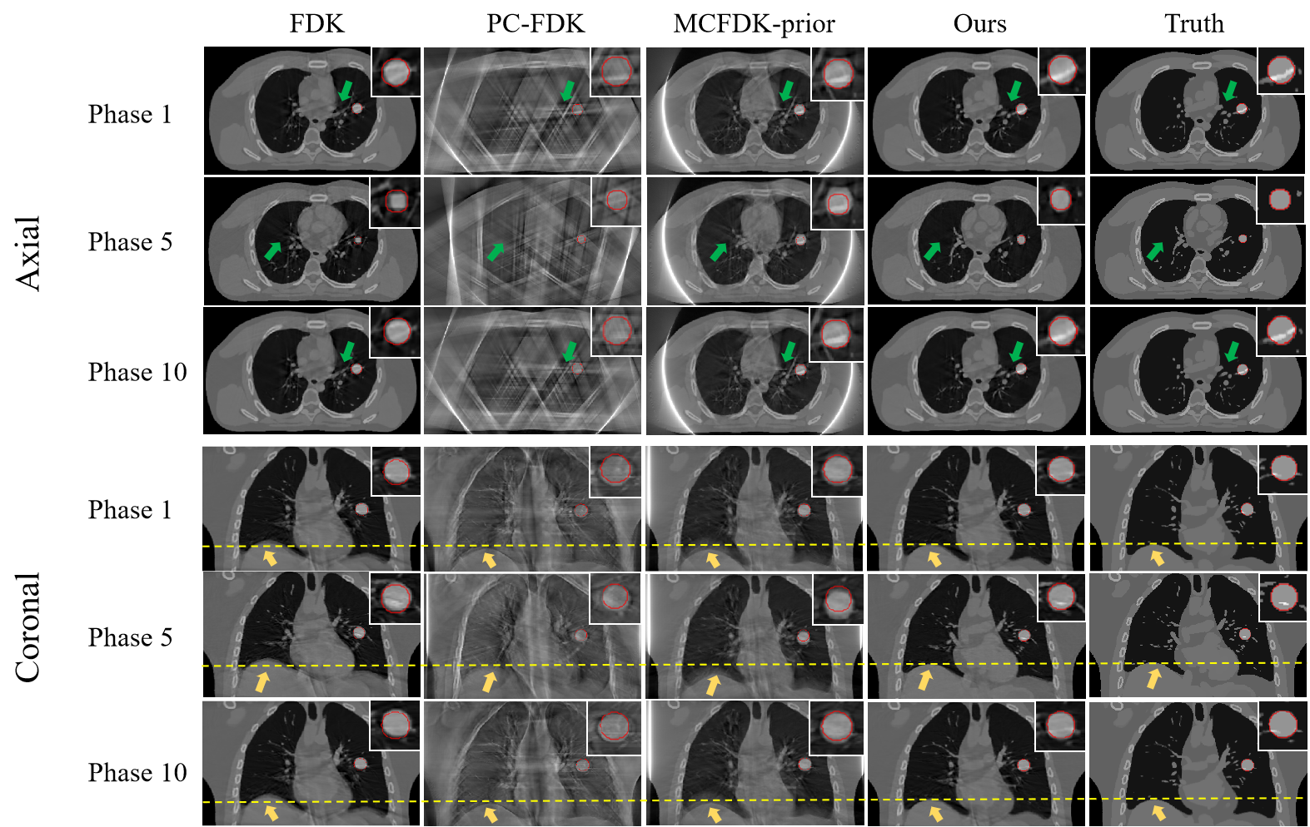
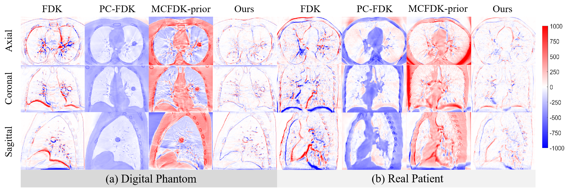
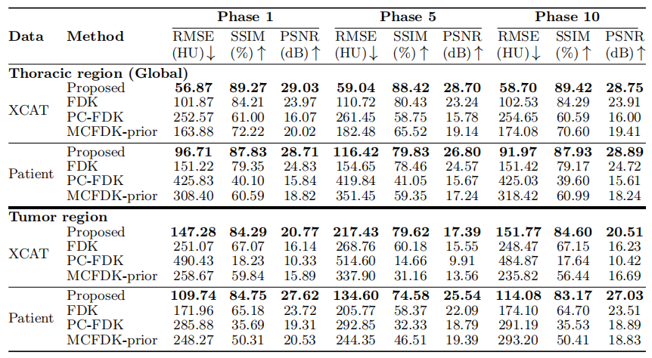
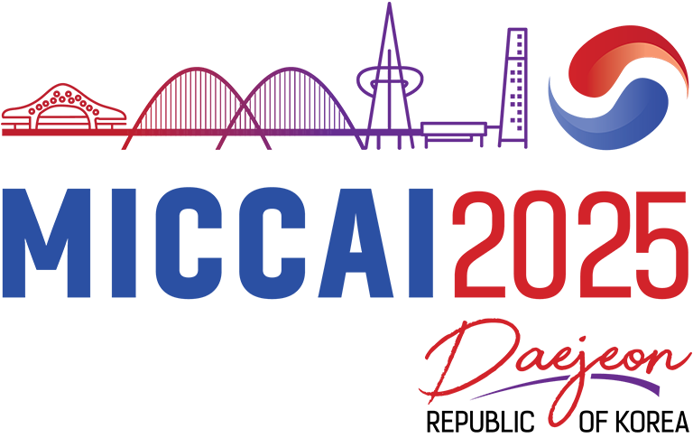
Projection-Driven Robust Motion Compensation for CBCT using a Patient-Specific Model Learned from Prior Scans
Yilin Shao^{1,3}, Jingjing Dai³, Lei Deng³, XinKai Xu², Jun Zhang⁴, Yaoqin Xie³, Xiaokun Liang³
¹Department of Shenzhen University of Advanced Technology, Southern University of Science and Technology, Shenzhen, 518055, China
²CGN Medical Technology (mianyang) Co., Ltd
³Shenzhen Institute of Advanced Technology, Chinese Academy of Sciences, Shenzhen, 518055, China
⁴Department of Oncology, People’s Hospital of Longhua, Shenzhen, 518109, China
Abstract
Respiratory motion artifacts severely compromise the diagnostic utility of Cone-Beam CT (CBCT). Motion-compensated (MoCo) reconstruction faces a critical trade-off: fast deformation vector field (DVF) estimation from prior scans can be inaccurate against anatomical changes, while accurate iterative methods are too slow for clinical workflows. We propose a learning-based MoCo framework to resolve this dilemma. It utilizes a deep neural network, trained patient-specifically on a prior 4D-CT, to rapidly and directly infer DVFs from 2D projections. This non-iterative approach leverages a learned motion model to ensure both efficiency and robustness against inter-fractional changes. These DVFs then guide a reconstruction pipeline that corrects motion on a perprojection basis by warping each back-projection. Experiments on phantom and clinical data demonstrate that this approach effectively corrects motion artifacts, yields superior reconstruction quality. Our framework yields high-quality static 3D images and enables full 4D-CBCT synthesis, paving the way for advanced adaptive radiotherapy workflows.
Motivation and Contributions
Experiments
Iterative methods are too slow for clinical workflows.
✔ A Non-Iterative, Projection-Driven Framework.
Prior-based methods lack robustness to anatomical changes.
✔ A Decoupled, Patient-Specific Motion Model.
Conventional 4D-CBCT suffers from quality degradation.
✔ High-Fidelity, Full 4D-CBCT Synthesis.
1. Robustness to Anatomical Changes
Our framework accurately reconstructs the contemporary shrunken tumor (red arrow) despite guidance from an outdated prior with a larger tumor, demonstrating high robustness.
Methods
2. Superior Reconstruction Quality
Our method's reconstruction ("Ours") shows superior visual quality, closely matching the ground-truth. The corresponding voxel-wise HU error map ("Ours") is substantially cleaner and closer to zero, indicating significantly higher accuracy compared to baseline methods which exhibit large, structured residual errors.
(a) Offline Training: Learning a Patient-Specific Motion Model
Data Generation: We leverage a prior 4D-CT scan to generate a large-scale, augmented training dataset. Inter-phase deformations are combined with Thin-Plate Spline (TPS) warps to simulate a wide range of respiratory motions and anatomical variations.;
The PVD-Net is trained patient-specifically to predict the DVF that warps a moving CT volume to match a reference projection.
(b) Online Reconstruction: Synthesize a high-quality, motion-free 3D-CBCT.
For each new projection, the pre-trained PVD-Net rapidly infers its DVF (Φ_{t}). This DVF then guides a modified back-projection process.
Conventional FDK simply averages all projections, leading to motion blur:
Our Motion-Compensated FDK (MC-FDK) replaces the standard back-projector B with a dynamic, DVF-warped operator B_{MC}:
The B_{MC} operator uses the predicted DVF (Φ_{t}) to warp the back-projected volume and apply a density correction, effectively undoing the motion for each projection angle:
3. High-Fidelity 4D-CBCT Synthesis
The proposed method generates high-quality reconstructions across the entire respiratory cycle (Phases 1, 5, and 10 shown), enabling full 4D-CBCT synthesis.
Also as shown in the table, our method consistently achieves the highest PSNR/SSIM and lowest RMSE across all evaluated respiratory phases (1, 5, 10). This stable, superior performance throughout the breathing cycle validates our framework's capability to synthesize complete and high-fidelity 4D-CBCT datasets.
Conclusion
We introduced a projection-driven, patient-specific deep learning framework for CBCT motion compensation.
Our non-iterative method is fast, accurate, and robust to inter-fraction anatomical changes. It effectively suppresses motion artifacts, enabling the synthesis of high-quality static 3D and full 4D-CBCT datasets, paving the way for advanced adaptive radiotherapy.
CMMCA
Workshop

