Slide 1
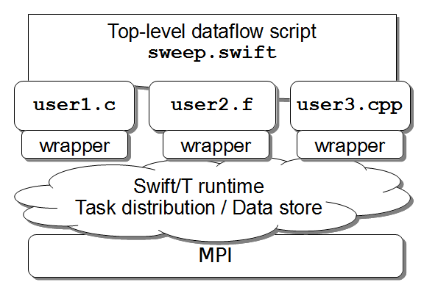
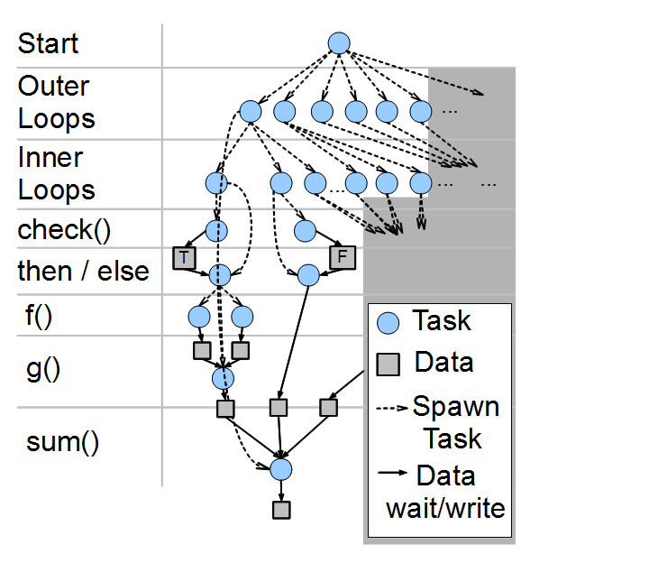
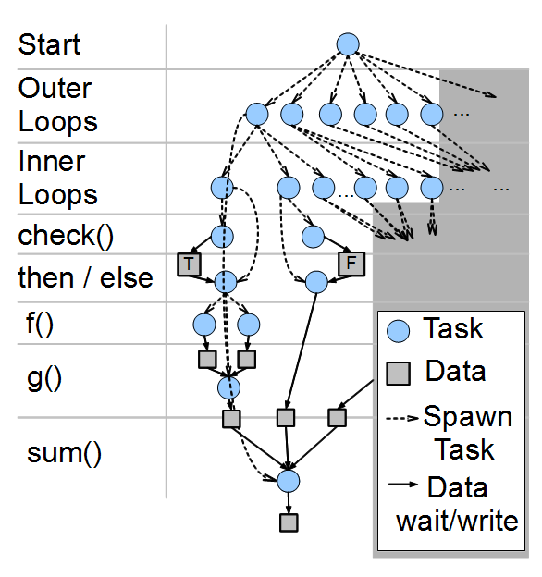
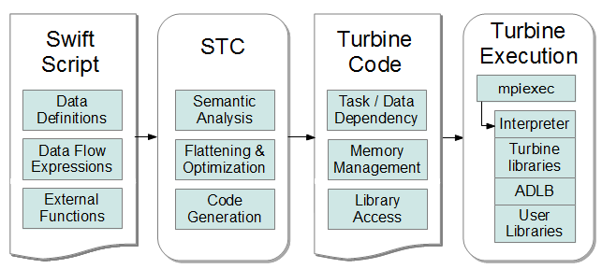
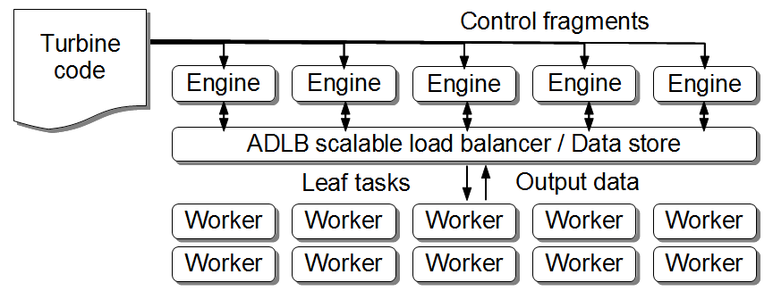
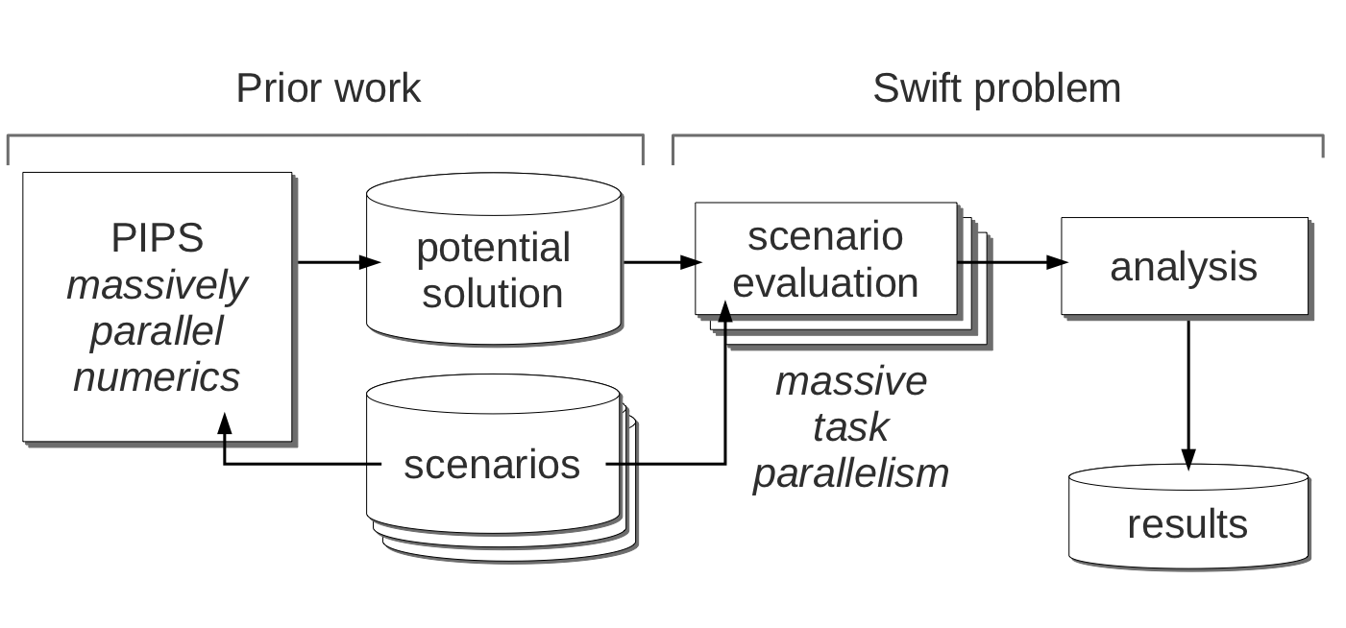
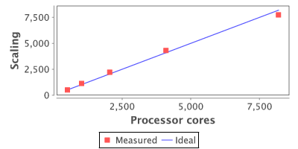
Swift/T: Scalable Dataflow Programming for Many-task Applications Justin M. Wozniak¹² <wozniak@mcs.anl.gov>, Timothy G. Armstrong², Michael Wilde¹²,
Daniel S. Katz¹², Ewing Lusk¹², and Ian T. Foster¹²
1: Argonne National Laboratory 2: University of Chicago http://exm.xstack.org
Overview: Dataflow programming at scale
Dataflow processing in distributed memory
Many important application classes that are driving the requirements for extreme-scale systems can be elegantly expressed as many-task data flow programs:
a Branch and bound a Stochastic programming a Materials by design a Uncertainty quantification
The data flow programming model of the Swift parallel scripting language can elegantly express the massive concurrency demanded by these applications through implicit parallelism, which has the productivity benefits of a high-level language.
In our current work, we have reimplemented the Swift system to run as an MPI program for high-performance computing.
Swift was previously implemented as a workflow language (c. 2007) for distributed computing (grids, clouds, etc.). That implementation is used in many active scientific applications (Wilde, 2011).
Compositional programming: User script integrates multiple libraries into a dataflow application
Whole program runs over MPI
We provide tools to call native libraries from Swift – not just executables
The data dependencies and tasks resulting from complex, large scale scripts must be handled by a distributed memory system
int X = 1000, Y = 1000;
int A[][];
int B[];
foreach x in [0:X-1] {
foreach y in [0:Y-1] {
if (check(x, y)) {
A[x][y] = g(f(x), f(y));
} else {
A[x][y] = 0;
}}
B[x] = sum(A[x]);
}
Data dependencies and tasks resulting from complex, large scale scripts must
Scalable run time based on ADLB
STC: An advanced, optimizing compiler
Less than 1% of the MPI processes are used as engines or servers, which process dataflow logic, manage tasks and data
Generates Turbine code for the Turbine runtime library (Wozniak, 2012)
Translates data flow expressions into data dependent tasks
Performs many optimizations – some general purpose, some specific to distributed memory computing
The Asynchronous Dynamic Load Balancer (ADLB) was developed previously (Lusk, 2010)
Swift PIPS script: Parallel power grid analysis
References
J. M. Wozniak, T. G. Armstrong, M. Wilde, D. S. Katz, E. Lusk, I. T. Foster. Swift/T: Large-scale application composition via distributed-memory data flow processing. Proc. CCGrid 2013.
J. M. Wozniak, A. Chan, T. G. Armstrong, M. Wilde, E. Lusk, I. T. Foster. A model for tracing and debugging large-scale task-parallel programs with MPE. Proc. Workshop on Leveraging Abstractions and Semantics in High-performance Computing (LASH-C) at PPoPP 2013.
J. M. Wozniak, T. G. Armstrong, M. Wilde, K. Maheshwari, D. S. Katz, E. L. Lusk, and I. T. Foster. Turbine: A distributed-memory dataflow engine for extreme-scale many-task applications. Proc. Workshop on Scalable Workflow Enactment Engines and Technologies (SWEET) 2012.
M. Wilde, M. Hategan, J. M. Wozniak, B. Clifford, D. S. Katz and I. T. Foster. Swift: A language for distributed parallel scripting. Parallel Computing 37(9), 2011.
E. L. Lusk, S. C. Pieper, and R. M. Butler. More scalability, less pain: A simple programming model and its implementation for extreme computing. SciDAC Review, 2010.
PIPS is a computationally intensive program to address problems in electrical power design and management. The original PIPS program produces potential grid management solutions. Swift is used to evaluate the solutions under varying scenarios, a naturally concurrent problem. The Swift script, which calls into PIPS libraries, was developed very quickly and scales well to 8,192 cores, the application requirement. Results from the IBM Blue Gene/P Intrepid at ANL.
Worldwide Swift usage through Nov 2012
This research is supported by the U.S. DOE Office of Science under contract DE-AC02-06CH11357, FWP-57810. Computing resources were provided by the Argonne Leadership Computing Facility. Some work by DSK was supported by the National Science Foundation, while working at the Foundation. Any opinion, finding, and conclusions or recommendations expressed in this material
are those of the authors and do not necessarily reflect the views of the National Science Foundation.

