Slide 1
EKL Session 2

Slide 2
Agenda
Recap of Session 1
Server-side BL Overview
Creation through Data setup
Creation on server

Slide 3
Recap of session 1
Full form of EKL
Enterprise Knowledge language
Can we have more than 1 CATRuleExit?
Yes
What is entry point for the BL
OpeningID
Which 3 type of intent we can create in BL
Validation , Compute , Execution
Which file is entrypoint for the EKL?
CATRuleExit
To create a EKL action from client session , which app access we should have
Engineering Rule Capture
Which env variable we should update for EKL customization?
CATKnowledgePath
Which one is correct in terms of traces? CE_CUSTO_TRACES=1, CKE_TRACES_ CUSTO=1, CKE_CUSTO_TRACES=1
CKE_CUSTO_TRACES=1

Slide 4
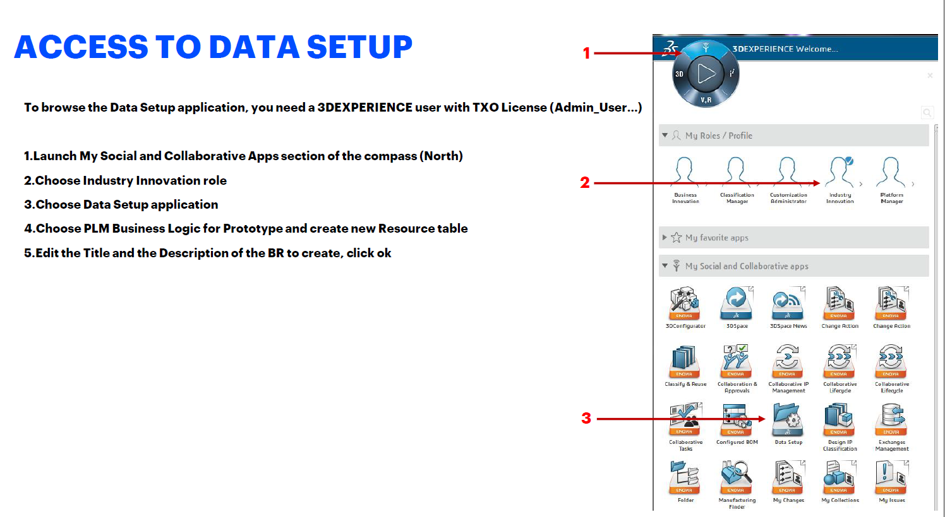
Access To Data Setup

Slide 5
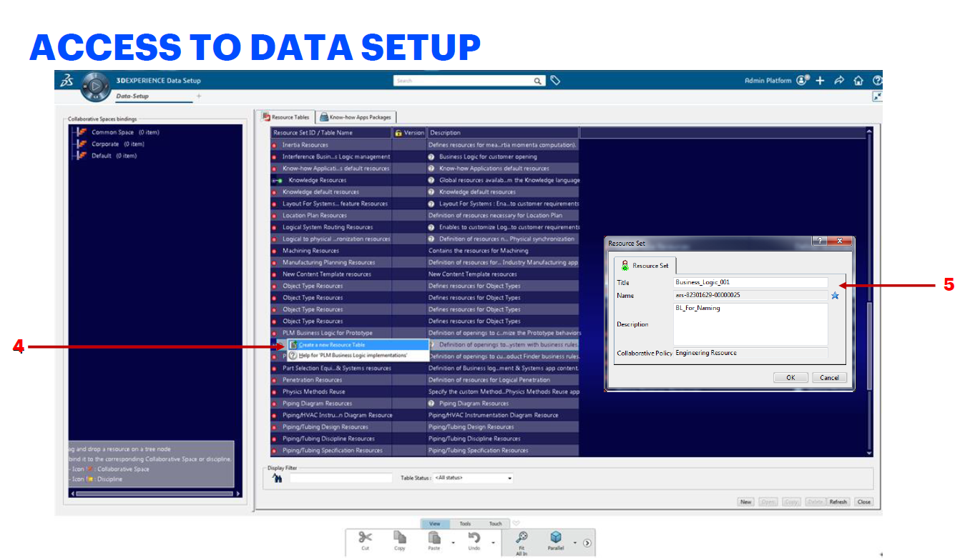

Slide 6
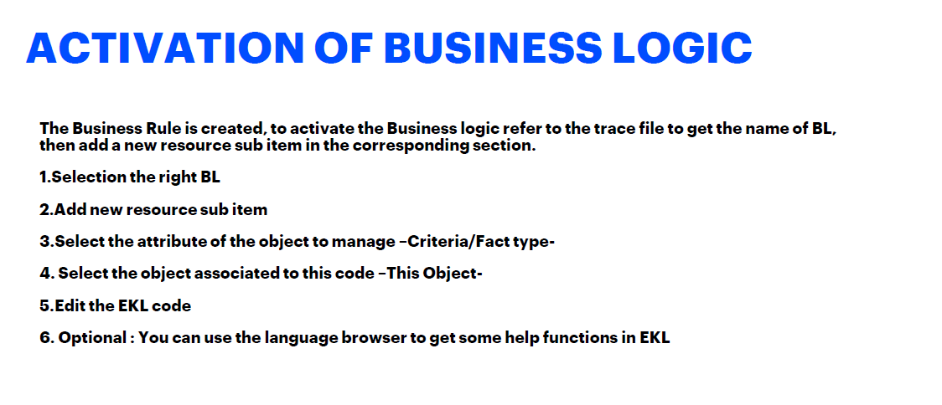

Slide 7
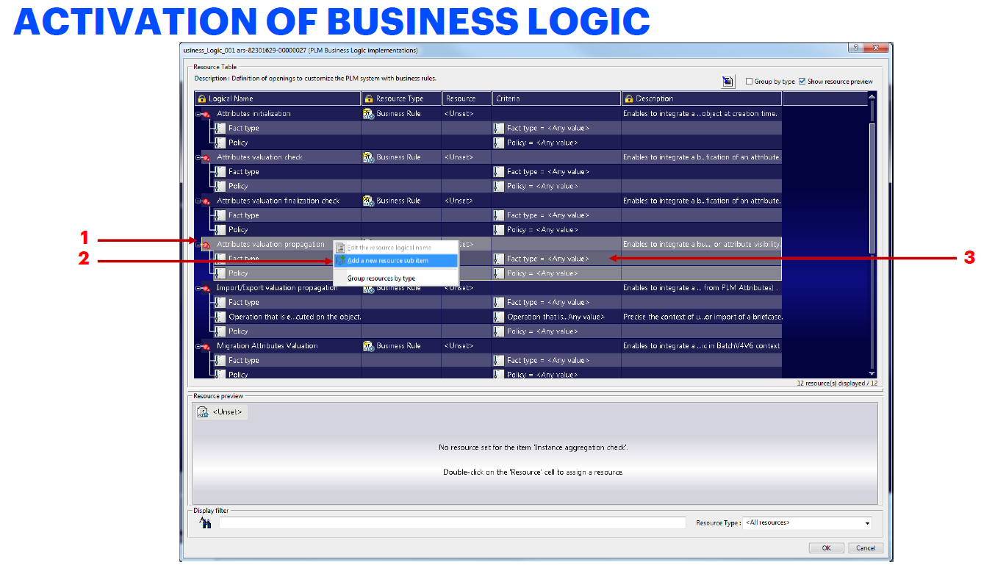

Slide 8
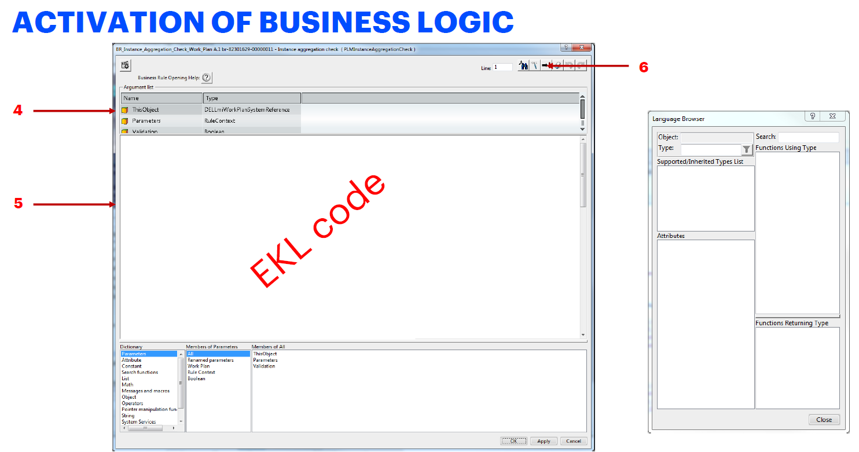

Slide 9
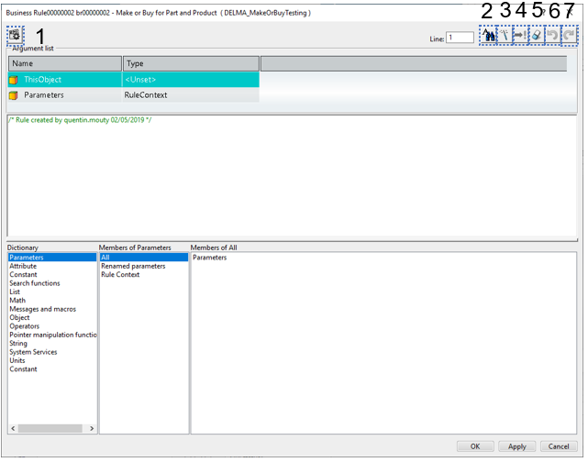
EKL Editor Overview
Settings
Find and replace
Language Browser
Check syntax
Language explore
Erase All
Undo
Redo

Slide 10
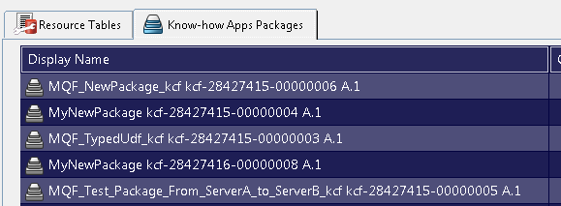
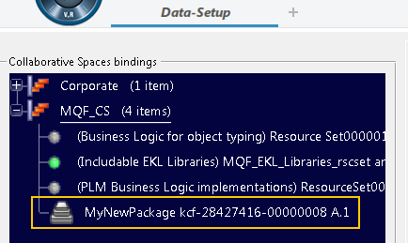
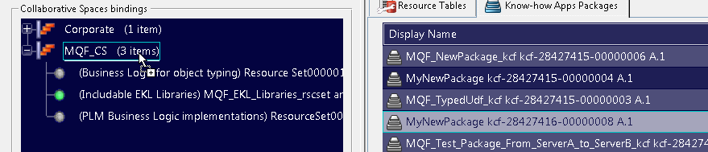

Binding the resource file in the Collabrative Space
In the Resource Table tab, locate the new package you created.
Drag and drop it onto the Collaborative Space you want it to be published to
Save
3
4

Slide 11
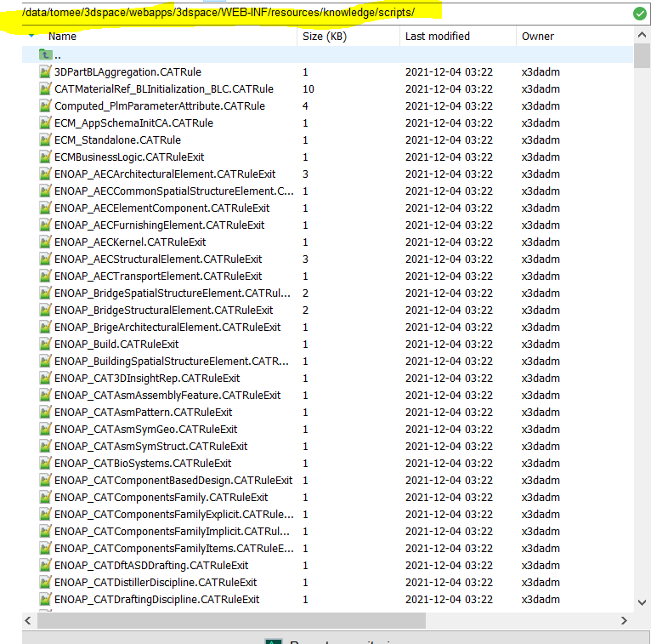
where to create BL directly on server
/data/tomee/3dspace/webapps/3dspace/WEB-INF/resources/knowledge/scripts

Slide 12
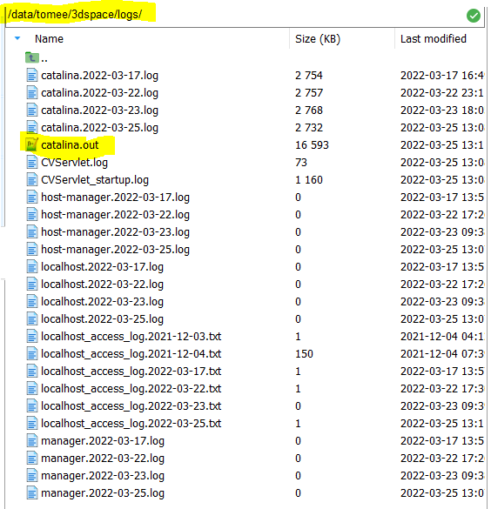
See the logs on server
/data/tomee/3dspace/logs

