Slide 1
MQL For Business Admin
By: Sridevi

Slide 2
MQL For Business Admin
Business Administration
MQL is used to do business administration of a Matrix database
Business administration involves the following activities:
  Creating new business definitions
  Modifying the existing business definitions if there is a change in business requirement
  Deleting the existing business definitions when they become obsolete
Business administration can be done using the Matrix Business Modeler also
MQL supports all the features of Business Modeler in a query language format

Slide 3
MQL For Business Admin
Business Administration
The user ‘creator’ is the super user in the system
He is both system and business admin
The system admin access overrides all the other access control setup
The user ‘guest’ is a normal user
To do business administration the user must be defined as a ‘Business Admin’ in business modeler
The user ‘creator’ can create new users and make new business/system administrators

Slide 4
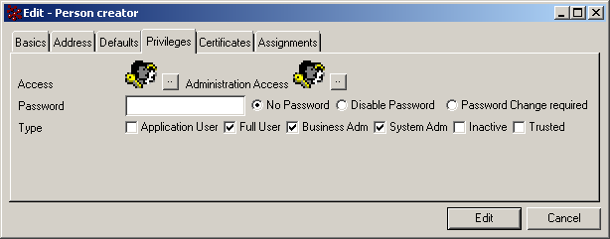
MQL For Business Admin
Business Administration

Slide 5
MQL For Business Admin
Access Control
The following are the admin objects in Matrix that control access:
  Person
  User Categories (Groups & Roles)
  Policies
  Rules
Apart from these four admin objects, the user can get access to a business object as a ‘Grantee’

Slide 6
MQL For Business Admin
Access Control: Person
The person definition in business modeler gives the following two kinds of access control:
  Access (access to business objects)
  Administration access (access to admin objects)
The access to business objects will override the access given by the policy
The access to admin objects is given only for Business/System administrators
This can be utilized to share the responsibilities among different persons

Slide 7
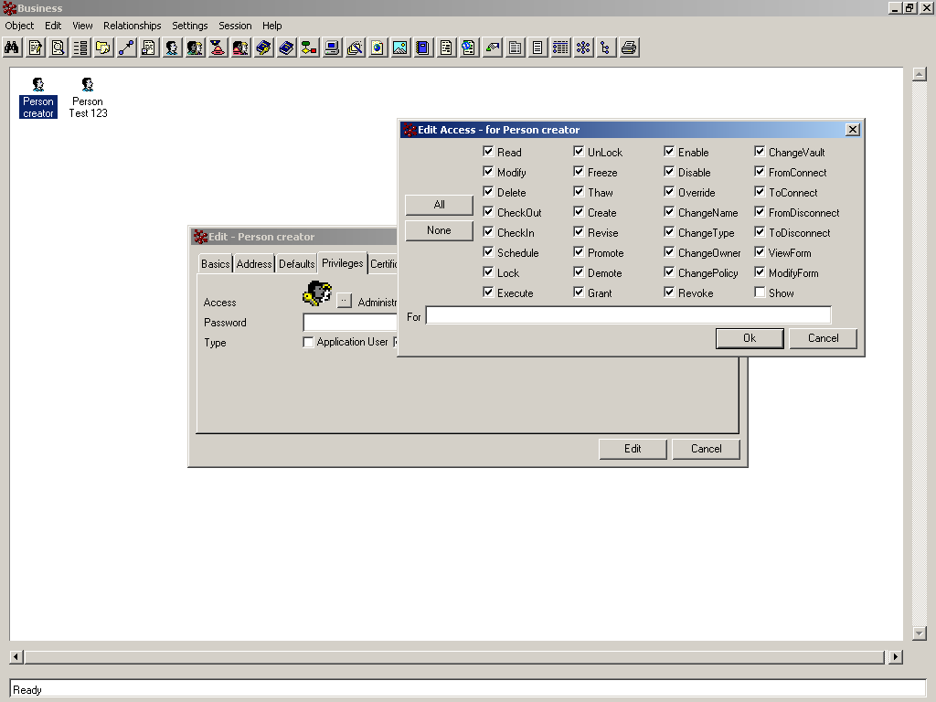
MQL For Business Admin
Access Control: Person

Slide 8
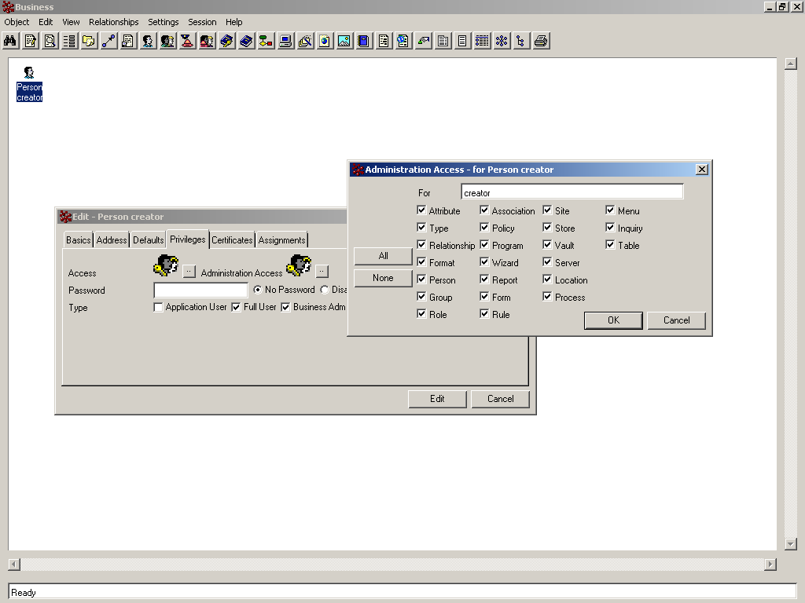
MQL For Business Admin
Access Control: Person

Slide 9
MQL For Business Admin
Access Control: Roles, Groups & Associations
Groups: A collection of people who work on a common project, have a common history, or share a set of functional skills.
Roles: A collection of people who have a common job type: Engineer, Supervisor, Purchasing Agent, Forms Adjuster, and so on.
Association: A collection of groups, roles, or other associations.

Slide 10
MQL For Business Admin
Access Control: Policies & Rules
Policy provides fine grain access restriction to a business object to the user, role, group
Using the policy you can setup state level access control for a business object
The user should have atleast ‘read’ access to find the object in the Matrix Navigator
Rules can be used to control access for a attribute, relationships, programs
When you setup a access rule on a attribute it reflects in all the places wherever the attribute is used
After checking the policy level access to the user, the system checks whether any rules preventing the user

Slide 11
MQL For Business Admin
Access Control: Policies & Rules...
Rules are used to take away the access not to add access to a business object
Also rules are helpful in controlling access over relationships
For example, a policy might allow all users in the Engineering group to modify the properties of Design Specification objects when the objects are in the Planning state
But you could create a rule to prevent those users from changing a particular attribute of Design Specifications

Slide 12
MQL For Business Admin
System-wide password settings
Setting the system wide password settings:
  System admin can set up password settings which can be enforced system wide
  Following is the MQL command:
    MQL <#> set password PASSWORD_ITEM [PASSWORD_ITEM];
    Where, PASSWORD_ITEM can be one of the following:
      Minsize, Maxsize
      Lockout
      Expires
      Allowusername
      Allowreuse, mixedalphanumeric

Slide 13
MQL For Business Admin
System-wide password settings...
  Example:
    MQL <2> set password minsize 3 maxsize 6 lockout 3 expires 30 !allowusername !allowreuse mixedalphanumeric;
    The above command will enforce the following password rules over all the users in the system:
      The password should have minimum 3 and maximum 6 chars
      The user can enter wrong password only 3 times
      The password expires in 30 days
      The password cannot be same as the user name
      The password cannot be reused
      The password should be a mixture of numbers and alphabets

Slide 14
MQL For Business Admin
Working with Persons
A person is someone who uses any Matrix application
Business administrator is responsible for maintaining the person details in the business modeler
The person definition has the following information about him:
  User Id, Full Name, Comment
  Address, Phone, Fax, Email
  Enable email/icon mail facility
  Default vault/site
  Privileges
  Assignments (Groups & Roles)

Slide 15
MQL For Business Admin
Working with Persons
The following is the query to create a person admin object:
  MQL <3> add person Neo;
    The above statement creates a person named ‘Neo’ and setup the following:
      Name as Neo
      Icon Mail enabled
      No password
      Makes the user as ‘Application User’, ‘Full User’
        ‘Application User’ – can login only using MQL
        ‘Full User’ – Normal user

Slide 16
MQL For Business Admin
Working with Persons
The following is the query to create a person admin object:
  MQL <3> add person Neo1
    fullname "Neo Anderson"
    address "The Matrix"
    phone "00101101011"
    fax “0011001001101”
    email "neo@thematrix.com"
    enable email password "trinity"
    type business,system,trusted,inactive
    admin attribute,vault;

Slide 17
MQL For Business Admin
Working with Groups
Groups are the user category grouped based of a common property among them
Groups can have the following:
  A Parent Group
  A default site
  Child groups
  Assignments (Person names)
Following is a sample statement to create a group:
  MQL <4> add group “Distribution Group”;
    The above command will create a blank group
    You can add assignments also after creating it

Slide 18
MQL For Business Admin
Working with Groups
Example:
  MQL <2> add group “Release Distribution” parent “Distribution Group” assign person “Neo”;
    The above statement adds a group called “Release Distribution” as a child of “Distribution Group”
    Assigns a person Neo to the group “Release Distribution”

Slide 19
MQL For Business Admin
Working with Roles
Roles are created and assigned based on the job type of the users
Roles can have the following:
  A Parent Role
  A default site
  Child roles
  Assignments (Person names)
Following is a sample statement to create a role:
  MQL <4> add role “Design Engineer”;
    The above command will create a blank role
    You can add assignments also after creating it

Slide 20
MQL For Business Admin
Working with Roles
Example:
  MQL <2> add role “Senior Design Engineer” parent “Design Engineer” assign person “Neo”;
    The above statement adds a role called “Senior Design Engineer” as a child of “Design Engineer”
    Assigns a person Neo to the role “Senior Design Engineer”

Slide 21
MQL For Business Admin
Working with Associations
Associations of combination of Groups, Roles & Persons
When there is a situation to combine various roles, groups and persons you can use associations
Associations can have the following:
  Name
  Description
  Definition
Following is a sample statement to create a association:
  MQL <4> add association “Engineering-Distribution”;
    The above command will create a blank association

Slide 22
MQL For Business Admin
Working with Associations
Example:
  MQL <2> add association "Distribution-Engineering" definition '"Release Distribution" && "Senior Design Engineer"';
    The above statement adds a association called “Distribution-Engineering”
    This association will have the combination of group “Release Distribution” and “Senior Design Engineer”

Slide 23
MQL For Business Admin
Working with Attributes
Attribute is any characteristic that can be assigned to a object or relationship
Attributes are the very basic admin objects used in the Matrix database
An attribute can have the following information:
  Name, description
  Type [integer, real, date, string, boolean]
  Default value
  Rule name
  Range values
  Modify trigger
  Multiline

Slide 24
MQL For Business Admin
Working with Attributes
Example:
  MQL <1> add attribute “Effectivity Date”
  description “Attribute to store the Engineering Effectivity Date of Part”
  type date;
  MQL <2> add attribute Color1
  description “Color of the product”
  type string
  range value Red
  range value Blue;

Slide 25
MQL For Business Admin
Working with Attributes
Example:
  MQL <3> add attribute Length
  description "Length of the product“
  type real trigger modify
  action “emxNotifyProgram"
  input “Design Engineer";

Slide 26
MQL For Business Admin
Working with Types
Types are the admin objects that defines what kind of data you are going to store in the Matrix database
Types in Matrix support inheritance
A type can be defined as abstract
The following are the information a type can have in Matrix:
  Name, Description
  List of attributes
  Derived from a super type
  Abstract type
  Methods and triggers

Slide 27
MQL For Business Admin
Working with Types
Example:
  MQL <1> add type Specification
  description “Used for creating Specification objects”
  attribute “Originator”, “Reviewer”
  trigger modifyattribute action “NotifyReviewer.tcl” input “Specification object has been modified”;

Slide 28
MQL For Business Admin
Working with Relationships
Relationships are created between types in Business Modeler
They can be instantiated as connections between the business objects in the Matrix navigator
A relationship can have the following information in its definition:
  Name, Description
  List of attributes associated
  Triggers
  From and To type names
  Prevent duplicates property

Slide 29
MQL For Business Admin
Working with Relationships
Example:
  MQL <1> add relationship "Has Specification"
  description “Relationship between Parts and Specifications”
  from
  meaning "Specification"
  type "Specification"
  cardinality one
  revision replicate
  to
  meaning “Product”
  type Product
  cardinality many
  clone float;

Slide 30
MQL For Business Admin
Working with Formats
Formats are user defined file formats used during the check in operation in Matrix
Formats are used to segregate the files inside a business object after check in
A format can have the following information:
  Name, Description
  Creator name (Mac OS related attribute)
  Type name (Mac OS related attribute)
  Editing program name
  Printing program name
  Suffix, mime type, version
  Viewer program name

Slide 31
MQL For Business Admin
Working with Formats
Example:
  MQL <34> add format Text
  description “For Text files”
  suffix “.txt”
  view “Notepad”
  edit “Notepad”;

Slide 32
MQL For Business Admin
Working with Policies
Policy gives the life cycle to the business object
Policy has the access privileges in each state and business rules defined for promoting or demoting the business object
Policy has the following information defined in its definition:
  Name, Description
  Sequence number for the business object revisions
  Store name
  Governed types
  Allowed formats
  State details

Slide 33
MQL For Business Admin
Working with Policies
A policy can have one or more states
A state in the policy has the following information defined in its definition:
  Name
  Versionable, Revisionable, Promote, Checkout History
  Access for Owner, Public, User (This can be a Person, Role, Group or Association)
  Triggers
  Events
  Signatures

Slide 34

MQL For Business Admin
Working with Policies
Following are the list of triggers that can be associated to a policy state:

Slide 35
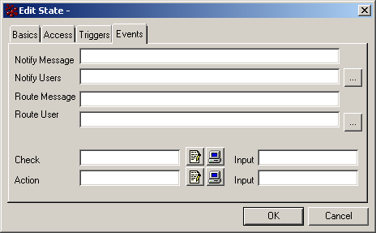
MQL For Business Admin
Working with Policies
Following are the list of events available for a state in the policy:

Slide 36
MQL For Business Admin
Working with Policies
Example:
  MQL <2> add policy “Specification”
  description “For Specification Objects”
  type Specification
  format MSWord
  defaultformat generic
  enforce
  sequence 1,2,3...
  store “HCC Store”;

Slide 37
MQL For Business Admin
Working with Policies
Example:
  MQL <2> mod policy “Specification”
  add state Create
  check "emxProgramTriggerNotifyMembers.tcl" input "Notification"
  action "emxProgramTriggerNotifyMembers.tcl" input "Notification"
  notify message "This is the notify message"
  add notify "Release Distribution"
  route message "This is the route message"
  add route "Release Distribution“
  owner all
  public read, show
  user "Design Engineer" promote, demote;

Slide 38
MQL For Business Admin
Working with Programs
A program is an object created by a Business Administrator to execute specific commands
A program can be written in TCL or JPO
A program can have the following information:
  Name, Description
  Type [Java, MQL, External]
  Execute [immediate or differed]
Example:
  MQL <2> add program emxTriggerNotify.tcl mql file “c:\\emxTriggerNotify.tcl”;

Slide 39
MQL For Business Admin
Working with Rules
Rules are used to limit the access to some specific attributes, relationships, programs
A rule can have following information:
  Name, Description
  Owner access
  Public access
  User access

Slide 40
Thank You

