Slide 9
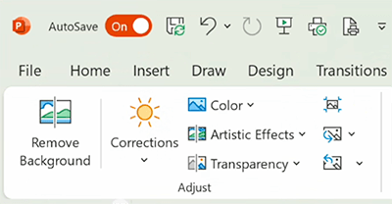
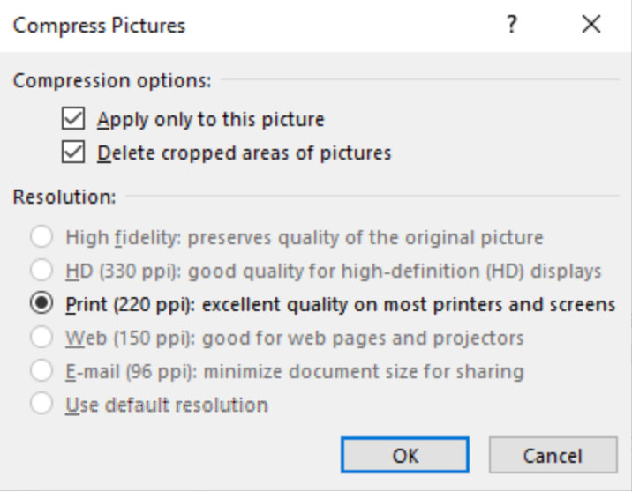
Instructions for adding photo (PC)
Select a photo from the PPT ready gallery. If desired, select an industry icon from the same gallery.
Or select your own photo and make sure it’s a JPG file with 150 dpi-300 dpi with at least 1000 px width. Browse the MOZone here.
Very large photos add file weight to the whole PowerPoint, making it hard to email, share and load quickly. Best practice is to compress photos that are a large file size. To compress a photo:
  Select the photo you wish to compress so that the Picture Format tab appears.
  On the Picture Format tab, in the Adjust group, select the Compress Pictures icon.
  Select Apply only to this picture. If this is left unchecked, compression of the whole presentation will deteriorate the logo on all slides.
  Select Delete cropped areas of pictures.
  Select Print (220 ppi): excellent quality on most printers and screens. Note: If 220 ppi is greyed out your photo does not to be compressed.
  Click OK.
Compress Pictures

Slide 10
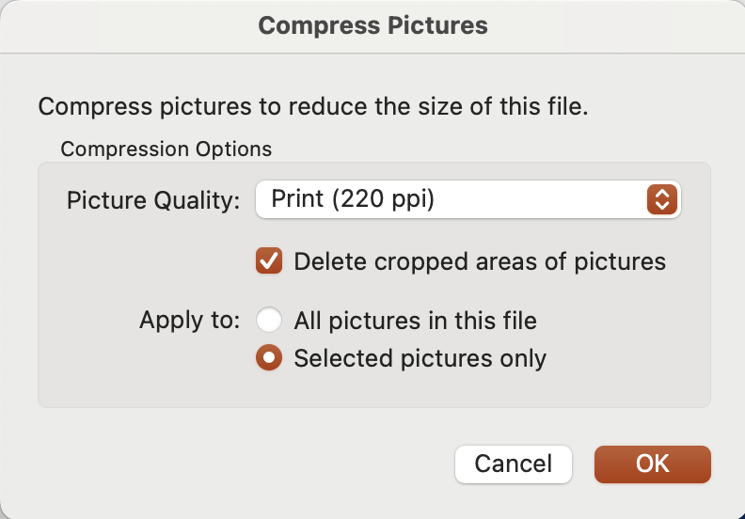
Instructions for adding photo (Mac)
Select a photo from the PPT ready gallery. If desired, select an industry icon from the same gallery.
Or select your own photo and make sure it’s a JPG file with 150 dpi-300 dpi with at least 1000 px width. Browse the MOZone here.
Very large photos will add file weight to the whole PowerPoint.
Ideal PowerPoint file weight is 10 mb or less to be able to email, share, and load quickly.
  Best practice for keeping the overall file size of the PowerPoint as low as possible is to compress photos that are a large file size.
  To compress a single image, select the photo you wish to compress, then go to File > Compress Pictures… > Picture Quality: Print 220 ppi > Apply to: Selected pictures only.
  Do not select All pictures in this file. This will deteriorate the logo on all slides.

Slide 11


This slide is an example of inserting a photo and industry icon
See instructions on previous slides

Slide 14
This slide is an example of inserting an industry icon
See instructions on previous slides

Slide 15
GS1 Competition Law Caution
GS1 operates under the GS1 Competition Law Caution. Strict compliance with competition laws is and always has been the policy of GS1.
The best way to avoid problems is to remember that the purpose of the group is to enhance the ability of all industry members to compete more efficiently.
This means:
  There shall be no discussion of prices, allocation of customers or products, boycotts, refusals to deal, or market share.
  If any participant believes the group is drifting toward impermissible discussion, the topic shall be tabled until the opinion of counsel can be obtained.
The full caution is available via the link below, if you would like to read it in its entirety: http://www.gs1.org/gs1-competition-law-caution.
Notes:
Presentation advice and guidance:
Start from the "why" of the Competition Law Caution, for example:
GS1 is a place where many stakeholders meet to develop standards in a collaborative manner. But we give comfort that this must always happen in a legally compliant manner, so that industry feels safe and protected to participate in our work in full legal compliance.
Between MOs, as we are all independent in a federation, we do collaborate to progress our work together for the benefit of our members – but the limit is that we shall not discuss competitive matters.
And then ensure to read the part in bold on the slide as that's the heart of the topic.

Slide 16


Slide 23




Contact information
Name
Title
GS1
Address Line 1
Address Line 2
Address Line 3
T
+00 (0)00 0000 0000
D
+00 (0)00 0000 0000
M
+00 (0)00 0000 0000
E
name@gs1.org
www.gs1.org

Slide 24
Title
Name
Title
Name
Title
Name
Title
Name
Title
Name
Title
Name

Slide 25
Two-column table
Category Name | Column 1 | Column 2
Category 1 | Sample text | Sample text with two lines. Sample text with two lines. Sample text with two lines. Sample text with two lines.
Category 2
Category 3
Category 4
Category 5

Slide 26
Four-column table
Category Name | Column 1 | Column 2 | Column 3 | Column 4
Category 1 | Sample text | Sample text with two lines. Sample text with two lines. | Sample text with three lines. Sample text with three lines. Sample text with three lines. | Sample text with four lines. Sample text with four lines. Sample text with four lines. Sample text with four lines. Sample text with four lines.
Category 2
Category 3
Category 4
Category 5

Slide 27
Useful symbols

Slide 28
Useful symbols

Slide 29
GS1 colours
GS1 Blue
GS1 Orange
GS1 Dark Gray
GS1 Dark Medium Gray
GS1 Light Medium Gray
GS1 Light Gray
GS1 Raspberry
GS1 Purple
GS1 Lavender
GS1 Slate
GS1 Sky
GS1 Link Blue
GS1 Mist
GS1 Teal
GS1 Mint
GS1 Grass
GS1 Forest
GS1 Olive
GS1 Lime
GS1 Gold
GS1 Peach
GS1 Tangerine
GS1 Honey
GS1 Terracotta

