Slide 1



Title can be any bright brand colour
Full-slide photo
Select picture layer on the left to change picture (Option/Right click on image > Change Picture…)

Slide 2

Photo right side
Pattern, gradation and photo are on individual layers
Select picture layer to change picture
(Option/Right click on image > Change Picture…)
Compress added picture if large file
(File > Compress Pictures > Select HD, delete cropped areas and Selected pictures only)
Position gradation at edge of photo
Position 2D pattern opposite photo
Make sure text boxes are in front of all other layers

Slide 3

Photo right side
Pattern, gradation and photo are on individual layers
Select picture layer to change picture
Compress added picture (selected image only)
Position gradation at edge of photo
Position 2D pattern opposite photo
Make sure text boxes are in front of all other layers
X
of shoppers switch brand if low quality information
X
of shoppers switch brand if low quality information
X
of shoppers switch brand if low quality information
CATEGORY ONE
CATEGORY TWO
CATEGORY THREE

Slide 4
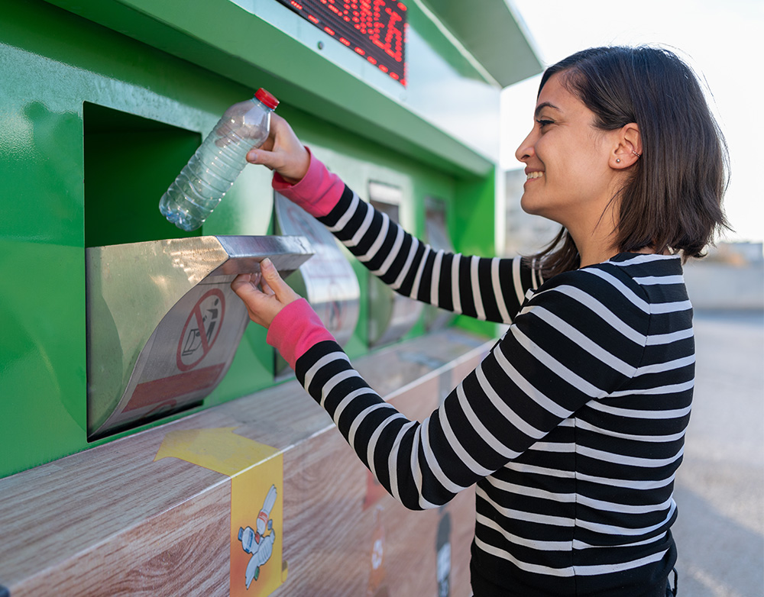
Photo left side
Pattern, gradation and photo are on individual layers
Select picture layer to change picture
Compress added picture (selected picture only)
Position gradation at edge of photo
Position 2D pattern opposite photo
Make sure text boxes are in front of all other layers

Slide 5

Topic divider or quote can be any bright brand colour

Slide 6

Photo right side
Pattern, gradation and photo are on individual layers
Select picture layer to change picture
(Option/Right click on image > Change Picture…)
Compress added picture if large file
(File > Compress Pictures > Select HD, delete cropped areas and Selected pictures only)
Position gradation at edge of photo
Position 2D pattern opposite photo
Make sure text boxes are in front of all other layers

Slide 7

Photo left side
Pattern, gradation and photo are on individual layers
Select picture layer to change picture
Compress added picture (selected picture only)
Position gradation at edge of photo
Position 2D pattern opposite photo
Make sure text boxes are in front of all other layers

Slide 8

Photo right side
Pattern, gradation and photo are on individual layers
Select picture layer to change picture
(Option/Right click on image > Change Picture…)
Compress added picture if large file
(File > Compress Pictures > Select HD, delete cropped areas and Selected pictures only)
Position gradation at edge of photo
Position 2D pattern opposite photo
Make sure text boxes are in front of all other layers

Slide 9

Photo left side
Pattern, gradation and photo are on individual layers
Select picture layer to change picture
Compress added picture (selected picture only)
Position gradation at edge of photo
Position 2D pattern opposite photo
Make sure text boxes are in front of all other layers

Slide 10
Speaker Name
Speaker photo
Logo
Title

Slide 11

Q&A

Slide 12

Thank you!
Full-slide photo
Select picture layer on the left to change picture (Option/Right click on image > Change Picture…)

Slide 13
GS1 Competition Law Caution
GS1 operates under the GS1 Competition Law Caution. Strict compliance with competition laws is and always has been the policy of GS1.
The best way to avoid problems is to remember that the purpose of the group is to enhance the ability of all industry members to compete more efficiently.
This means:
  There shall be no discussion of prices, allocation of customers or products, boycotts, refusals to deal, or market share.
  If any participant believes the group is drifting toward impermissible discussion, the topic shall be tabled until the opinion of counsel can be obtained.
The full caution is available via the link below, if you would like to read it in its entirety: http://www.gs1.org/gs1-competition-law-caution.
Notes:
Presentation advice and guidance:
Start from the "why" of the Competition Law Caution, for example:
GS1 is a place where many stakeholders meet to develop standards in a collaborative manner. But we give comfort that this must always happen in a legally compliant manner, so that industry feels safe and protected to participate in our work in full legal compliance.
Between MOs, as we are all independent in a federation, we do collaborate to progress our work together for the benefit of our members – but the limit is that we shall not discuss competitive matters.
And then ensure to read the part in bold on the slide as that's the heart of the topic.

