Slide 1
Medical Imaging Workshop Challenge
Magnetic Resonance Images and Computed Tomography Images
Wallace Loos
October 25th, 2019

Slide 2
Motivation
High number of medical imaging acquisitions
The data quality assessment still has many steps performed manually
Checking if the image is correctly named (according to the exam modality)

Slide 3
Challenge
The challenge is divided into two parts: a multiclass classification, and a multi-label part.
Multiclass classification consists of 5 different tasks:
Modality classification: MR image or CT image
MR sequence classification: T1, T2, T2-star, FLAIR, or Diffusion-weighted imaging (DWI),
CT Angiography classification: Noncontrast (NCCT) or contrast (CTA)
Vendor classification: GE, Siemens, Philips or Toshiba
For MRI
Magnetic Field strength classification : 1.5T or 3T
Acquisition plane classification: sagittal/coronal/axial

Slide 4
Challenge
The challenge is divided into two parts: a multiclass classification, and a multi-label part.
Multi-label classification part:
Modality: MR image or CT image
MR sequence: T1, T2, T2-star, FLAIR, or Diffusion-weighted imaging (DWI),
Noncontrast or contrast (for CT images)
Vendor: GE, Siemens, Philips or Toshiba
Magnetic Field strength classification : 1.5T or 3T (for MR images)
Acquisition plane classification: sagittal/coronal/axial (for MR images)

Slide 5
Dataset
The dataset is comprised of 717 stroke patients. There are 563 MR exams (22876 images) and 164 CT exams (23411 images)
MRI
 | GE |  | Philips |  | Siemens
 | 1.5 | 3 | 1.5 | 3 | 1.5 | 3
DWI | 19 | 23 | 8 | 23 | 20 | 23
T1 | 18 | 20 | 11 | 17 | 21 | 29
T2 | 17 | 27 | 12 | 15 | 30 | 26
FLAIR | 24 | 24 | 13 | 23 | 29 | 23
GRE | 14 | 14 | 8 | 12 | 19 | 1
CT
 | GE | Philips | Siemens | Toshiba
CTA | 23 | 25 | 16 | 23
NCCT | 21 | 21 | 21 | 14

Slide 6
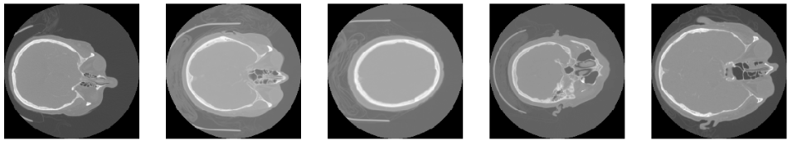
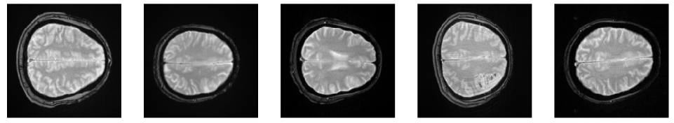
Visualizing The Dataset
CT
MRI

Slide 7
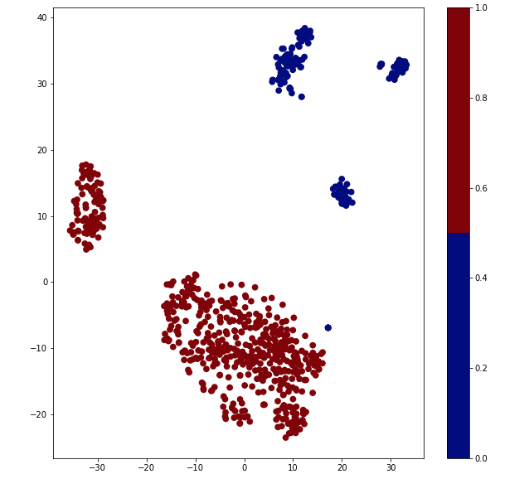
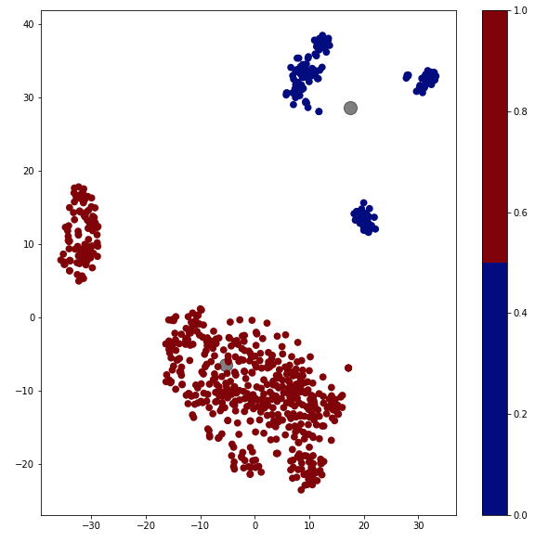
Visualizing The Dataset
MRI
MRI
Centroids
CT
CT
t-Distributed Stochastic Neighbor Embedding (t-SNE)
Kmeans (acc): 0.993122

Slide 8

Infrastructure
The challenge is supported by the AWS Cloud Credits for Research. For each team a cloud computer instance will be provided to develop their solutions.

Slide 9

Call for Abstracts
All teams are welcome to write an abstract to ISMRM. The authors of the abstract would be the members of the team and the organizing committee members of this challenge

