Slide 1
Data and Gradient Subtleties
Lecture 6/10

Slide 2
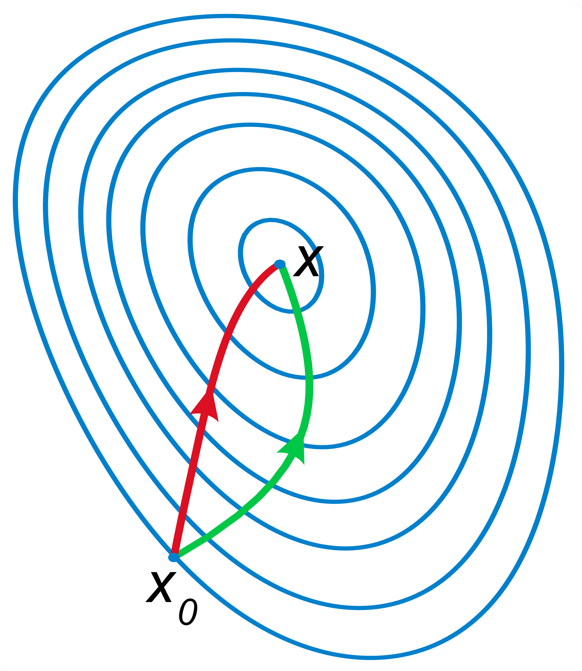
Gradient

Slide 3

Data

Slide 4
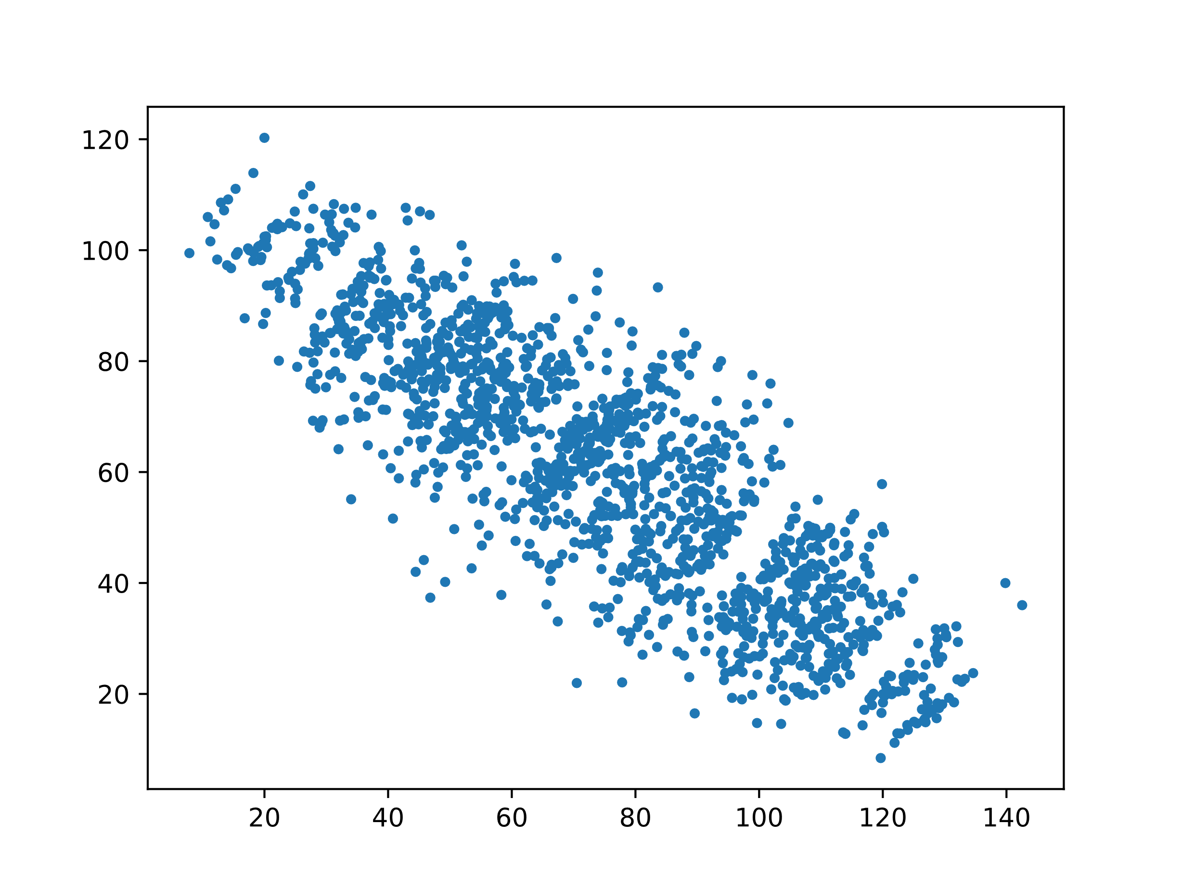
Simpson’s Paradox

Slide 5
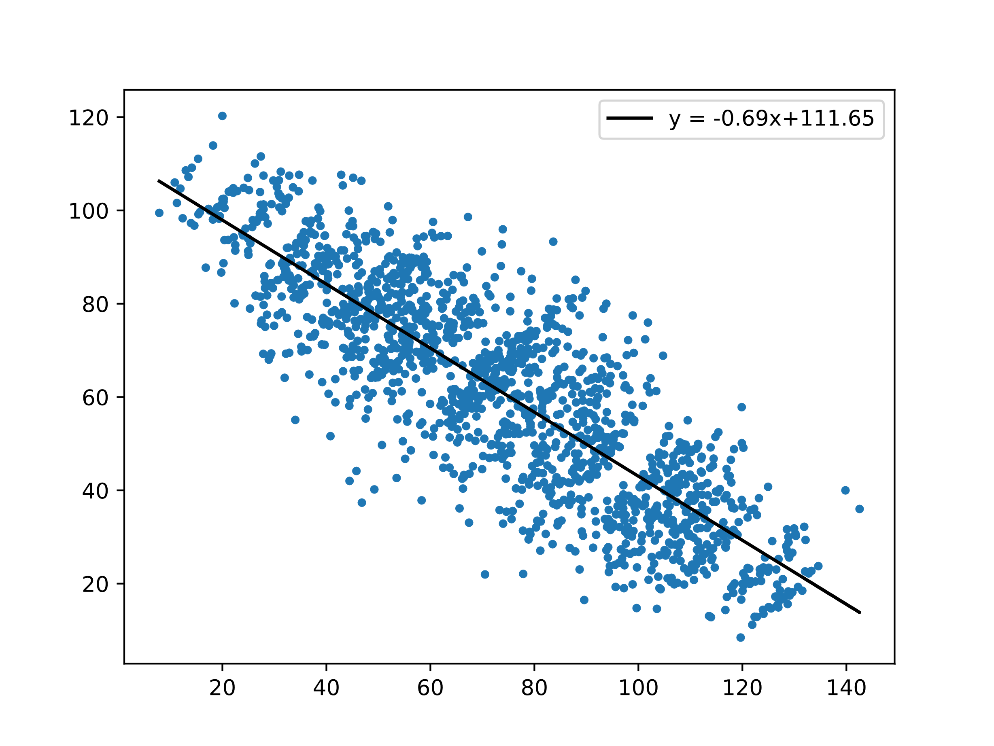
Simpson’s Paradox

Slide 6
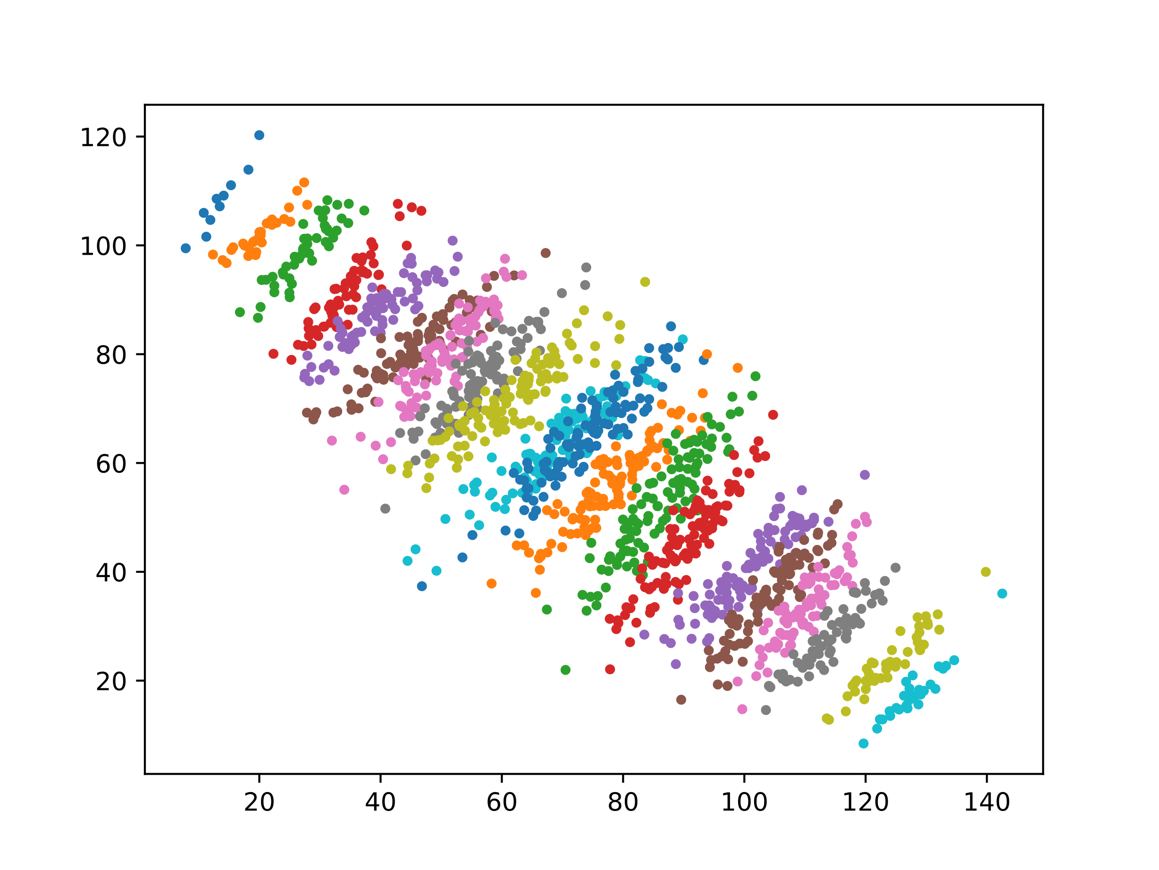
Simpson’s Paradox

Slide 7
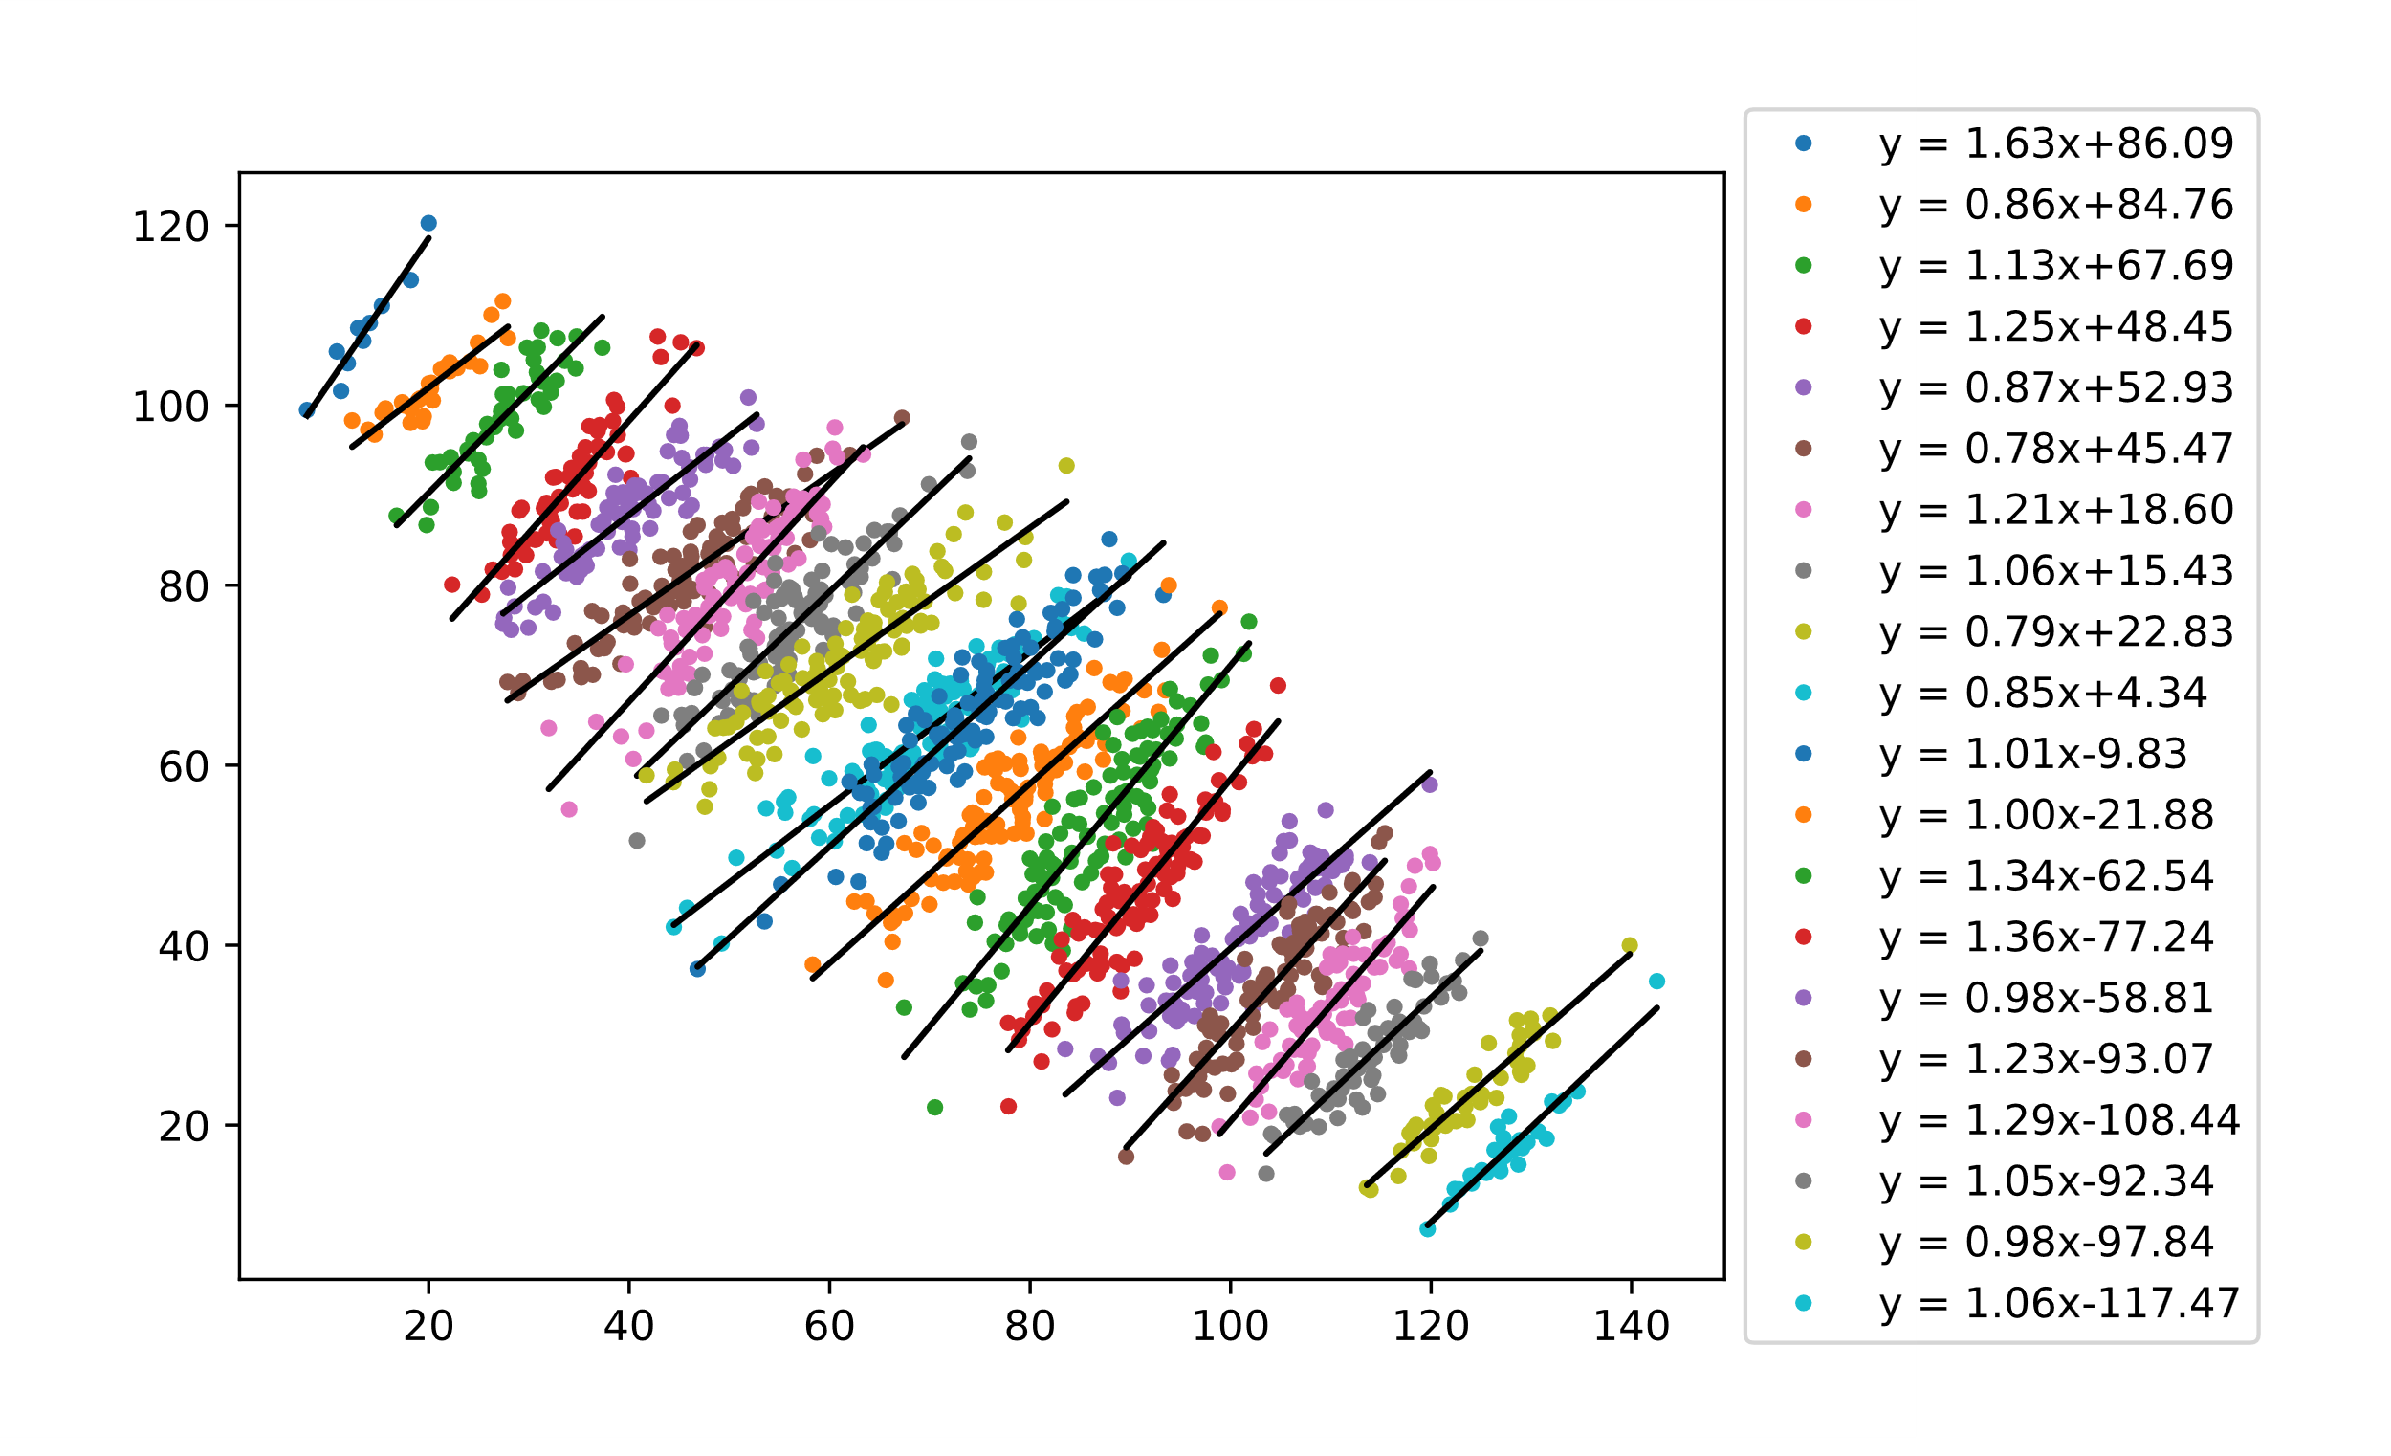

Simpson’s Paradox
$$y = 1.0868x − 14.643$$

Slide 8
Data Augmentation: Images
Flip horizontal / vertical
Rotate
Rescale
Crop
Dilate/shrink
Add white noise
Add salt/pepper noise
Add white/black boxes
+ anything that you can think of!

Slide 9
Data Augmentation: Audio
Add white noise
Shifting tone
Vary speed
Filter frequencies (drop/add low/high frequencies)

Slide 10
Data Augmentation: Text
Synonym substitute
Random insertion

Slide 11
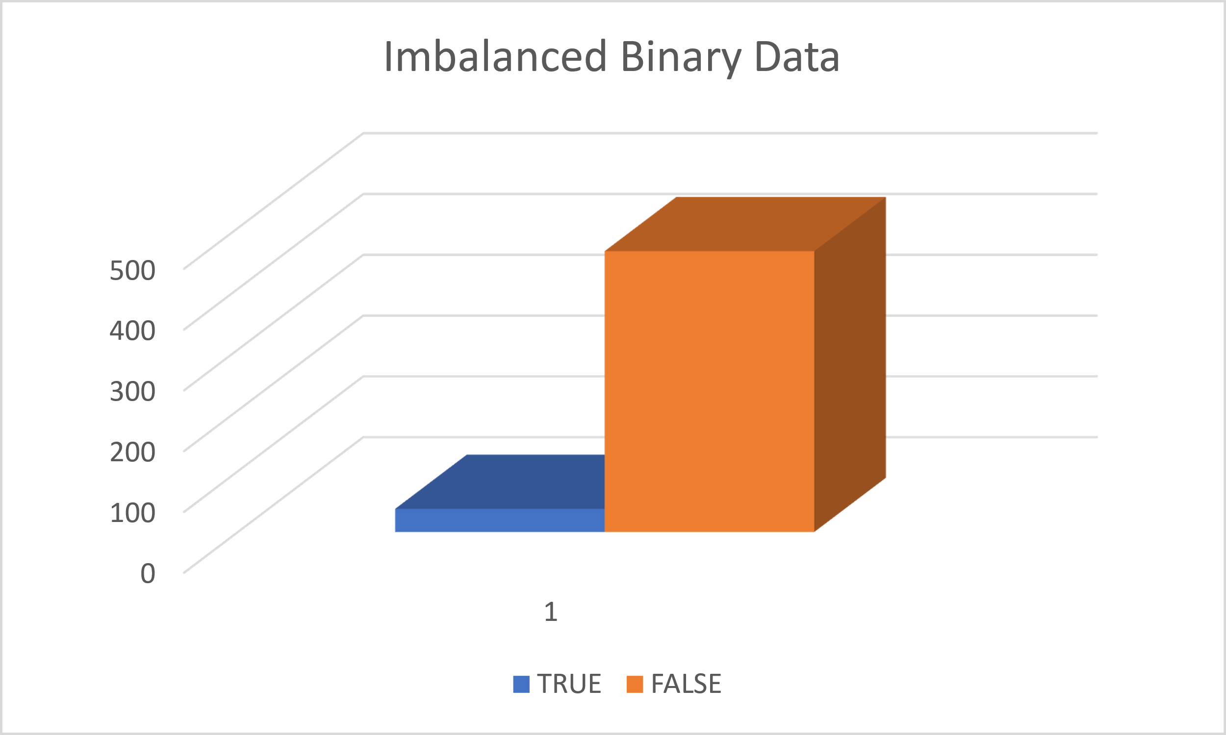
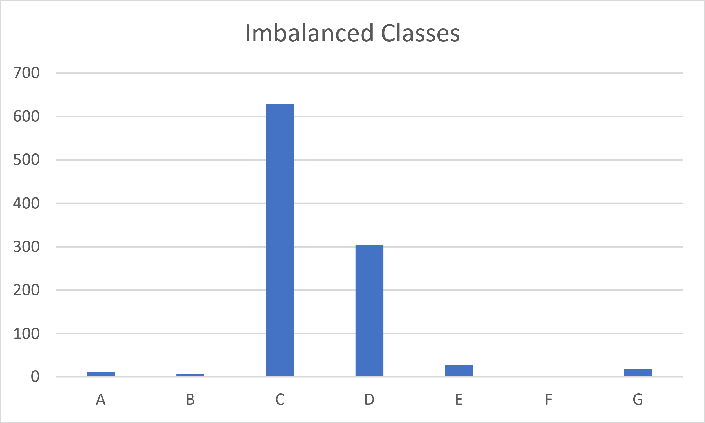
Imbalanced Data: Definition
Binary
Non-Binary

Slide 12
Imbalanced Data: Binary Metrics
Precision: Number of true positive predictions divided by the sum of true positive and false positive predictions.
Recall (or Sensitivity): Number of true positive predictions divided by the sum of true positive predictions and false negative predictions.
F1 Score: Harmonic mean of precision and recall.
ROC (Receiver Operating Characteristic): ROC curve plots the true positive rate (TPR) against the false positive rate (FPR).
AUC-ROC (Area Under the ROC Curve): AUC-ROC summarizes the ROC curve as a single metric by computing the area under the curve.
G-mean: Geometric mean of the recall for the positive class and the recall for the negative class.
Notes:
Harmonic Mean: H = n/(1/x_1 + 1/x_2 + 1/x_3 + … + 1/x_n)

Slide 13
Imbalanced Data: Compensation Techniques
Data-level:
Over sampling / Under sampling
Synthetic data generation
Algorithm-level
Cost-sensitive learning / Class weight adjustment

