Slide 1
Transfer learning
Lecture 5/10

Slide 2
What is transfer learning
Reuse a model trained on one task as the starting point for a model on a second task
Allows the second model to benefit from the knowledge learned by the first model
Can lead to faster training times and improved performance on the second task

Slide 3
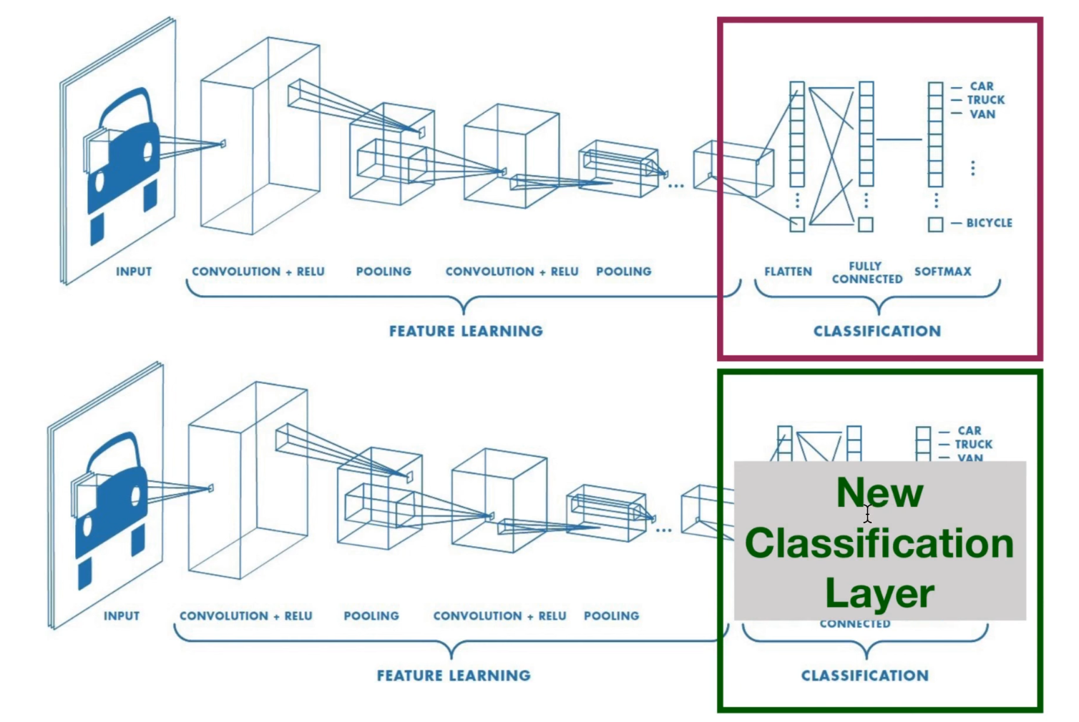
Notes:
In transfer learning, it's common to use pre-trained weights for the majority of the model and then fine-tune only a subset of the layers. This is because the lower layers* of a deep neural network tend to learn more general features, such as edges and textures, which are useful for a wide range of tasks. The higher layers*, on the other hand, tend to learn more task-specific features, such as object parts or object classes. Therefore, it's typically beneficial to keep the pre-trained weights for the lower layers*, while retraining the higher layers* to adapt them to the new task.
However, it is not always necessary to retrain all the layers, it depends on the size of the dataset, the similarity between the old task and the new task, the computational resources and other factors. The choice of which layers to retrain and which to keep frozen can be determined through experimentation, such as by comparing the performance of different model configurations. That choice is a hyperparameter (again!).
* The first layers, closest to the input, are referred to as the lower layers, while the last layers, closest to the output, are referred to as the higher layers.

Slide 4
What does it look like in PyTorch
-> DL_Practice_5_a_solutions.ipynb on Github

