Slide 1
PyTorch
Lecture 1/10

Slide 2
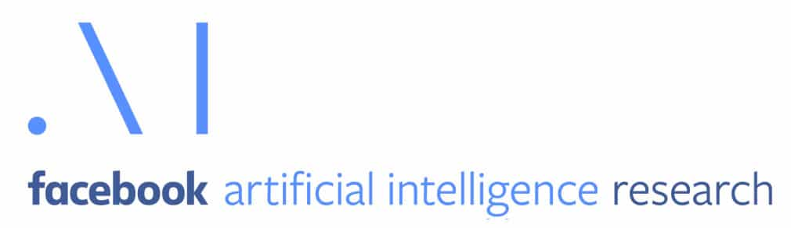
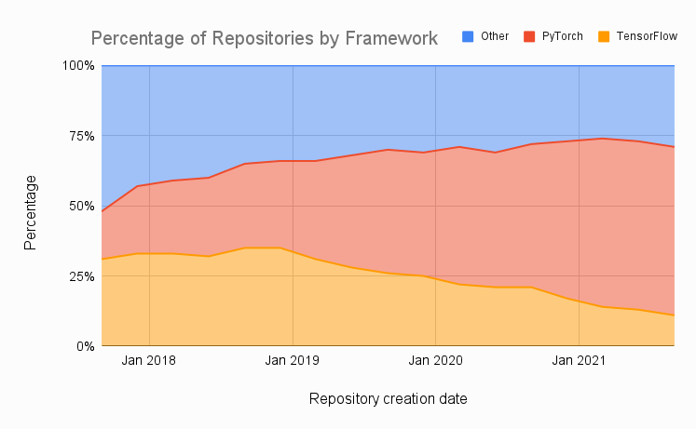
PyTorch in a few words…
Developed by Facebook’s AI research group
Getting very popular
Easy to use
Good performance in production
Flexible across a wide range of tasks
Provides tools for parallelizing & distributing computations

