Slide 1
PyTorch
Lecture 2/10

Slide 2

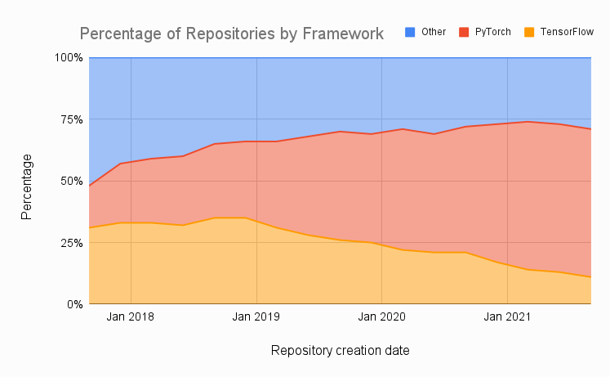
PyTorch in a few words…
Developed by Facebook’s AI research group
Getting very popular
Easy to use
Good performance in production
Flexible across a wide range of tasks
Provides tools for parallelizing & distributing computations

Slide 3
Key Concepts of PyTorch
Tensor: multi-dimensional array of numbers
Autograd: automatic differentiation engine (to avoid manual computation of gradients, cf. last TD correction)
Neural network module: base class to inherit from for all our neural network classes
Optimizer: an algorithm that is used to update the parameters based on the computed gradients and a given loss function
Dataset/Dataloader: a base class for our data
Notes:
Inheritance allows us to define a class that inherits all the methods and properties from another class.

Slide 4


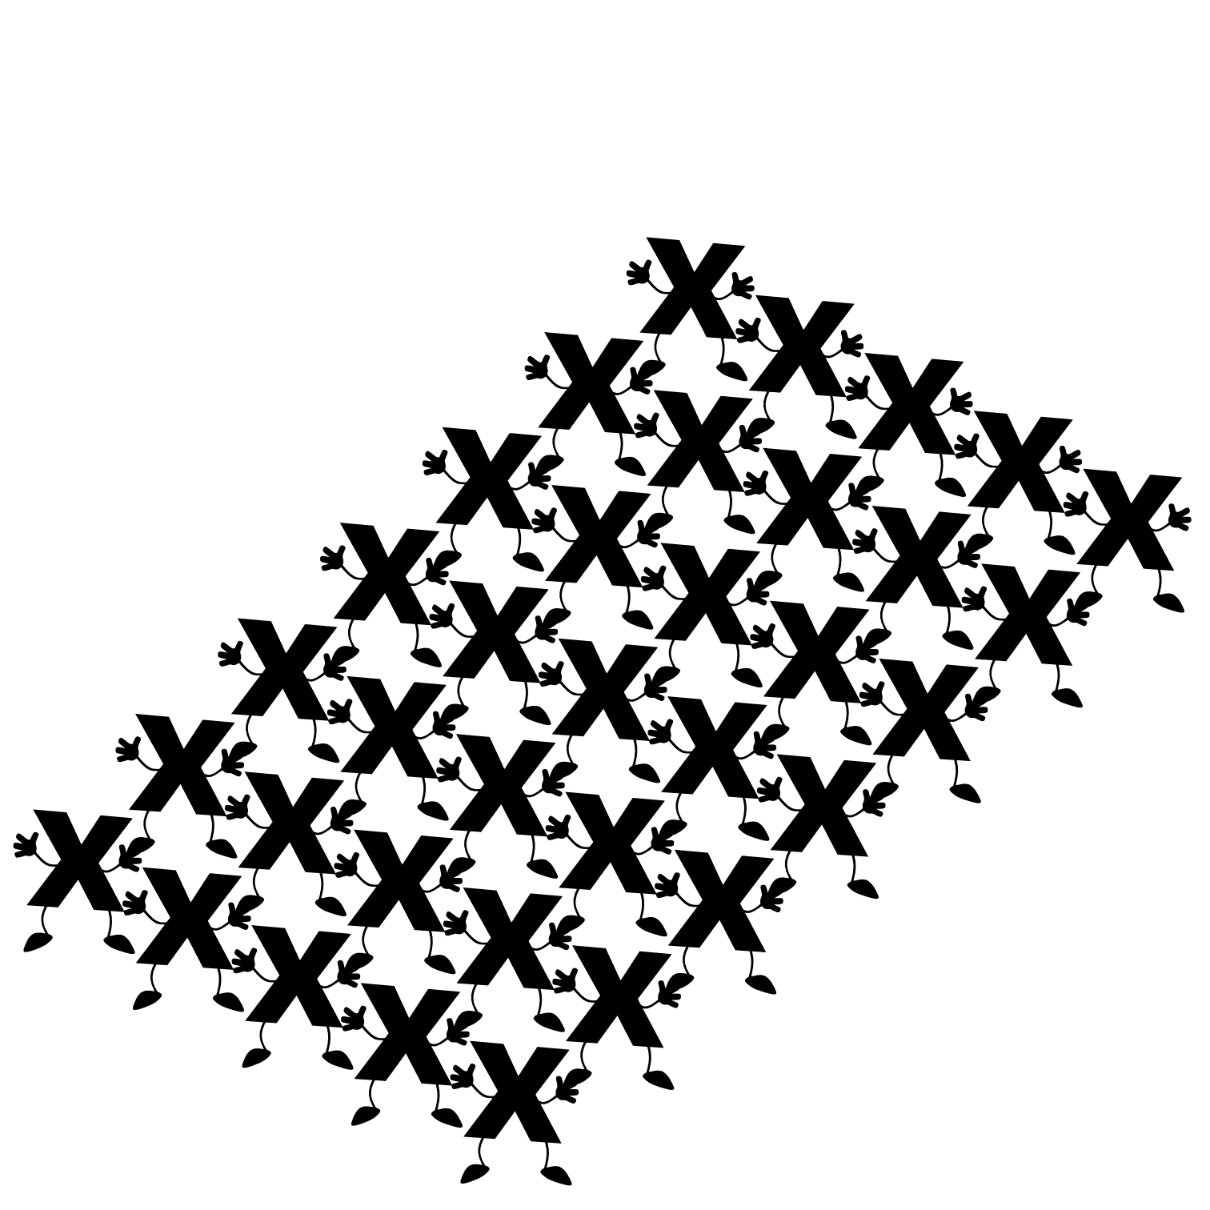
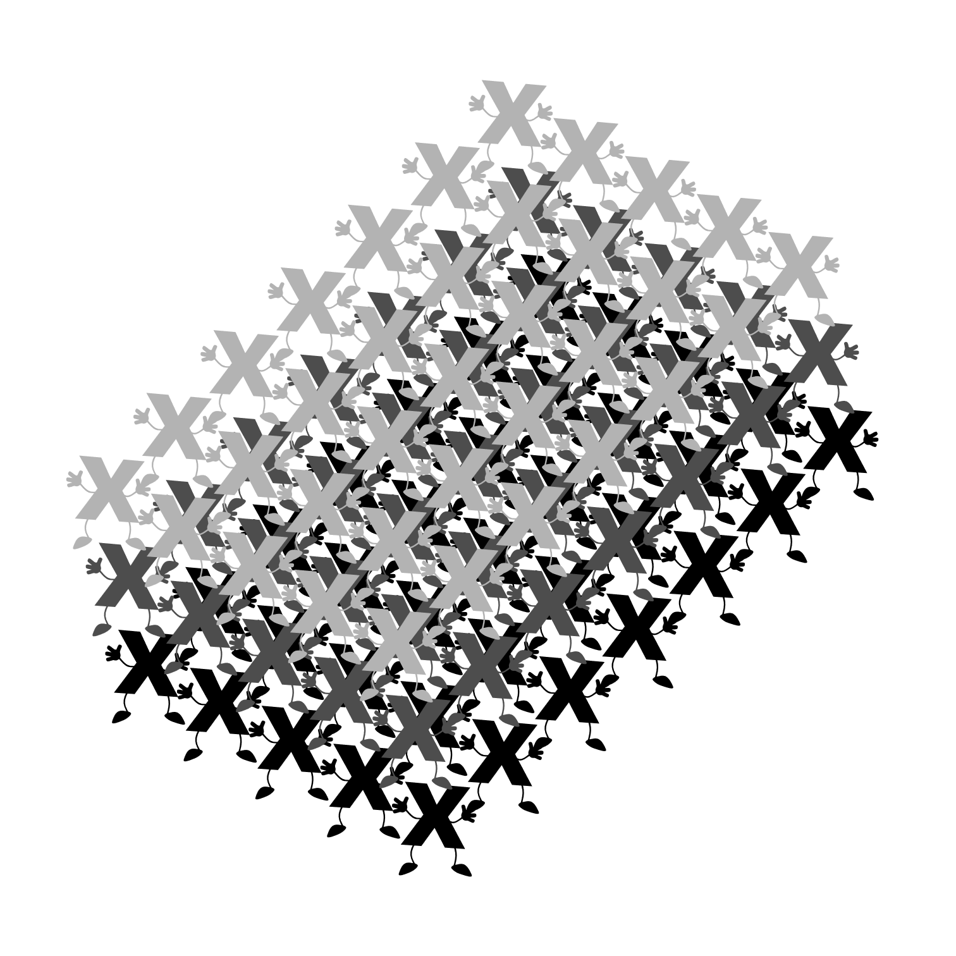
Tensor
Scalar
Vector
Matrix
Tensor

Slide 5
Autograd
Symbolic derivative of a function is precise; however, as the function of interest become more complex, the symbolic derivative becomes increasingly difficult to determine.
Finite difference approach uses the definition of a derivative to estimate the derivative of a function; however, it suffers from low accuracy and instability.
Automatic differentiation is using the chain rule to break the computation of the derivative. It achieves machine precision accuracy.

Slide 6

Symbolic derivative
$$z\left(x\right)= \frac{x^{2}}{5}+\cos{x}$$
$$z^{′}\left(x\right)=−\sin{x}+\frac{2}{5}x$$

Slide 7

Finite differences
$$z\left(x\right)= \frac{x^{2}}{5}+\cos{x}$$
$$z^{′}\left(x\right)=\frac{z\left(x+ε\right)−z(x−ε)}{2 ε}$$

Slide 8
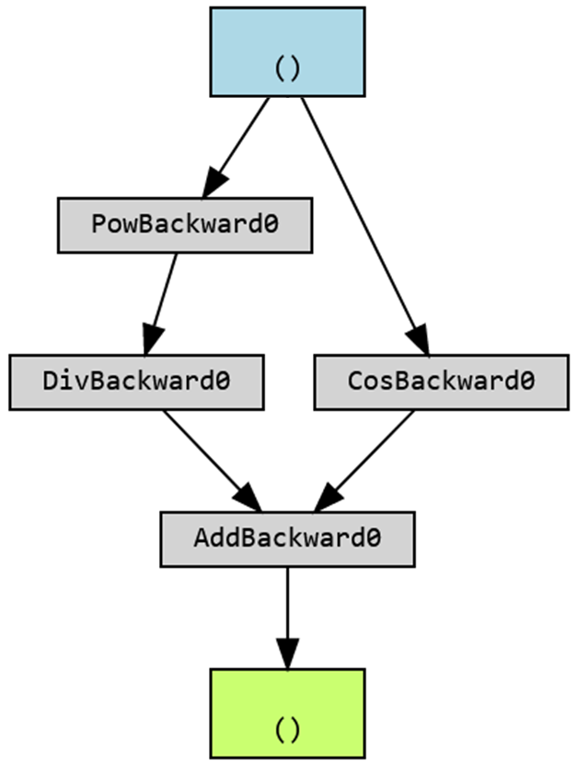
Autograd (automatic differentiation)
x = torch.tensor(1.0, requires_grad=True)
z = ((x**2)/5) + torch.cos(x)

Slide 9

Symbolic derivative
$$z\left(x,y\right)= \frac{x}{y}+(\cos{x}∗\sin{x})$$
$$\frac{∂z}{∂x}(x,y)= \frac{−y∗\sin{x}∗\sin{y}+1}{y}$$
$$\frac{∂z}{∂y}(x,y)= \frac{y^{2}∗\cos{x}∗\cos{y}−x}{y²}$$

Slide 10

Finite differences
$$z\left(x,y\right)= \frac{x}{y}+(\cos{x}∗\sin{x})$$
$$\frac{∂z}{∂x}(x,y)= \frac{z\left(x+ε,y\right)−z(x−ε,y)}{2ε}$$
$$\frac{∂z}{∂x}(x,y)= \frac{z\left(x,y+ε\right)−z(x,y−ε)}{2ε}$$

Slide 11
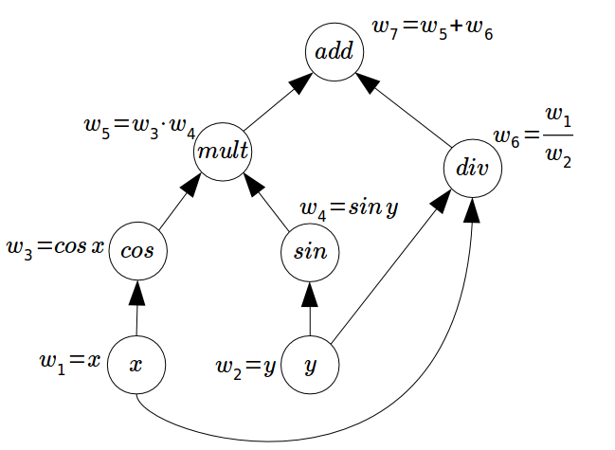
Autograd
x = torch.tensor(1.0, requires_grad=True)
y = torch.tensor(5.0, requires_grad=True)
z = (x/y) + torch.cos(x)*torch.sin(y)
(Internally)

Slide 12
Neural network module class
class Net(nn.Module):
def __init__(self):
super().__init__()
# initialize here your neural network
# (define its layers, etc…)
[…]
def forward(self, x):
# computes the outputs / predictions
[…]
return …
Notes:
No need for backward!

Slide 13
Neural network module class: an example
class Net(nn.Module):
def __init__(self):
super(Net, self).__init__()
self.fc1 = nn.Linear(1, 10)
self.fc2 = nn.Linear(10, 1)
def forward(self, x):
x = self.fc1(x)
x = nn.ReLU()(x)
x = self.fc2(x)
return x
Notes:
Pas d’activation function sur la dernière couche, on a le droit ! On pourrait aussi en mettre une.

Slide 14
Optimizer
All optimizers used in this course are variations of gradient descent:
Stochastic Gradient Descent (SGD): simple gradient descent aggregated by batches
Adaptive Moment Estimation (Adam): extension of SGD with momentum and moving average of the gradients to accelerate the training process and prevent oscillations.
Root Mean Squared Propagation (RMSProp): extension of SGD that is designed to deal with the issue of vanishing gradients. It normalizes the gradients by the root mean square of their recent magnitudes.
It is easy to switch from one optimizer to another with PyTorch*.
* We will see more on optimizers later in this course.

Slide 15
Dataset & Dataloader
To handle custom datasets, create a dataset class, and use a Dataloader to iterate through it.
class CustomDataset(Dataset):
def __init__(self):
# initialize your dataset
# (define the path, etc…)
def __getitem__(self, index):
# return one item of data
[…]
return …
def __len__(self):
# return the length of the dataset
return …
Notes:
Creating a PyTorch Dataset and managing it with Dataloader keeps your data manageable and helps to simplify your machine learning pipeline. A Dataset stores all your data, and Dataloader is can be used to iterate through the data, manage batches, transform the data, and much more.

Slide 16

Now it’s time to torch!

