Slide 1
CycleGAN - implementation
Lecture 10/10

Slide 2
GAN (reminder)
Generative Adversarial Networks
How many neural networks?
A generator
takes a random noise vector as input and generates a new sample of data that should look like it came from the training data
A discriminator
takes in both real and generated data as input and tries to distinguish between them
Generate new data that is similar to the training data e.g., images

Slide 3
GAN in PyTorch (Generator)
# Define the generator network
class Generator(nn.Module):
def __init__(self):
super(Generator, self).__init__()
self.fc1 = nn.Linear(100, 128) # noise
self.fc2 = nn.Linear(128, 784) # why 784? 28x28
def forward(self, x):
x = nn.functional.relu(self.fc1(x))
x = nn.functional.relu(self.fc2(x)) # maybe not relu
return x

Slide 4
GAN in PyTorch (Discriminator)
# Define the discriminator network
class Discriminator(nn.Module):
def __init__(self):
super(Discriminator, self).__init__()
self.fc1 = nn.Linear(784, 128) # why 784? 28x28
self.fc2 = nn.Linear(128, 1) # why 1? Real/Fake
def forward(self, x):
x = nn.functional.relu(self.fc1(x))
x = nn.functional.sigmoid(self.fc2(x))
return x

Slide 5
GAN in PyTorch (Training both)
# Create the generator and discriminator
generator = Generator()
discriminator = Discriminator()
# Train the GAN
criterion = nn.BCELoss()
optimizer_g = optim.Adam(generator.parameters(), lr=0.0002)
optimizer_d = optim.Adam(discriminator.parameters(), lr=0.0002)
for epoch in range(100):
for i, data in enumerate(dataloader):
cf_next_slide

Slide 6
GAN in PyTorch (Training both)
for epoch in range(100):
for i, data in enumerate(dataloader):
real_data = data[0].view(-1, 784)
# Train the discriminator
optimizer_d.zero_grad()
d_real = discriminator(real_data) # REAL IMAGE
z = torch.randn(real_data.shape[0], 100)
x_gen = generator(z)
d_gen = discriminator(x_gen.detach()) # GENERATED IMAGE
loss_d = criterion(d_real, torch.ones_like(d_real)) + criterion(d_gen, torch.zeros_like(d_gen))
loss_d.backward()
optimizer_d.step()
# Train the generator
cf_next_slide

Slide 7
GAN in PyTorch (Training both)
for epoch in range(100):
for i, data in enumerate(dataloader):
real_data = data[0].view(-1, 784)
# Train the discriminator
cf previous_slide
# Train the generator
optimizer_g.zero_grad()
z = torch.randn(real_data.shape[0], 100)
x_gen = generator(z)
d_gen = discriminator(x_gen) # GENERATED IMAGE
loss_g = criterion(d_gen, torch.ones_like(d_gen))
loss_g.backward()
optimizer_g.step()

Slide 8
CycleGAN: glasses <-> no glasses
Let’s (quickly) read through the paper* together
PDF in DeepLearningCourse/papers/
* Zhu, J.Y., Park, T., Isola, P. and Efros, A.A., 2017. Unpaired image-to-image translation using cycle-consistent adversarial networks. In Proceedings of the IEEE international conference on computer vision (pp. 2223-2232).

Slide 9
Neural network structure
Generator
Convolutions to 64 channels
Downsampling (stride of 2 on the convolutional layers)
Residual blocks
Transposed convolutions
Upsampling
Map it back to RGB (3 channels)
Discriminator
Downsampling to 62x62
PatchGAN like

Slide 10
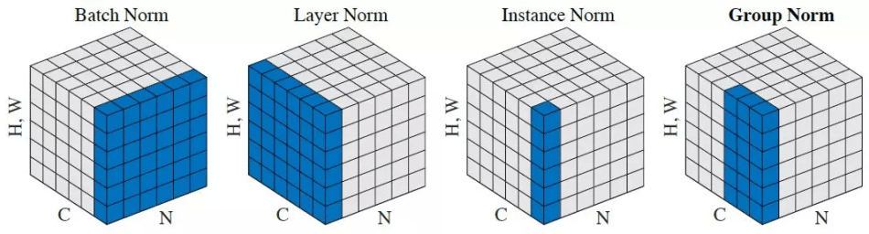
Neural network structure

Slide 11
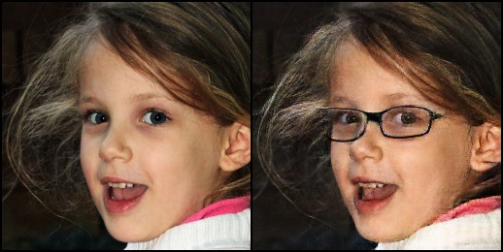
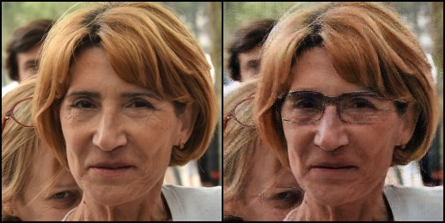
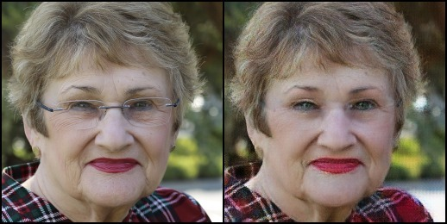







Results to obtain
100 epochs, no learning rate decay, 3 hours 15 minutes

Slide 12
CycleGAN: glasses <-> no glasses
Code will be pushed* every now and then so that you can catch up if necessary
Data is not on GitHub**, download it from the drive:
https://drive.google.com/drive/folders/1gO84LDFLB2w_FjLlzj2fjn2RTn95ocIV?usp=share_link
*usual GitHub
**supposedly it’s bad

