Slide 1
Data and Gradient Subtleties
Lecture 6/10

Slide 2
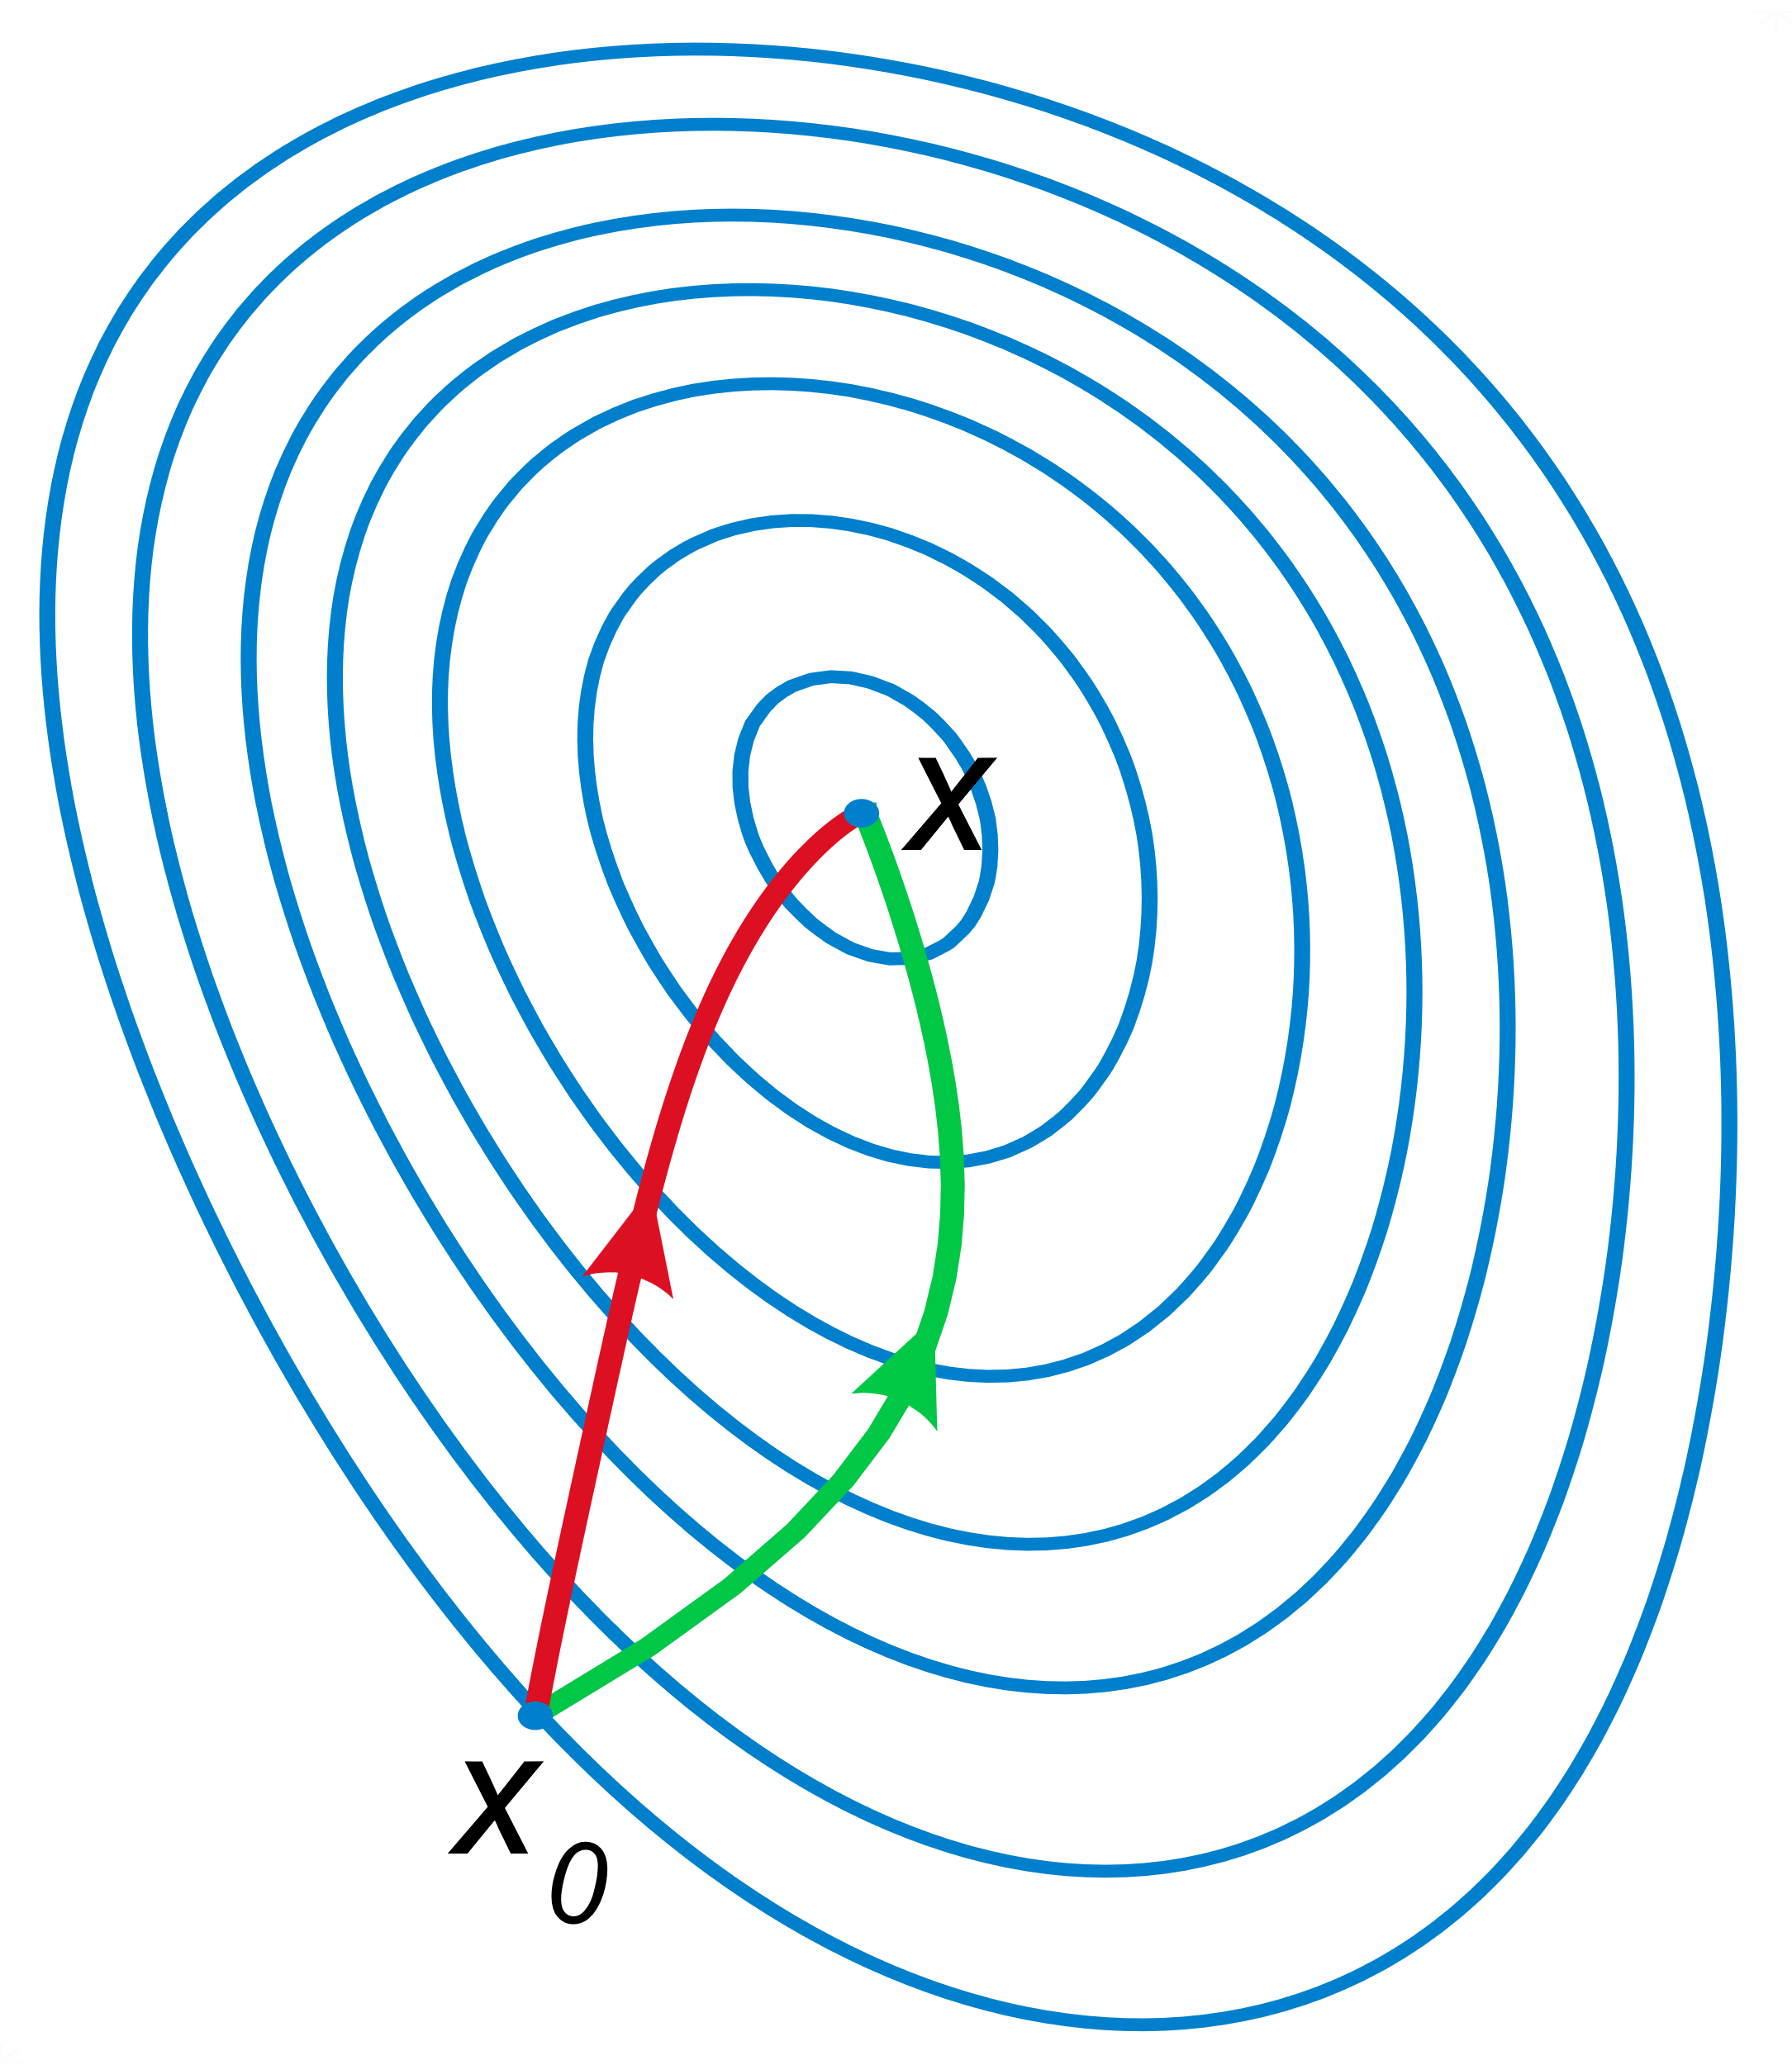
Gradient

Slide 3
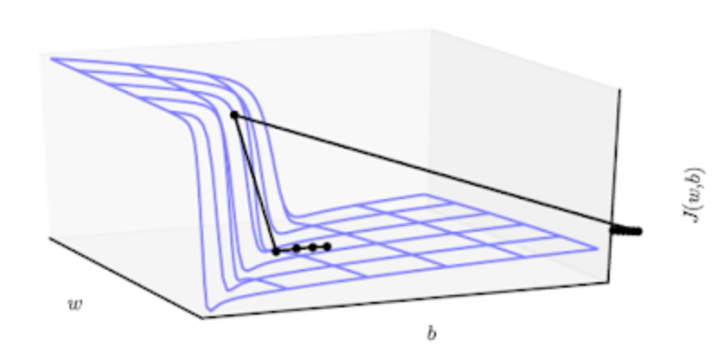
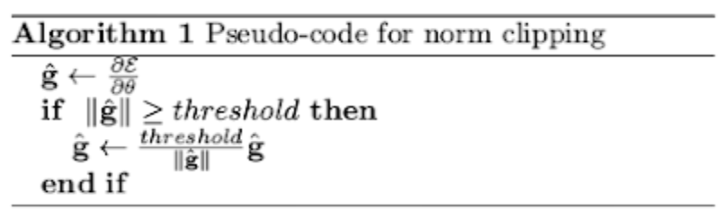
Exploding -> gradient clipping
Notes:
Rappel, le graphe c’est la loss en fonction des paramètres.

Slide 4
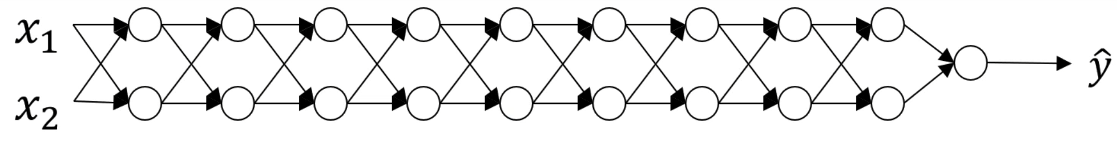
Vanishing / exploding gradients
Notes:
Figure from DeepLearningAI C2W1L10
Ne prenons pas en compte les biais ni les fonctions d’activation et faisons l’hypothèse que seules les diagonales des matrices sont non nulles par simplicité.
Si la matrice est diagonalisable et que toutes ses valeurs propres sont < 1 ou > 1 alors on retrouve ça … mais en soit … le but c’est pas de montrer que ça arrive toujours mais que ça peut arriver à cause de trop de multiplications d’affilées.

Slide 5
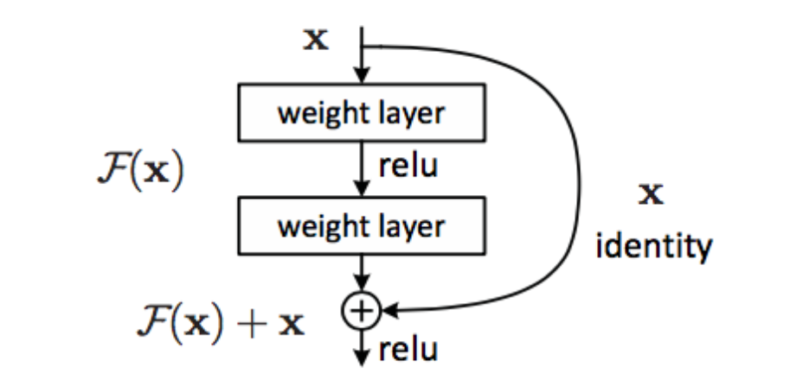
Vanishing
Increase learning rate
LeakyReLU instead of ReLU
Use residual connections.
Notes:
Pour le deuxième point, voir la fin du TD 1
Pour le troisième point, voir le TD 6a mais d’abord expliquer pourquoi ça marcherait potentiellement
Image from: https://arxiv.org/abs/1512.03385 (Deep Residual Learning for Image Recognition)

Slide 6

Data

Slide 7
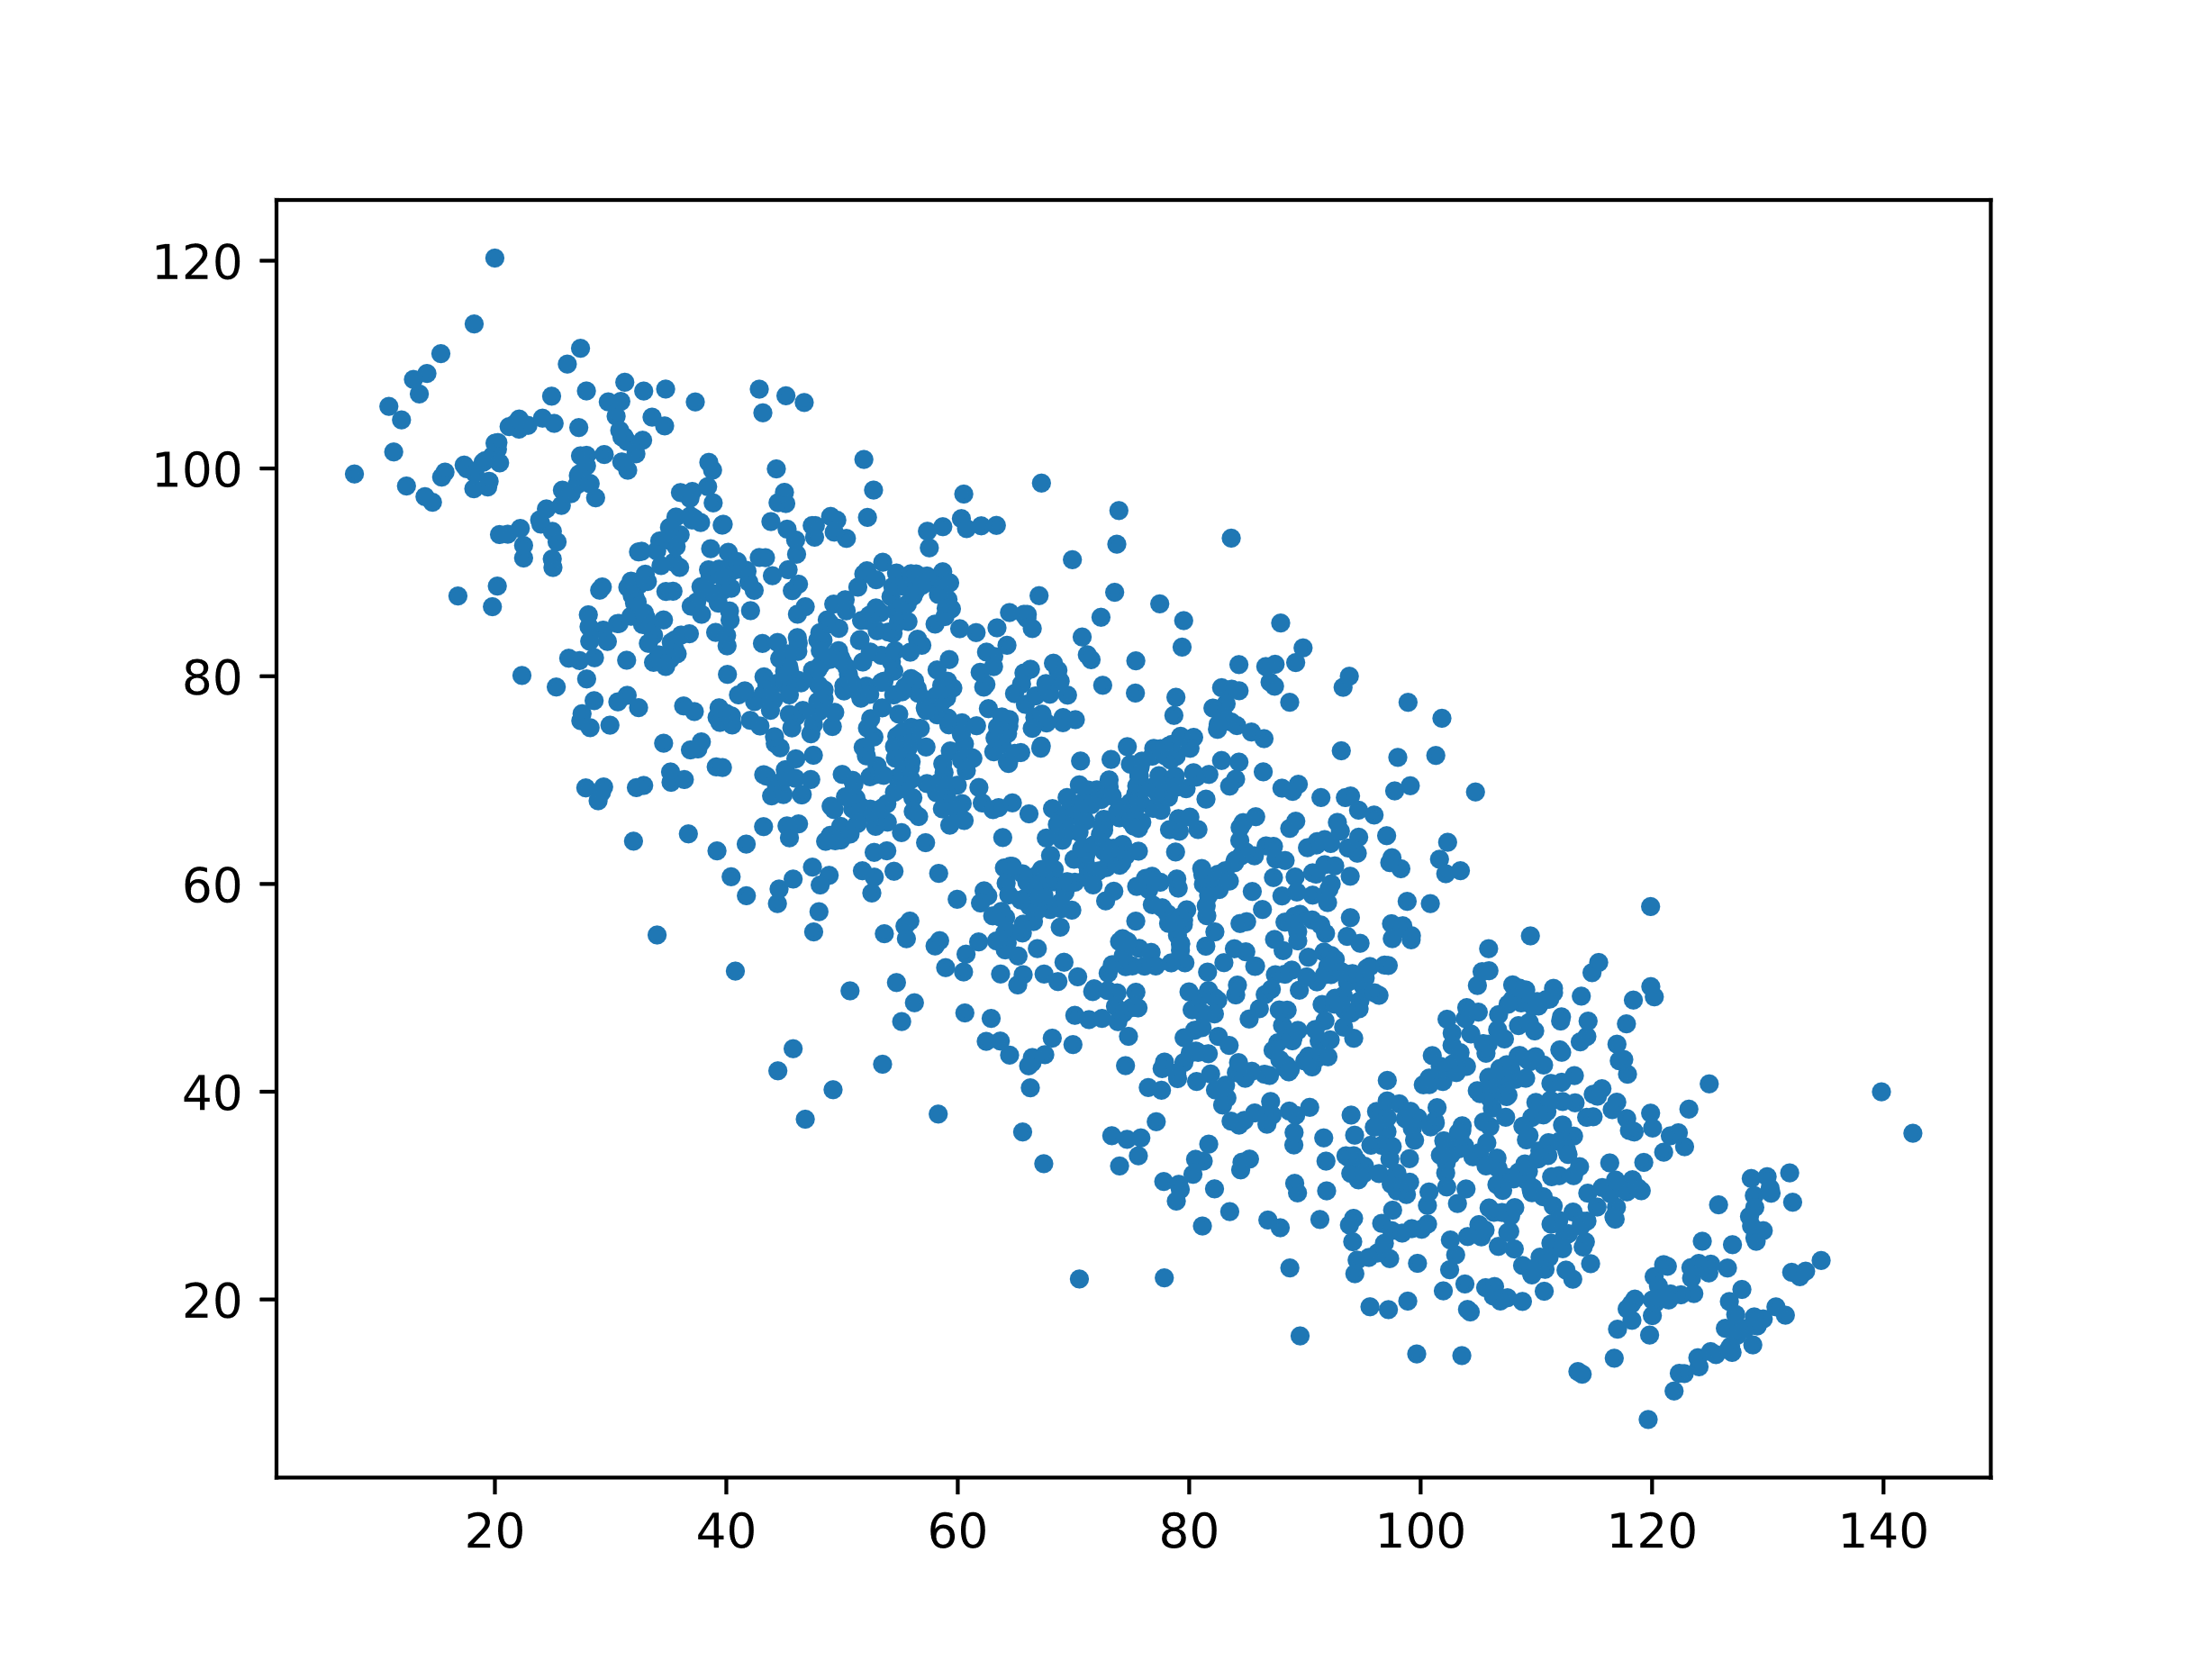
Simpson’s Paradox

Slide 8
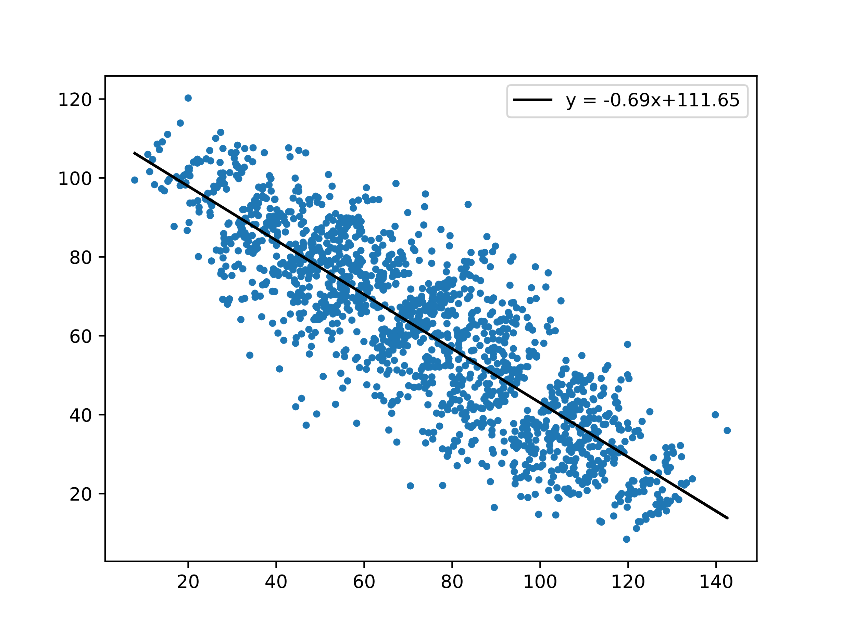
Simpson’s Paradox

Slide 9
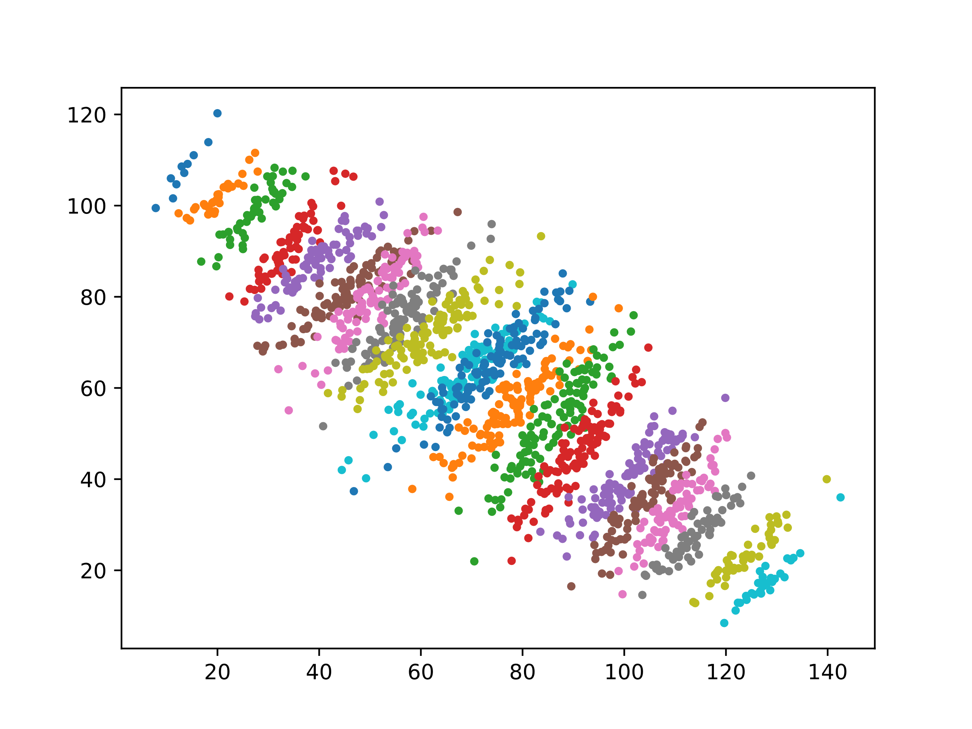
Simpson’s Paradox

Slide 10
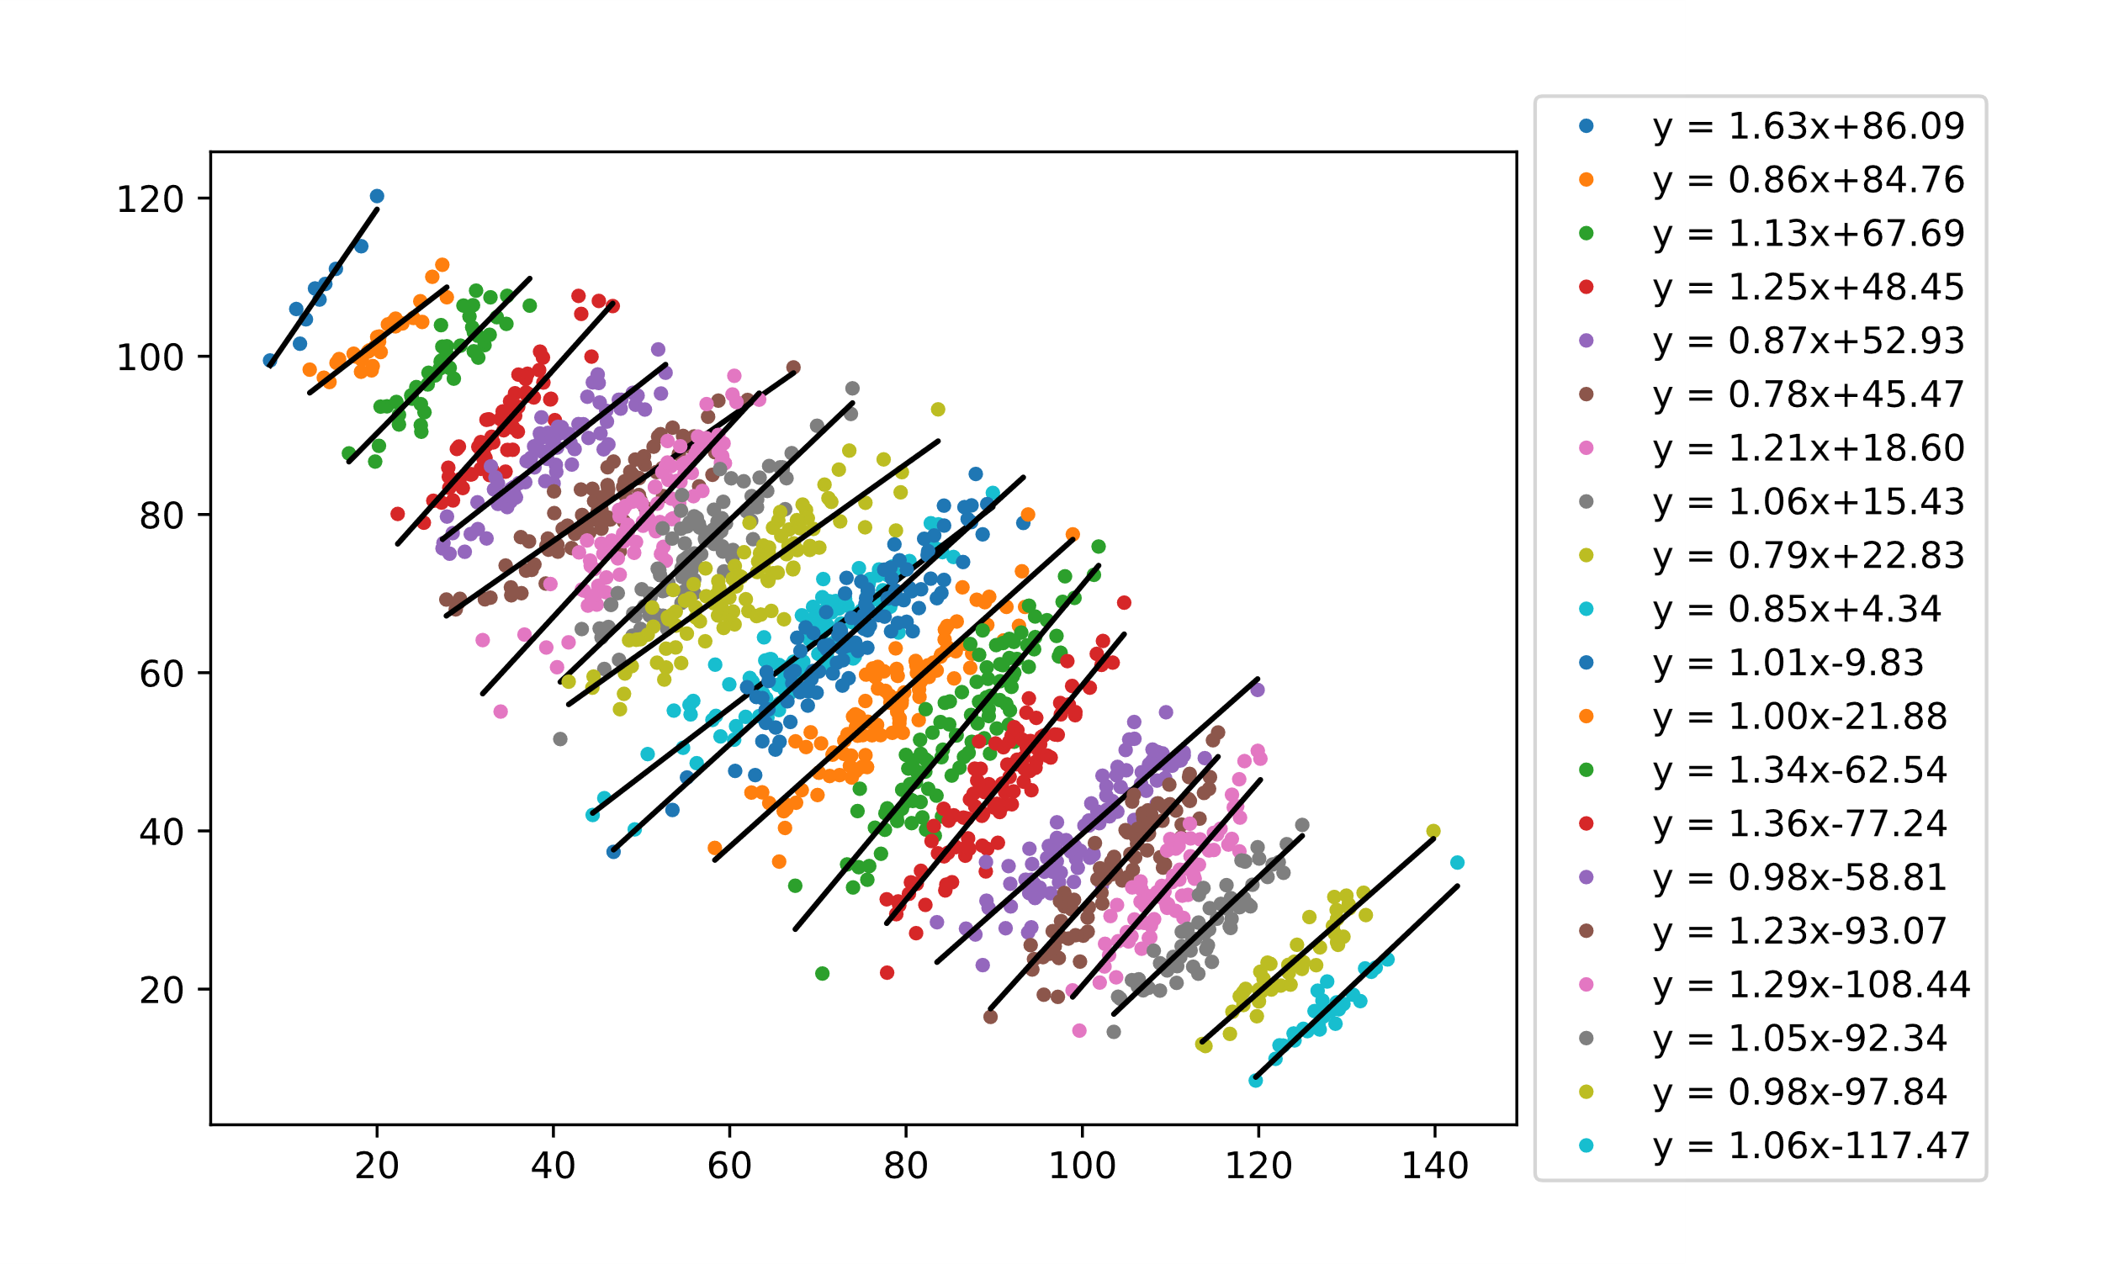

Simpson’s Paradox
$$y = 1.0868x − 14.643$$

Slide 11
Data Augmentation: Images
Flip horizontal / vertical
Rotate
Rescale
Crop
Dilate/shrink
Add white noise
Add salt/pepper noise
Add white/black boxes
+ anything that you can think of!

Slide 12
Data Augmentation: Audio
Add white noise
Shifting tone
Vary speed
Filter frequencies (drop/add low/high frequencies)

Slide 13
Data Augmentation: Text
Synonym substitute
Random insertion

Slide 14
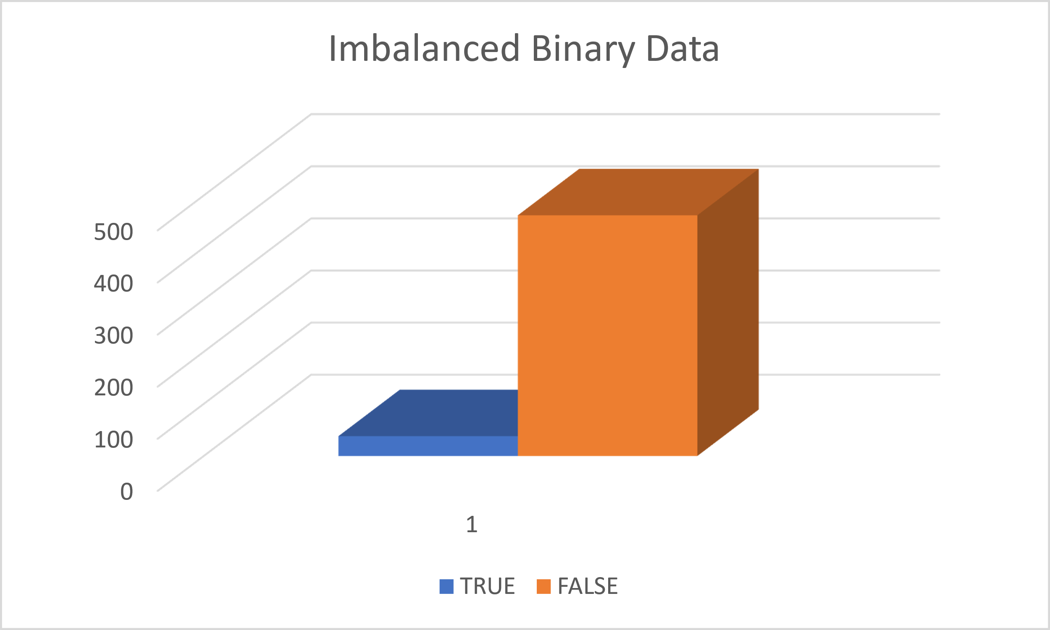
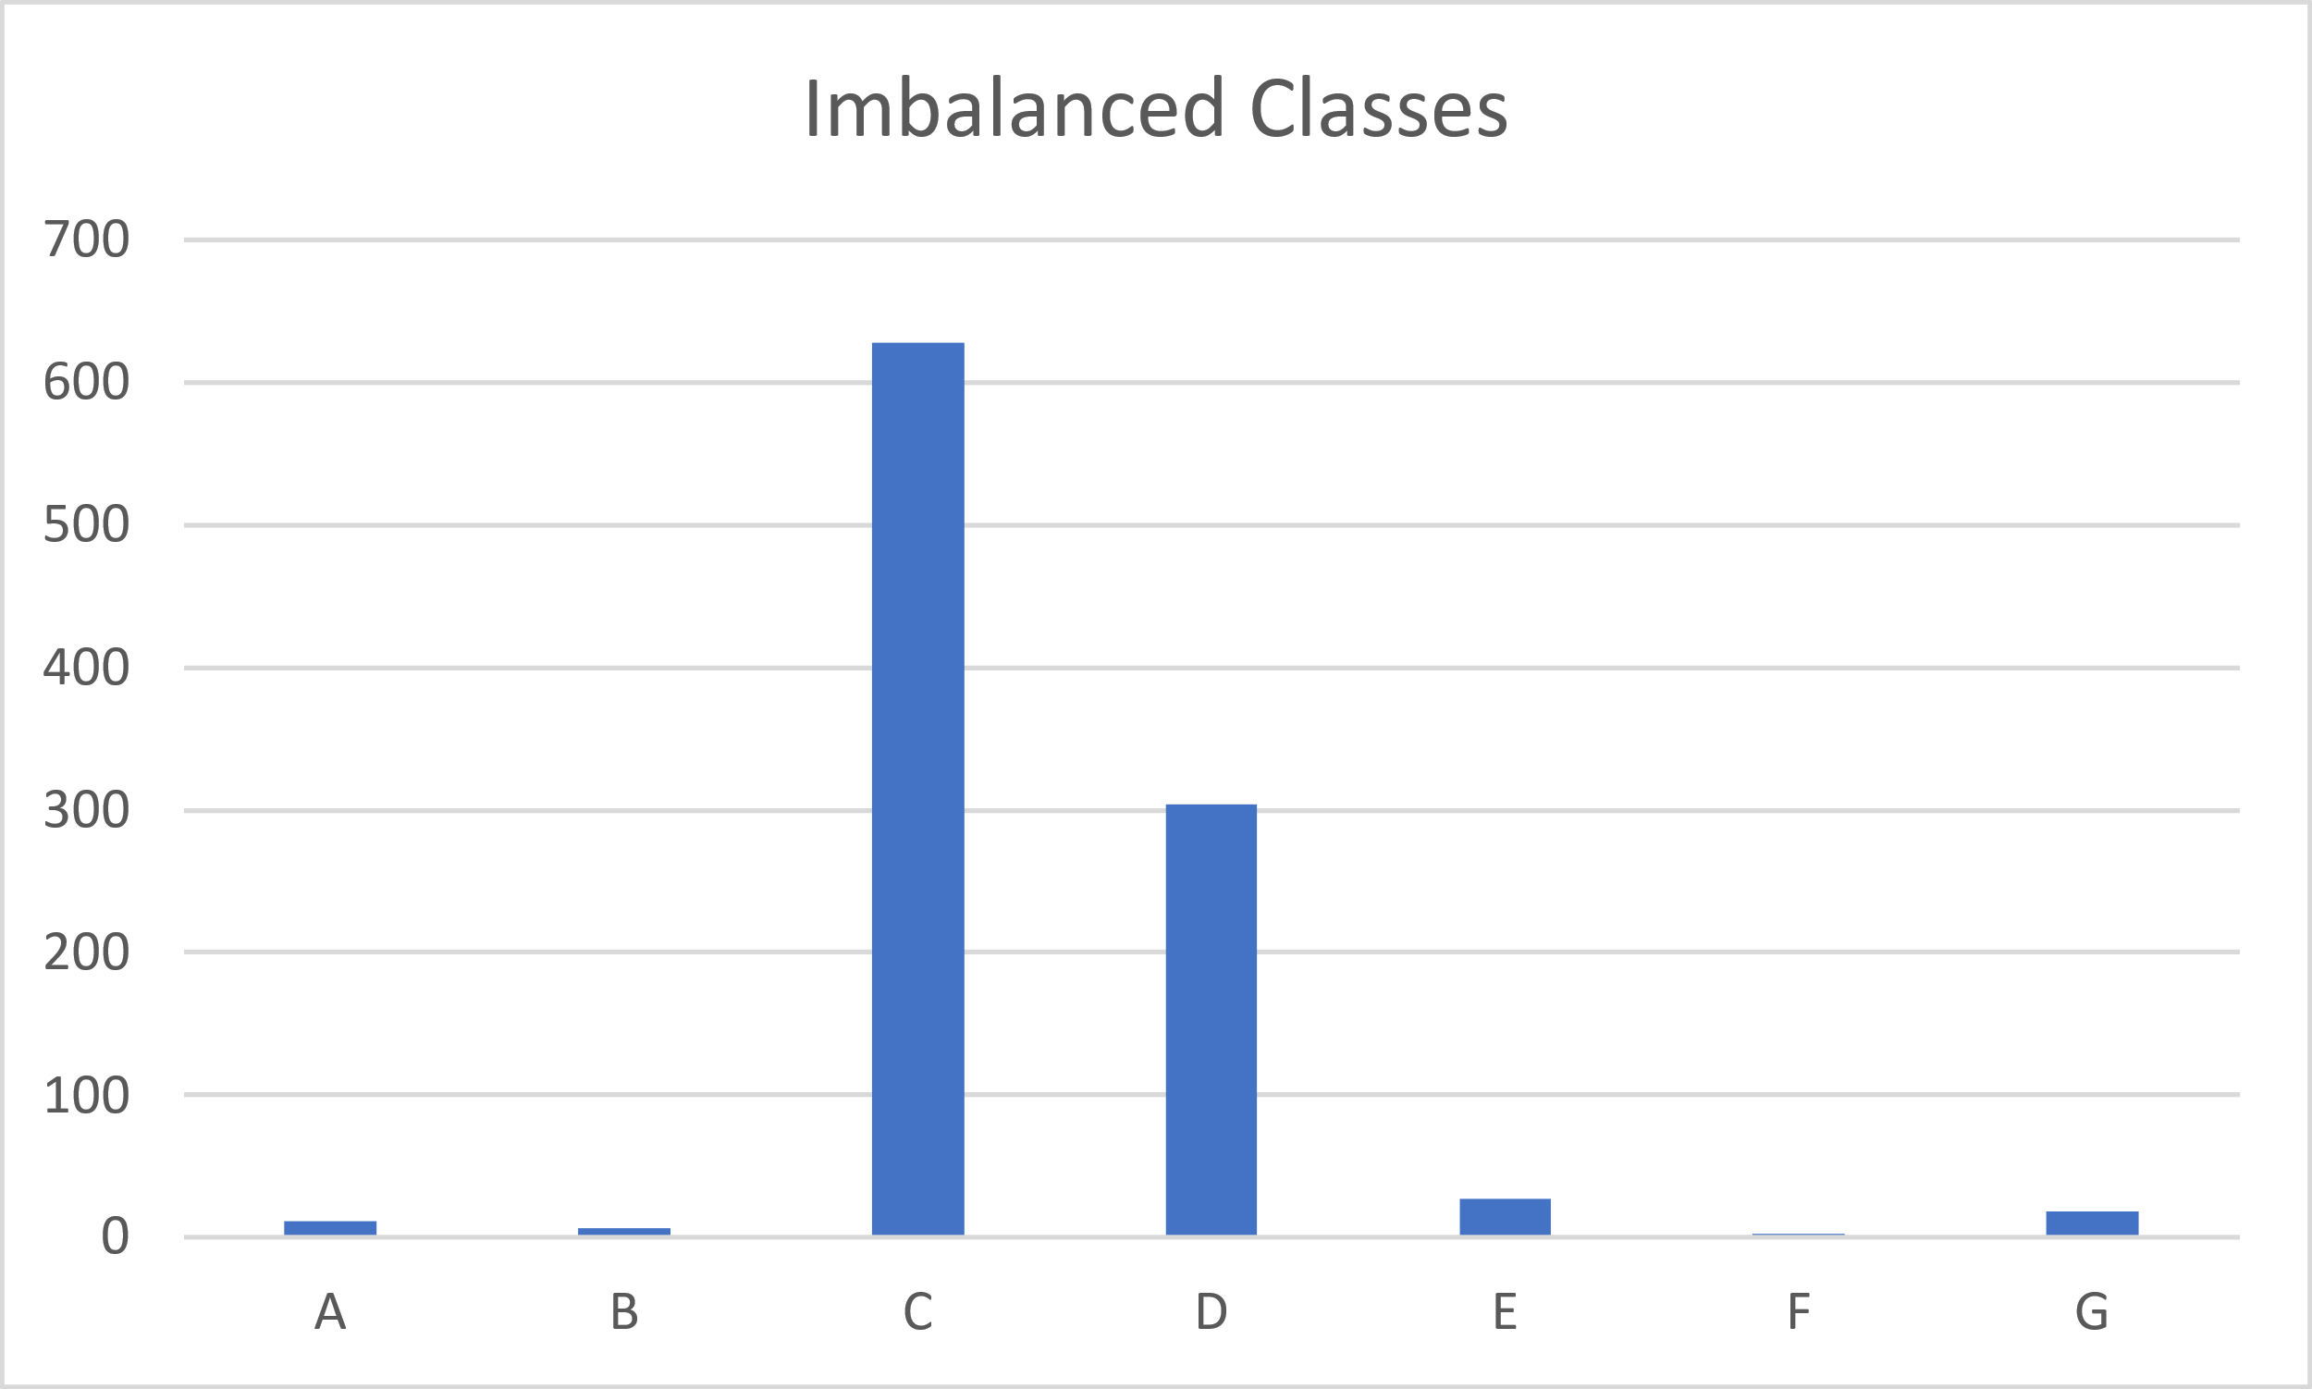
Imbalanced Data: Definition
Binary
Non-Binary

Slide 15
Imbalanced Data: Binary Metrics
Precision: Number of true positive predictions divided by the sum of true positive and false positive predictions.
Recall (or Sensitivity): Number of true positive predictions divided by the sum of true positive predictions and false negative predictions.
F1 Score: Harmonic mean of precision and recall.
ROC (Receiver Operating Characteristic): ROC curve plots the true positive rate (TPR) against the false positive rate (FPR).
AUC-ROC (Area Under the ROC Curve): AUC-ROC summarizes the ROC curve as a single metric by computing the area under the curve.
G-mean: Geometric mean of the recall for the positive class and the recall for the negative class.
Notes:
Harmonic Mean: H = n/(1/x_1 + 1/x_2 + 1/x_3 + … + 1/x_n)

Slide 16
Imbalanced Data: Compensation Techniques
Data-level:
Over sampling / Under sampling
Synthetic data generation
Algorithm-level
Cost-sensitive learning / Class weight adjustment

