Slide 1
PyTorch
Lecture 1/10

Slide 2

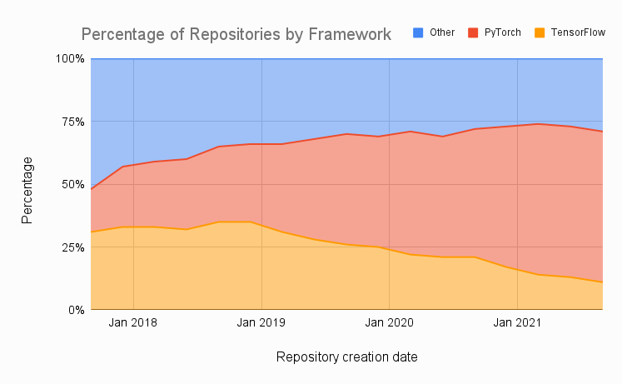
PyTorch in a few words…
Developed by Facebook’s AI research group
Getting very popular
Easy to use
Good performance in production
Flexible across a wide range of tasks
Provides tools for parallelizing & distributing computations

Slide 3
Key Concepts of PyTorch
Tensor: Multi-dimensional array of numbers
Autograd: A library for automatically computing gradients
Neural network module: Base class for all neural network classes
Optimizer: An algorithm that is used to adjust the parameters of a neural network in order to minimize a loss function
Dataset: A base class for our data

Slide 4


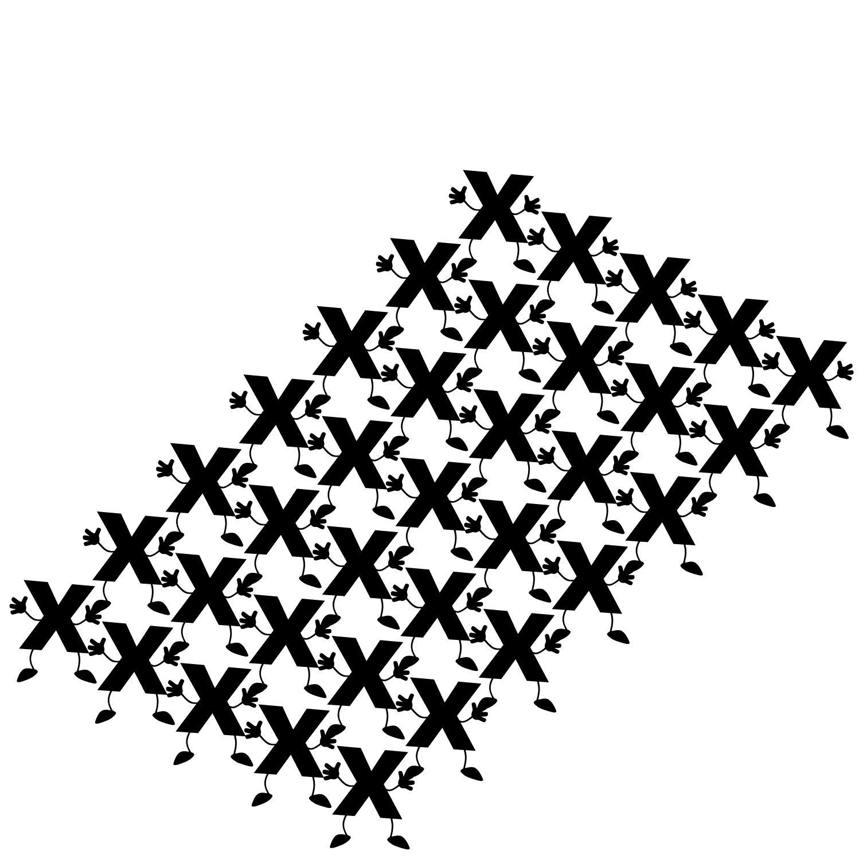
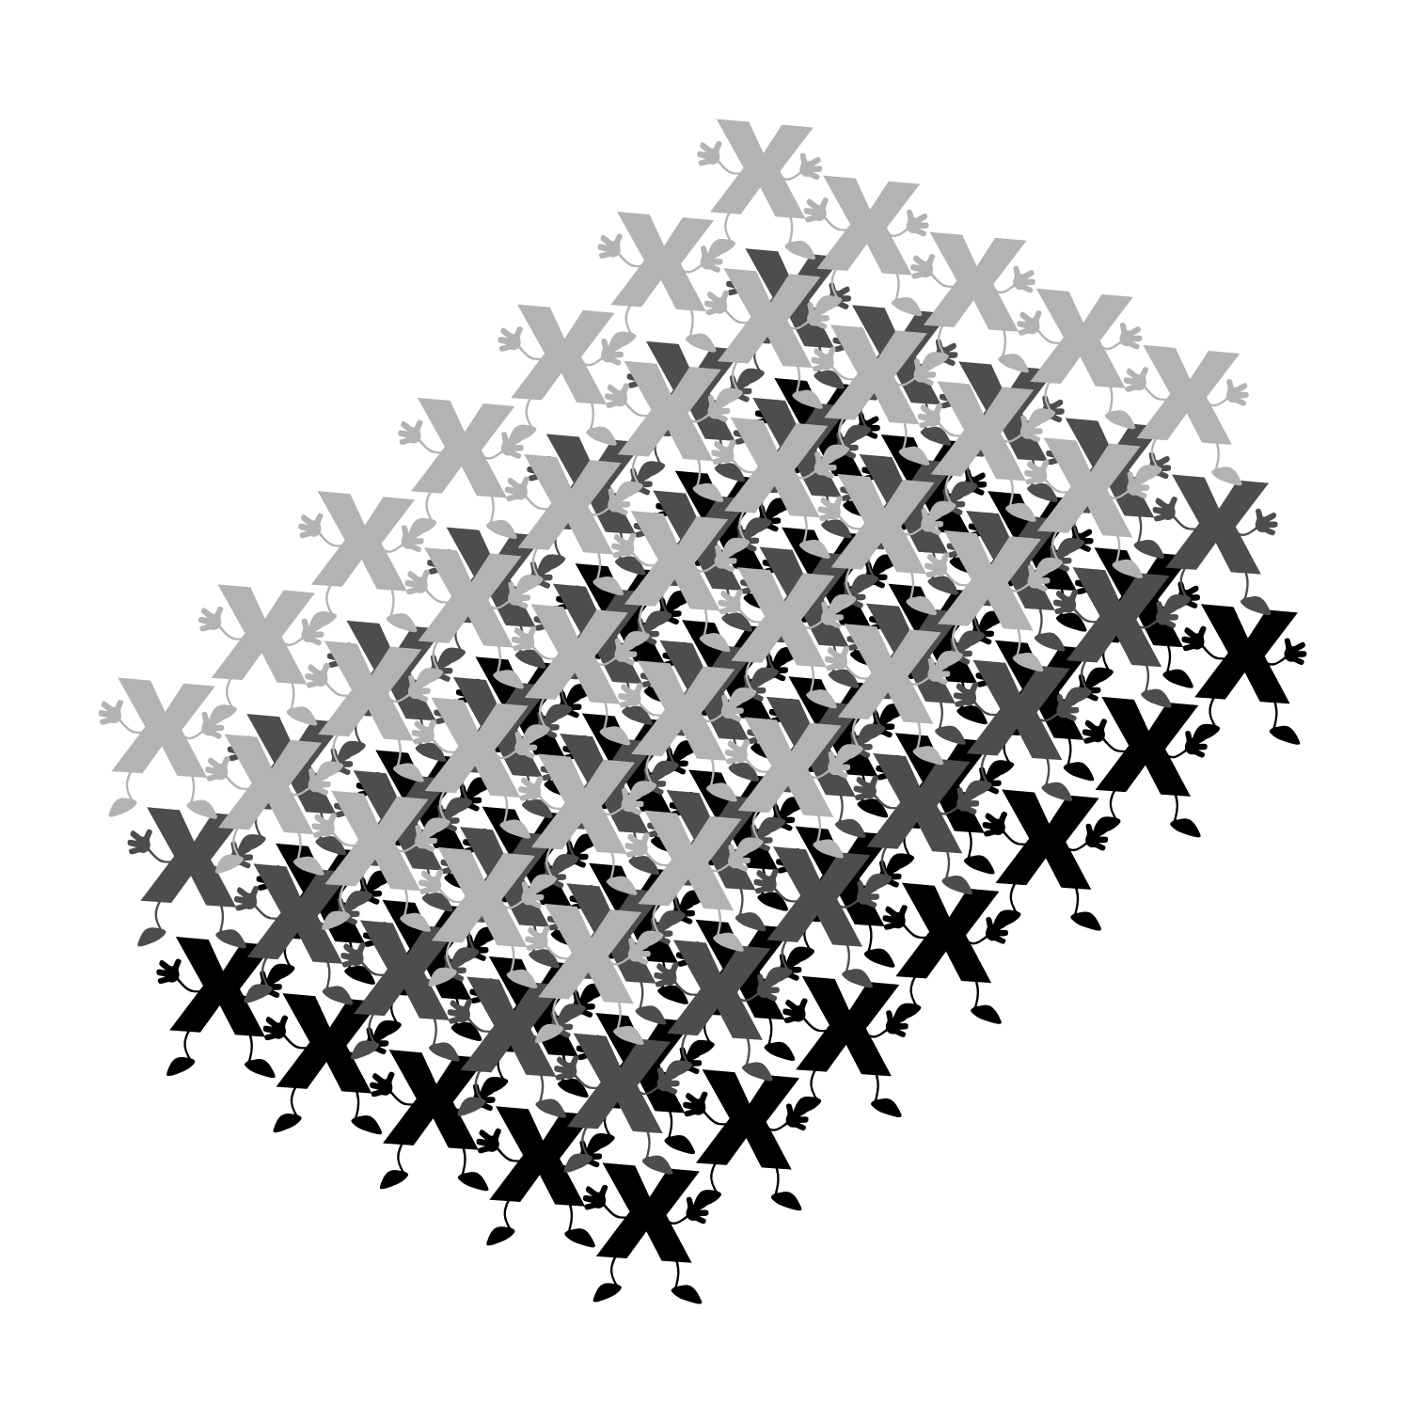
Tensor
Scalar
Vector
Matrix
Tensor

Slide 5
Autograd
https://autograd.readthedocs.io/en/latest/background.html
Autograd is an Automatic Differentiation system
The symbolic derivative of a function is precise; however as the function of interest become more complex, the symbolic derivative becomes increasingly difficult to determine. Numeric methods can be used to compute the derivative of such functions. The finite difference approach uses the definition of a derivative to estimate the derivative of a function; however, it suffers from low accuracy and instability.
AD is able to compute an approximation of the derivative of a function, without computing a symbolic expression of the derivative and with machine precision accuracy.

