Slide 1
Architecture (Basics)
Lecture 4/10

Slide 2
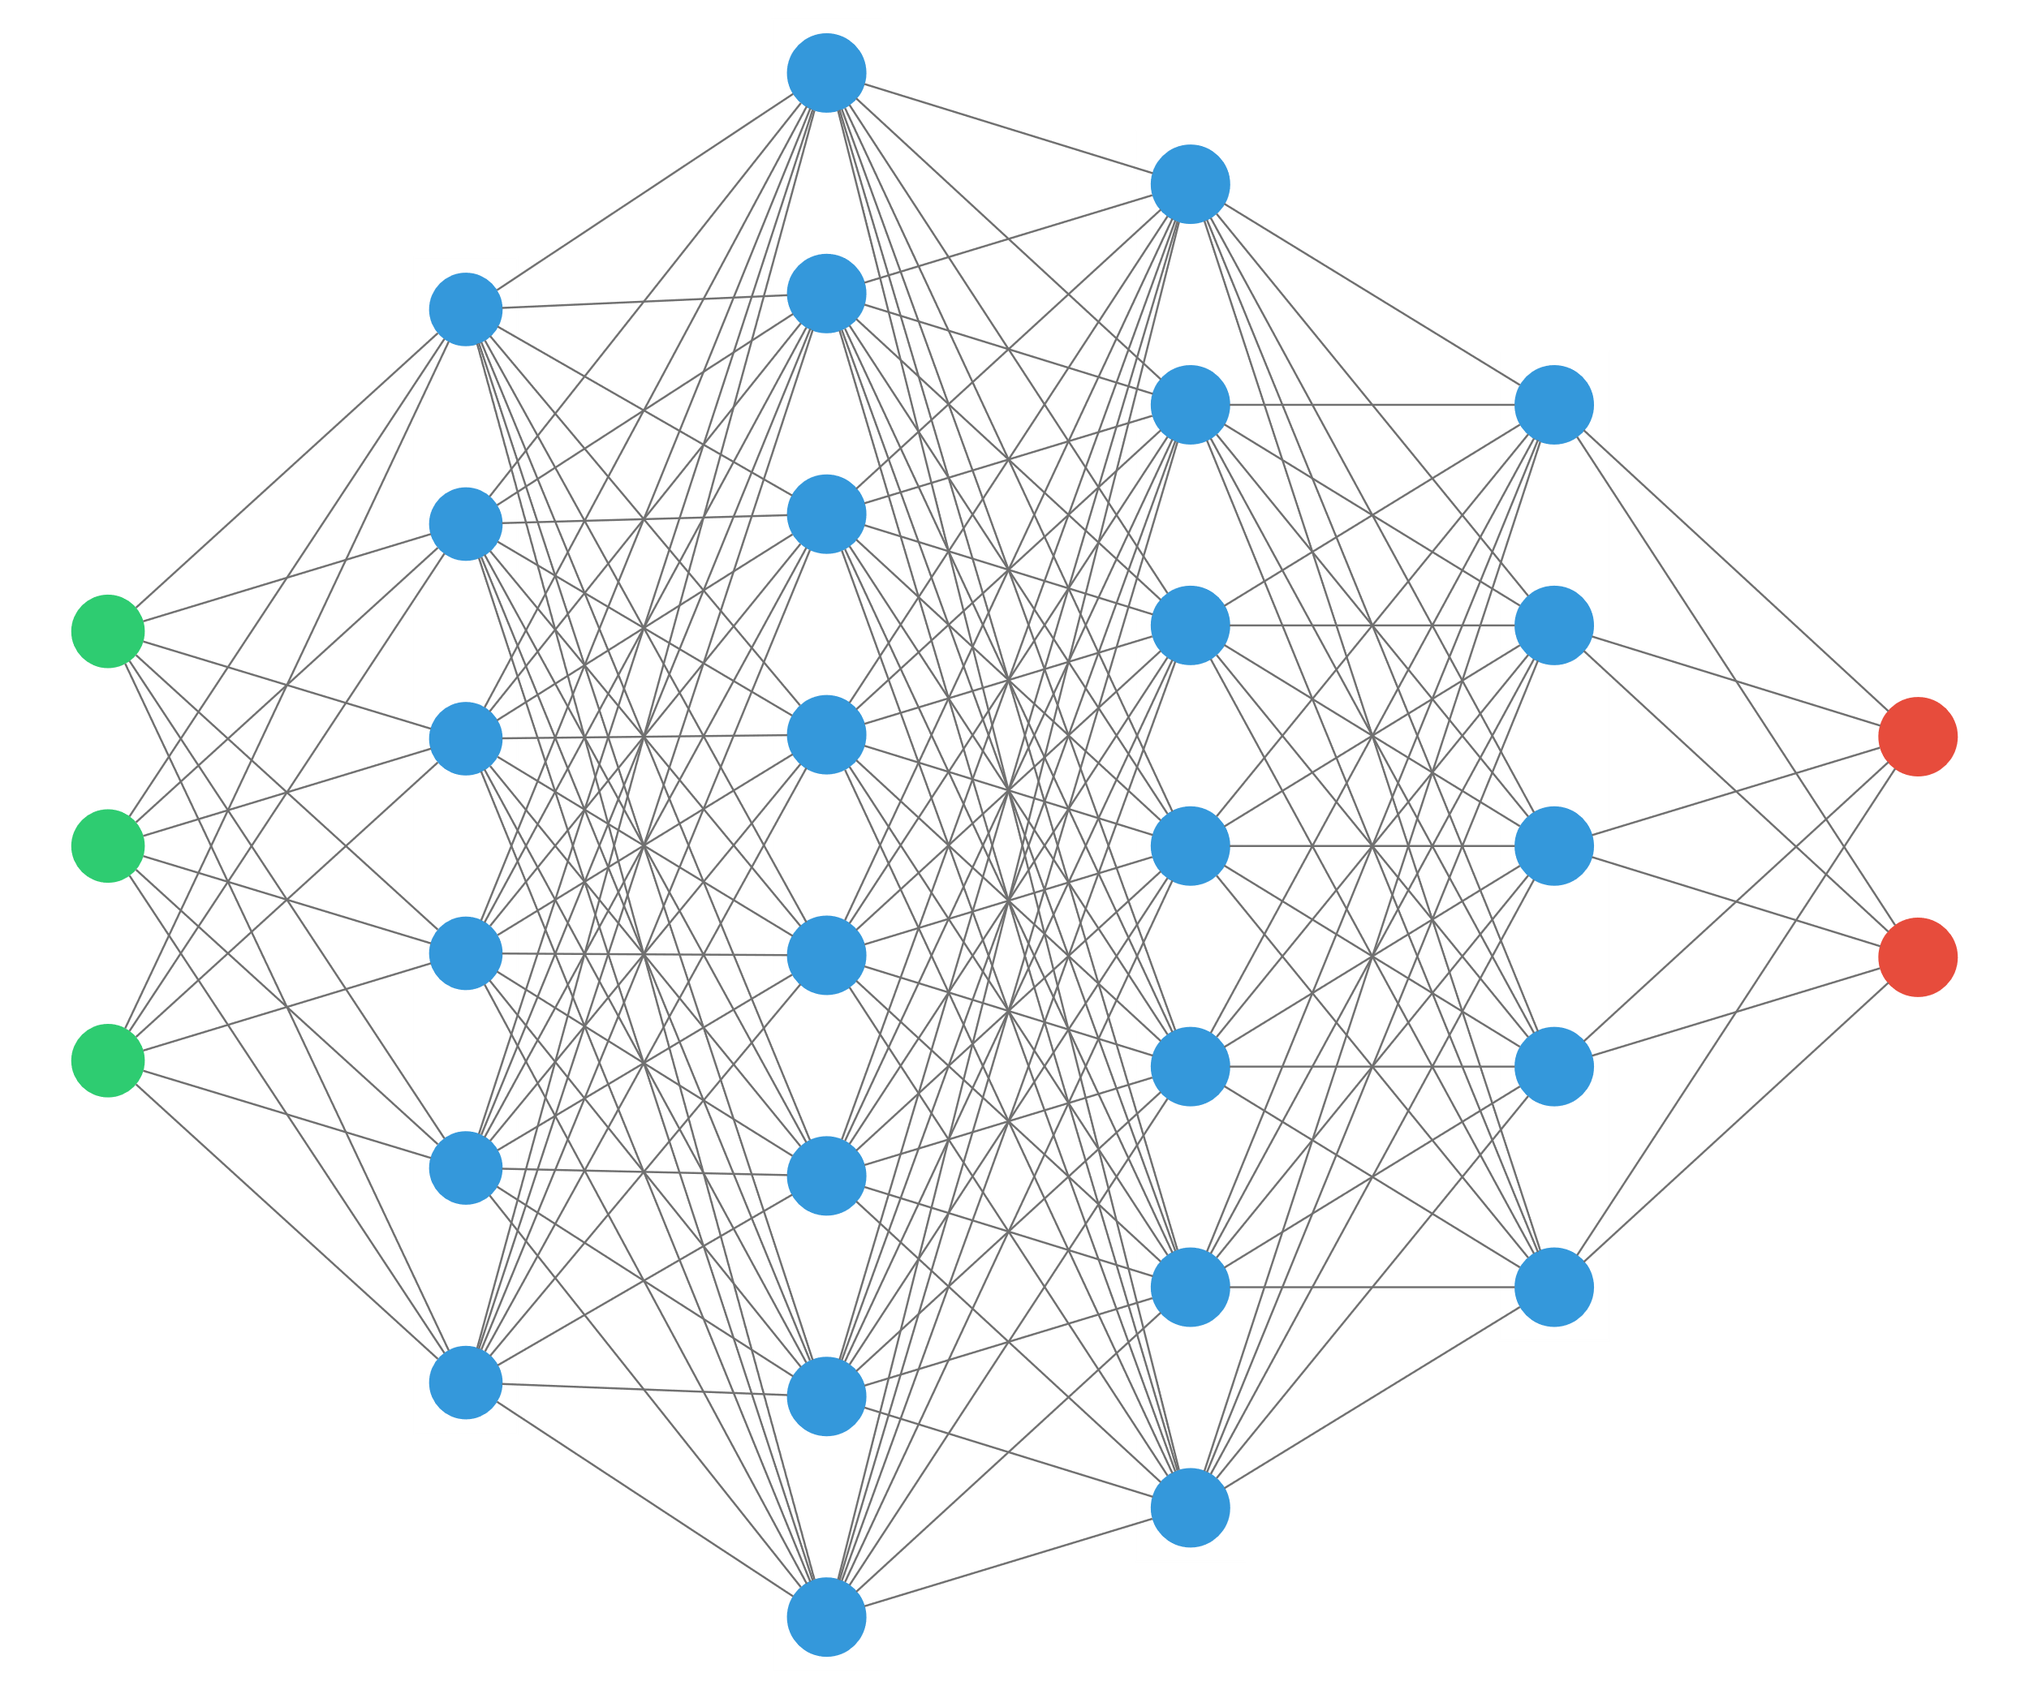
Preceptrons

Slide 3
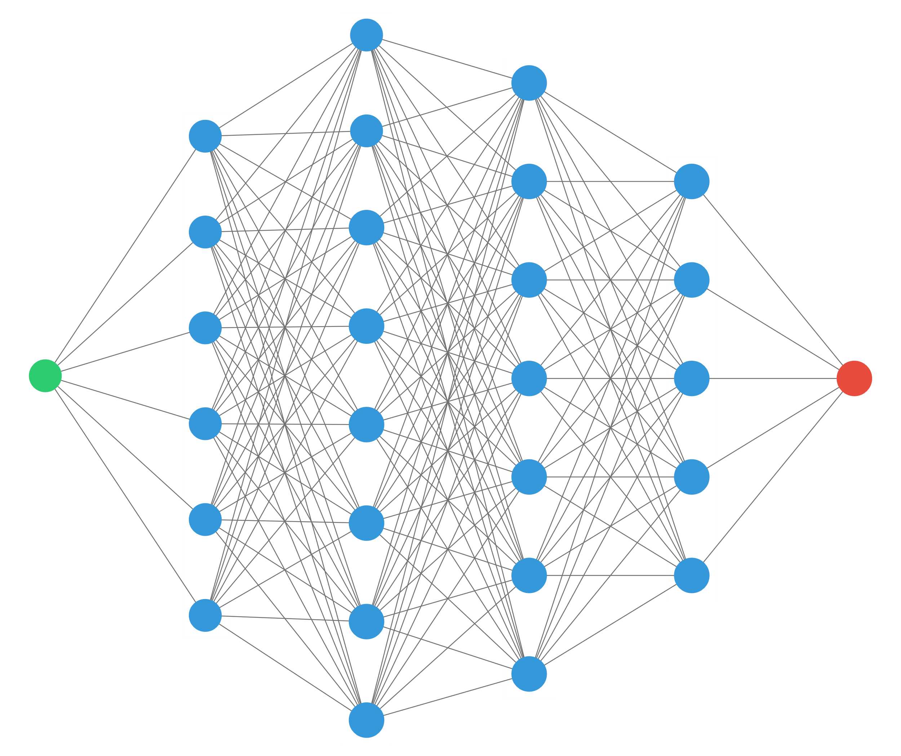


1D perceptron
$$x$$
$$y$$
“any continuous function can be approximated by a 2 layers perceptron” (with ReLU activation)

Slide 4
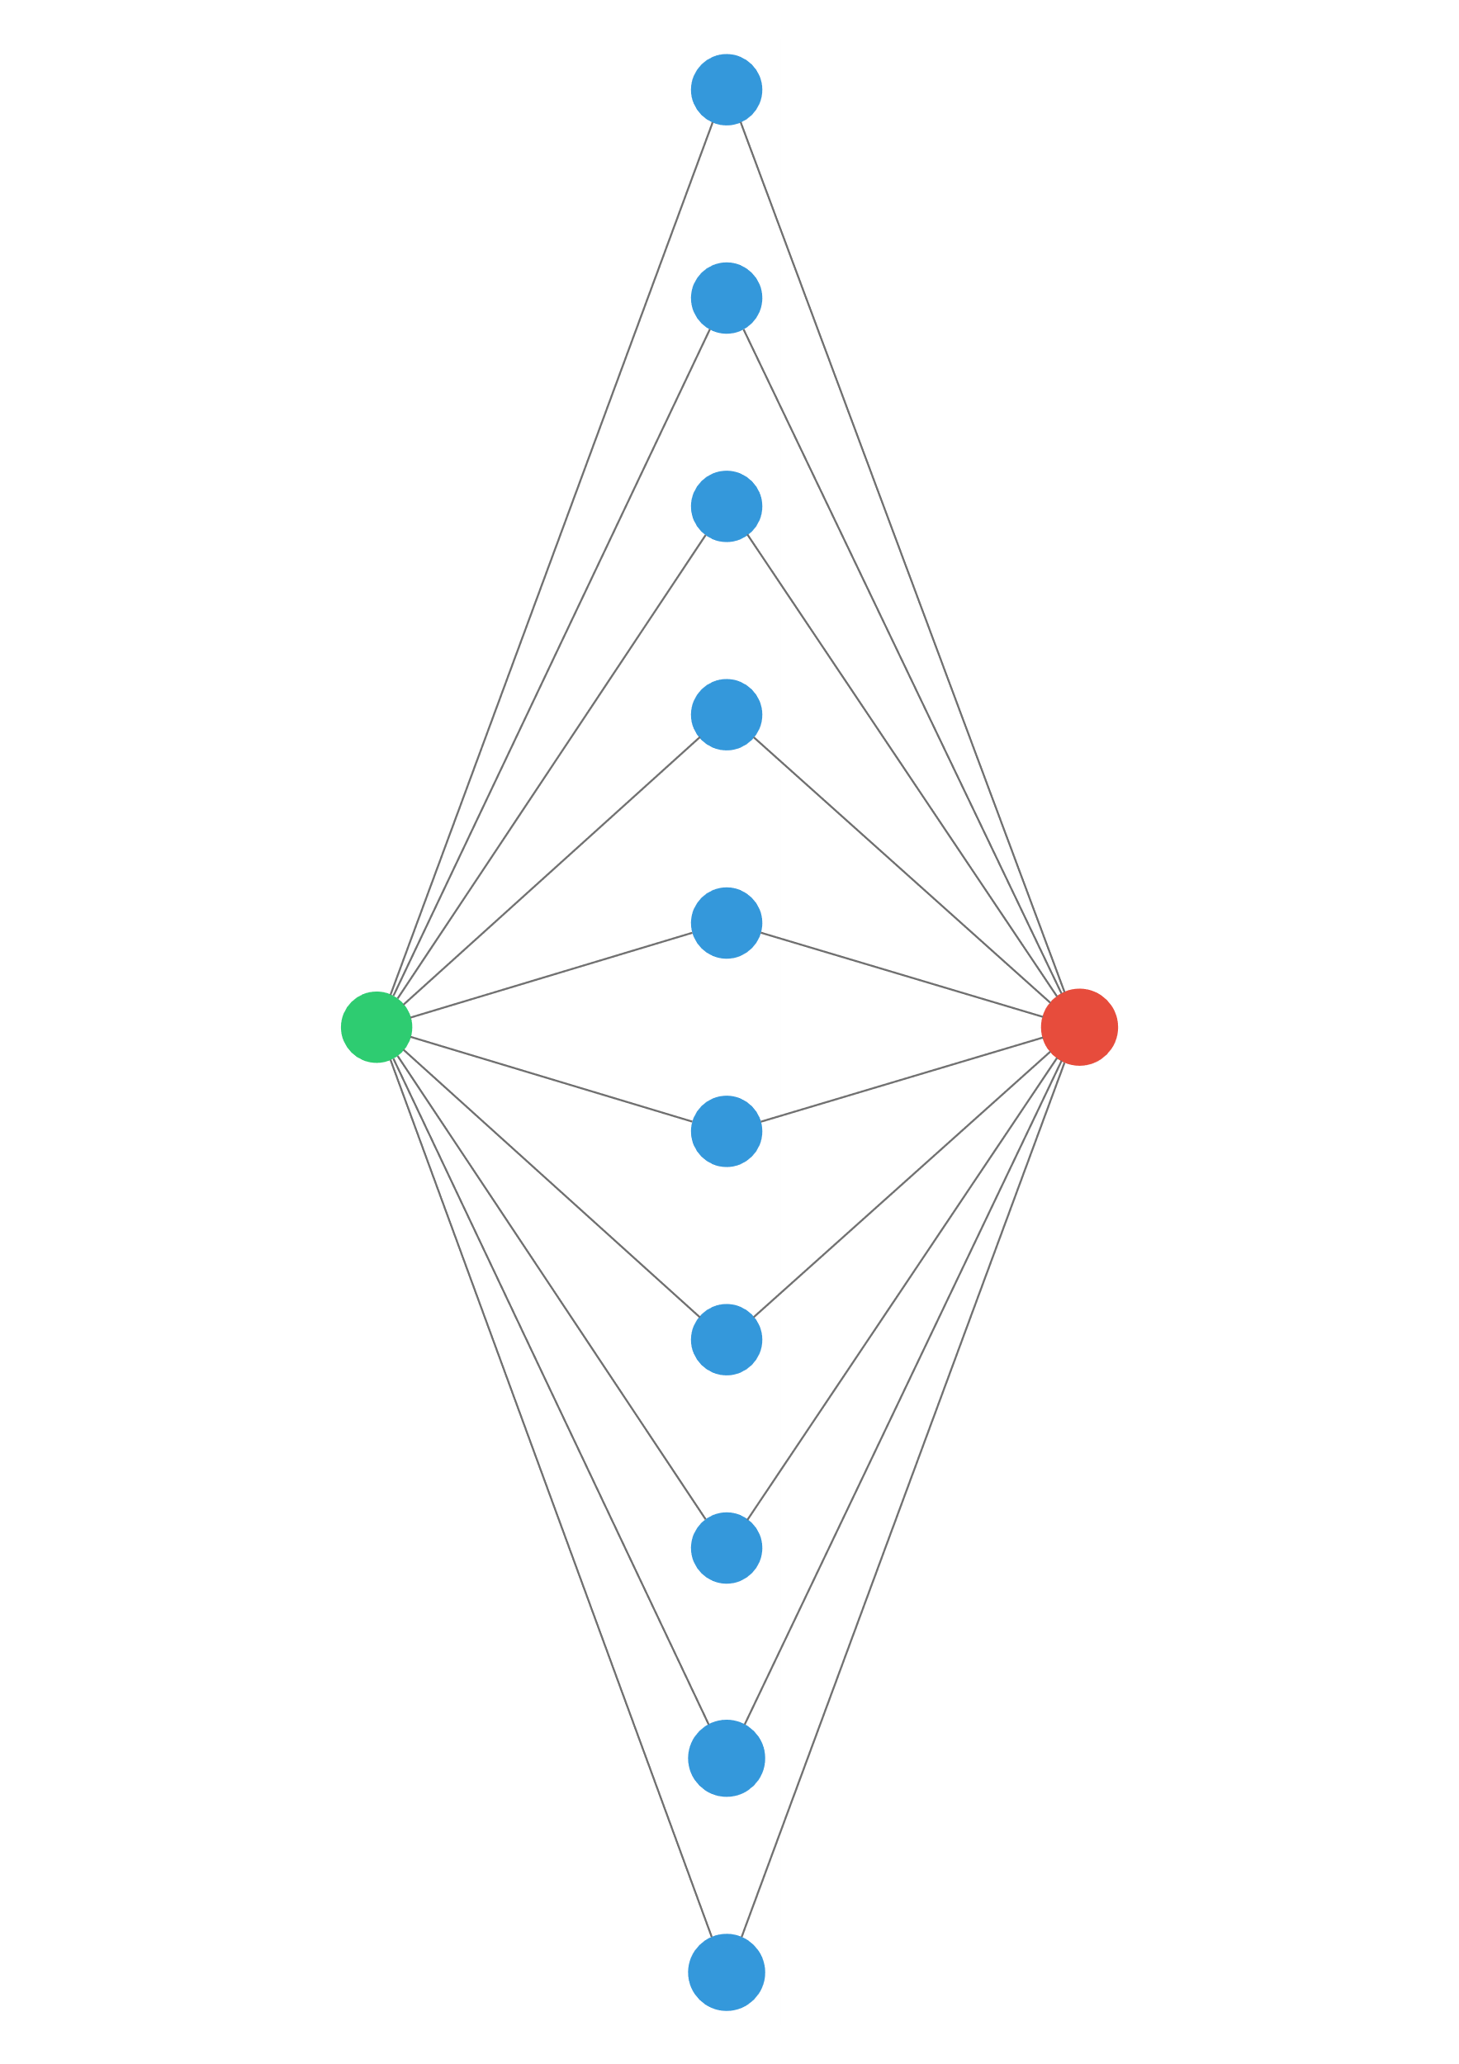
1D perceptron
$$x$$
$$y$$
“any continuous function can be approximated by a 2 layers perceptron” (with ReLU activation)
… provided there are enough neurons in the middle layer!

Slide 5
Convolutional layer

Slide 6
Pooling layer

Slide 7
SoftMax Layer

