Slide 1
PyTorch
Lecture 1/10

Slide 2

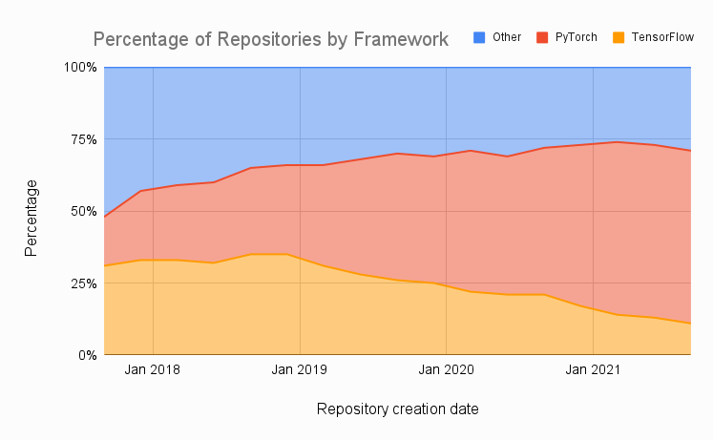
PyTorch in a few words…
Developed by Facebook’s AI research group
Getting very popular
Easy to use
Good performance in production
Flexible across a wide range of tasks
Provides tools for parallelizing & distributing computations

Slide 3
Key Concepts of PyTorch
Tensor: Multi-dimensional array of numbers
Autograd: A library for automatically computing gradients
Neural network module: Base class for all neural network classes
Optimizer: An algorithm that is used to adjust the parameters of a neural network in order to minimize a loss function
Dataset/Dataloader: A base class for our data

Slide 4


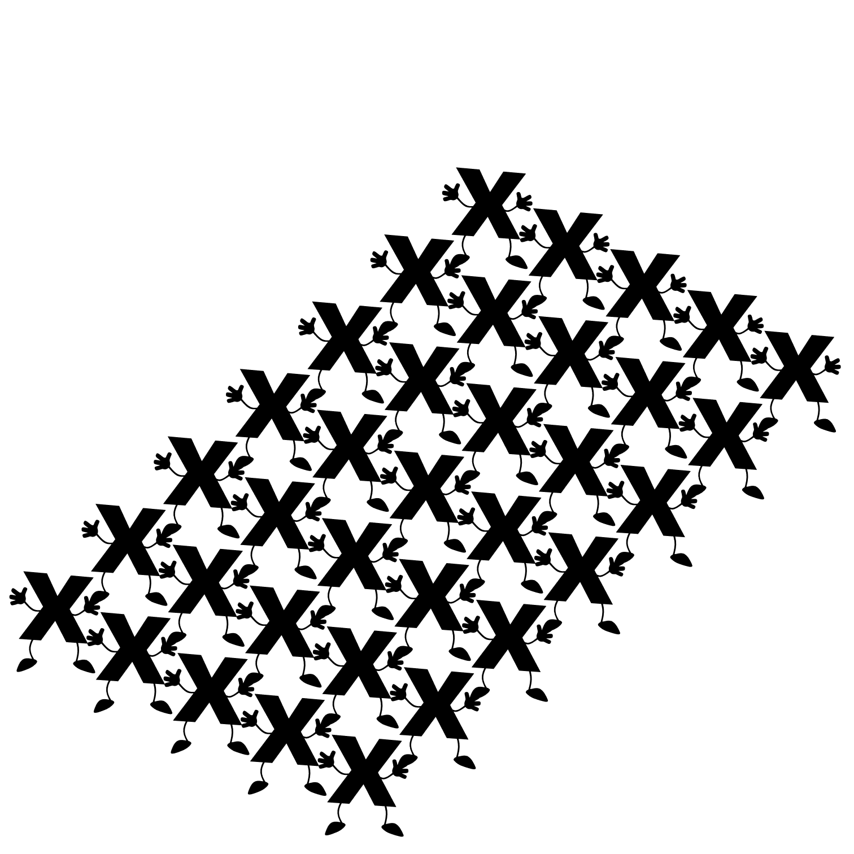
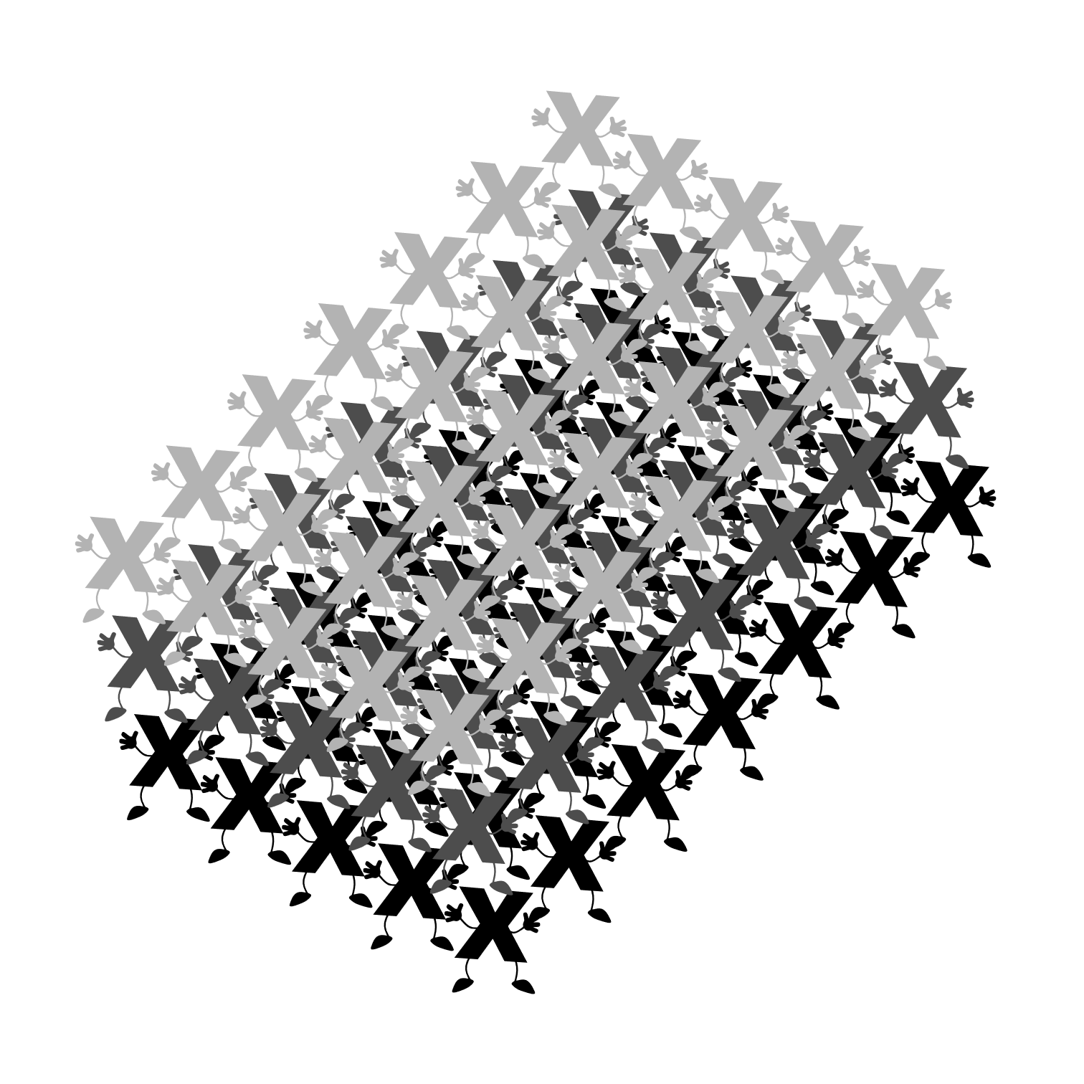
Tensor
Scalar
Vector
Matrix
Tensor

Slide 5
Autograd
Symbolic derivative of a function is precise; however, as the function of interest become more complex, the symbolic derivative becomes increasingly difficult to determine.
Finite difference approach uses the definition of a derivative to estimate the derivative of a function; however, it suffers from low accuracy and instability.
Automatic differentiation is using the chain rule to break the computation of the derivative. It achieves machine precision accuracy.

Slide 6

Symbolic derivative
$$z\left(x\right)= \frac{x^{2}}{5}+\cos{x}$$
$$z^{′}\left(x\right)=−\sin{x}+\frac{2}{5}x$$

Slide 7

Finite differences
$$z\left(x\right)= \frac{x^{2}}{5}+\cos{x}$$
$$z^{′}\left(x\right)=\frac{z\left(x+ε\right)−z(x−ε)}{2 ε}$$

Slide 8
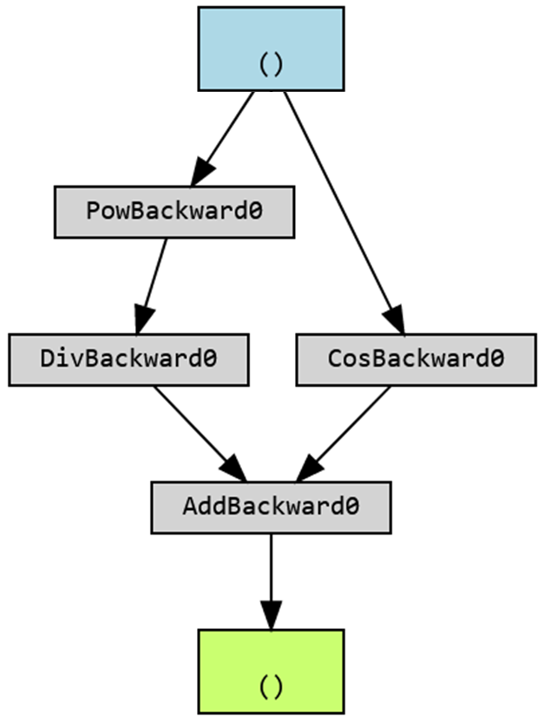
Autograd (automatic differentiation)
x = torch.tensor(1.0, requires_grad=True)
z = ((x**2)/5) + torch.cos(x)

Slide 9

Symbolic derivative
$$z\left(x,y\right)= \frac{x}{y}+(\cos{x}∗\sin{x})$$
$$\frac{∂z}{∂x}(x,y)= \frac{−y∗\sin{x}∗\sin{y}+1}{y}$$
$$\frac{∂z}{∂y}(x,y)= \frac{y^{2}∗\cos{x}∗\cos{y}−x}{y²}$$

Slide 10

Finite differences
$$z\left(x,y\right)= \frac{x}{y}+(\cos{x}∗\sin{x})$$
$$\frac{∂z}{∂x}(x,y)= \frac{z\left(x+ε,y\right)−z(x−ε,y)}{2ε}$$
$$\frac{∂z}{∂x}(x,y)= \frac{z\left(x,y+ε\right)−z(x,y−ε)}{2ε}$$

Slide 11
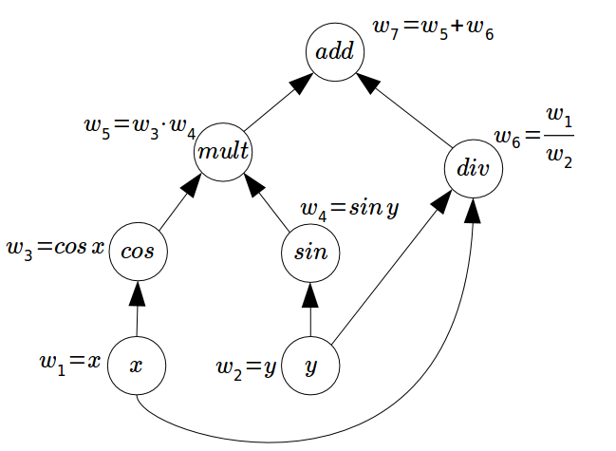
Autograd
x = torch.tensor(1.0, requires_grad=True)
y = torch.tensor(5.0, requires_grad=True)
z = (x/y) + torch.cos(x)*torch.sin(y)
(Internally)

Slide 12
Neural network module class
class ManualLinearRegression(nn.Module):
def __init__(self):
super().__init__()
# initialize here your neural network
# (define its layers, etc…)
[…]
def forward(self, x):
# computes the outputs / predictions
[…]
return …

Slide 13
Neural network module class: an example
class Net(nn.Module):
def __init__(self):
super(Net, self).__init__()
self.fc1 = nn.Linear(1, 10)
self.fc2 = nn.Linear(10, 1)
def forward(self, x):
x = self.fc1(x)
x = nn.ReLU()(x)
x = self.fc2(x)
return x

