Slide 1
A word on CPUs vs GPUs

Slide 2
CPU -> Central Processing Unit. Can’t do much in parallel but is extremely fast.
GPU -> Graphics Processing Unit (for images, videos, animations, …). Good for ML / DL because can perform many calculations in parallel but not as fast as CPUs.
TPU -> Tensor Processing Unit (specifically designed for ML / DL)

Slide 3
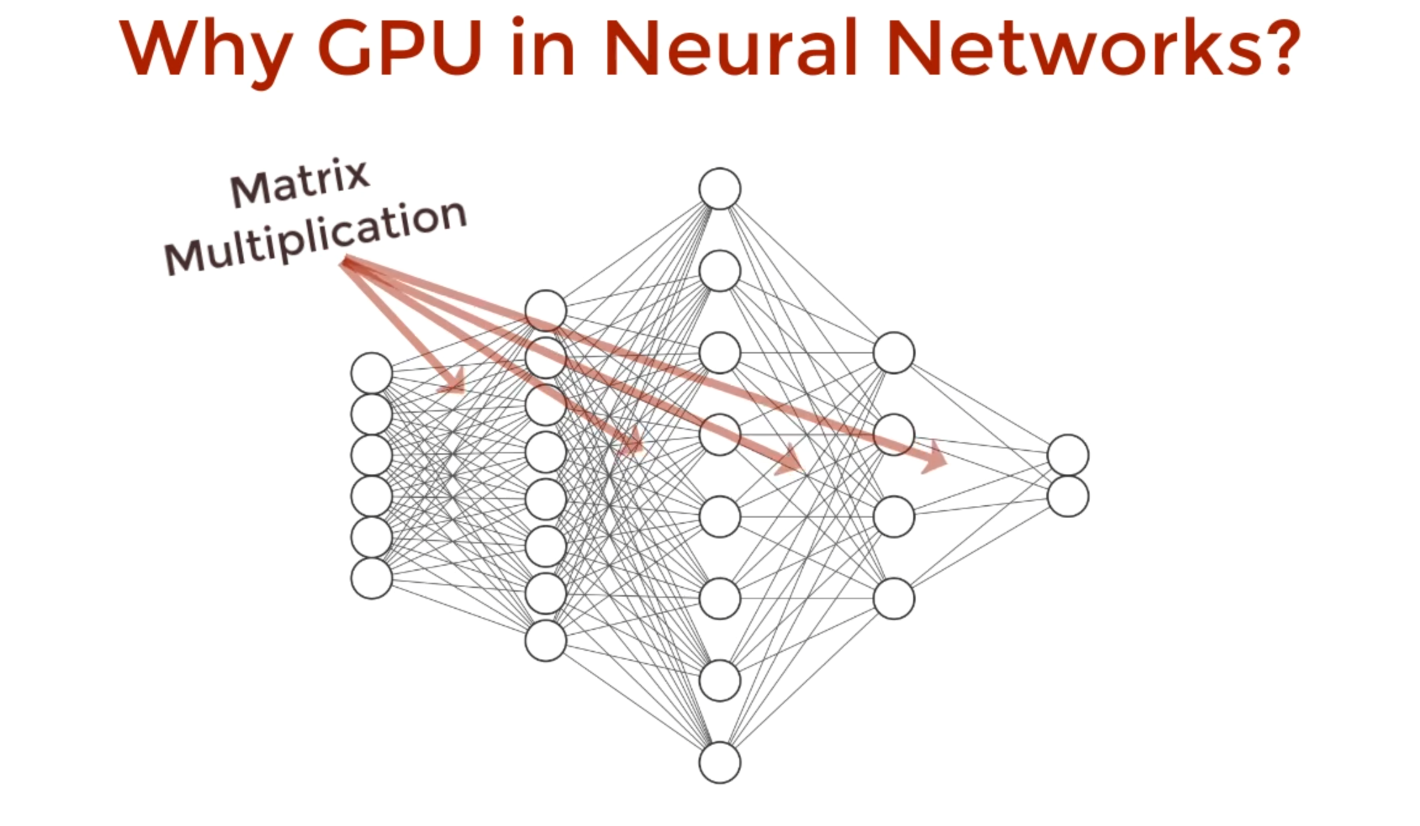
Parallelizable

Slide 4
Let’s see, in practice, what happens

Slide 5
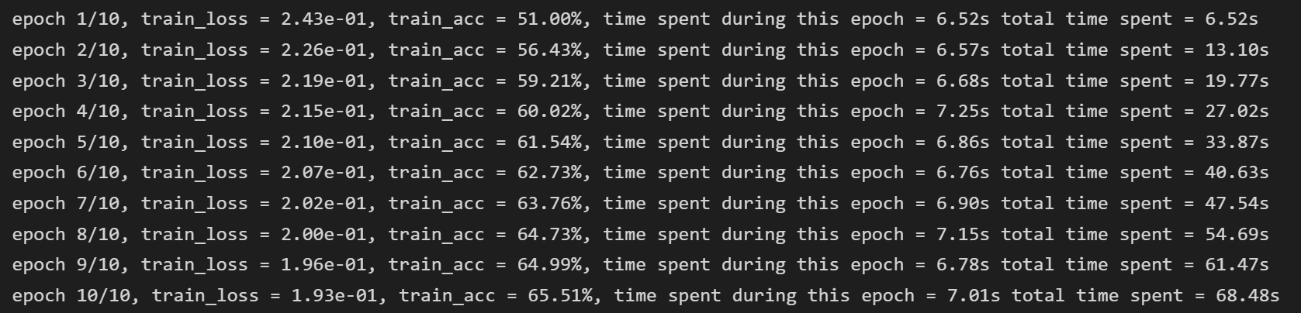
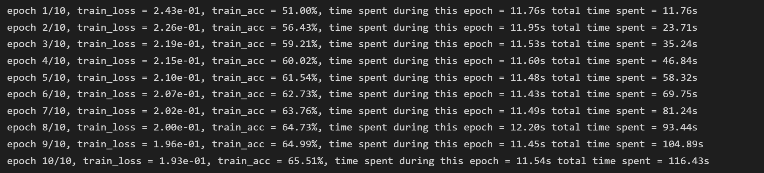
GPU
CPU
Notes:
Results are the same. I set up a seed. So, it goes faster, and it doesn’t change the results!
This is last TD with BATCH_SIZE = 4 btw (the bigger the BATCH_SIZE the better because more parallelization is possible).

