Slide 1
Architecture (Advanced)
Lecture 7/10

Slide 2
Transposed Convolutional Layer
: Plain
Convolution
Transposed Convolution
Animations credits for this section: https://github.com/vdumoulin/conv_arithmetic/blob/master/README.md

Slide 3
Transposed Convolutional Layer: Padding
Convolution
Transposed Convolution

Slide 4
Transposed Convolutional Layer: Strides
Convolution
Transposed Convolution

Slide 5
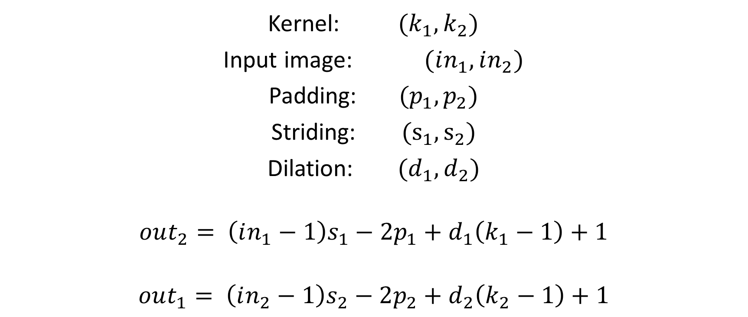
Transposed Convolution Output Size
Kernel: ${(k}_{1}, k_{2})$
Input image: $(in_{1},in_{2})$
Padding: $(p_{1},p_{2})$
Striding: $(s_{1},s_{2})$
Dilation: $(d_{1},d_{2})$
$$out_{2}= \left(in_{1}−1\right)s_{1}−2p_{1}+d_{1}\left(k_{1}−1\right)+1$$
$$out_{1}= \left(in_{2}−1\right)s_{2}−2p_{2}+d_{2}\left(k_{2}−1\right)+1$$

