Slide 1
Data and Gradient Subtleties
Lecture 6/10

Slide 2
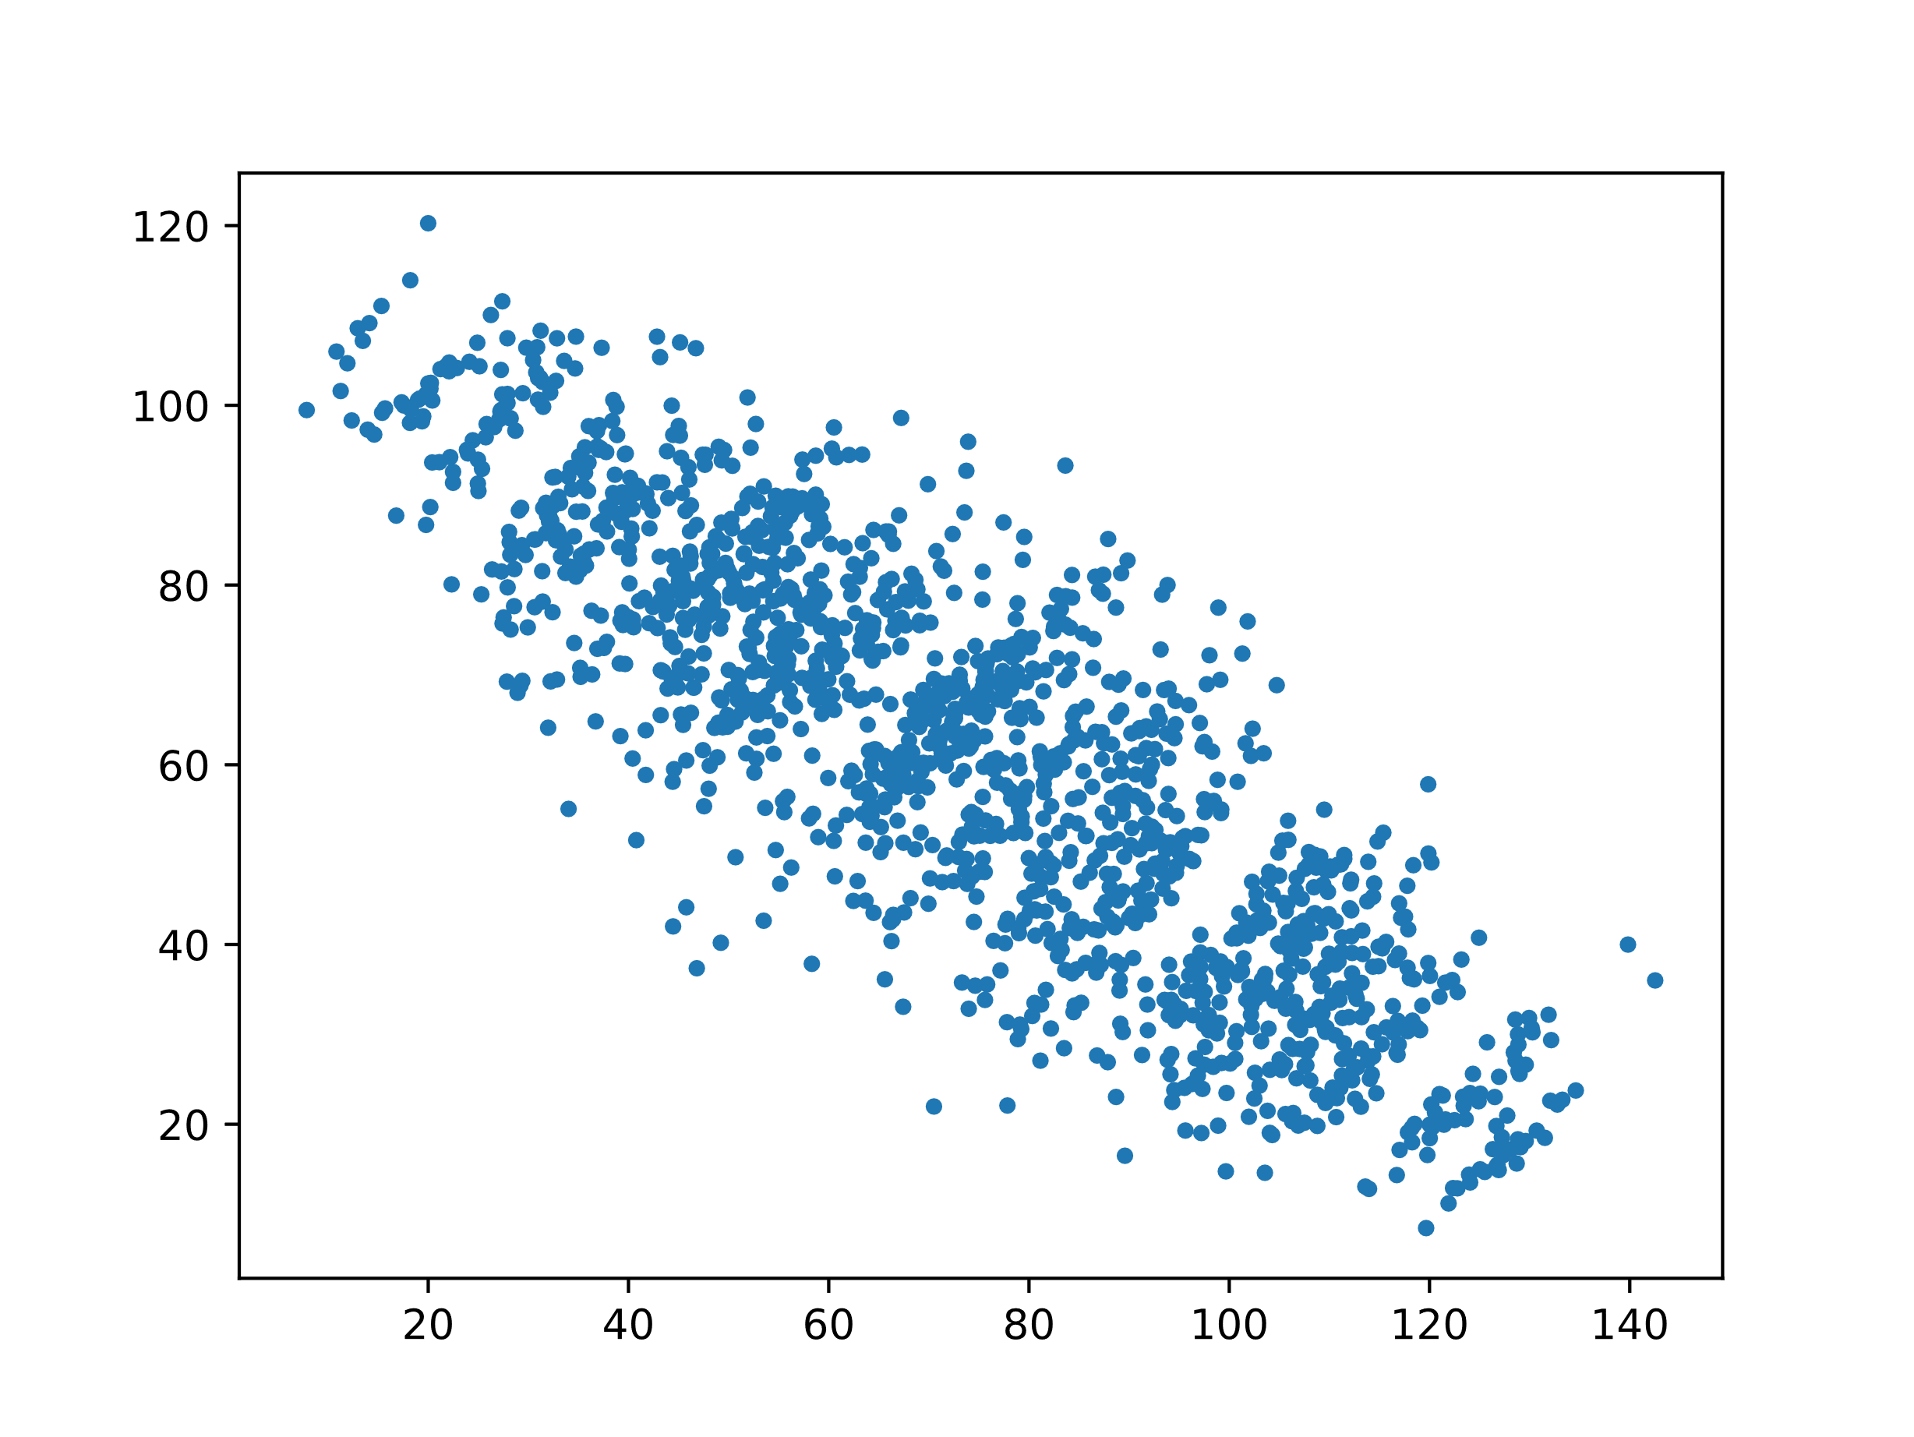
Simpson’s Paradox

Slide 3
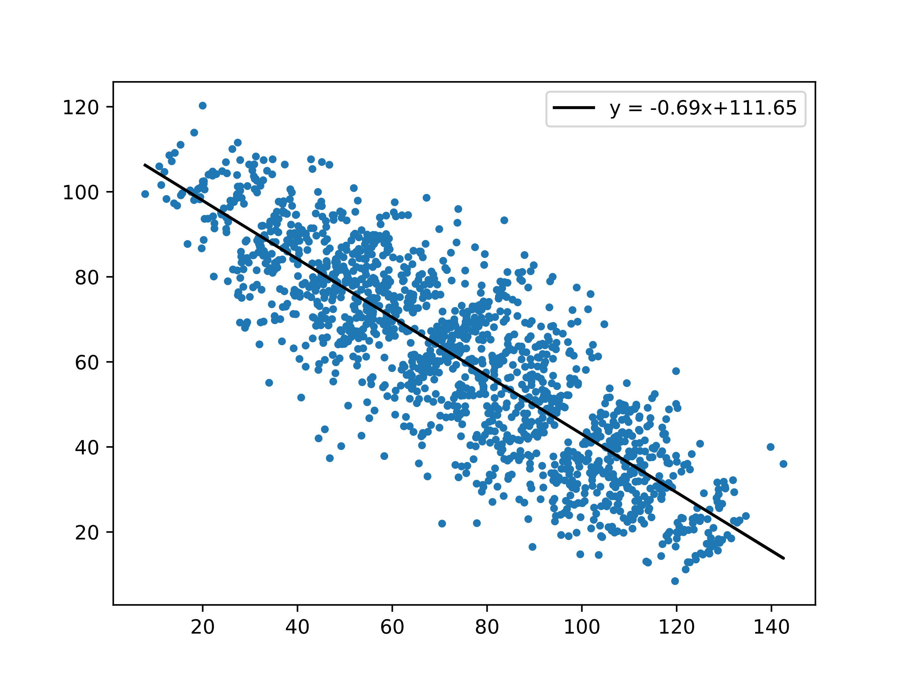
Simpson’s Paradox

Slide 4
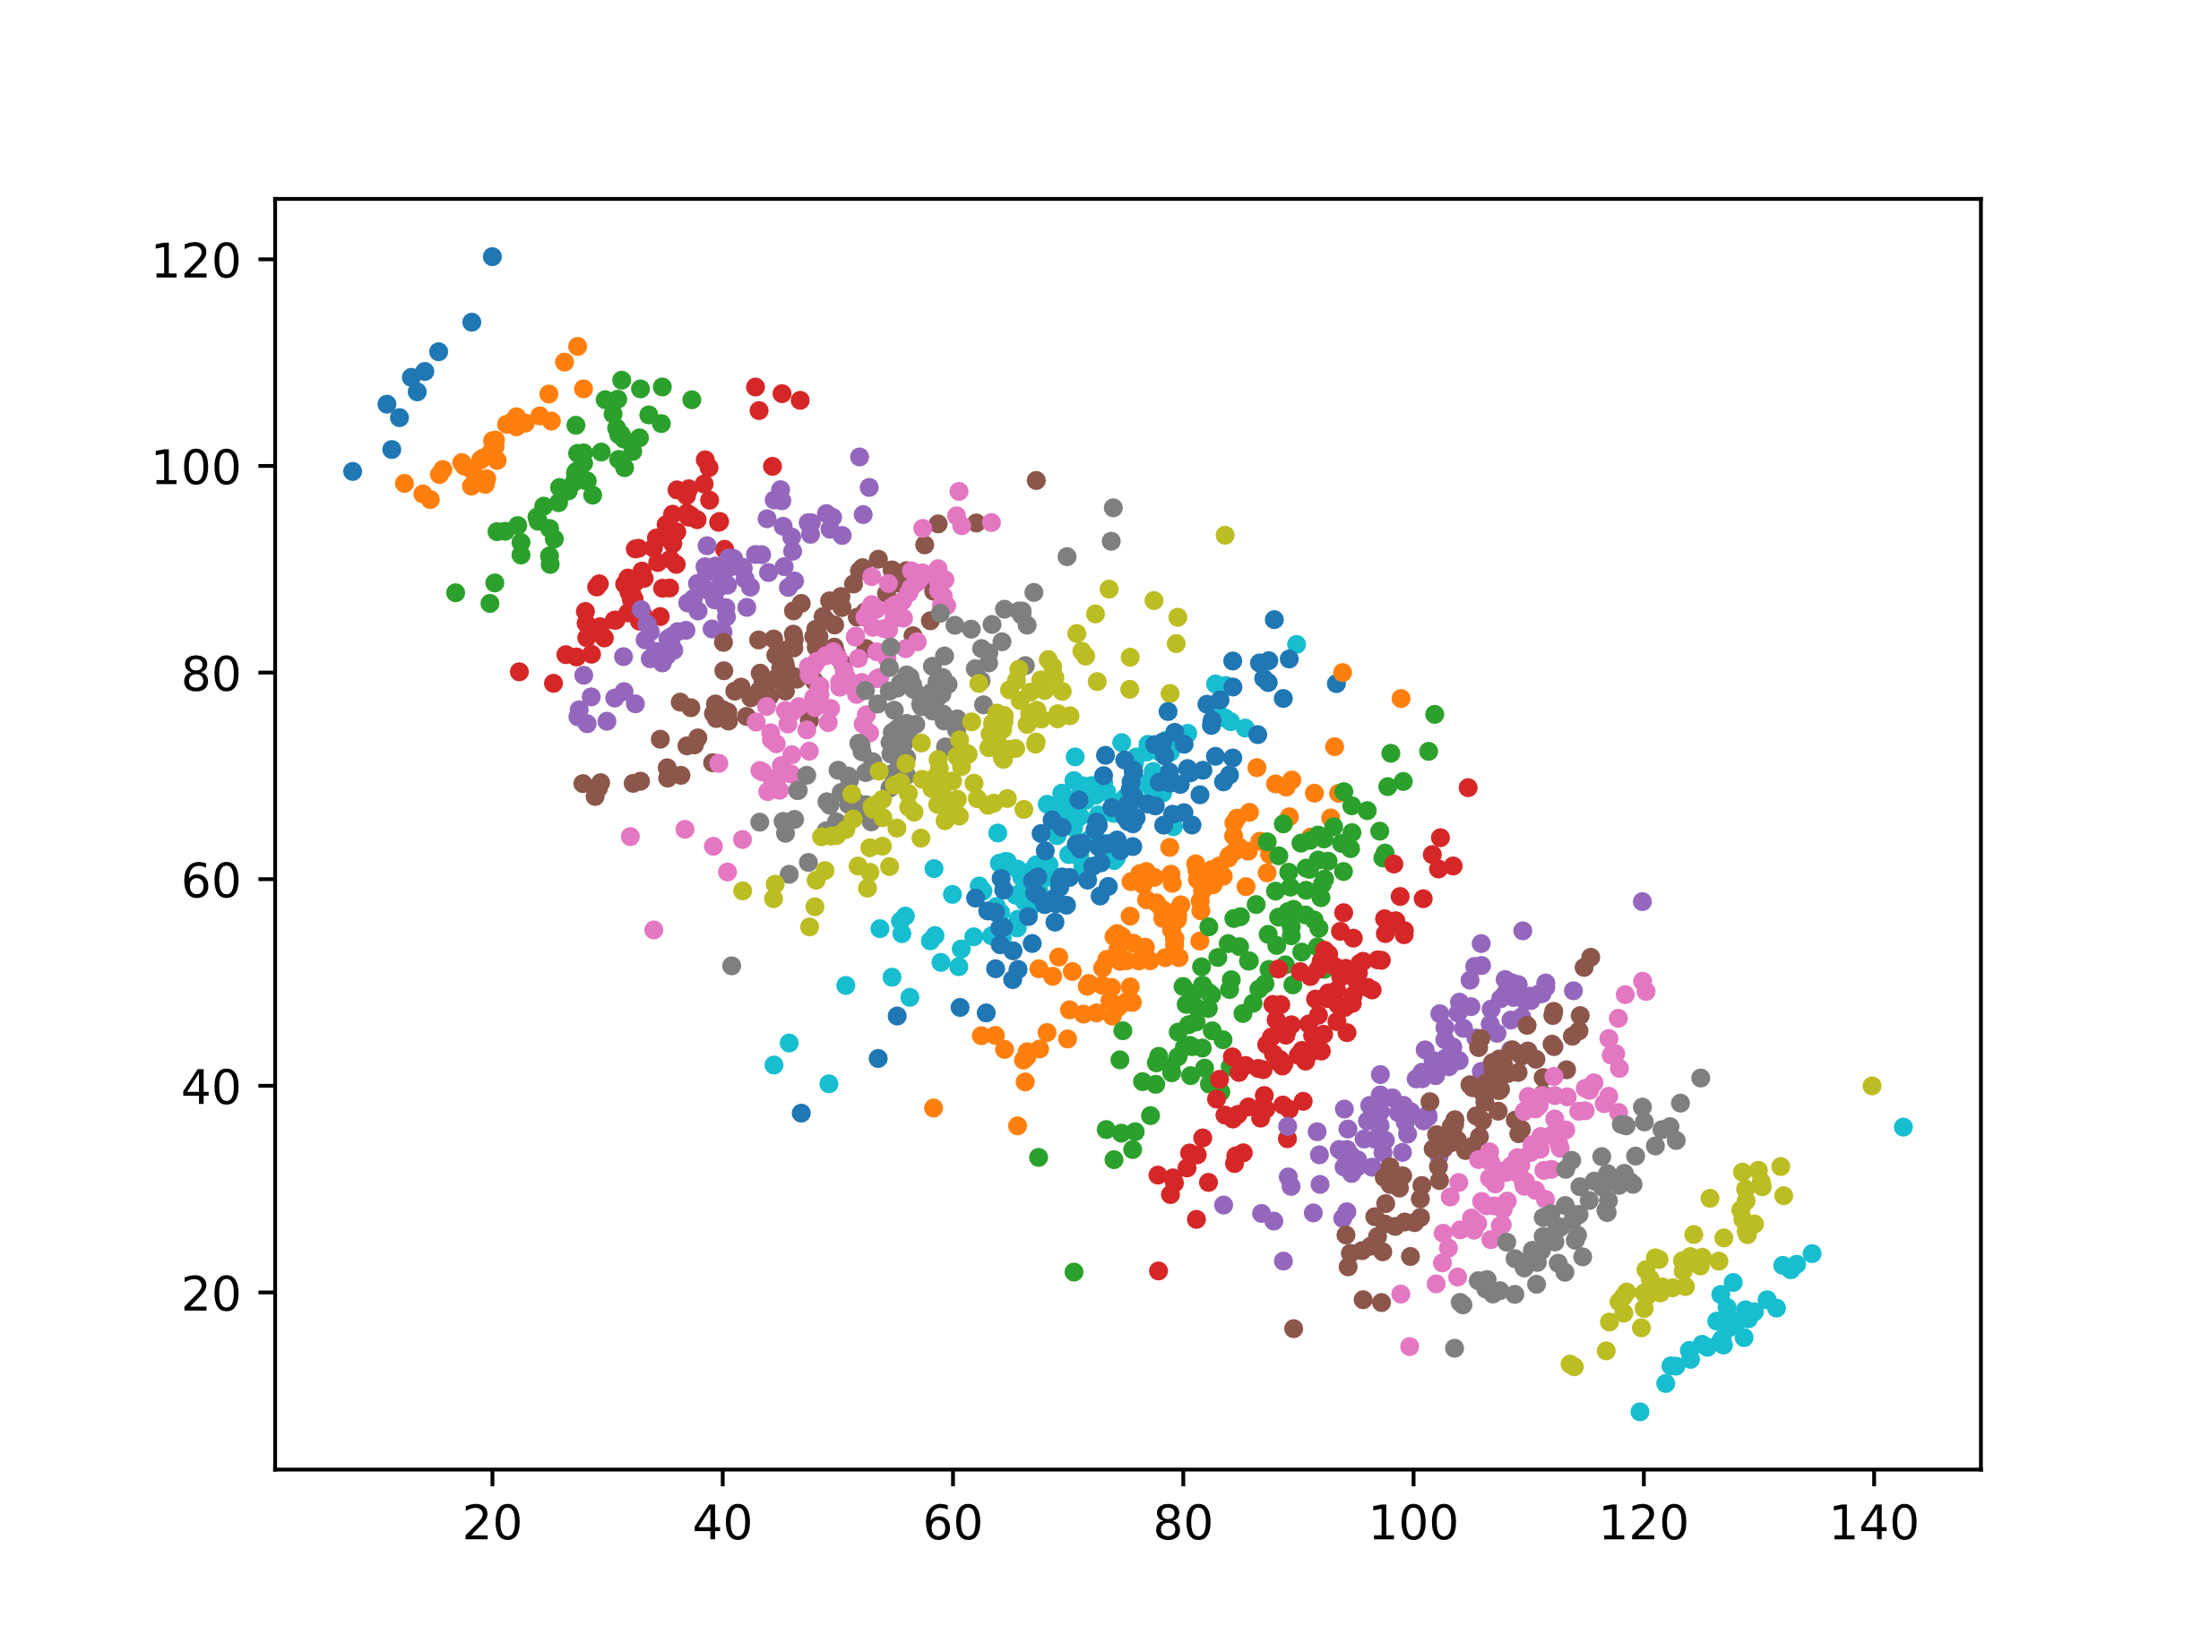
Simpson’s Paradox

Slide 5
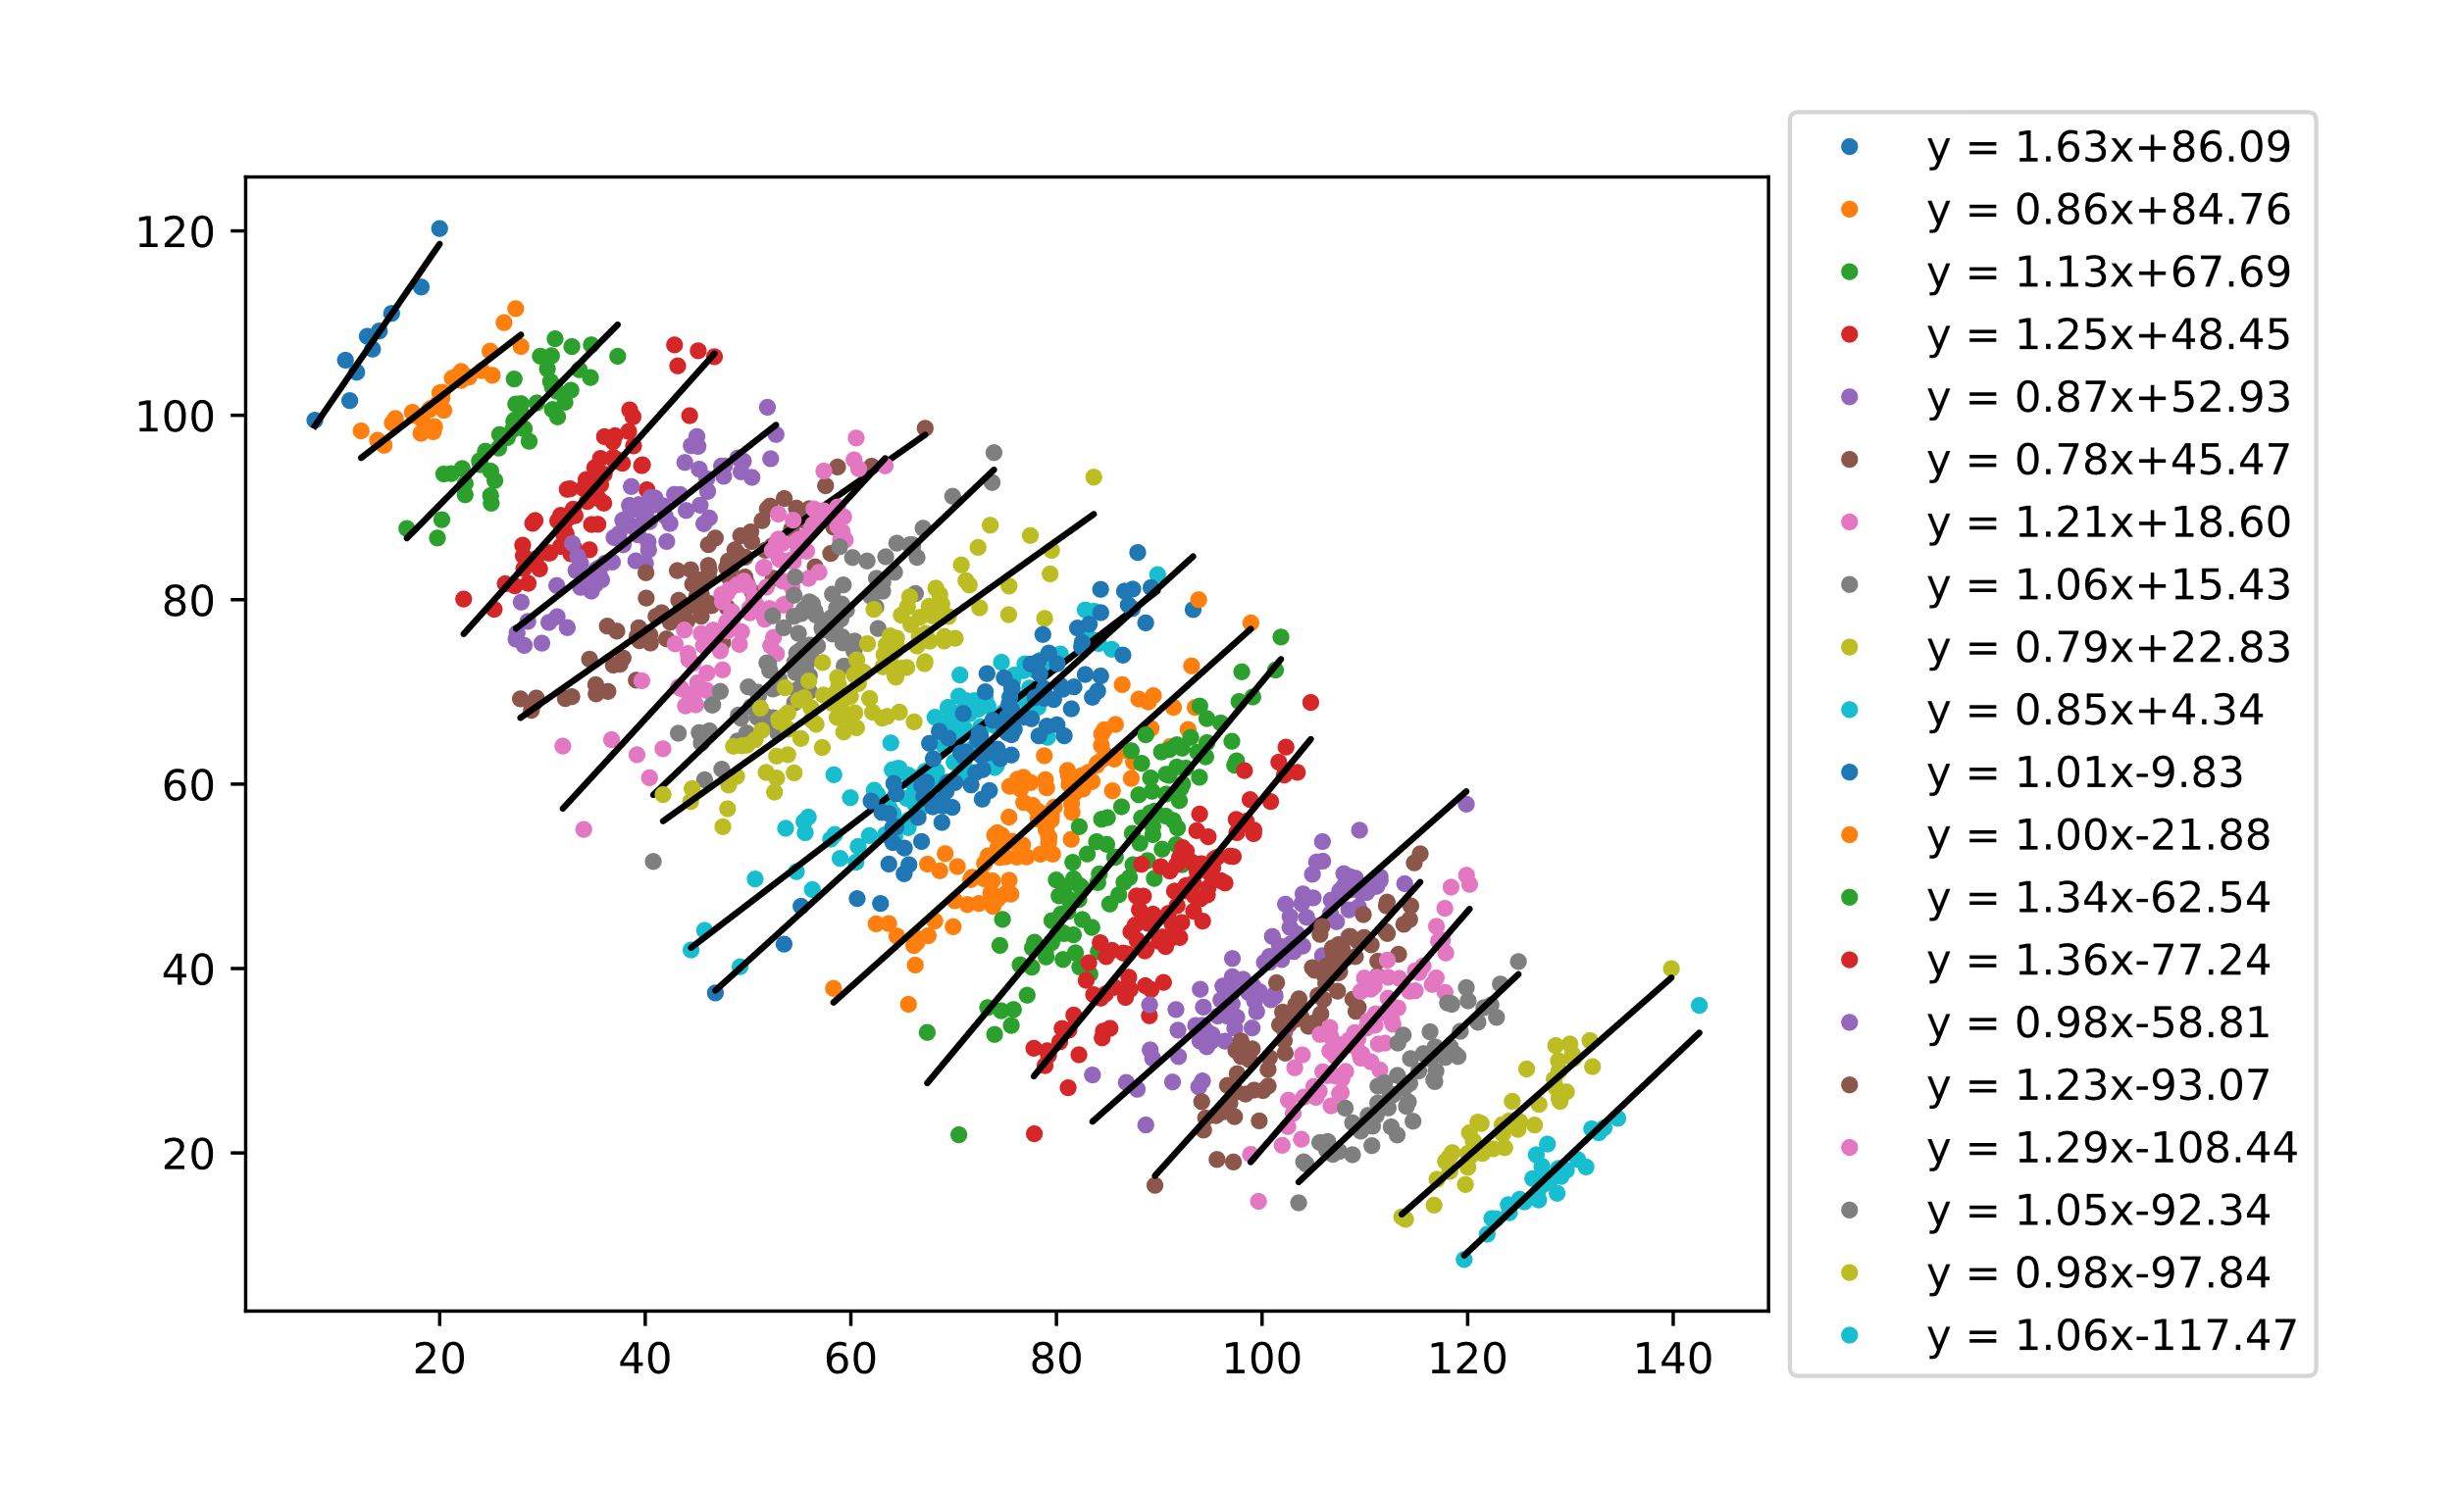

Simpson’s Paradox
$$y = 1.0868x - 14.643$$

