Slide 1
Architecture (Advanced)
Lecture 7/10

Slide 2
Transposed Convolutional Layer
: Plain
Convolution
Transposed Convolution
Animations credits for this section: https://github.com/vdumoulin/conv_arithmetic/blob/master/README.md

Slide 3
Transposed Convolutional Layer: Padding
Convolution
Transposed Convolution

Slide 4
Transposed Convolutional Layer: Strides
Convolution
Transposed Convolution

Slide 5
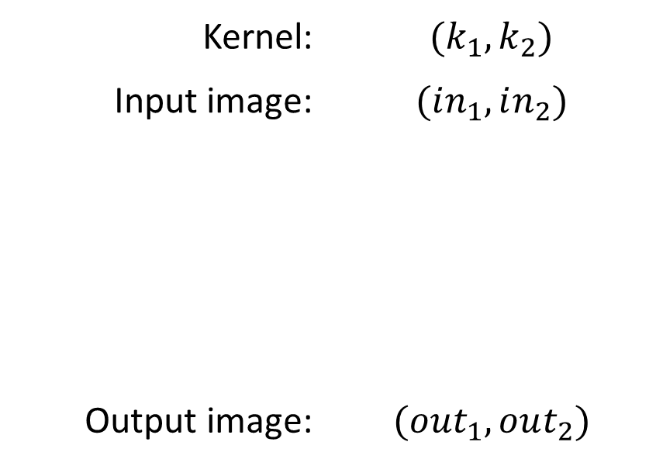
Transposed Convolution Output Size
Kernel: | $${(k}_{1}, k_{2})$$
Input image: | $$(in_{1},in_{2})$$
Output image: | $$(out_{1},out_{2})$$
$$out_{i}=in_{i}−1+k_{i}$$

Slide 6
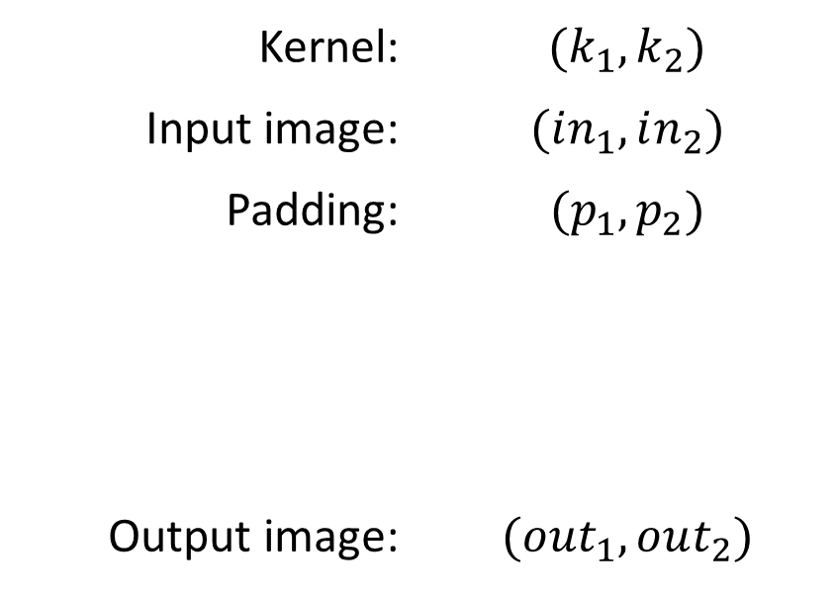
Transposed Convolution Output Size
Kernel: | $${(k}_{1}, k_{2})$$
Input image: | $$(in_{1},in_{2})$$
Padding: | $$(p_{1},p_{2})$$
Output image: | $$(out_{1},out_{2})$$
$$out_{i}=in_{i}−1−2p_{i}+k_{i}$$

Slide 7
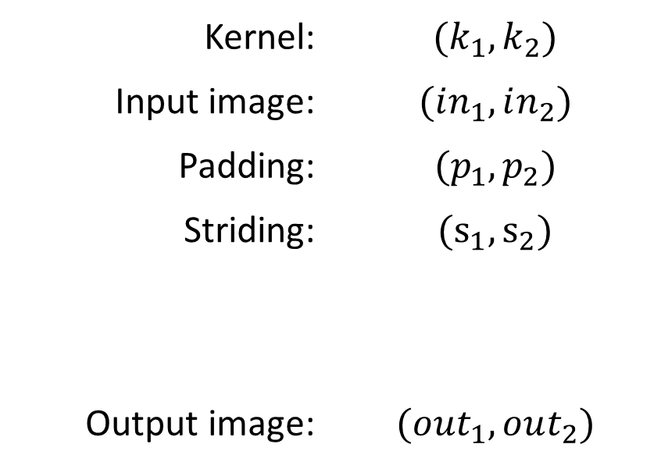
Transposed Convolution Output Size
Kernel: | $${(k}_{1}, k_{2})$$
Input image: | $$(in_{1},in_{2})$$
Padding: | $$(p_{1},p_{2})$$
Striding: | $$(s_{1},s_{2})$$
Output image: | $$(out_{1},out_{2})$$
$$out_{i}= \left(in_{i}−1\right)s_{i}−2p_{i}+k_{i}$$

Slide 8
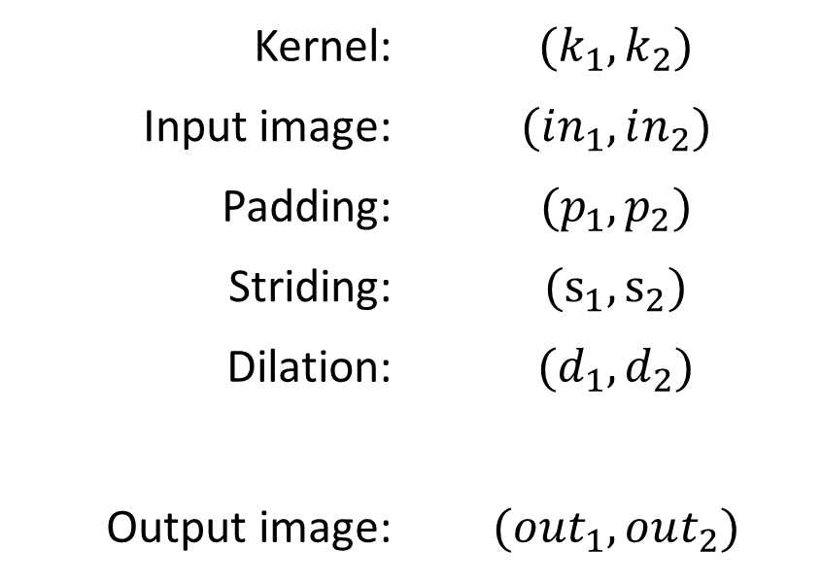
Transposed Convolution Output Size
Kernel: | $${(k}_{1}, k_{2})$$
Input image: | $$(in_{1},in_{2})$$
Padding: | $$(p_{1},p_{2})$$
Striding: | $$(s_{1},s_{2})$$
Dilation: | $$(d_{1},d_{2})$$
Output image: | $$(out_{1},out_{2})$$
$$out_{i}= \left(in_{i}−1\right)s_{i}−2p_{i}+d_{i}\left(k_{i}−1\right)+1$$

Slide 9
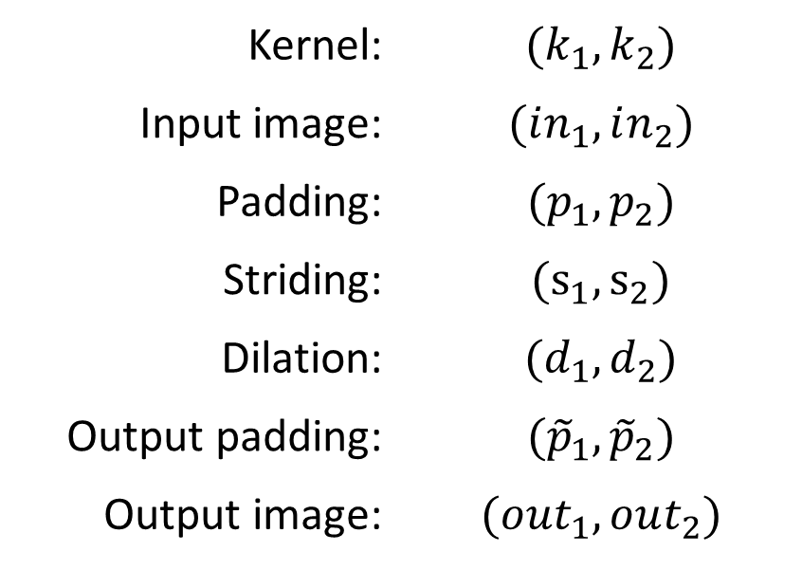
Transposed Convolution Output Size
Kernel: | $${(k}_{1}, k_{2})$$
Input image: | $$(in_{1},in_{2})$$
Padding: | $$(p_{1},p_{2})$$
Striding: | $$(s_{1},s_{2})$$
Dilation: | $$(d_{1},d_{2})$$
Output padding: | $$({\tilde{p}}_{1},{\tilde{p}}_{2})$$
Output image: | $$(out_{1},out_{2})$$
$$out_{i}= \left(in_{i}−1\right)s_{i}−2p_{i}+d_{i}\left(k_{i}−1\right)+1+{\tilde{p}}_{i}$$

Slide 10
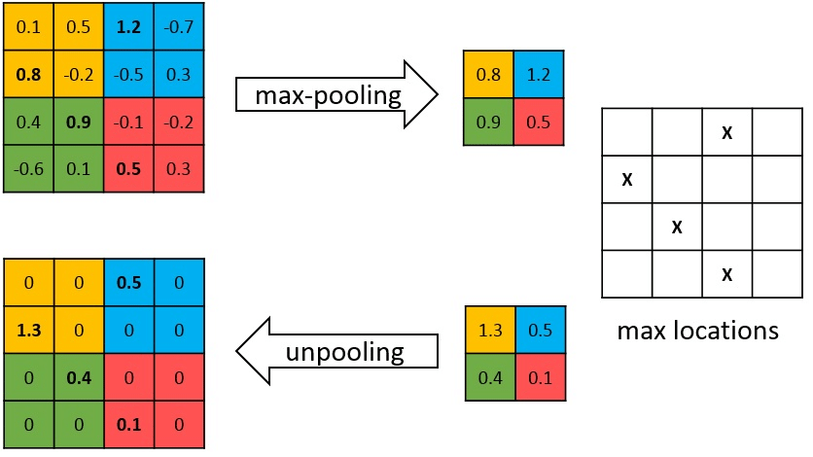
Max Unpool
Max Pool is not fully invertible, since the non-maximal values are lost.
Max Unpool takes in the indices of the maximal values and computes a partial inverse in which all non-maximal values are set to zero.

Slide 11
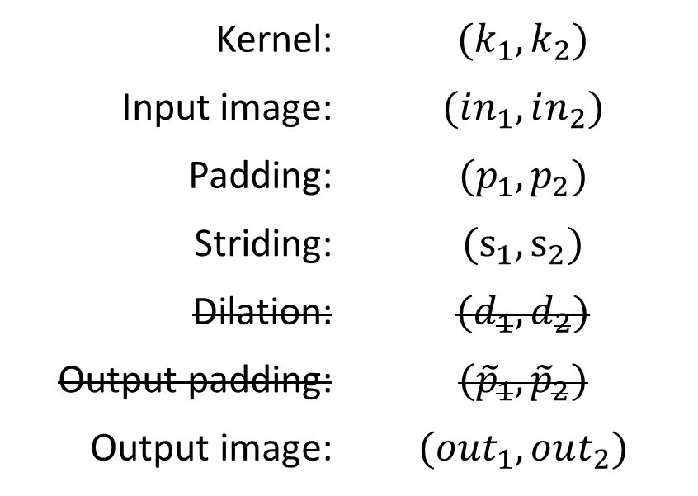
Max Unpool Output Size
Kernel: | $${(k}_{1}, k_{2})$$
Input image: | $$(in_{1},in_{2})$$
Padding: | $$(p_{1},p_{2})$$
Striding: | $$(s_{1},s_{2})$$
Dilation: | $$(d_{1},d_{2})$$
Output padding: | $$({\tilde{p}}_{1},{\tilde{p}}_{2})$$
Output image: | $$(out_{1},out_{2})$$
$$out_{i}= \left(in_{i}−1\right)s_{i}−2p_{i}+k_{i}$$

Slide 12
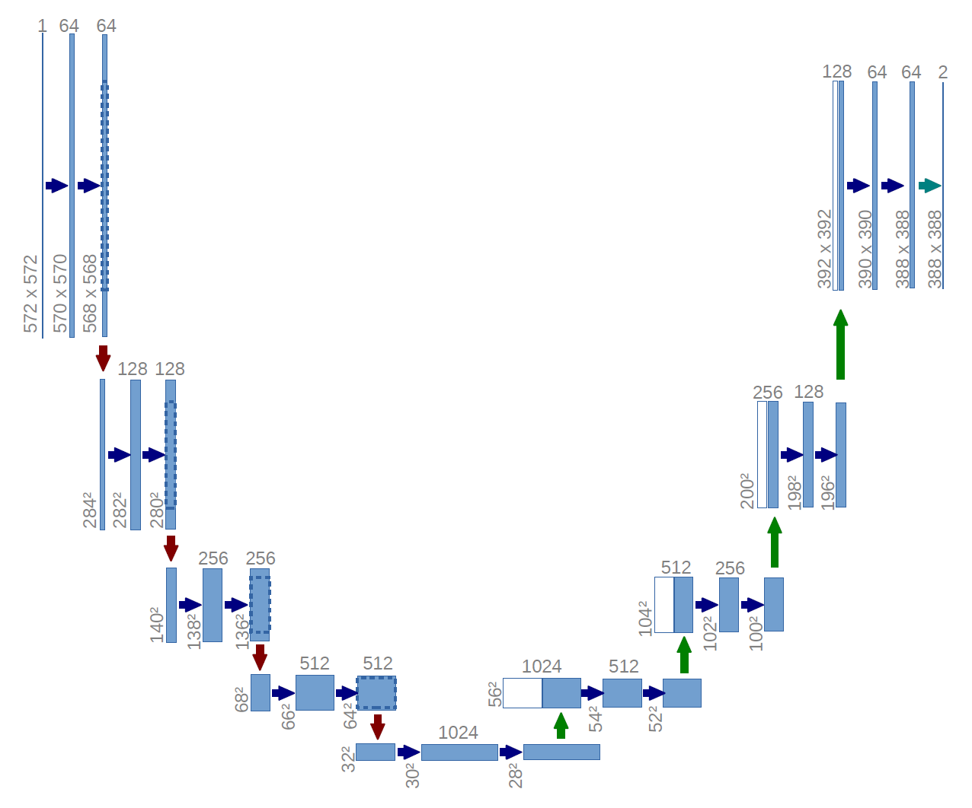

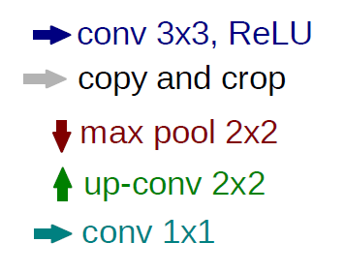
U Net
Notes:
U-Net est un réseau de neurones à convolution développé pour la segmentation d'images biomédicales.

Slide 13
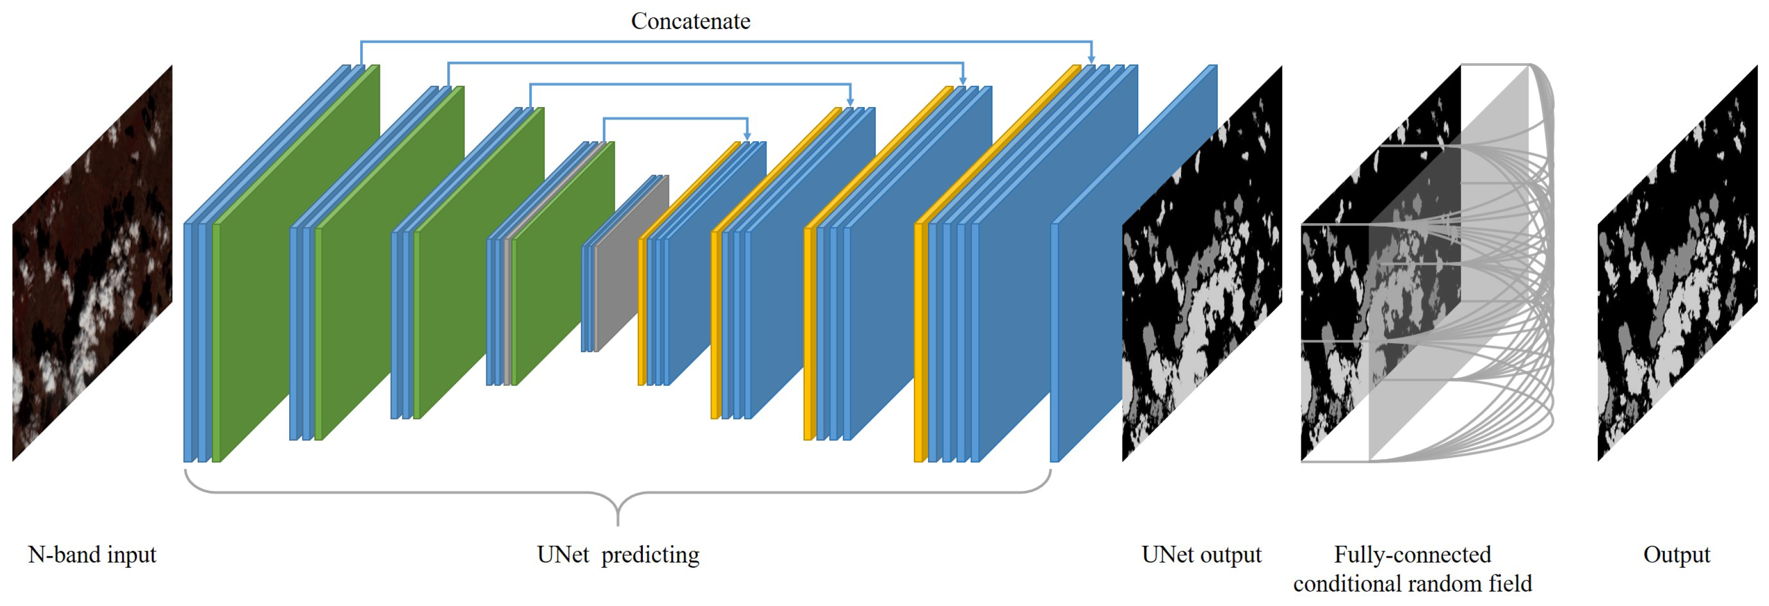
U Net architectures

Slide 14
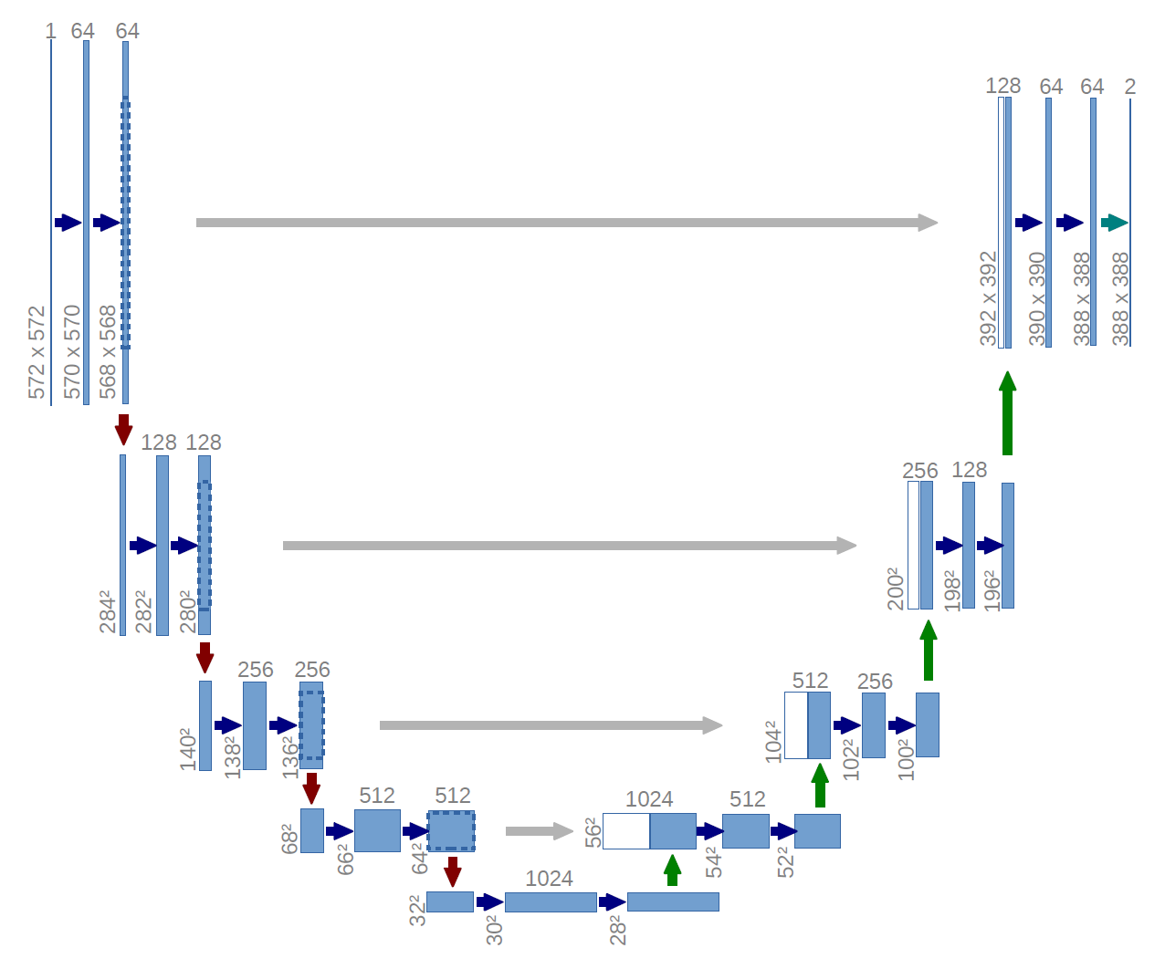
Skip Connections

Slide 15

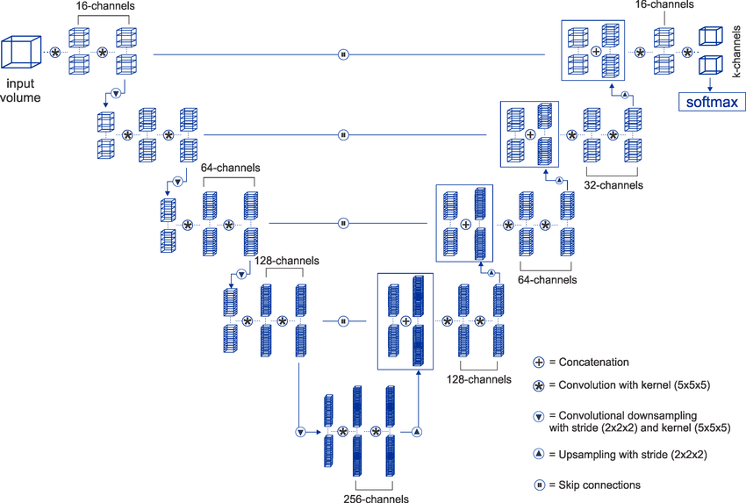
V Net

