Slide 1
Architecture (Basics)
Lecture 4/10

Slide 2
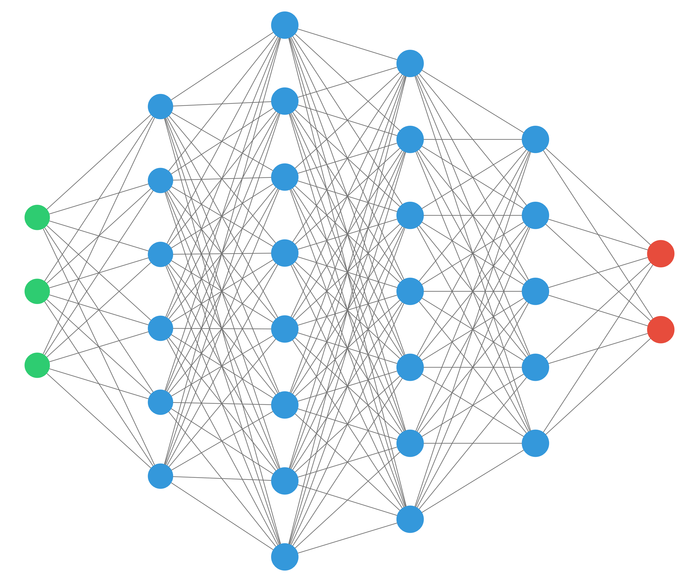
Preceptrons

Slide 3
Convolutional layer

Slide 4
Pooling layer

Slide 5
SoftMax Layer

