Slide 1
Data and Gradient Subtleties
Lecture 6/10

Slide 2
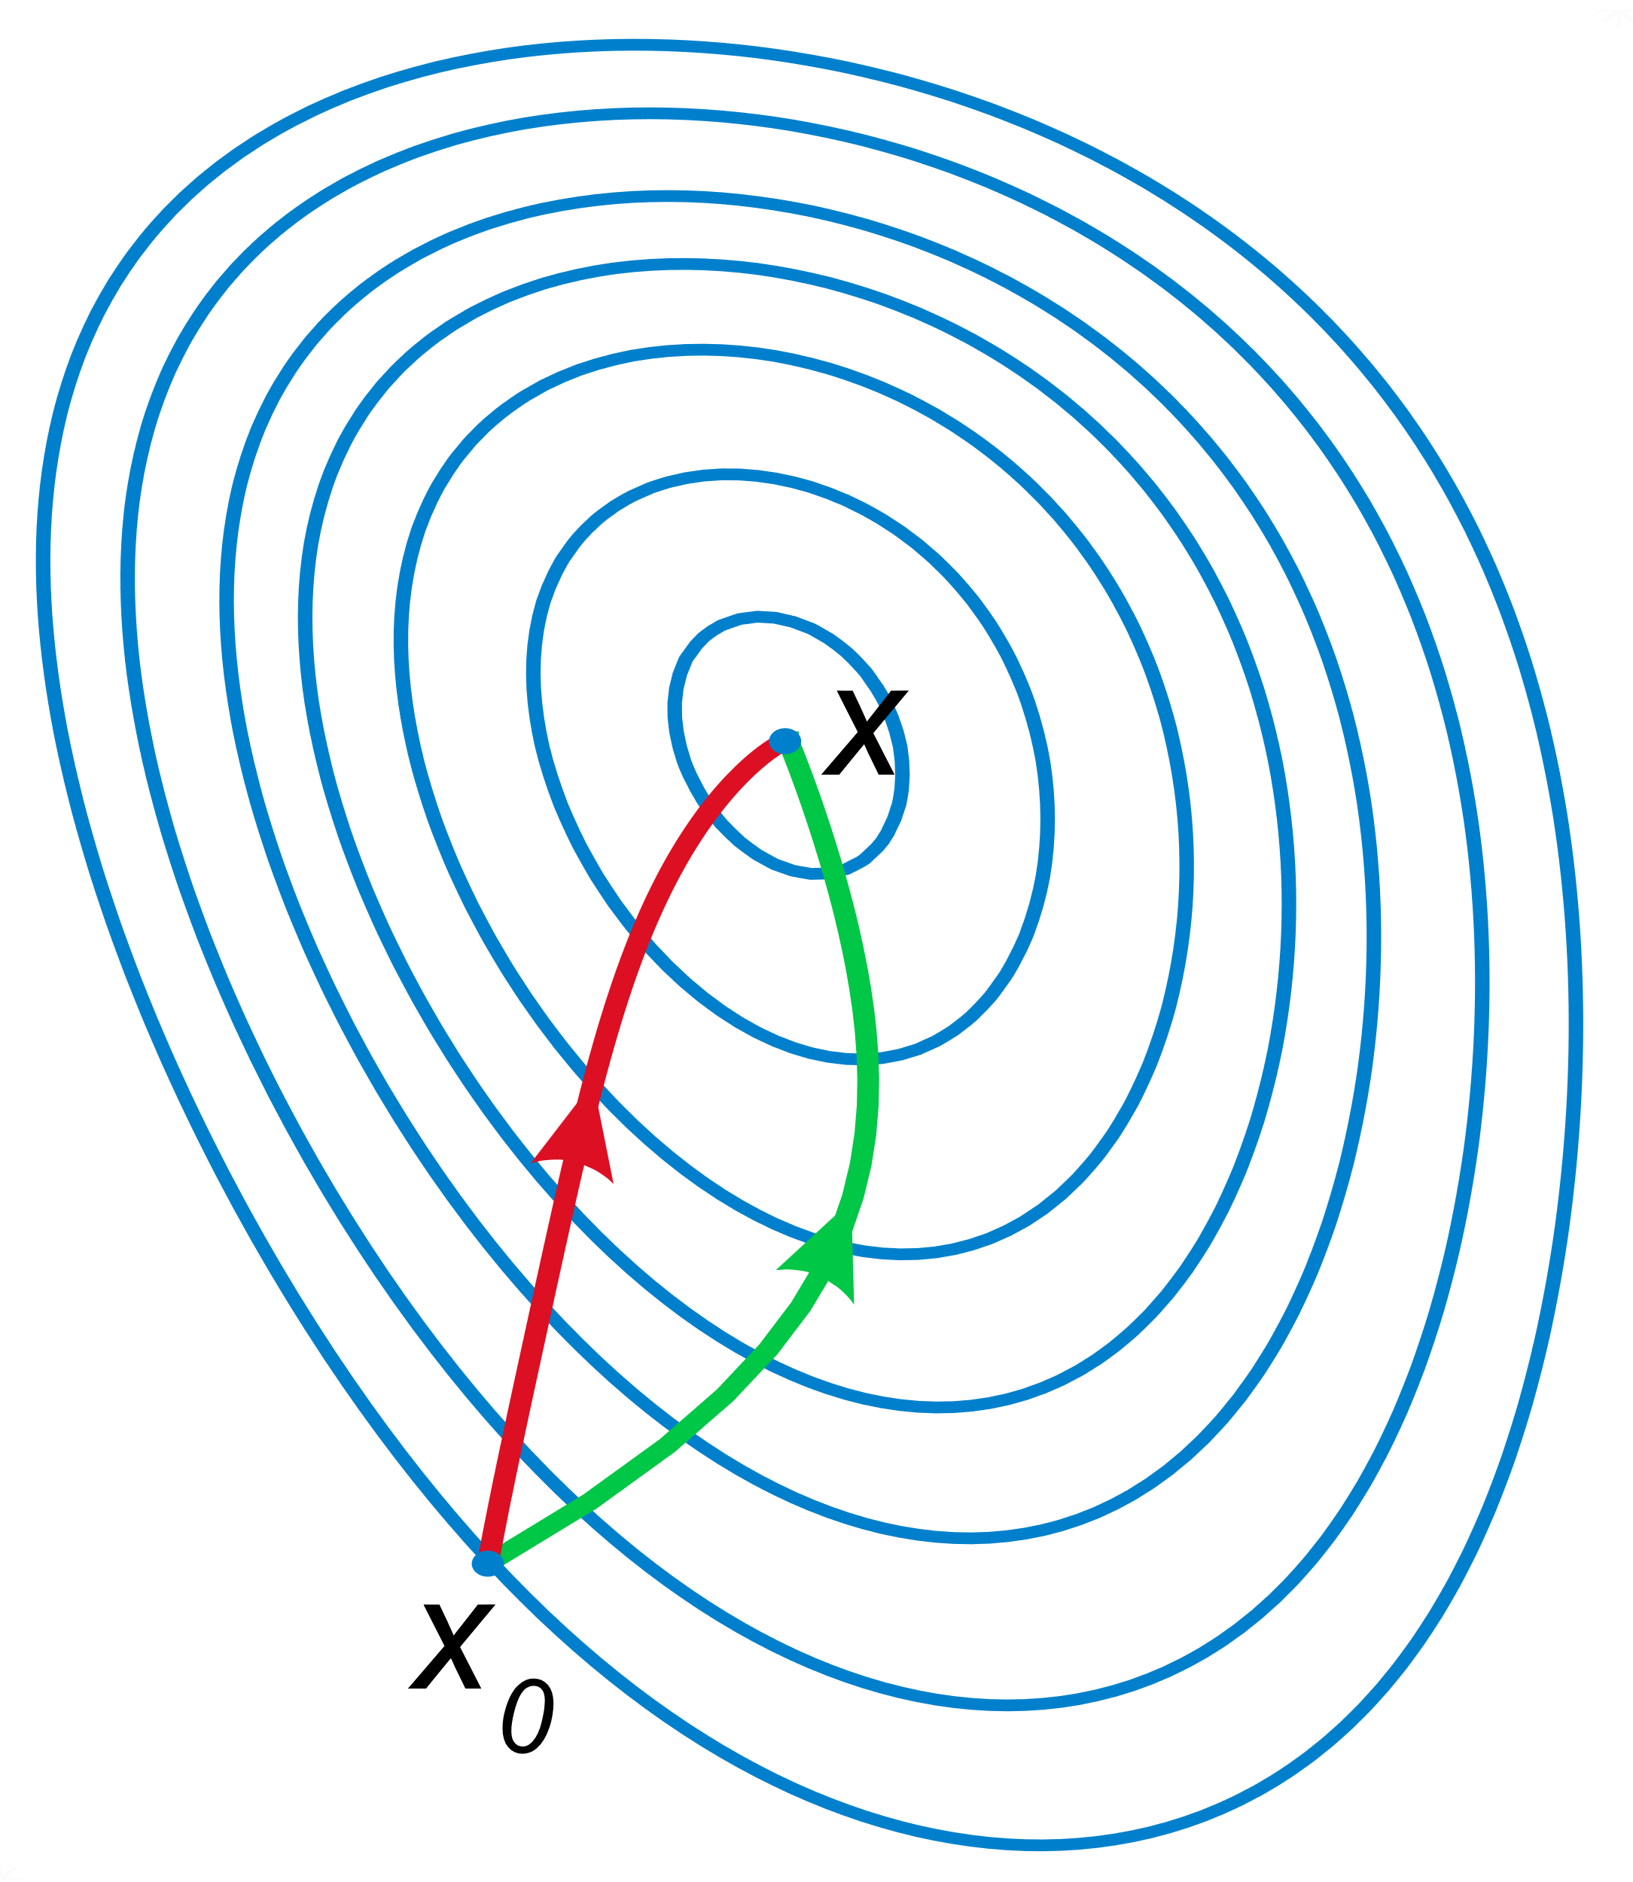
Gradient

Slide 3

Data

Slide 4
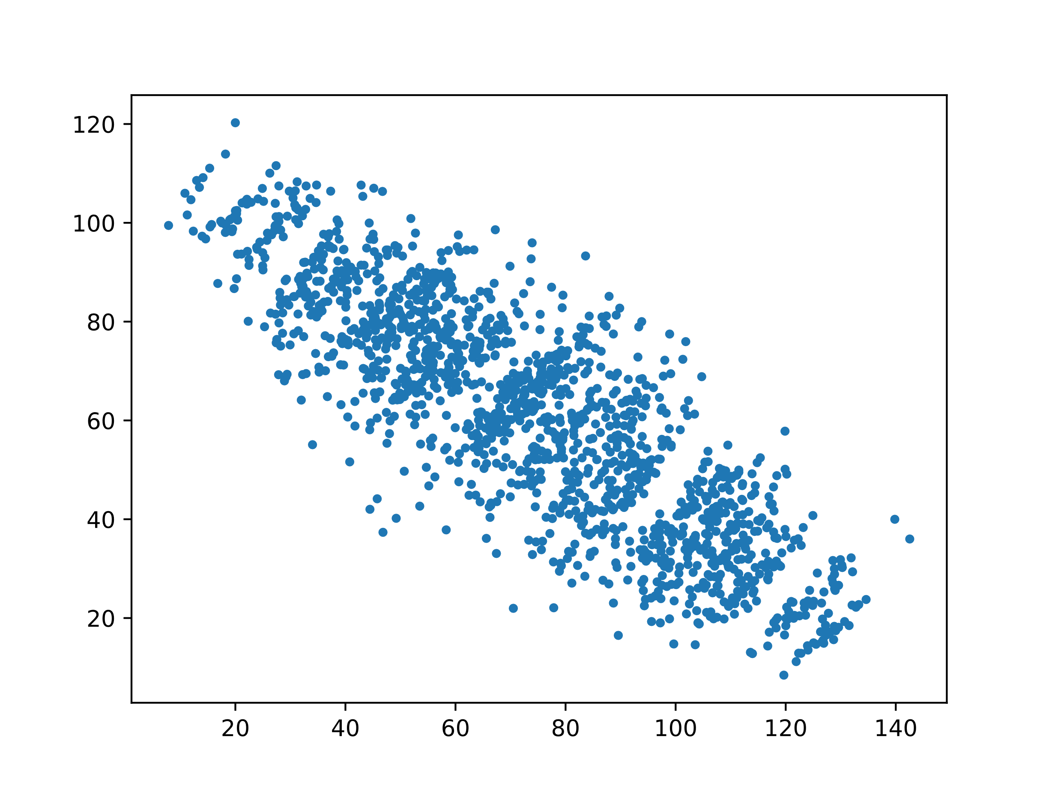
Simpson’s Paradox

Slide 5
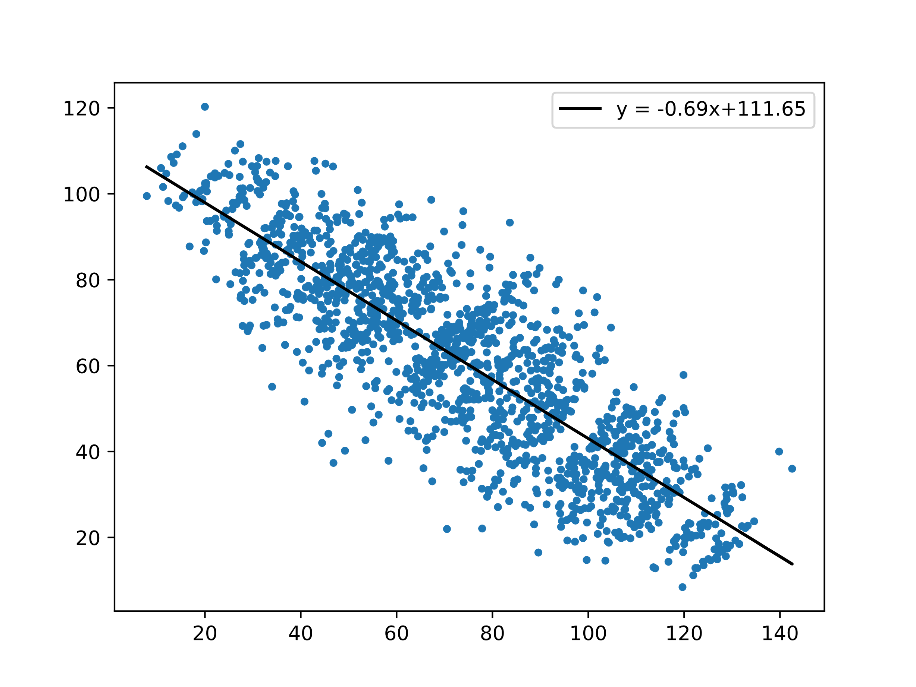
Simpson’s Paradox

Slide 6
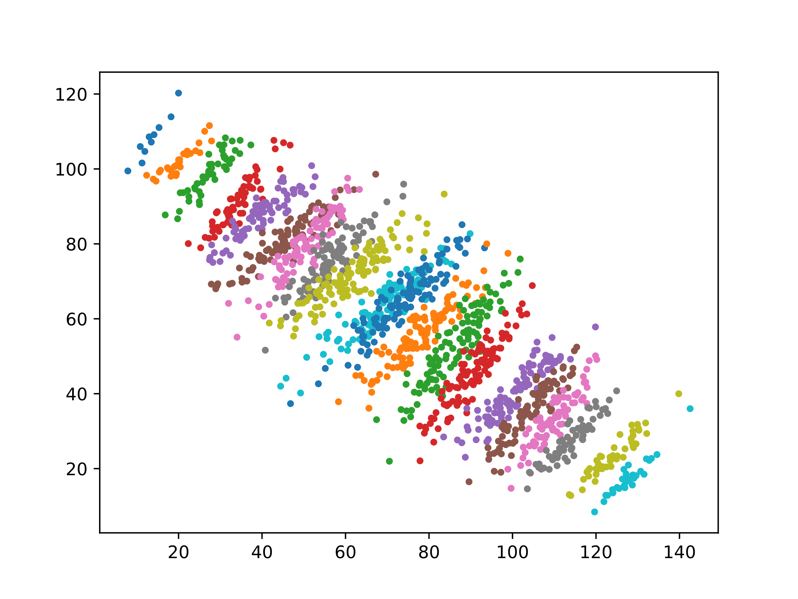
Simpson’s Paradox

Slide 7
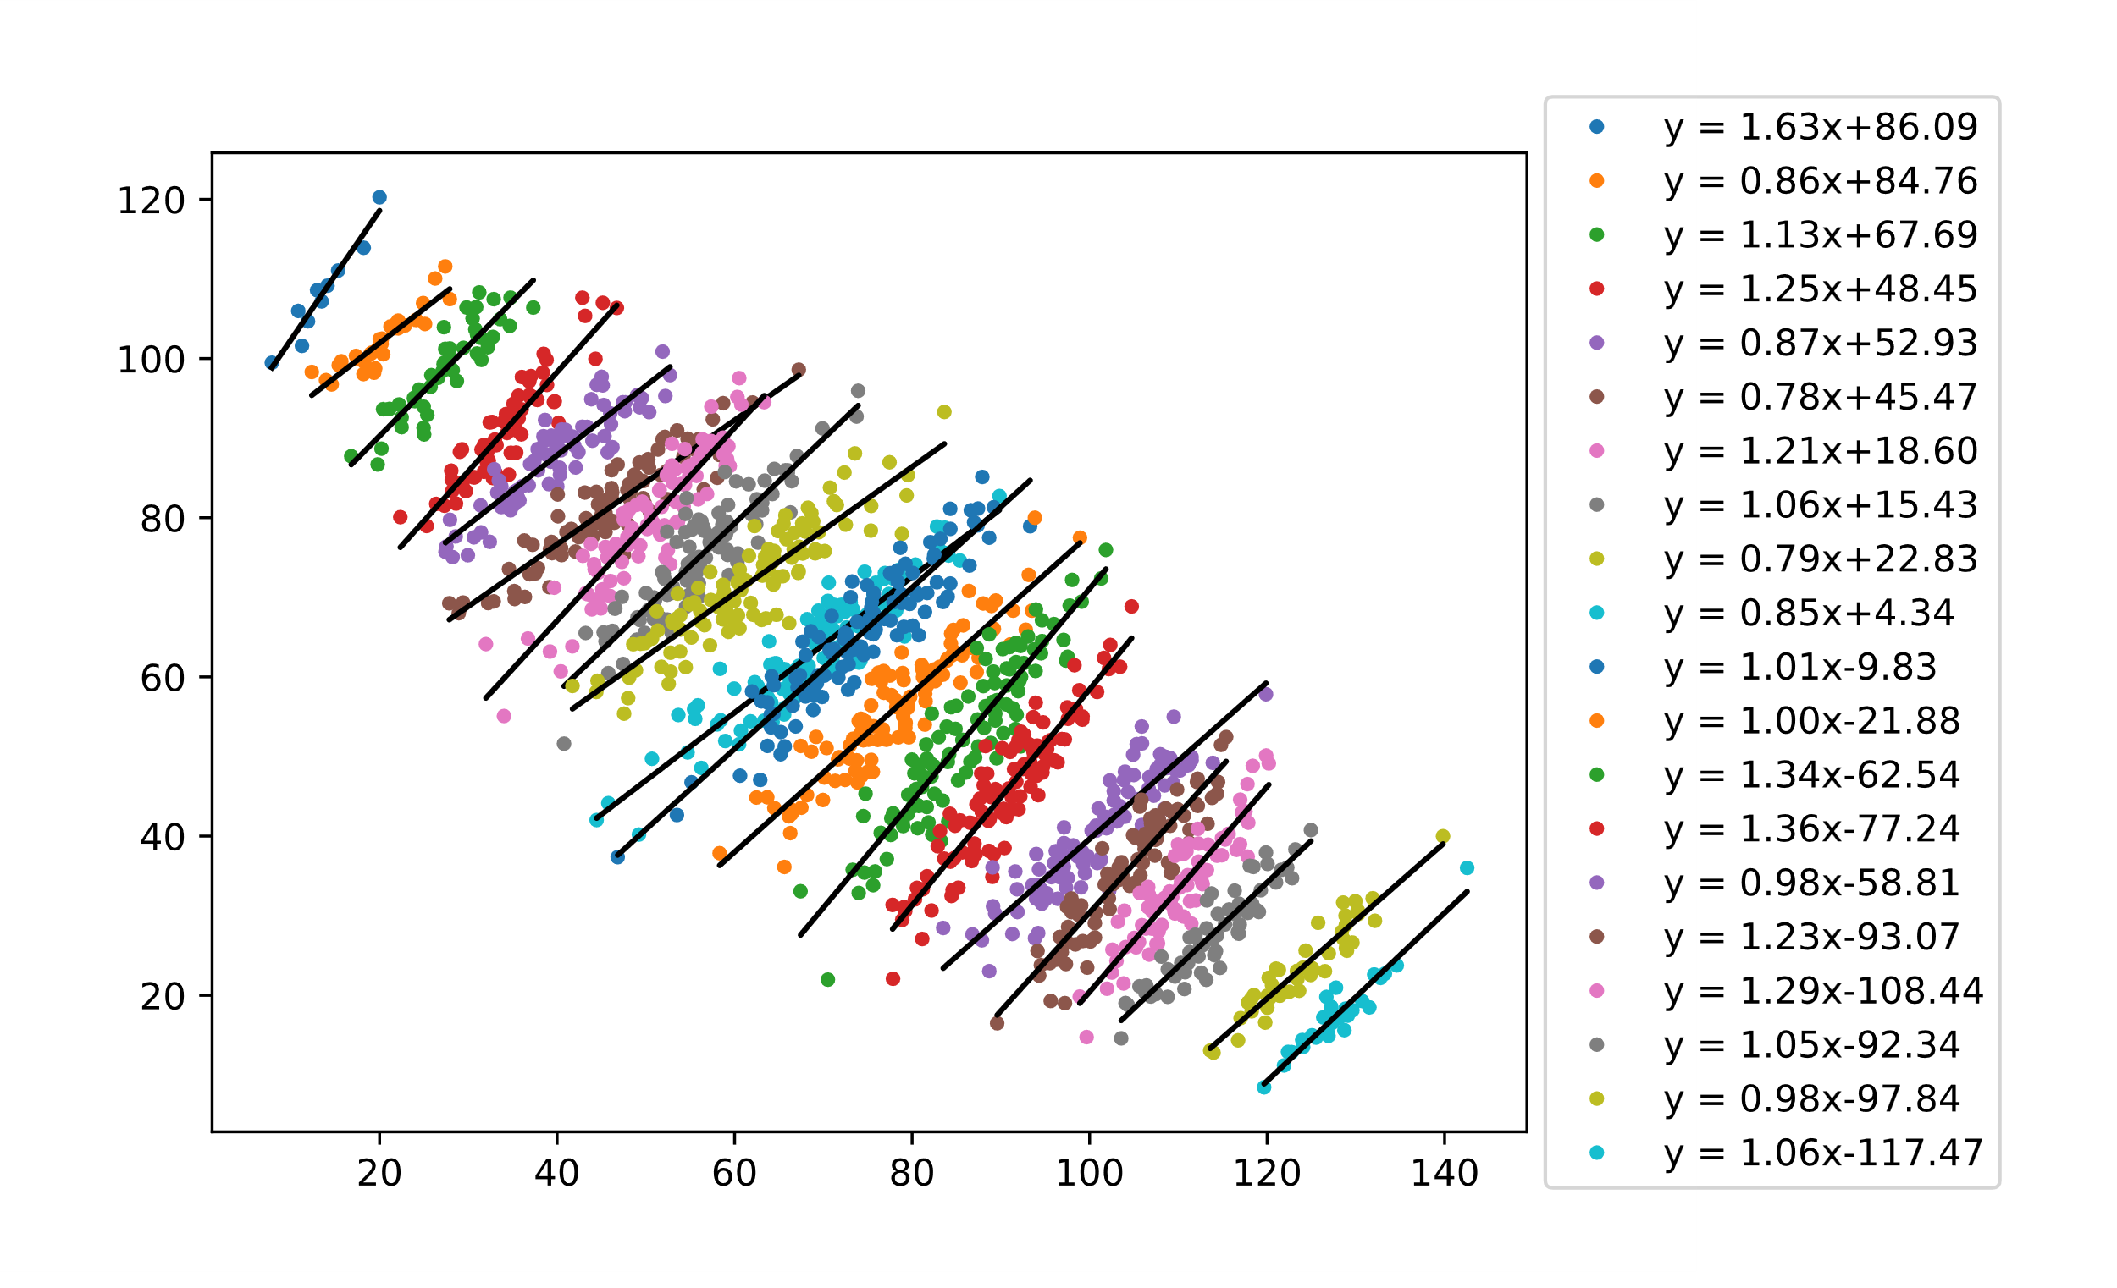

Simpson’s Paradox
$$y = 1.0868x − 14.643$$

Slide 8
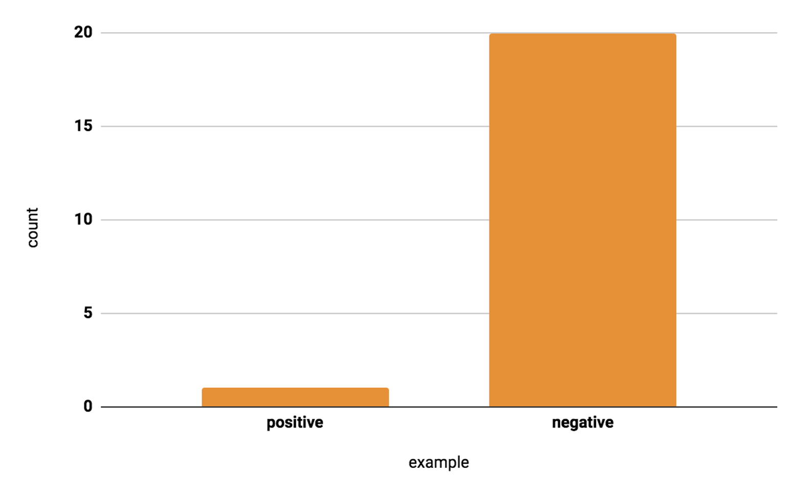
Imbalanced Data
Data-level:
Over sampling / Under sampling
Synthetic data generation
Algorithm-level
Cost-sensitive learning / Class weight adjustment

Slide 9
Data Augmentation: Images
Flip horizontal / vertical
Rotate
Rescale
Crop
Dilate/shrink
Add white noise
Add salt/pepper noise
Add white/black boxes
+ anything that you can think of!

Slide 10
Data Augmentation: Audio
Add white noise
Shifting tone
Vary speed
Filter frequencies (drop/add low/high frequencies)

Slide 11
Data Augmentation: Text
Synonym substitute
Random insertion

