Slide 1
Architecture (Basics)
Lecture 4/10

Slide 2
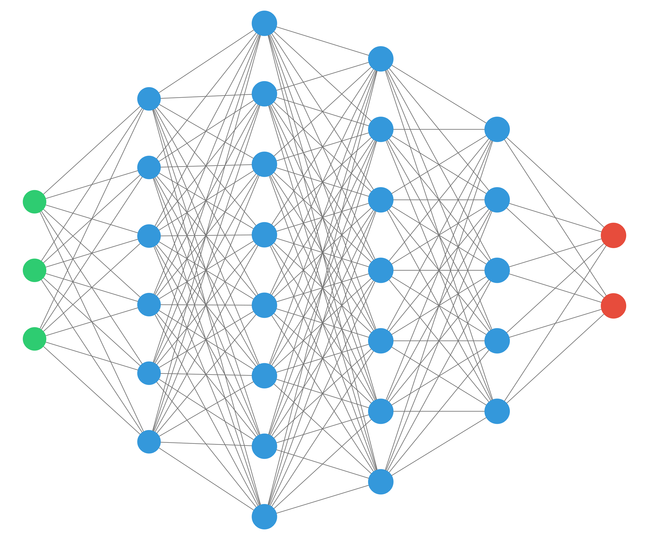
Preceptrons

Slide 3
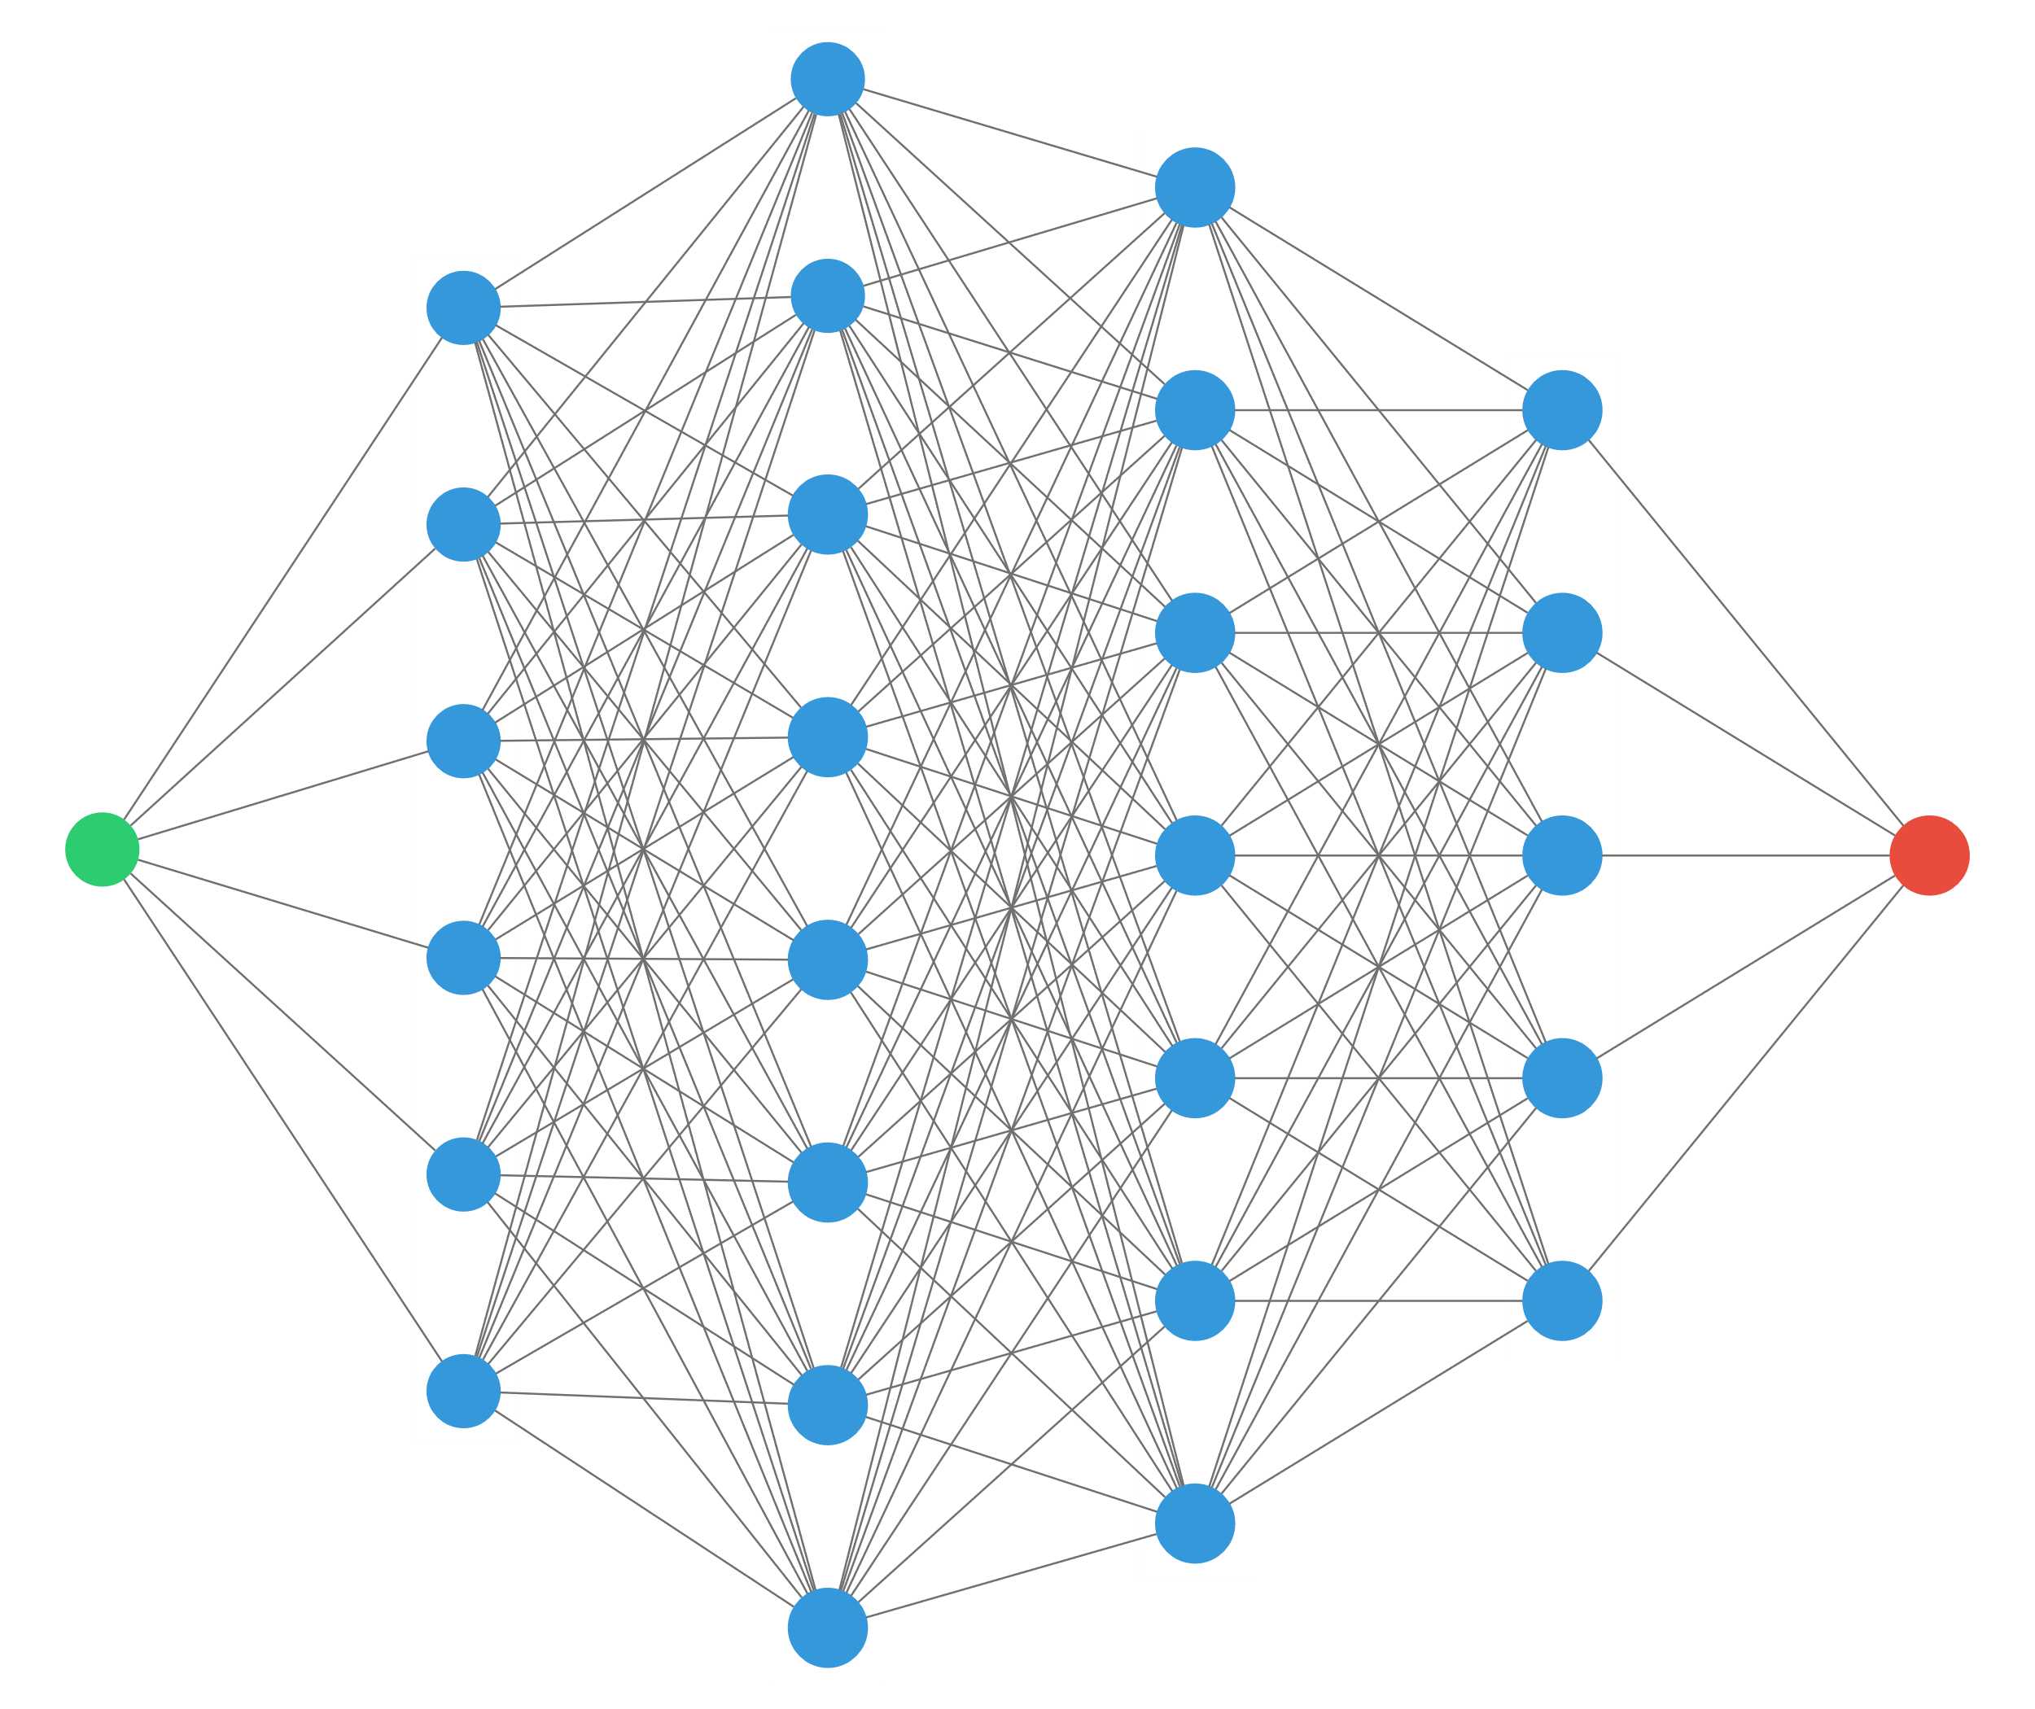


1D perceptron
$$x$$
$$y$$
“any continuous function can be approximated by a 2 layers perceptron” (with ReLU activation)

Slide 4
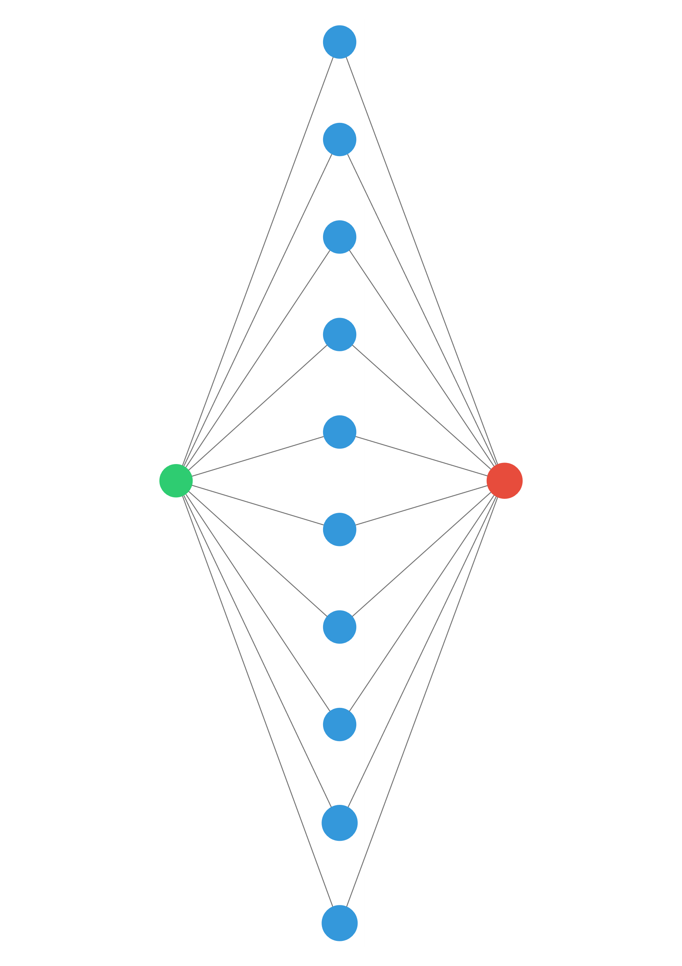
1D perceptron
$$x$$
$$y$$
“any continuous function can be approximated by a 2 layers perceptron” (with ReLU activation)
… provided there are enough neurons in the middle layer!

Slide 5

Theorem
Let $f∈𝒞\left(\left[a,b\right]\right)$
$𝒫(n)$ the set of 2 layers preceptrons with $n$ neurons
Then: $∀ε>0, ∃ n∈ℕ, p∈𝓟\left(n\right) s.t. {\left|f−p\right|}_{∞}<ε$

Slide 6



Proof
$f∈𝒞\left(\left[a,b\right]\right)$
$ε>0$
$p∈𝒫(n)$
$\left|f\left(x\right)−p(x)\right|$
$$a$$
$$b$$

Slide 7

Goal
$∀ f∈𝒞\left(\left[a,b\right]\right)$
$∀ ε>0$
$∃ p∈𝒫(n)$
$s.t. \left|f\left(x\right)−p(x)\right|<ε$
$$a$$
$$b$$

Slide 8
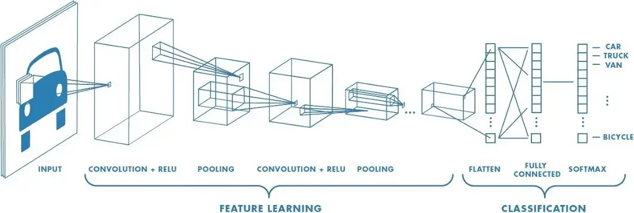
Convolutional layer
Image credit for this section: “A Comprehensive Guide to Convolutional Neural Networks“
https://towardsdatascience.com/a-comprehensive-guide-to-convolutional-neural-networks-the-eli5-way-3bd2b1164a53

Slide 9
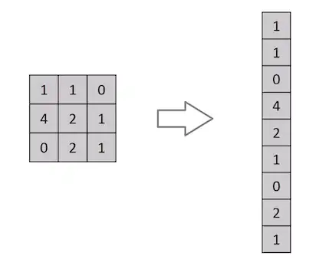
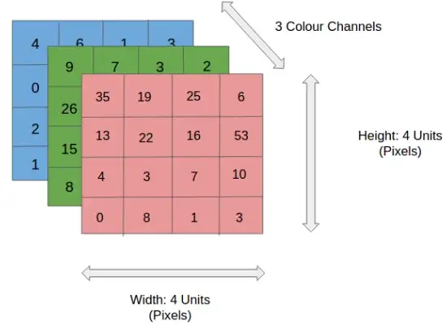
What is wrong with dense layers?

Slide 10
What is a convolution?
1 | 0 | 1
0 | 1 | 0
1 | 0 | 1
“Kernel”

Slide 11
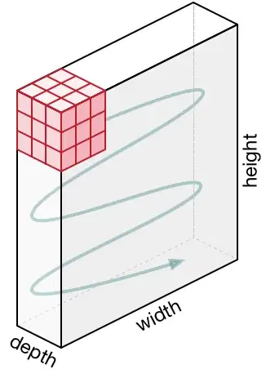
What if image is RGB?

Slide 12
Pooling layer

Slide 13
SoftMax Layer

