Slide 1
PyTorch
Lecture 1/10

Slide 2

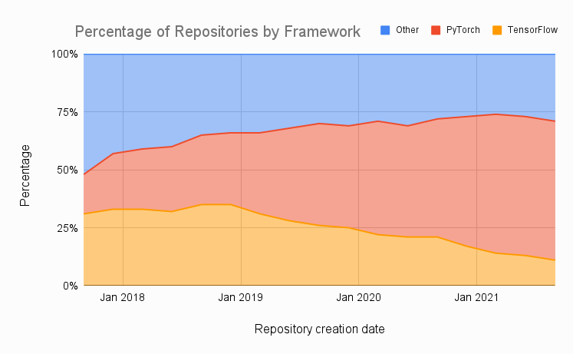
PyTorch in a few words…
Developed by Facebook’s AI research group
Getting very popular
Easy to use
Good performance in production
Flexible across a wide range of tasks
Provides tools for parallelizing & distributing computations

Slide 3
Key Concepts of PyTorch
Tensor: Multi-dimensional array of numbers
Autograd: A library for automatically computing gradients
Neural network module: Base class for all neural network classes
Optimizer: An algorithm that is used to adjust the parameters of a neural network in order to minimize a loss function

Slide 4
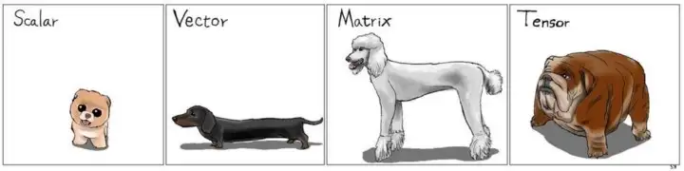
Tensor

