Slide 1
DL & NLP pour le diagnostic
Romain Lhotte & Paul Dubois
MICS – CentraleSupélec
Notes:
DL = Deep Learning. NLP = Natural Language Processing.

Slide 2
Course Structure
Lectures: 10 * 3h sessions
1h30 theory
1/4thh break
1h30 practice
Examination:
5 Kaggle challenges: 50% of the total grade; deadline on 17th of March 2024 at 5pm
1 Group Project: 50% of the grade
2-3 per group
Oral presentations on the 26th of March 2024 (1:30 pm)
Slides and written report must be in English. Presentation does not need to.
Easiest presentations that are thoroughly understood are preferred to complicated ones that only scratched the surface.

Slide 3
Outline of the class
Introduction to Deep Learning
PyTorch
Optimizers review. Types of Machine Learning problems and their losses.
Deep Learning Neural Network Architectures Overview Part. 1
Transfer Learning
Data and gradient subtleties
Deep Learning Neural Network Architectures Overview Part. 2
Deep Learning Neural Network Architectures Overview Part. 3
Deep Learning Neural Network Architectures Overview Part. 4 (Natural Language Processing)
TDs (Student choice -> CycleGAN)
Notes:
C’est amené à changer un tantinet

Slide 4

Objectives
When and where should DL be used.
What subranch of DL should be used.
How it works
How to implement it
Notes:
PyTorch est probablement pas la librairie la plus simple à utiliser mais une des plus répandues

Slide 5
Application of DL
Few examples of the application of deep learning:
Image and video analysis: image and video classification, object detection, and segmentation.
Healthcare: medical image analysis, drug discovery, and prediction of patient outcomes.

Slide 6
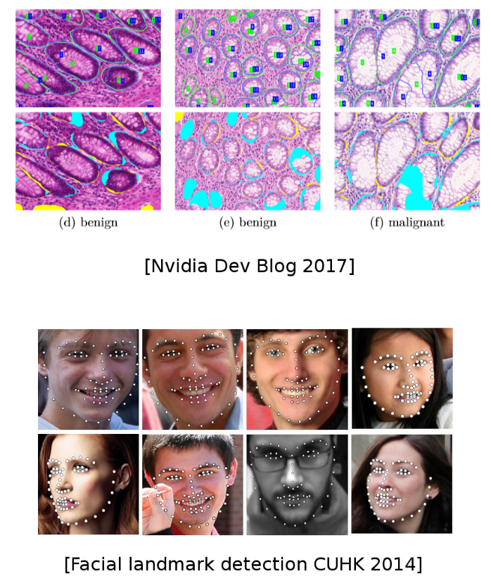

Slide 7
Application of DL
Few examples of the application of deep learning:
Image and video analysis: image and video classification, object detection, and segmentation.
Healthcare: medical image analysis, drug discovery, and prediction of patient outcomes.
Speech and language processing: speech recognition systems and Natural Language Processing tasks such as machine translation, language generation, and text classification.

Slide 8

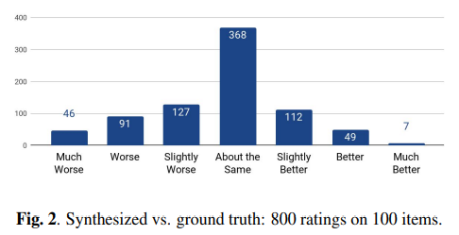
Tacotron 2 Natural TTS Synthesis by Conditioning WaveNet on Mel Spectrogram Predictions

Slide 9
Application of DL
Few examples of the application of deep learning:
Image and video analysis: image and video classification, object detection, and segmentation.
Healthcare: medical image analysis, drug discovery, and prediction of patient outcomes.
Speech and language processing: speech recognition systems and Natural Language Processing tasks such as machine translation, language generation, and text classification.
Finance: analyse financial data and make predictions about stock prices, credit risk, and fraud detection.
Robotics: object recognition and manipulation in robots.
Gaming: create artificial intelligence agents that can play games such as chess and Go at a high level.

Slide 10
Application of DL
Few examples of the application of deep learning:
Image and video analysis: image and video classification, object detection, and segmentation.
Healthcare: medical image analysis, drug discovery, and prediction of patient outcomes.
Speech and language processing: speech recognition systems and Natural Language Processing tasks such as machine translation, language generation, and text classification.
Finance: analyse financial data and make predictions about stock prices, credit risk, and fraud detection.
Robotics: object recognition and manipulation in robots.
Gaming: create artificial intelligence agents that can play games such as chess and Go at a high level.

Slide 11
Organisation of the class
All resources are available on GitHub
https://github.com/MICS-Lab/DeepLearningCourse2024/
Usually, one teacher for the first 1h30 and two teachers during the second 1h30
Always bring your laptops
GPUs will be at your disposal

Slide 12
Intro to Deep Learning
Lecture 1/10

Slide 13
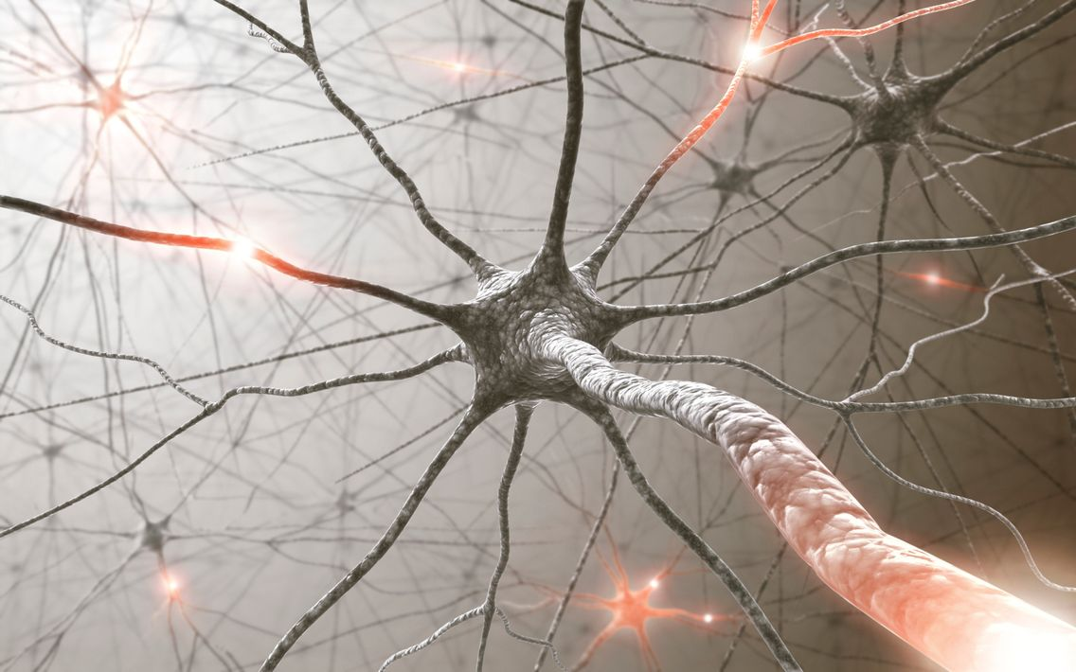
Biological Neuron
Notes:
Nous en avons des milliers dans le corps, beaucoup sont dans notre cerveau. Les neurones se transmettent des information grâce à des signaux électriques et chimiques. Il existe des tas de visualisation très jolies sur internet.

Slide 14
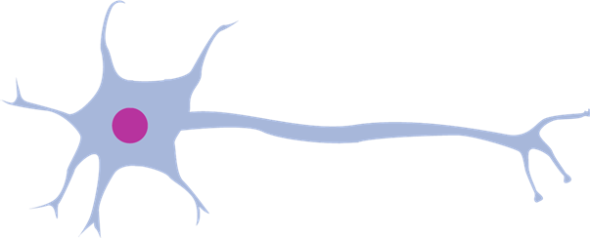
Biological Neuron
kernel
synapse
axon
cell
dendrite
Notes:
Les composants principaux d’un neurone biologique. Axon pour envoyer un signal, dendrite pour recevoir un signal, et synapse c’est l’

Slide 15
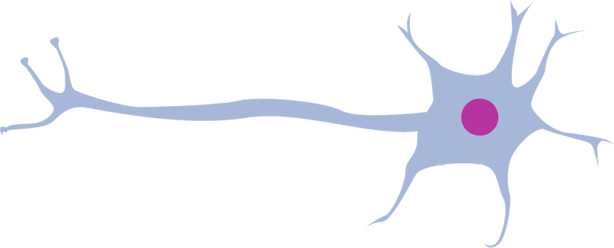




Synaptic integration
$$N_{1}$$
$$N_{2}$$
$$N_{0}$$
$$N_{3}$$
Notes:
L’intégration synaptique est le processus de transmission des information d’un neurone à un autre (au niveau biologique).
Considérons le neurone de droite [montrer]: voyons sous quelles conditions il va transmettre l’information (un signal, une activation).
Tout d’abord, si un des neurones auquel il est connecté lui envoie un petit signal… [animation] Il ne transmet pas le signal.

Slide 16
Synaptic integration
$$N_{1}$$
$$N_{2}$$
$$N_{0}$$
$$N_{3}$$
Notes:
Ensuite, si un des neurones auquel il est connecté lui envoie un gros signal… [animation] Il transmet le signal.

Slide 17
Synaptic integration
$$N_{1}$$
$$N_{2}$$
$$N_{0}$$
$$N_{3}$$
Notes:
Mais si plusieurs des neurones auquel il est connecté lui envoient tous un petit signal… [animation] Il transmet le signal!
On dit que l’intégration synaptique se fait en puissance et en quantité.

Slide 18
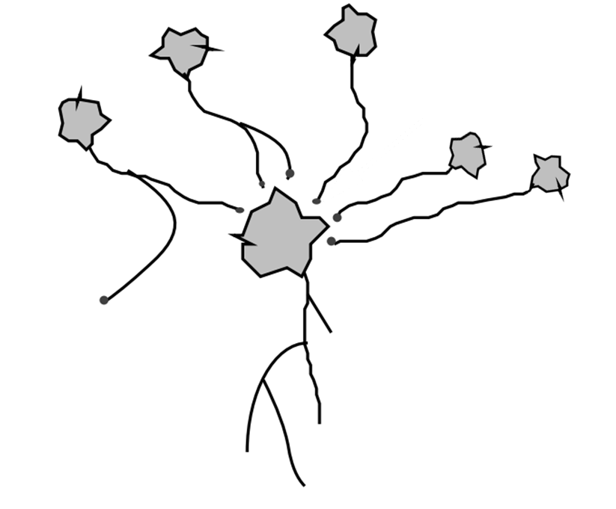
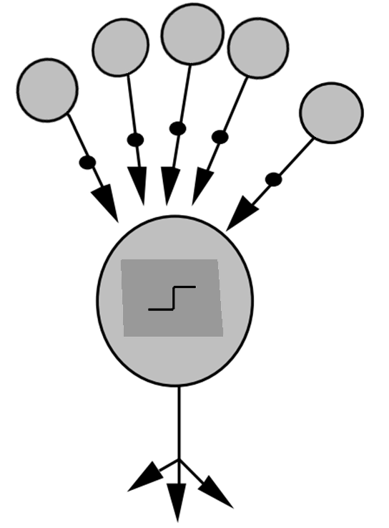
Simulation of a neuron
weights
cell
synapses
aggregation function
axon
outputs
Biological neuron
Computer neuron
Notes:
Passons maintenant à la simulation informatique de neurones.
(On considère le neurone central)
Les connexions entre neurones biologiques se font via des synapses; toutes ne sont pas de la même « qualité »: certaines transmettent très bien les signaux, d’autre beaucoup moins.
Nous simulons cela au niveau informatique via des poids.
Ensuite, le neurone biologique possède un corps cellulaire, qui décide si oui ou non, il transmet le signal. Ceci est fait au niveau informatique par une « fonction d’agrégat ».
Enfin, le neurone biologique a un axone, pour envoyer le signal a un ou plusieurs autres neurones. En informatique, le neurone possède une ou plusieurs sorties.

Slide 19


Using neurons
$$x$$
$$y$$

Slide 20


Adding complexity: width
$$y$$
$$x$$

Slide 21
Adding complexity: depth
$$x$$
$$y$$

Slide 22


Adding complexity: width & depth
$$x$$
$$y$$

Slide 23
Adding complexity: width & depth
$$x$$
$$y$$

Slide 24





Mathematically: layers
$$x$$
$$l^{1}$$
$$l^{2}$$
$$l^{3}$$
$$y$$
Notes:
Treat each layer as a vector

Slide 25




Mathematically
$$x$$
$$∗W^{1}$$
$$l^{1}$$
$$∗W^{2}$$
$$l^{2}$$
$$∗W^{3}$$
$$l^{3}$$
$$∗W^{4}$$
$$y$$
Notes:
Treat each layer as a vector

Slide 26













Mathematically: forward
$$x$$
$$∗W^{1}$$
$$l^{1}$$
$$∗W^{2}$$
$$l^{2}$$
$$∗W^{3}$$
$$l^{3}$$
$$∗W^{4}$$
$$y$$
$$l^{1}=W^{1}x$$
$$l^{2}=W^{2}l^{1}$$
$$l^{3}=W^{3}l^{2}$$
$$y=W^{4}l^{3}$$
Notes:
Some neurons may be consistently too large/small, so we add a bias

Slide 27







Mathematically: forward
$$+b^{1}$$
$$+b^{2}$$
$$+b^{3}$$
$$x$$
$$∗W^{1}$$
$$l^{1}$$
$$∗W^{2}$$
$$l^{2}$$
$$∗W^{3}$$
$$l^{3}$$
$$∗W^{4}$$
$$y$$
$$l^{1}=W^{1}x+b^{1}$$
$$l^{2}=W^{2}l^{1}+b^{2}$$
$$l^{3}=W^{3}l^{2}+b^{3}$$
$$y=W^{4}l^{3}+b^{4}$$
Notes:
Need to add complexity: linear transform twice is itself a linear transform

Slide 28




Mathematically: forward
$$+b^{1}$$
$$+b^{2}$$
$$+b^{3}$$
$$x$$
$$∗W^{1}$$
$$l^{1}$$
$$∗W^{2}$$
$$l^{2}$$
$$∗W^{3}$$
$$l^{3}$$
$$∗W^{4}$$
$$y$$
$$l^{1}=σ(W^{1}x+b^{1})$$
$$l^{2}=σ(W^{2}l^{1}+b^{2})$$
$$l^{3}=σ(W^{3}l^{2}+b^{3})$$
$$y=σ(W^{4}l^{3}+b^{4})$$
Notes:
With non-linear activation function sigma, the complexity of the system can not be simplified to a single layer.

Slide 29
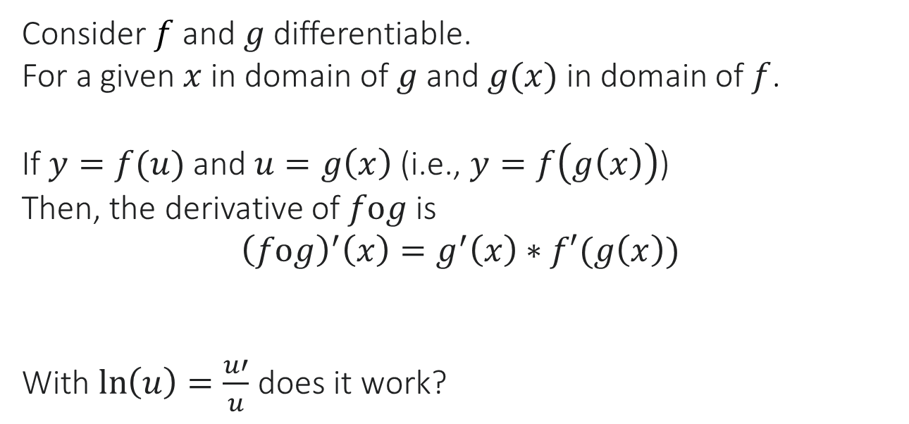
Mathematical Interlude
Consider $f$ and $g$ differentiable.
For a given $x$ in domain of $g$ and $g(x)$ in domain of $f$.
If $y=f(u)$ and $u=g\left(x\right)$ (i.e., $y=f\left(g\left(x\right)\right)$)
Then, the derivative of $fog$ is
$${\left(fog\right)}^{′}\left(x\right)=g^{′}\left(x\right)∗f′(g\left(x\right))$$
With $\ln\left(u\right)=\frac{u′}{u}$ does it work?
Notes:
With non-linear activation function sigma, the complexity of the system can not be simplified to a single layer.

Slide 30
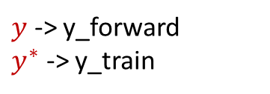
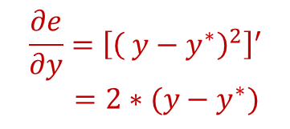
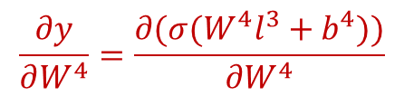
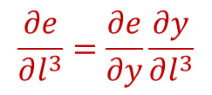
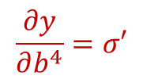

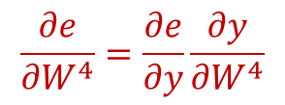
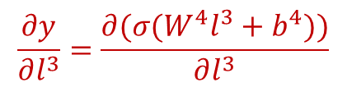
Mathematically: backward
$y$ -> y_forward
$y^{∗}$ -> y_train
$$\frac{∂e}{∂y}={\left[{\left( y−y^{∗}\right)}^{2}\right]}^{′}$$
$=2∗(y−y^{∗})$
$$+b^{1}$$
$$+b^{2}$$
$$+b^{3}$$
$$x$$
$$∗W^{1}$$
$$l^{1}$$
$$∗W^{2}$$
$$l^{2}$$
$$∗W^{3}$$
$$l^{3}$$
$$∗W^{4}$$
$$y$$
$$l^{1}=σ(W^{1}x+b^{1})$$
$$l^{2}=σ(W^{2}l^{1}+b^{2})$$
$$l^{3}=σ(W^{3}l^{2}+b^{3})$$
$$y=σ(W^{4}l^{3}+b^{4})$$
$$\frac{∂e}{∂l^{3}}=\frac{∂e}{∂y}\frac{∂y}{∂l^{3}}$$
$$\frac{∂e}{∂W^{4}}=\frac{∂e}{∂y}\frac{∂y}{∂W^{4}}$$
$$e={\left( y−y^{∗}\right)}^{2}$$
What is written on the screen is not rigorous nor exhaustive (it does not say where these functions are evaluated) but we will see it in a more rigorous way during the TD 1
$$\frac{∂y}{∂l^{3}}=\frac{∂(σ(W^{4}l^{3}+b^{4}))}{∂l^{3}}$$
$$\frac{∂y}{∂W^{4}}=\frac{∂(σ(W^{4}l^{3}+b^{4}))}{∂W^{4}}$$
$$\frac{∂y}{∂b^{4}}=σ′$$
Notes:
Using chain rule, we step by step calculate the derivative of the error function in terms of all intermediate variables.
Then, we use gradient descent to update all parameters.

Slide 31
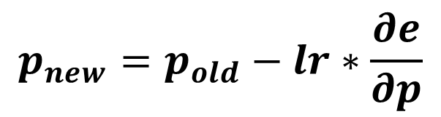
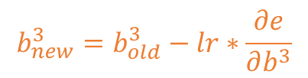


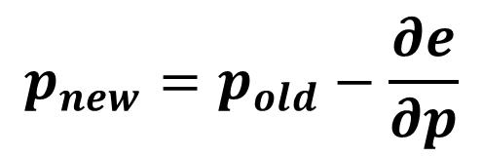
Mathematically: update
$$p_{new}=p_{old}−\frac{∂e}{∂p}$$
$$p_{new}=p_{old}−lr∗\frac{∂e}{∂p}$$
$$b_{new}^{3}=b_{old}^{3}−lr∗\frac{∂e}{∂b^{3}}$$
$$+b^{1}$$
$$+b^{2}$$
$$+b^{3}$$
$$x$$
$$∗W^{1}$$
$$l^{1}$$
$$∗W^{2}$$
$$l^{2}$$
$$∗W^{3}$$
$$l^{3}$$
$$∗W^{4}$$
$$y$$
$$l^{1}=σ(W^{1}x+b^{1})$$
$$l^{2}=σ(W^{2}l^{1}+b^{2})$$
$$l^{3}=σ(W^{3}l^{2}+b^{3})$$
$$y=σ(W^{4}l^{3}+b^{4})$$
$$W_{new}^{3}=W_{old}^{3}−lr∗\frac{∂e}{∂W^{3}}$$
$$e={\left( y−y^{∗}\right)}^{2}$$
Notes:
We update the parameters by subtracting the gradient, times the learning rate.

Slide 32
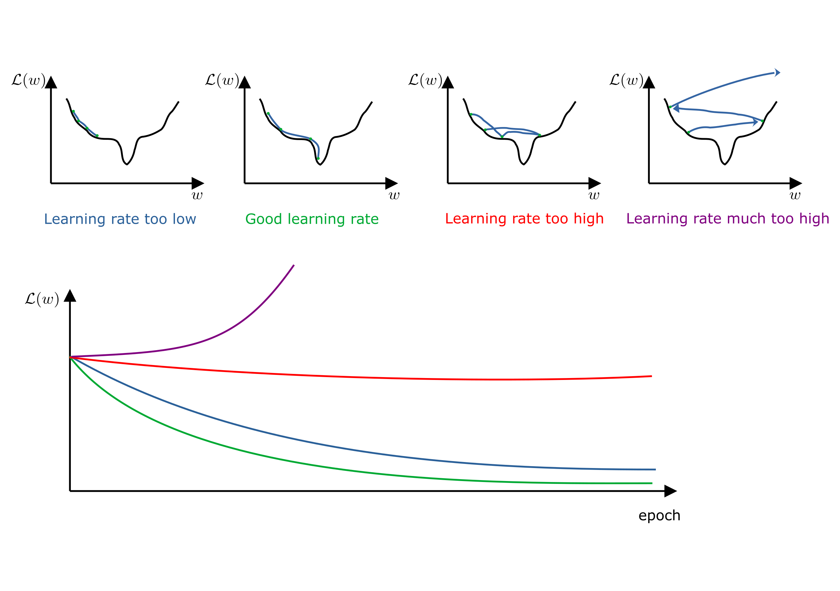
Interlude: Learning Rate

Slide 33
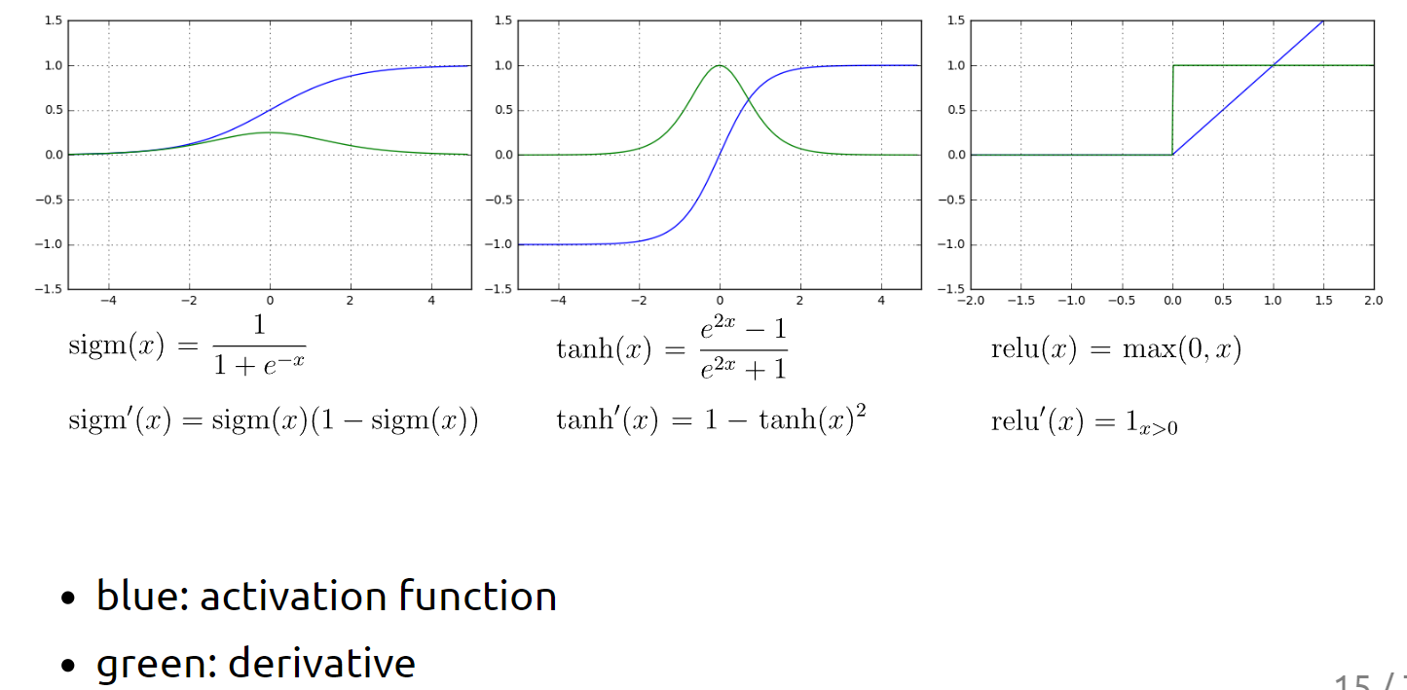
Interlude: Activation Function
Notes:
Quelle fonction d'activation devrait être utilisée ? Eh bien, si vous traitez une régression logistique binaire (est-ce un cancer ou pas), vous voulez des valeurs de sortie entre 0 et 1, donc la fonction d'activation de la dernière couche sera sigm. Si vous voulez prédire le prix d'une action, vous voudrez peut-être utiliser relu sur la dernière couche car vous voulez des valeurs de sortie dans R+. Pour les fonctions d’activation sur les couches cachées, il y a un certain nombre de règles qui existent mais le plus facile est de former le réseau avec certaines fonctions d'activation, de les changer et de voir si votre loss diminue. Si c’est le cas, garder les nouvelles fonctions d’activation, sinon garder les anciennes. En gros, le choix de la fonction d'activation à utiliser est un hyperparamètre (si vous ne savez pas ce qu’est un hyperparamètre j’explique dans quelques slides).

Slide 34
Training steps (training set)
Feed one piece of data (for which you know the desired output)
Calculate the error
Backpropagate the error to all intermediate variables
Update the parameters
Layers vectors cannot be updated but calculating their gradient speeds-up the calculations
Every time we feed the network, we get one point of the error function and its local gradient
While we could feed the same point until convergence, it is better to feed all our data before showing the same data again
Notes:
Note that in reality, x and y are also multi-dimensional vectors, but all the math remains the same.

Slide 35
Training / Validation / Testing set
1/ The model is initially fit on a training data set, which is a set of examples used to fit the parameters (e.g., weights of connections between neurons in artificial neural networks) of the model.
2/ Successively, the fitted model is used to predict the responses for the observations in a second data set called the validation data set. We get a loss; we change some architectural parameters (like activation function, or number of layers, or number of neurons in a layer), we do step 1/ again, and we see if the validation loss is smaller. If it is, we happy. Though, the loss we get is now biased … because we “learned” from the validation set something.
3/ Finally, the test data set is a data set used to provide an unbiased evaluation of a final model fit on the training data set.

Slide 36

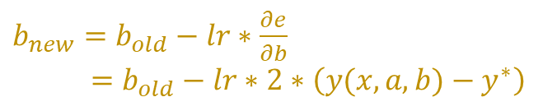


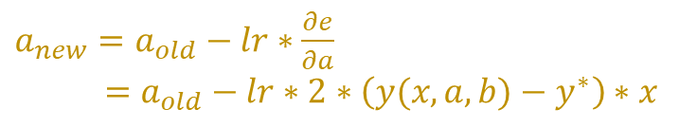

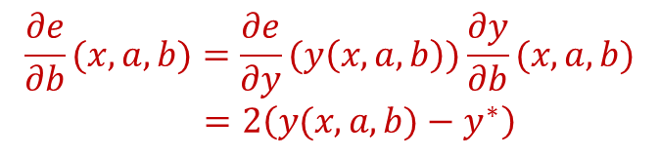

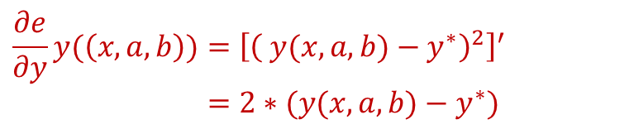

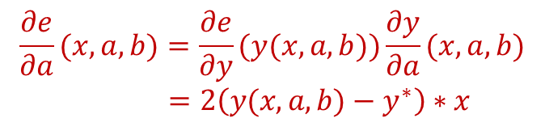
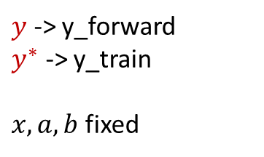
Simplest case by hand
$y$ -> y_forward
$y^{∗}$ -> y_train
$x, a, b$ fixed
$$+b$$
$$e(y\left(x, a,b\right))={\left( y(x, a,b)−y^{∗}\right)}^{2}$$
$$x$$
$$∗a$$
$$y$$
$$\frac{∂e}{∂y}y(\left(x, a,b\right))={\left[{\left( y(x, a,b)−y^{∗}\right)}^{2}\right]}^{′}$$
$=2∗(y(x, a,b)−y^{∗})$
$$y=a∗x+b$$
$$\frac{∂e}{∂a}(x, a,b)=\frac{∂e}{∂y}(y(x, a,b))\frac{∂y}{∂a}(x, a,b)$$
$=2\left(y(x, a,b)−y^{∗}\right)∗x$
$a_{new}=a_{old}−lr∗\frac{∂e}{∂a}$
$=a_{old}−lr∗2∗\left(y(x, a,b)−y^{∗}\right)∗x$
$$\frac{∂e}{∂b}(x, a,b)=\frac{∂e}{∂y}(y\left(x,a,b\right))\frac{∂y}{∂b}(x, a,b)$$
$=2\left(y(x, a,b)−y^{∗}\right)$
$b_{new}=b_{old}−lr∗\frac{∂e}{∂b}$
$=b_{old}−lr∗2∗\left(y(x, a,b)−y^{∗}\right)$
Notes:
Les dérivées finales que l’on veut calculer ce sont par rapport à a et b, parce que ce sont a et b qu’on veut faire bouger.
We consider the simplest possible case: 1D x, 1D y, and no activation function.
Note that this is in fact just a linear model.

