Slide 1
Optimizers’ review and different techniques to improve your Neural Network
Lecture 3/10

Slide 2
Outline of the class
Introduction to Deep Learning
PyTorch
Optimizers review. Types of Machine Learning problems and their losses.
Layers Types 1 (linear: width vs depth)
Layers Types 2 (conv, pooling & softmax)
Architectures (RNN) & Transfer Learning
Practical Exercises and hyperparameter optimization
Attention. Transformers.
Text Generation. Low-Rank Adaptation of Large Language Models
Exam

Slide 3
Optimizers’ review
Reminders:
Backpropagation -> algorithm which computes the gradient of the parameters within a neural network with respect to the loss.
Gradient descent optimization algorithms -> take that gradient for each parameter and use it to figure out how it should update the parameter to reduce the loss.
Choosing the optimizer is considered to be among the most crucial design decisions in deep learning (reminder: we consider the optimizer as a hyperparameter (and similarly its parameters (learning_rate, etc …) are considered as hyperparameters)).
But the growing literature now lists hundreds of optimization methods.

Slide 4
Optimizers’ review
Descending through a Crowded Valley - Benchmarking Deep Learning Optimizers. Robin M. Schmidt, Frank Schneider, Philipp Hennig:
“Analyzing more than 50,000 individual runs [on different Deep Learning problems], we contribute the following three points: (i) Optimizer performance varies greatly across tasks. (ii) We observe that evaluating multiple optimizers with default parameters works approximately as well as tuning the hyperparameters of a single, fixed optimizer. (iii) While we cannot discern an optimization method clearly dominating across all tested tasks, we identify a significantly reduced subset of specific optimizers and parameter choices that generally lead to competitive results in our experiments: Adam remains a strong contender, with newer methods [more complicated and less documented] failing to significantly and consistently outperform it.”
Notes:
Lien vers l’article : https://arxiv.org/abs/2007.01547

Slide 5
SGD
PyTorch naming is a bit confusing. The implementation of SGD is actually just gradient descent. The stochasticity comes purely from using (shuffled) mini-batches for each optimizer step. Without this dataloading aspect, the optimisation algorithm would effectively perform GD, rather than SGD.

Slide 6

SGD
train_loader = DataLoader(dataset=train_data, batch_size=1, shuffle=True)
for epoch in range(n_epochs):
for inputs, targets in train_loader: optimizer.zero_grad() output = model(inputs) loss = loss_fn(output, targets) loss.backward() optimizer.step()
-> this example pushes the stochasticity to the limit by computing gradients on single samples (for input, target in dataset).
Notes:
Première ligne : on crée un DataLoader object appelé train_loader. Ca coupe le dataset (train_data) en batchs, ces batchs sont de taille 1. Et on shuffle.
Troisième ligne : On fait n_epochs epochs (ça veut dire que chacune des données du dataset de base (train_data) sera montrée n_epochs fois au réseau
Quatrième ligne : Pour chacune des epochs on va faire len(train_loader) choses. Ici len(train_loader) c’est len(train_data) puisque mes batchs sont de taille 1 j’ai donc autant de batchs que de données.
Cinquième ligne : Pour chacun de mes batchs, je mets d’abord le gradient à 0.
Sixième ligne : Je fais une passe forward.
Septième ligne : Je calcule ma loss (par exemple MSE).
Huitième ligne : Je calcule mon gradient.
Neuvième ligne : Je donne mon gradient à mon optimiseur, et mon optimiseur fait des trucs avec les poids pour les améliorer en utilisant l’info du gradient. Dans le cas de SGD, on fait une gradient descente classique i.e. a_new = a_old – learning_rate * gradient. Mais d’autres optimiseurs font des trucs plus avancés que cette formule et on va les voir.

Slide 7

SGD
train_loader = DataLoader(dataset=train_data, batch_size=32, shuffle=True)
for epoch in range(n_epochs):
for inputs, targets in train_loader: optimizer.zero_grad() output = model(inputs) loss = loss_fn(output, targets) loss.backward() optimizer.step()
-> in practice a larger batch size usually allows you to use a larger learning rate
Notes:
IMPORTANT
larger batch size -> gradient is more precise -> less ‘danger’ in having a larger learning rate

Slide 8
SGD
PyTorch naming is a bit confusing. The implementation of SGD is actually just gradient descent. The stochasticity comes purely from using (shuffled) mini-batches for each optimizer step. Without this dataloading aspect, the optimisation algorithm would effectively perform GD, rather than SGD.

Slide 9

Momentum
$v_{t, i}=γv_{t−1, i}+∂loss/∂θ_{t,i}$
$$θ_{t+1, i}=θ_{t,i} −lr ∗v_{t, i}$$
-> New hyperparameter!
-> Why momentum really works
Notes:
One way to think of SGD with momentum is a ball rolling down a hill, where areas of high gradient are steep parts of the hill and areas of low gradient are very flat areas. Sometimes the global minima, the point with the lowest loss, is in the middle of a giant flat area. The problem is that because these flat areas have small gradients, they also give small update steps which makes learning slow.
What if we expanded on the "ball rolling down a hill" analogy? We'd want to add something to our optimizer that made it keep the "momentum" gained rolling down the steep hills whilst it's going across the flat areas.
Well, that's exact what optimizers with momentum does! Our parameter update is now calculated using a velocity, v, which depends on the current gradient multiplied by the learning rate plus the previous velocity multiplied by the momentum γ.

Slide 10
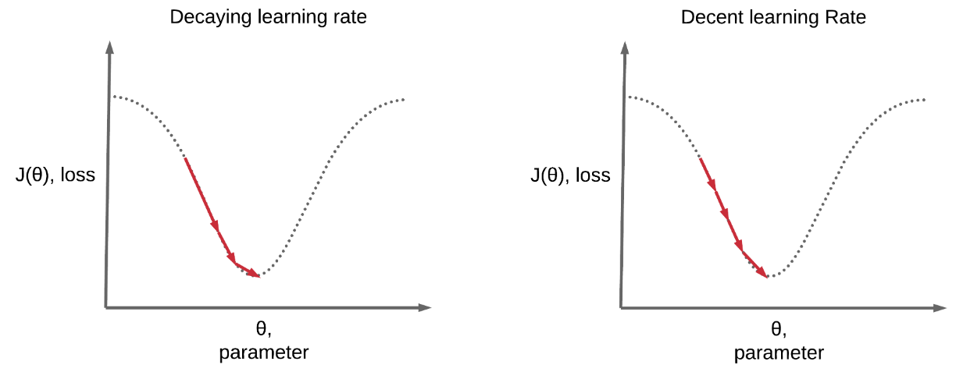
Learning rate scheduling
Constant learning rate
Notes:
Bien rappeler aux étudiants ce qu’on représente en x, et en y à chaque fois sur les graphes de loss en fonction des paramètres.

Slide 11
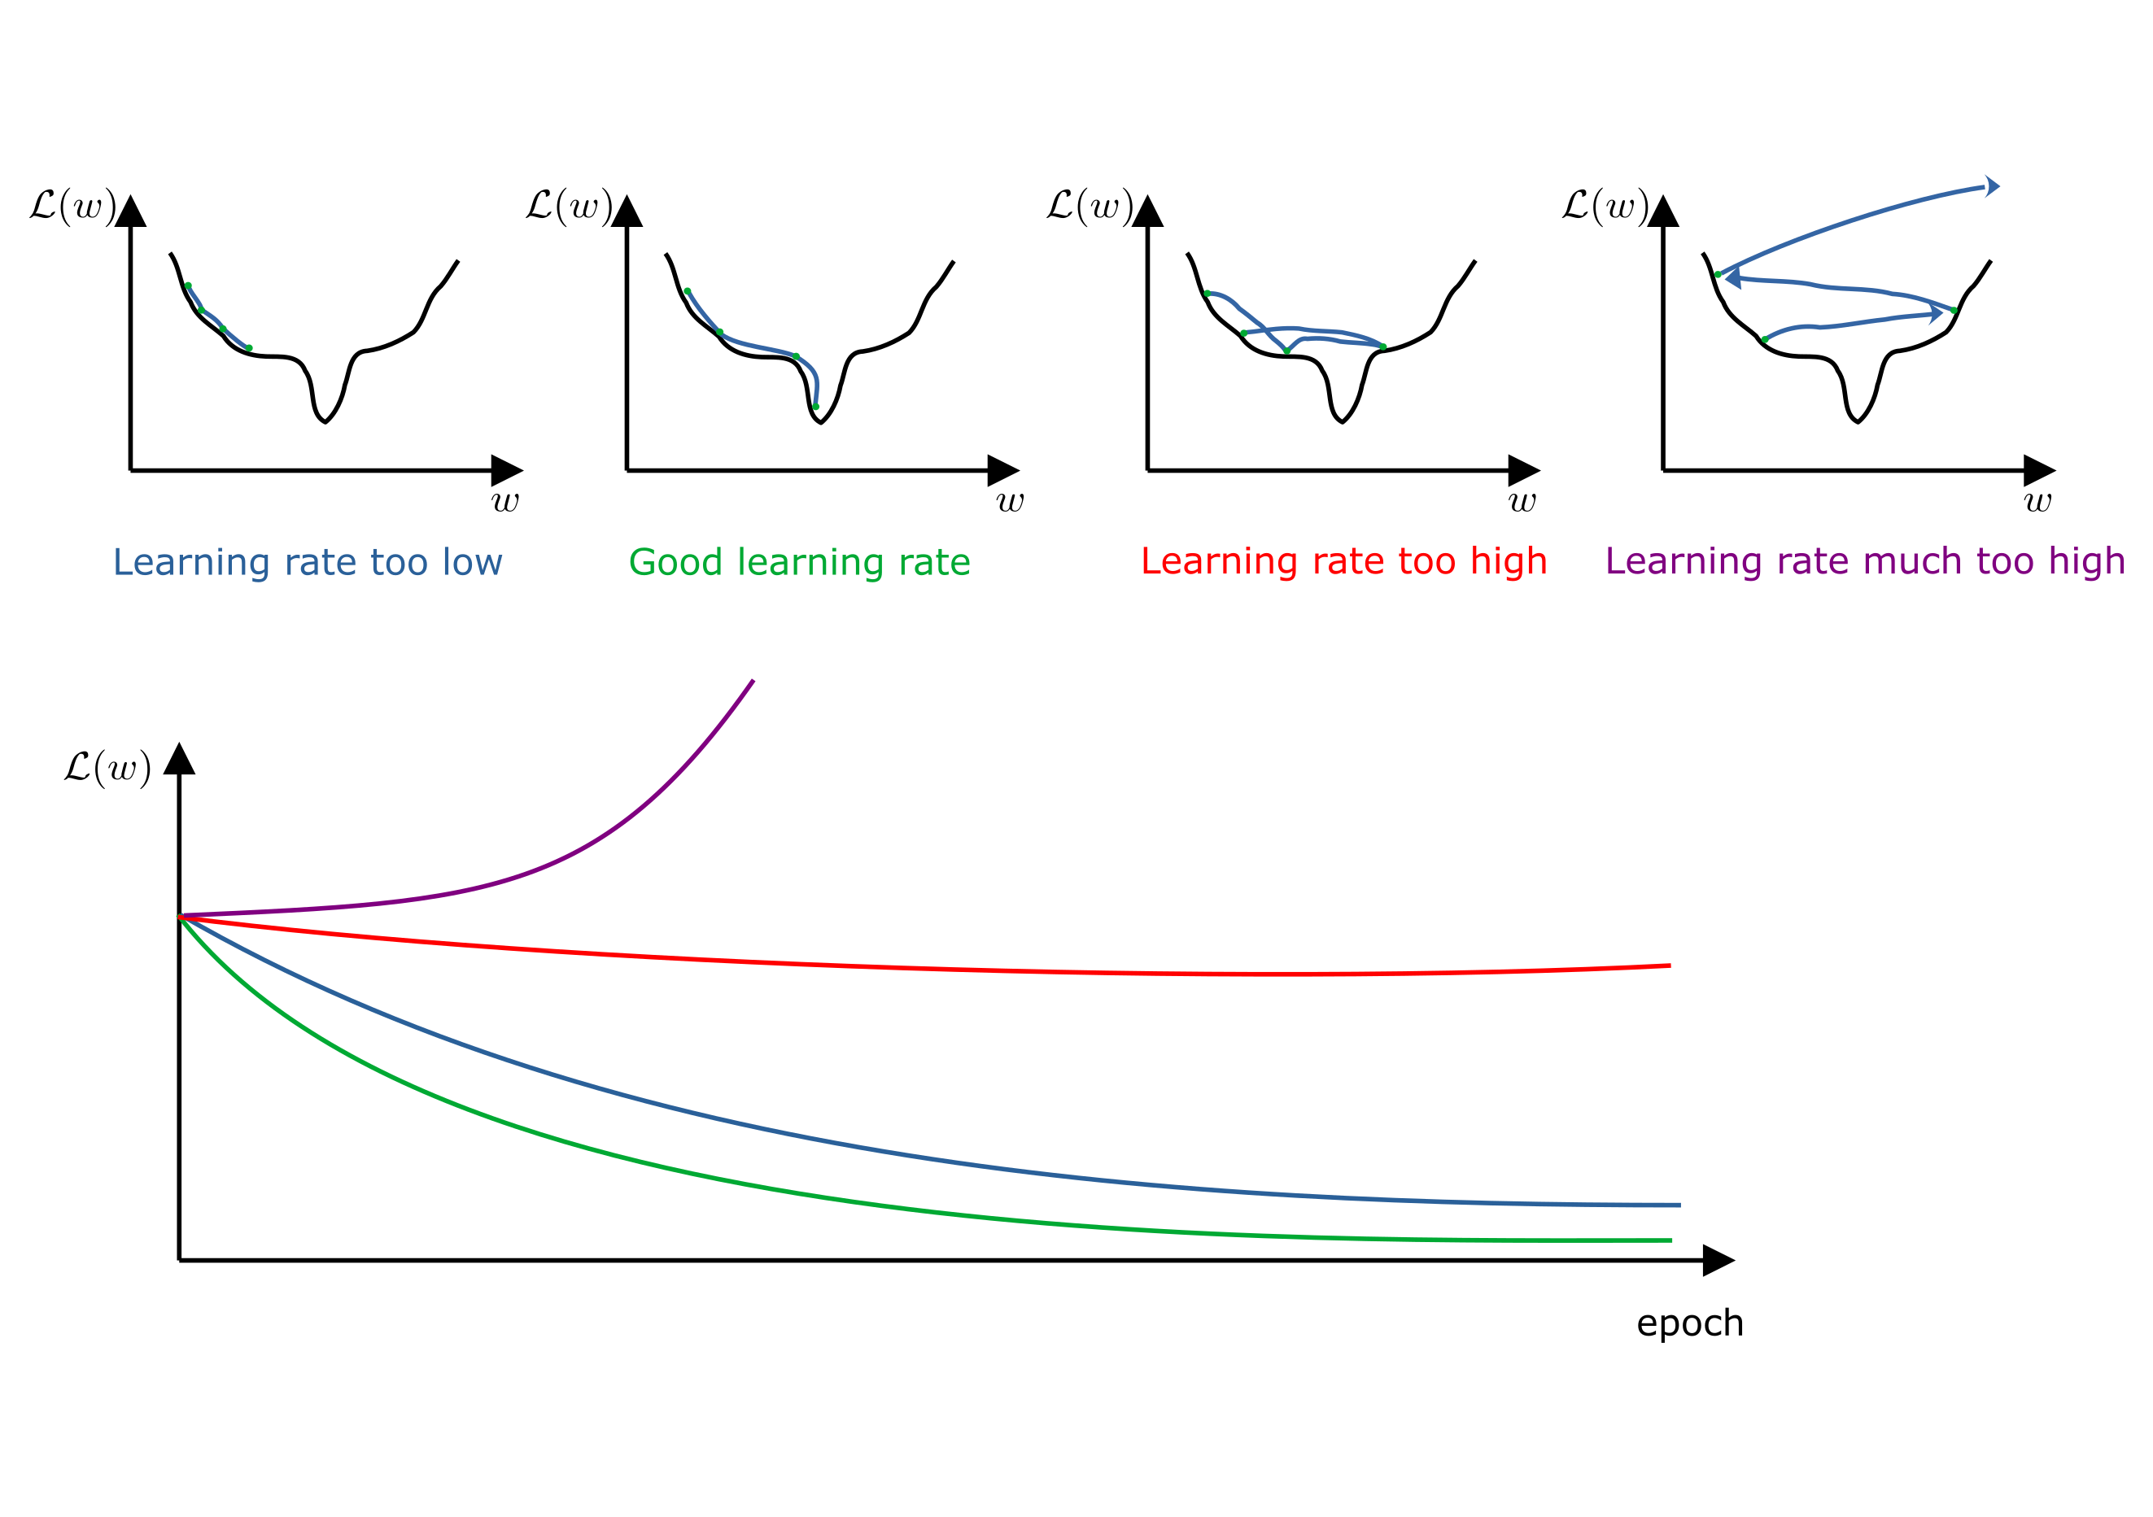
Learning rate scheduling
Notes:
Bien rappeler aux étudiants ce qu’on représente en x, et en y à chaque fois sur les graphes de loss en fonction des paramètres.
On veut vite arriver à côté du trou (donc le learning rate doit être élevé au début) puis après on veut diminuer le learning rate sinon il y a un risque qu’on oscille juste de part et d’autre du trou.

Slide 12
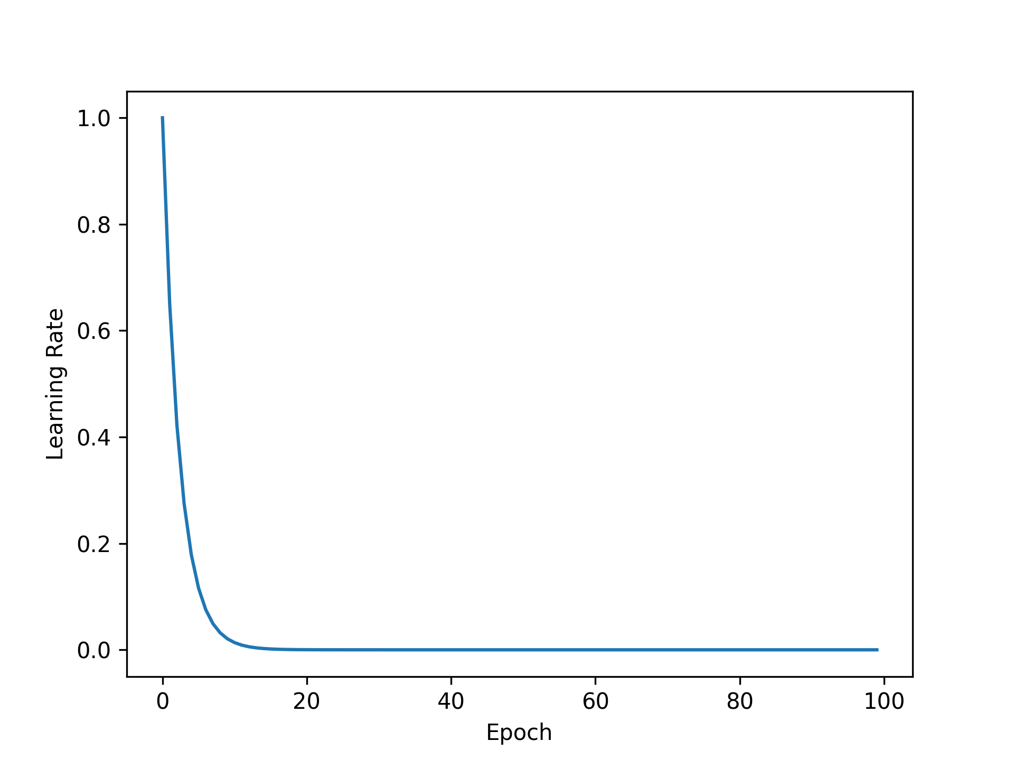
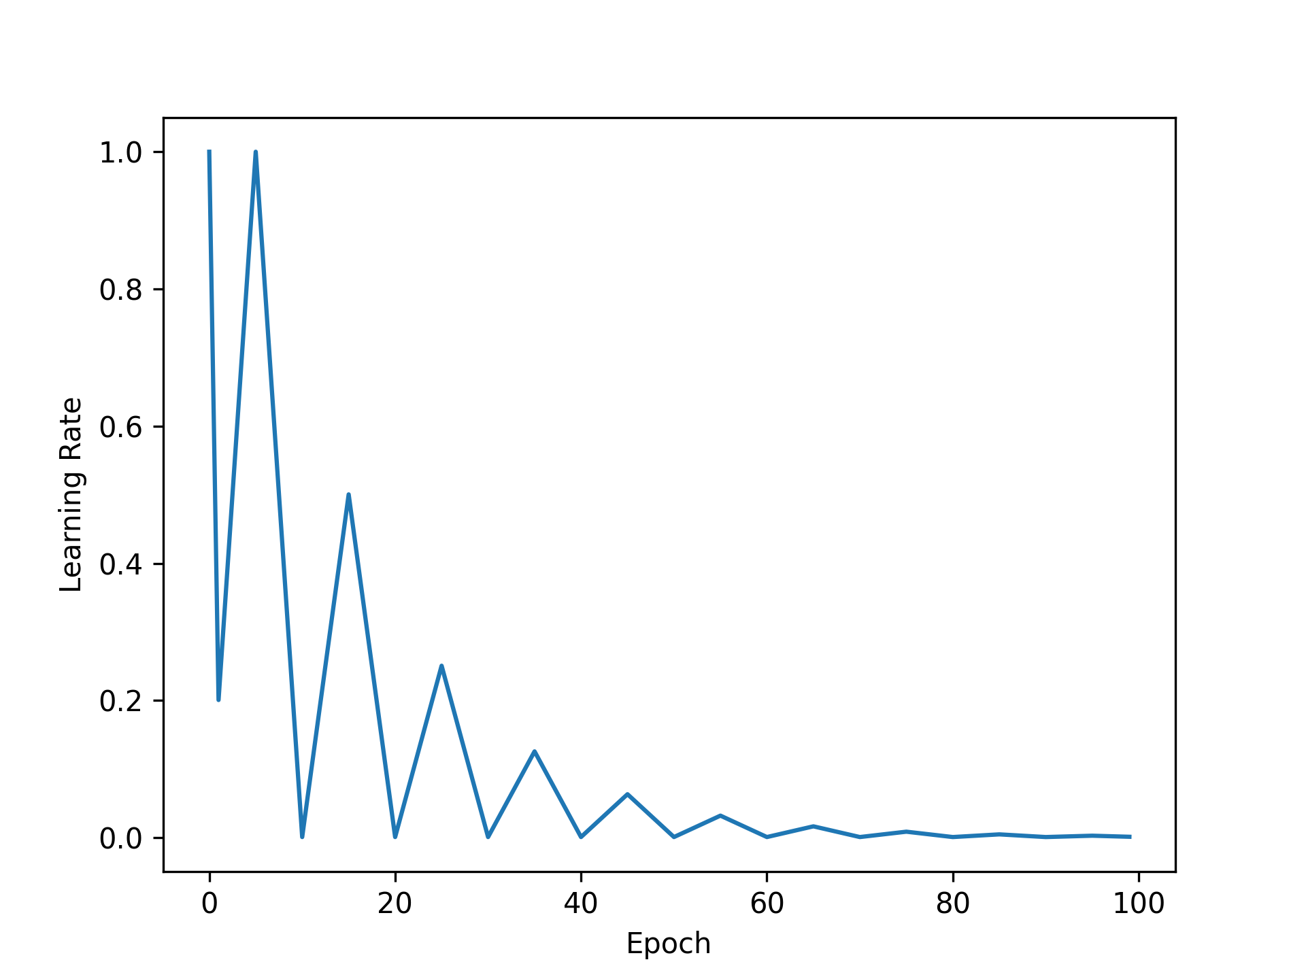
Learning rate scheduling
Exponential decay
Triangular exponential decay
Notes:
Pareil, y a tout type de façons (parfois un peu perchés) de scheduler le learning rate. Le choix de quel scheduling est en lui-même un hyperparamètre.

Slide 13
We will explore different optimizers, different learning rates schedulers in TD no worries!
Notes:
On va d’ailleurs coder la dernière figure dès maintenant.

Slide 14
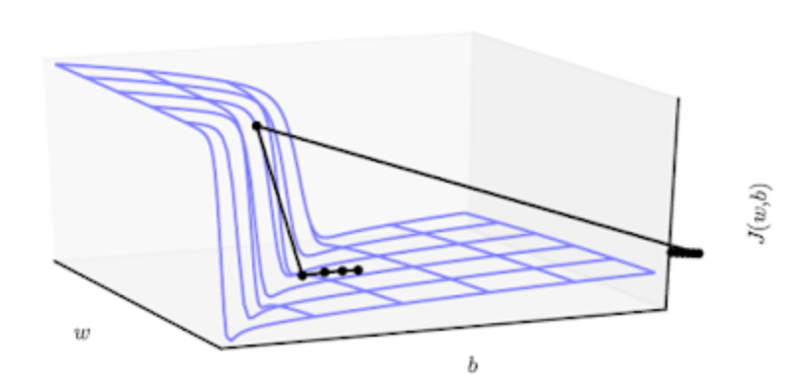
Gradient clipping
Notes:
Bien rappeler aux étudiants ce qu’on représente en x, en y et en z à chaque fois sur les graphes de loss en fonction des paramètres.

Slide 15
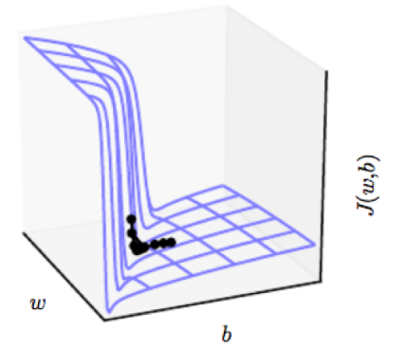
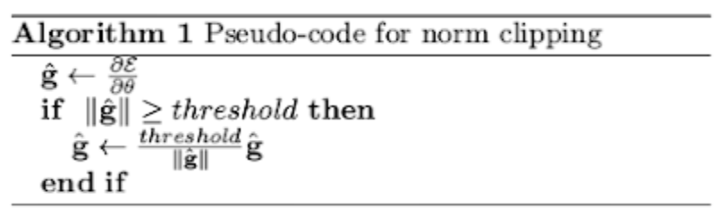
Gradient clipping
Notes:
Bien rappeler aux étudiants ce qu’on représente en x, en y et en z à chaque fois sur les graphes de loss en fonction des paramètres.

Slide 16
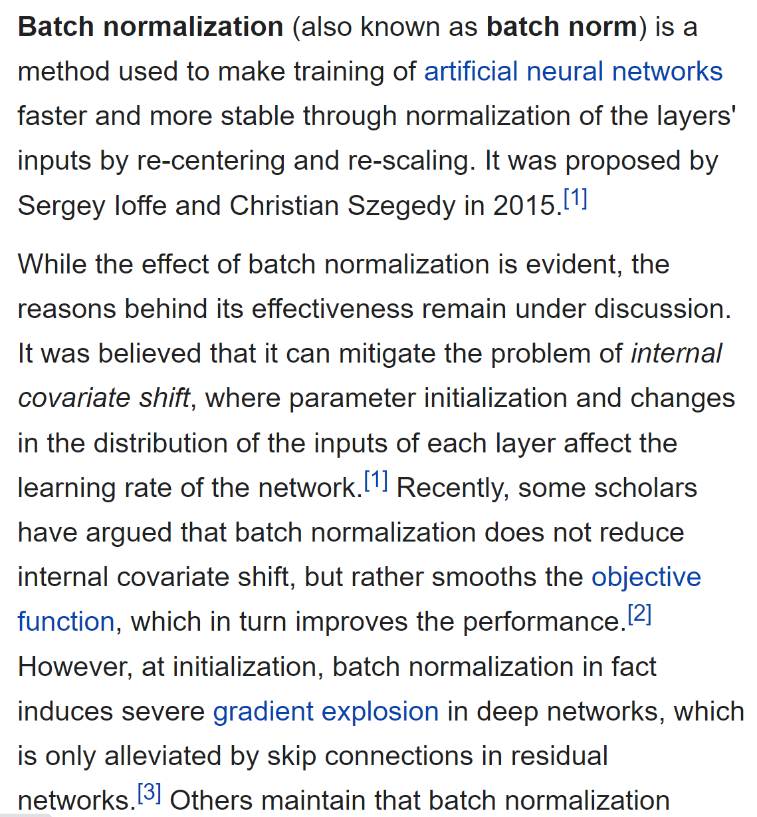
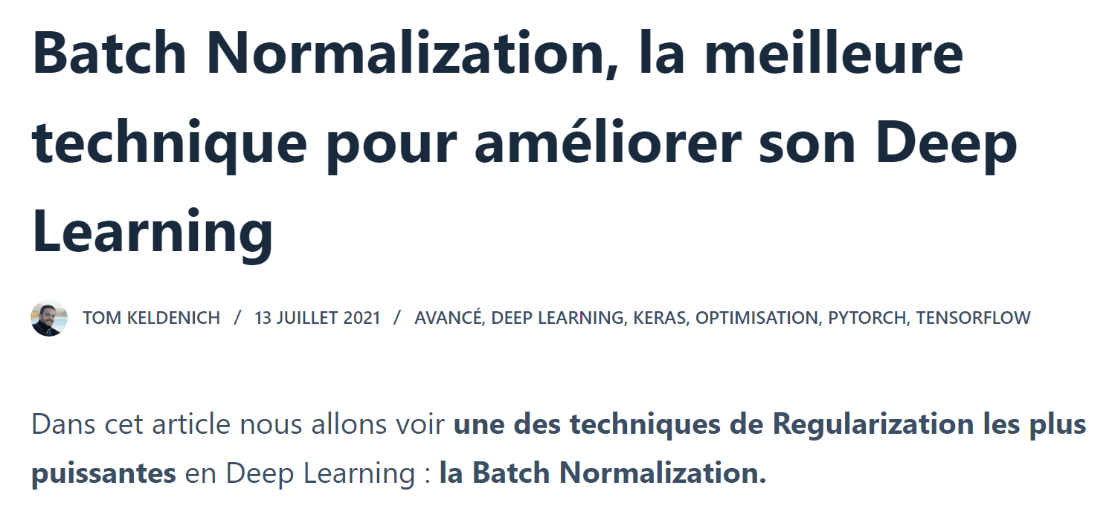
Batch normalization
Notes:
Deux screenshots pour montrer que le Deep Learning c’est récent et qu’on ne comprend pas forcément tout (on parle souvent de boîte noire). Les gens ne sont pas forcément d’accord, et les gens exagèrent souvent quand ils montrent des choses nouvelles. Le principal c’est de tester avec et sans, de regarder les loss sur le validation set, et si le résultat est meilleur, garder la chose.

Slide 17
Batch normalization
Change the input data of a neural network so that the mean is zero and the standard deviation is one
Normalization after each layer (i.e., at the entrance to each new layer) also allows for better learning.
Why is it called "Batch" Normalization?
-> The normalization we are currently talking about is not carried out on the entire dataset.

Slide 18
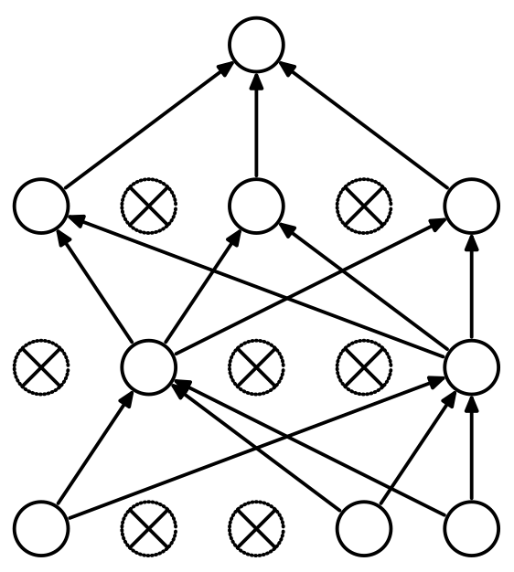
Dropout
Regularization technique for neural network models proposed by Srivastava et al. in their 2014 paper “Dropout: A Simple Way to Prevent Neural Networks from Overfitting”
Notes:
The choice of neurons to be deactivated is random. All neurons are assigned a probability p which determines their activation. A new hyperparameter!! When p = 0.1, each neuron has a 1 in 10 chance of being deactivated. At each epoch, we apply this random deactivation. That is, at each pass (forward propagation) the model will learn with a different configuration of neurons, with the neurons randomly turning on and off. This procedure effectively generates slightly different models with different neuron configurations at each iteration. Caution: Dropout is only active during model training. During tests, each neuron remains active.
Caution2: Consider the neurons at the output layer. During training, each neuron usually get activations only from n neurons from the hidden layer due to dropout. Now, imagine we finished the training and remove dropout. Now activations of the output neurons will be computed based on more neurons ! This is likely to put the output neurons in unusual regime, so they will produce too large absolute values, being overexcited. To avoid this, the outputs are scaled by a factor of 1/(1-p) during training.

Slide 19


Losses
torch.nn.L1Loss
torch.nn.MSELoss
In the case of categorical output, what should be considered?

Slide 20
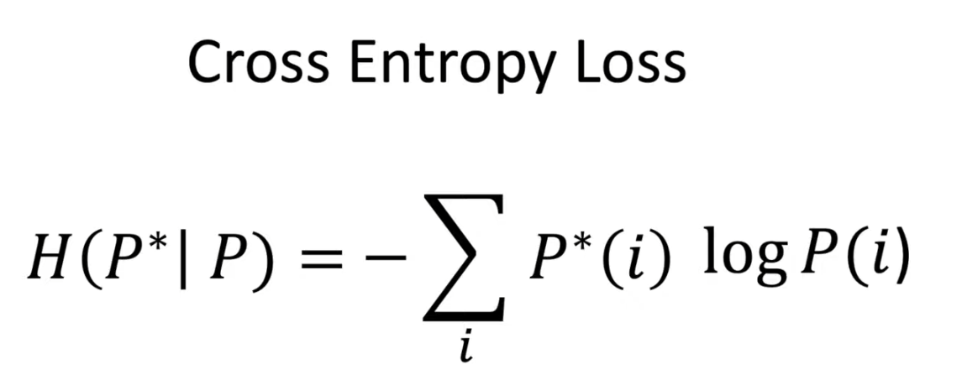
Losses
- i: input
- P*: true probability (P*(i) is either going to be 0 or 1)
- P: predicted probability
Notes:
Donner un exemple (dog cat horse human) et calculer la loss

Slide 21

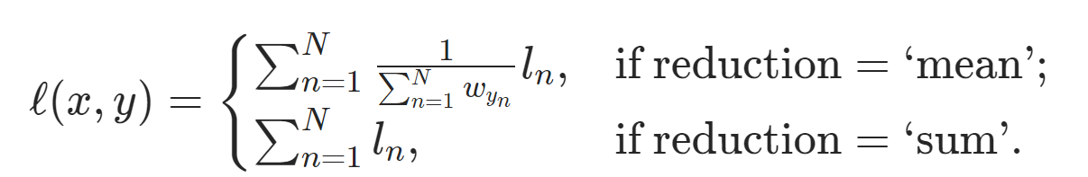
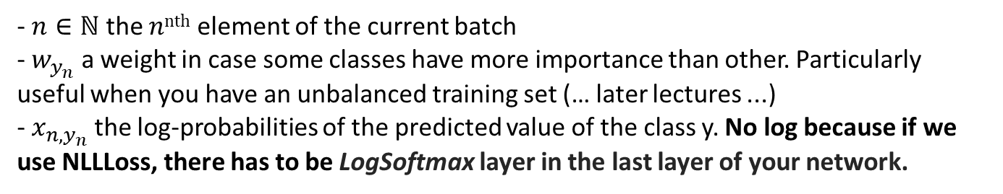
Losses
- $n∈ℕ$ the $nnth$ element of the current batch
- $w_{y_{n}}$ a weight in case some classes have more importance than other. Particularly
useful when you have an unbalanced training set (… later lectures ...)
- $x_{n, y_{n}}$ the log-probabilities of the predicted value of the class y. No log because if we
use NLLLoss, there has to be LogSoftmax layer in the last layer of your network.
And then we sum / mean across the batch :
torch.nn.NLLLoss
Notes:
Pourquoi y a que x_{n, y_{n}} ? Parce que, pour tous les autres le, P*(i) vaut 0 !!!
Si on fait mean, on divise pas par N mais par les poids attention !!!!!! En pratique de toute façon, avec PyTorch, on s’en fiche … mais c’est important de savoir comment ça marche quand même.

Slide 22
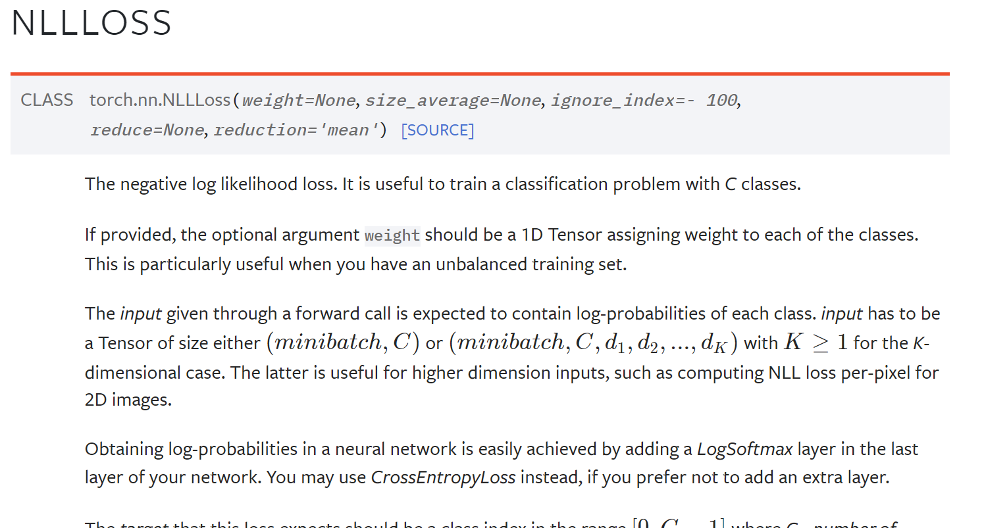


Losses

Slide 23
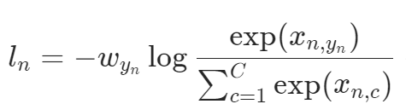

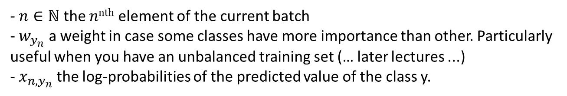



Losses
LogSoftMax
LogSoftMax
- $n∈ℕ$ the $nnth$ element of the current batch
- $w_{y_{n}}$ a weight in case some classes have more importance than other. Particularly
useful when you have an unbalanced training set (… later lectures ...)
- $x_{n, y_{n}}$ the log-probabilities of the predicted value of the class y.
And then we sum / mean across the batch :
torch.nn.CrossEntropyLoss
Notes:
Why log : cf. formula
Why SoftMax: we want values between 0 and 1!!! Cf. next slide.

Slide 24
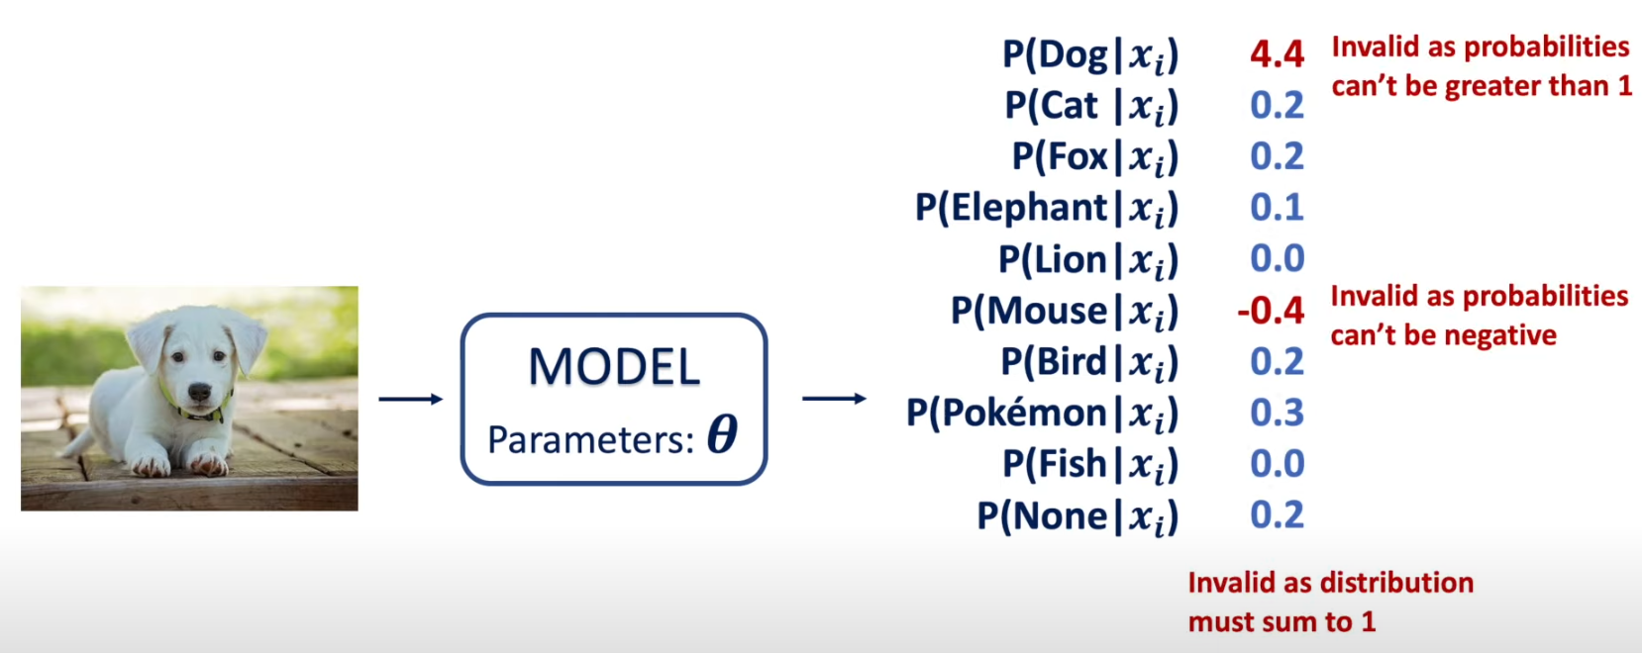
Why SoftMax?
From Intuitively Understanding the Cross Entropy Loss
Adian Liusie 2021
Notes:
We want probabilities! And we don’t want negative values in a logarithm …
Image source: https://www.youtube.com/watch?v=Pwgpl9mKars

Slide 25
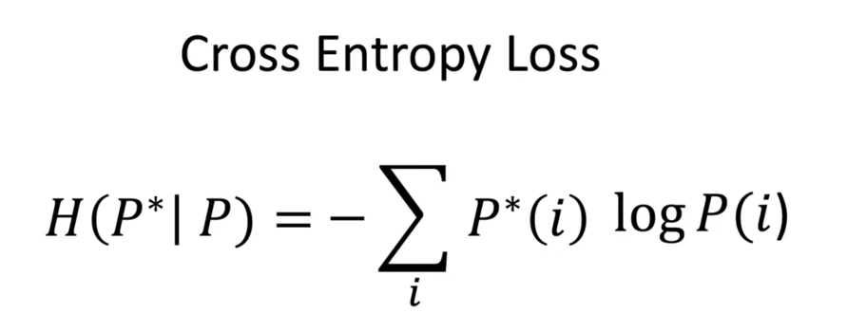
Losses
torch.nn.L1Loss
torch.nn.MSELoss
LogSoftmax + torch.nn.NLLLoss or torch.nn.CrossEntropyLoss

