Slide 1
Session 2
Conditions, Loops & Classes
Digital Health, Mastère Spécialisé · 2026
Paul Dubois

Slide 2
1. Making decisions

Slide 3
if / elif / else
temp = 38.4
if temp >= 39:
print("high fever")
elif temp >= 38:
print("fever")
else:
print("no fever")
Notes:
Session 1 gave the values; this session gives the control: run this code only sometimes, run that code many times, and give a name to a block of code. Three pieces of syntax, and they are the same for every block in Python: a line ending with a colon, then an indented block. Four spaces, always the same. The indentation is not decoration, it is the syntax: it is what tells Python where the block stops. if takes anything that is true or false, including the truthiness of Session 1 (if heart_rates:). The comparison >= produces a bool; = would be an assignment and a syntax error here.

Slide 4
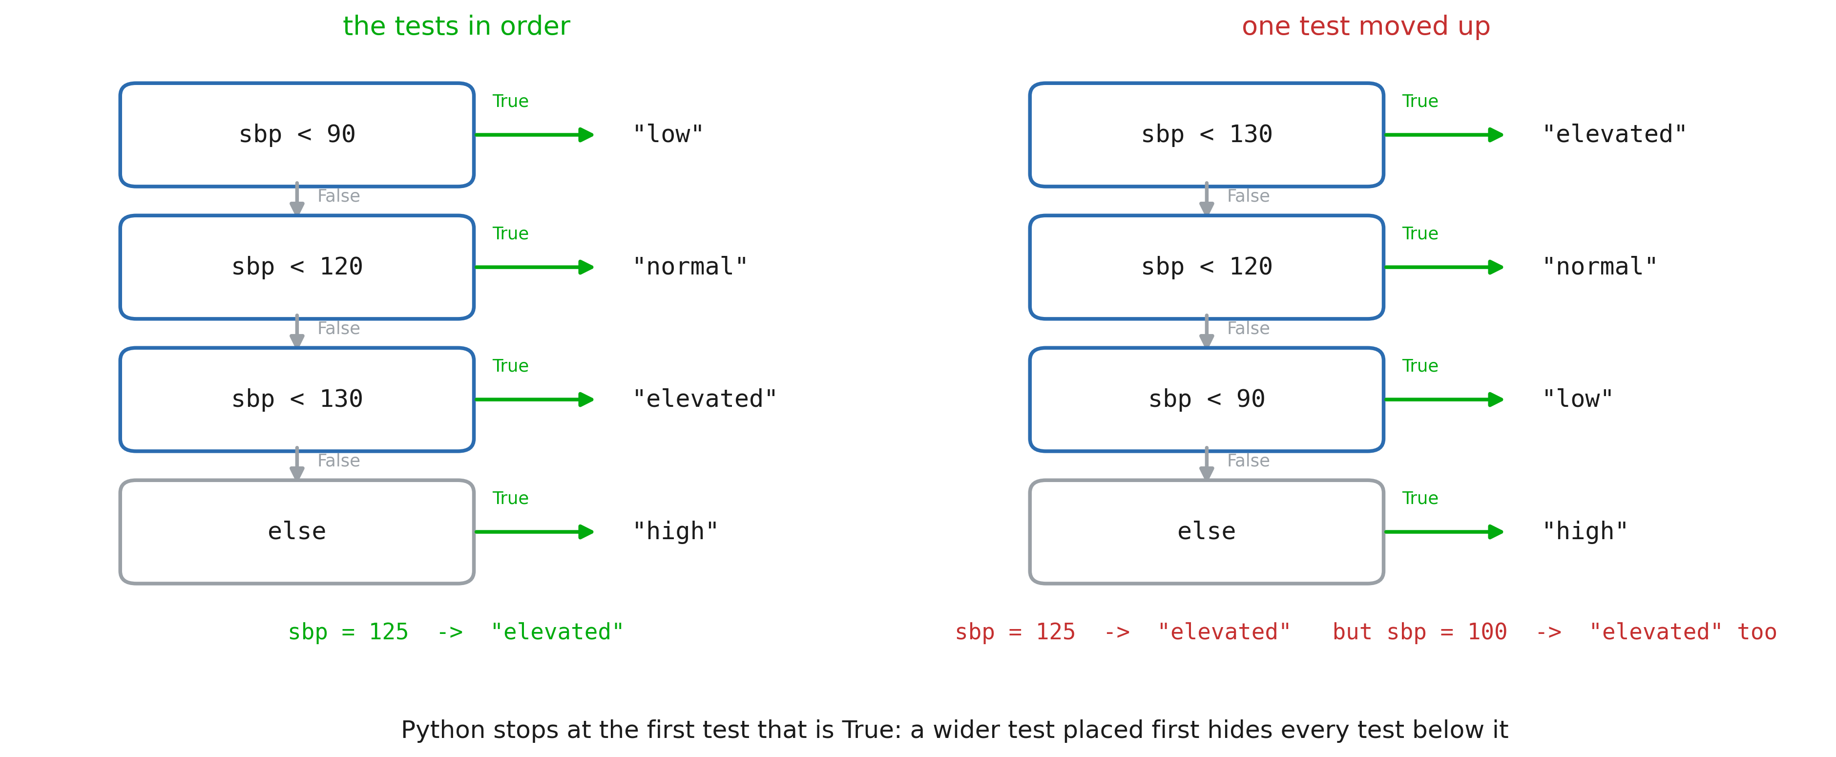
Order of tests
Notes:
With elif, Python tests from top to bottom and stops at the first true test: the rest is never evaluated. So each elif silently means “and none of the tests above matched”, which is exactly why sbp < 120 does not need to repeat and sbp >= 90. The classic bug is on the right: a wider test placed first swallows the narrower ones, and every patient below 130 comes out “elevated”. Nothing crashes, the numbers are just wrong, which is the dangerous kind of bug. The rule: for thresholds, go from the narrowest to the widest, and let else catch what is left.

Slide 5
2. Repeating work

Slide 6
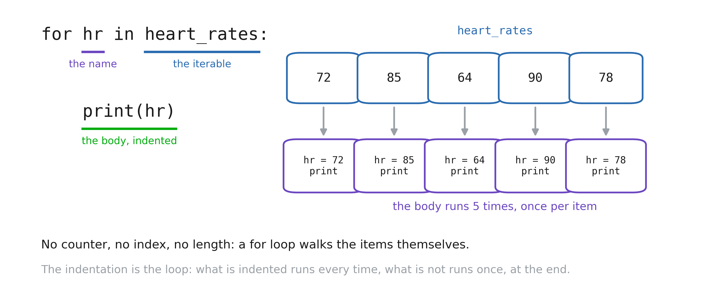
for loop
Notes:
Read it as the English sentence it is: “for each heart rate in heart rates, do this”. The name on the left is created by the loop and takes a new value each turn; there is no counter to initialise and no length to get right. Point at the indented block: it runs once per item, five times here, and what is not indented runs once, after the loop. The most common beginner bug of the session is a line that is accidentally in or out of the body. Coming from another language, they will want for i in range(len(xs)): xs[i]. Show them the direct form once and they rarely go back.

Slide 7
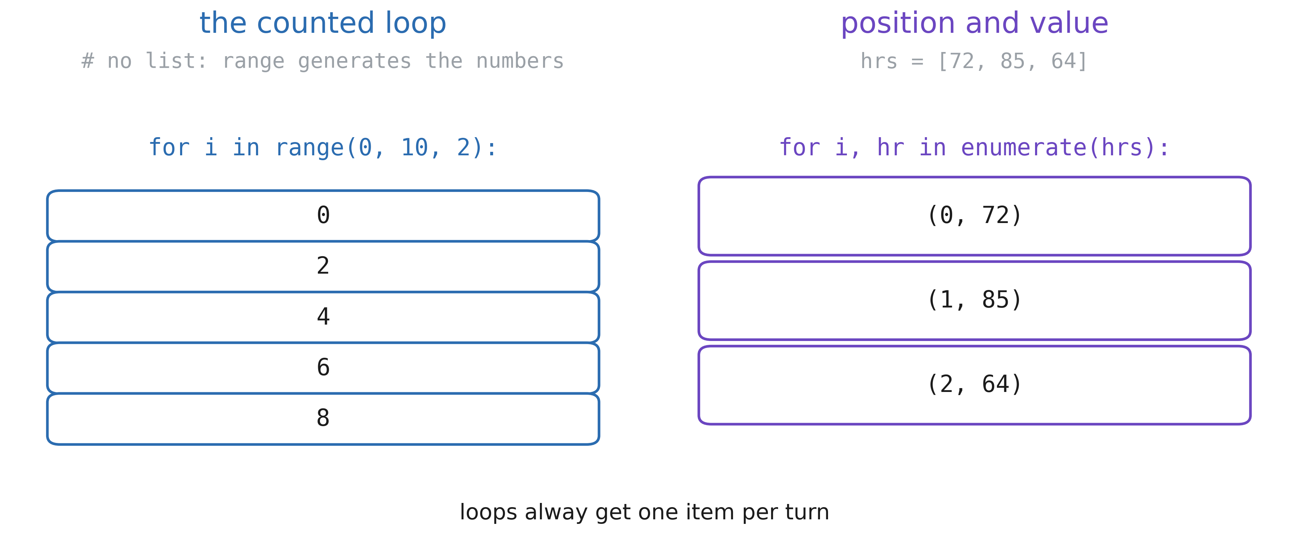
range and enumerate
Notes:
range(stop), range(start, stop), range(start, stop, step): the counted loop, used when the number of turns is the point and the items are not. Note range(5) stops at 4, like a slice, and that range builds nothing: it hands out the numbers one at a time, which is why range(10_000_000) is instant and costs no memory. enumerate when you need the position as well as the value: it gives a pair each turn, unpacked into two names exactly like a, b = 1, 2 in Session 1. Start elsewhere with enumerate(hrs, start=1) when you want to count from 1 for a human reader. If they find themselves writing for i in range(len(hrs)) and then hrs[i], enumerate is what they wanted.

Slide 8
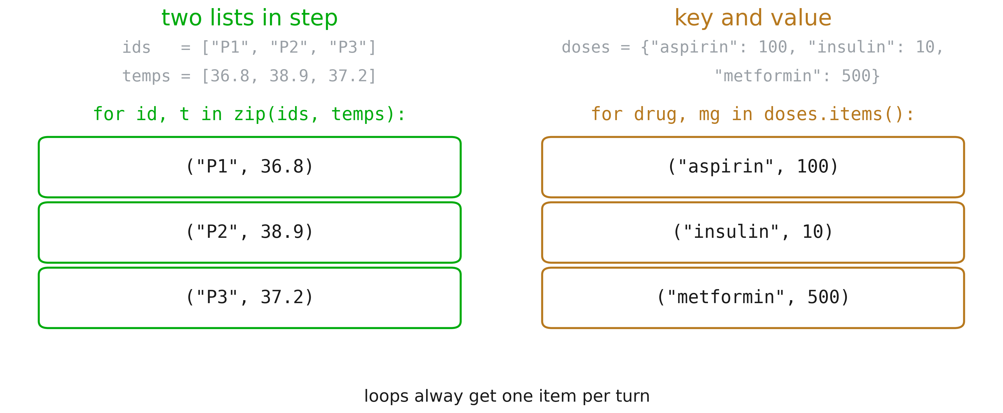
zip and .items()
Notes:
zip walks two (or more) sequences in step: ids and temperatures, heights and weights, measured and predicted. Again a pair per turn, unpacked into two names. One trap worth saying out loud: zip stops at the shortest sequence, silently. If the ids and the temperatures do not have the same length, the extra ones are dropped without a word, so check len first when the two come from different files. .items() does the same for a dictionary, giving the key and the value; .keys() and .values() exist when only one of them is needed. Iterating a dict directly gives the keys alone, which is a common surprise. These four helpers cover almost every loop they will write this year.

Slide 9
Accumulating a result
total = 0
for hr in heart_rates:
total = total + hr
mean = total / len(heart_rates)
Notes:
The accumulator pattern: a variable created before the loop, updated inside it, used after it. Sum, count, maximum, a list being built: they are all this shape. Create it before the loop, or the name does not exist yet; total = 0 for a sum, best = values[0] for a maximum (not 0, which breaks on negative values). They will do this by hand in the notebook, then meet sum, max and np.mean, which do the same thing faster and with less room for error. Writing it once by hand is what makes the shortcut readable afterwards.

Slide 10
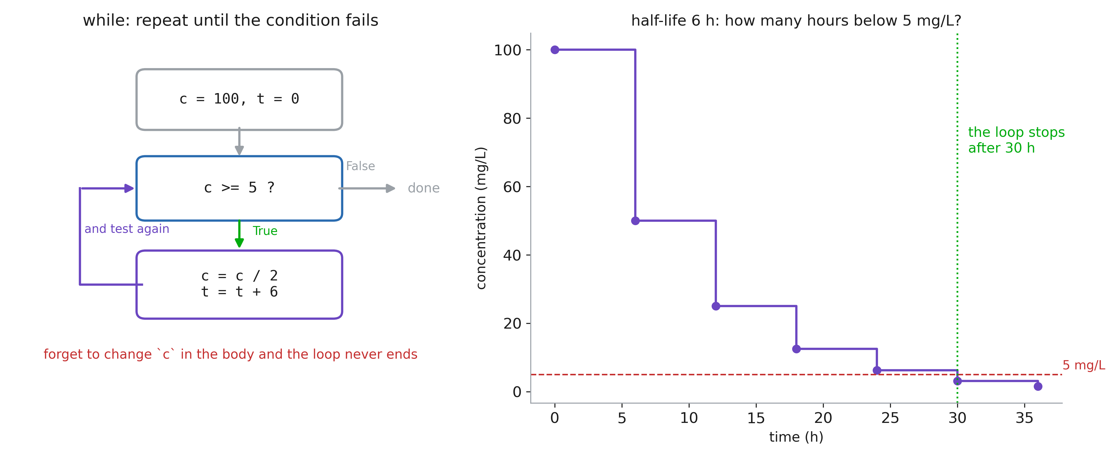
while: unknown number of iterations
Notes:
A for loop walks a finite collection; a while loop asks a question before each turn and stops when the answer is False. Use it when the number of turns depends on the computation itself: a half-life falling under a threshold, a solver converging, reading until the end of a stream. Every while loop needs three things, and forgetting the third is the classic infinite loop: an initial state, a condition that mentions it, and a body that changes it. The interrupt button (■) is their way out; mention it before they need it.

Slide 11
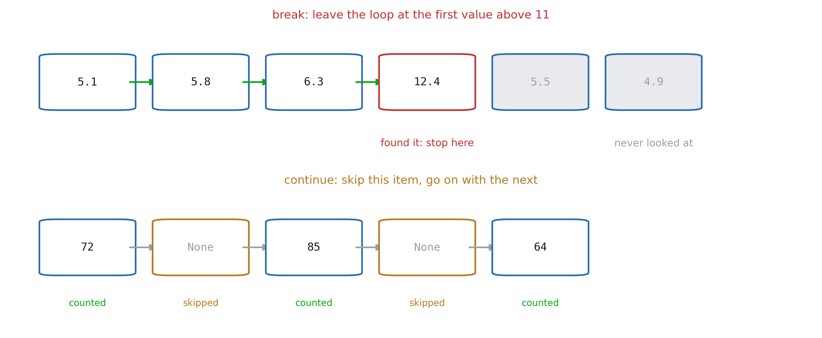
break and continue
Notes:
break leaves the loop immediately: the search is over, the remaining items are never looked at. This is how you find the first abnormal value without scanning the rest. continue abandons the current turn only and goes on to the next: the idiom for skipping missing values, which in real exports is most of the work. Both work in for and in while. Keep them for cases that read as “stop” or “skip”: nested in three levels of if, they become unreadable.

Slide 12
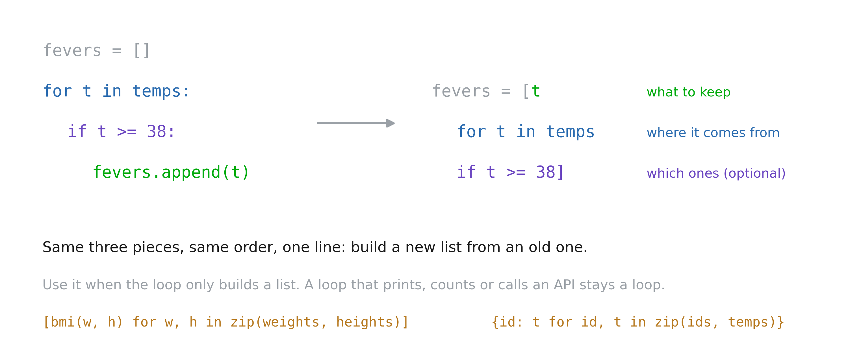
Comprehensions
Notes:
A comprehension is the same loop written as one expression: what to keep, where it comes from, and optionally which ones. Python reads it in that order, and so should they. It is the idiomatic way to transform a list into another list, and it shows up constantly in real code, so they must be able to read one even if they prefer writing loops. The limit: a comprehension builds a collection. A loop that prints, writes a file or calls a service stays a loop. And a comprehension with two for and three if should go back to being a loop.

Slide 13
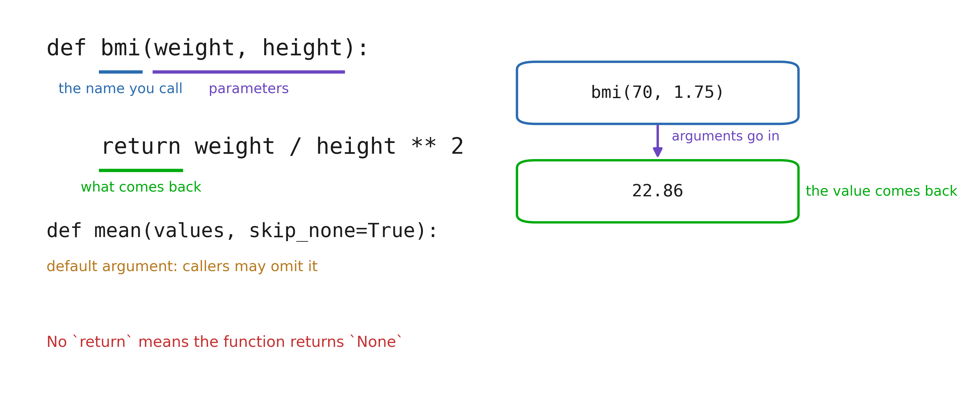
Functions
Notes:
def creates a function; calling it runs the body with the arguments bound to the parameters, and return hands a value back to the caller. Insist on the difference between printing and returning: print shows a value to a human and gives nothing back, return produces a value the rest of the program can use. A function that prints its result cannot be reused. Default arguments (skip_none=True) give an option without forcing every caller to think about it. Keyword arguments at the call site (mean(values, skip_none=False)) are worth the extra characters: in six months, that line still says what it does. Scope in one sentence: names created inside the function disappear when it returns.

Slide 14
3. Objects and classes

Slide 15
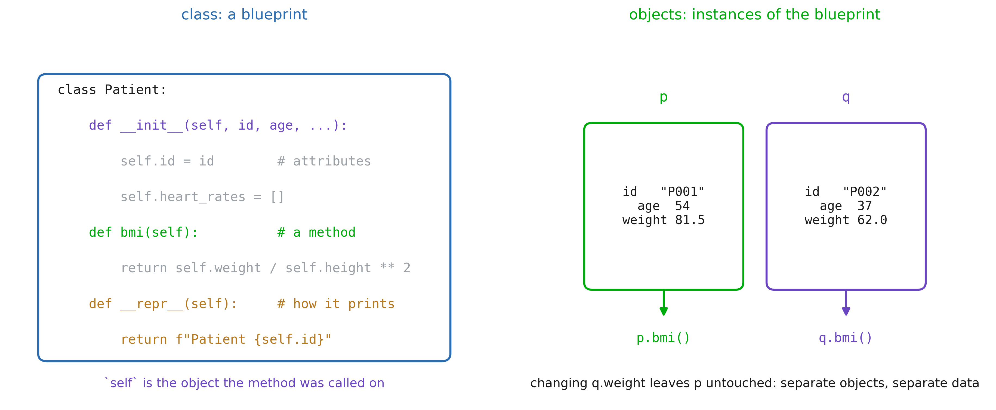
A class is a blueprint
Notes:
They have been using objects since Session 1 without the word: a str has .upper(), a list has .append(). A class is how you define your own type, for data that travels together. __init__ runs at creation and stores the attributes on self; self is simply the object the method was called on, and it is the first parameter of every method. p.bmi() is just Patient.bmi(p). The names with double underscores are hooks Python calls for you: __init__ at creation, __repr__ when the object is displayed, __len__ for len(obj). Define __repr__ early, it turns an unreadable <object at 0x7f...> into something they can debug with. Two objects of the same class are independent: changing q.weight leaves p untouched.

Slide 16
Dictionary or class?
# dict: data only
p = {"id": "P001", "age": 54}
p["age"]
# class: data + behaviour
class Patient:
def bmi(self): ...
p.bmi()
Notes:
Honest answer: for a handful of fields read once from a CSV, a dict is fine, and that is what pandas will give them anyway. A class earns its place when behaviour belongs with the data (a BMI computed from the patient’s own fields), when the same shape is created many times, or when you want a guarantee that every object has the same attributes, which a dict never gives you: a typo in a key creates a new key instead of an error.

Slide 17
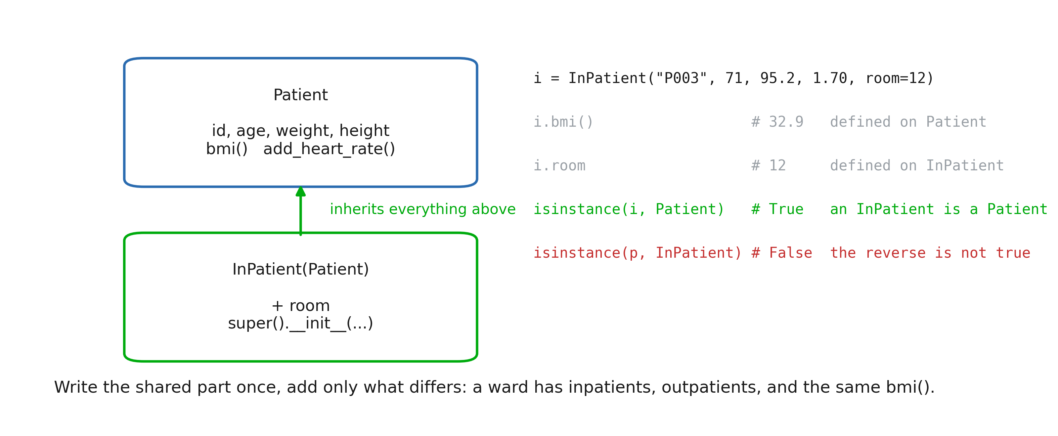
Inheritance
Notes:
class InPatient(Patient) means “an InPatient is a Patient, plus a room”. The class in brackets is the parent (base class, superclass); the new one is the child, or subclass. Everything defined on Patient is available on an InPatient without being written again: the attributes set in __init__, bmi(), add_heart_rate(), __repr__. super().__init__(id, age, weight, height) calls the parent’s constructor, so the shared attributes are set in one place, by the class that owns them. Forgetting that call is the classic mistake: the object is created, and then i.bmi() fails with AttributeError: 'InPatient' object has no attribute 'weight', because nobody ever set it. isinstance(i, Patient) is True, and that is the whole point: code written for patients works unchanged on inpatients. The reverse is False; an InPatient is a special case of Patient, not the other way round. Prefer isinstance(x, Patient) to type(x) == Patient, which answers False for every subclass and quietly breaks the idea. A warning: inheritance is tempting and often wrong. Use it when the sentence “X is a Y” is literally true; when X merely has a Y, store it as an attribute instead.

Slide 18
Parent class
class Patient():
def __init__(self, id, age, weight, height):
self.id = id
self.age = age
self.weight = weight
self.height = height
def __repr__(self):
return f"Patient {self.id}"
i = Patient("P003", 71, 95.2, 1.70)
i.bmi() # -> computes 95.2^2 / 1.70

Slide 19
Child class
class InPatient(Patient):
def __init__(self, id, age, weight, height, room):
super().__init__(id, age, weight, height)
self.room = room
def __repr__(self):
return f"InPatient {self.id}, room {self.room}"
i = InPatient("P003", 71, 95.2, 1.70, room=12)
i.bmi() # not on InPatient -> found on Patient
i # InPatient('P003', room 12)
Notes:
The rule is one line: Python looks for the name on the object’s own class first, then on its parent, then on its parent, up to object; the first one found wins. i.bmi() is not defined on InPatient, so Python walks up and runs the one on Patient. repr(i) is defined on both, so the child’s version wins: that is overriding. An overridden method can still reuse the one it replaced: super().__repr__() inside the child calls the parent’s version, which is how you extend behaviour instead of copying it. Same idea as super().__init__, which is nothing more than an overridden __init__ calling the original. The payoff is polymorphism: one loop over a mixed list of Patient and InPatient objects calls p.bmi() on each, and each object runs the right version. No test on the type anywhere, which is exactly the if ladder that rots when a new case appears. Debugging habit: when a method does not do what they expect, ask which class it came from. type(i).__mro__ prints the search order, help(InPatient) shows what was inherited and what was redefined.

