Slide 1
Session 0
Libraries, Environments, and uv
Digital Health, Mastère Spécialisé · 2026
Paul Dubois

Slide 2
1. Libraries

Slide 3
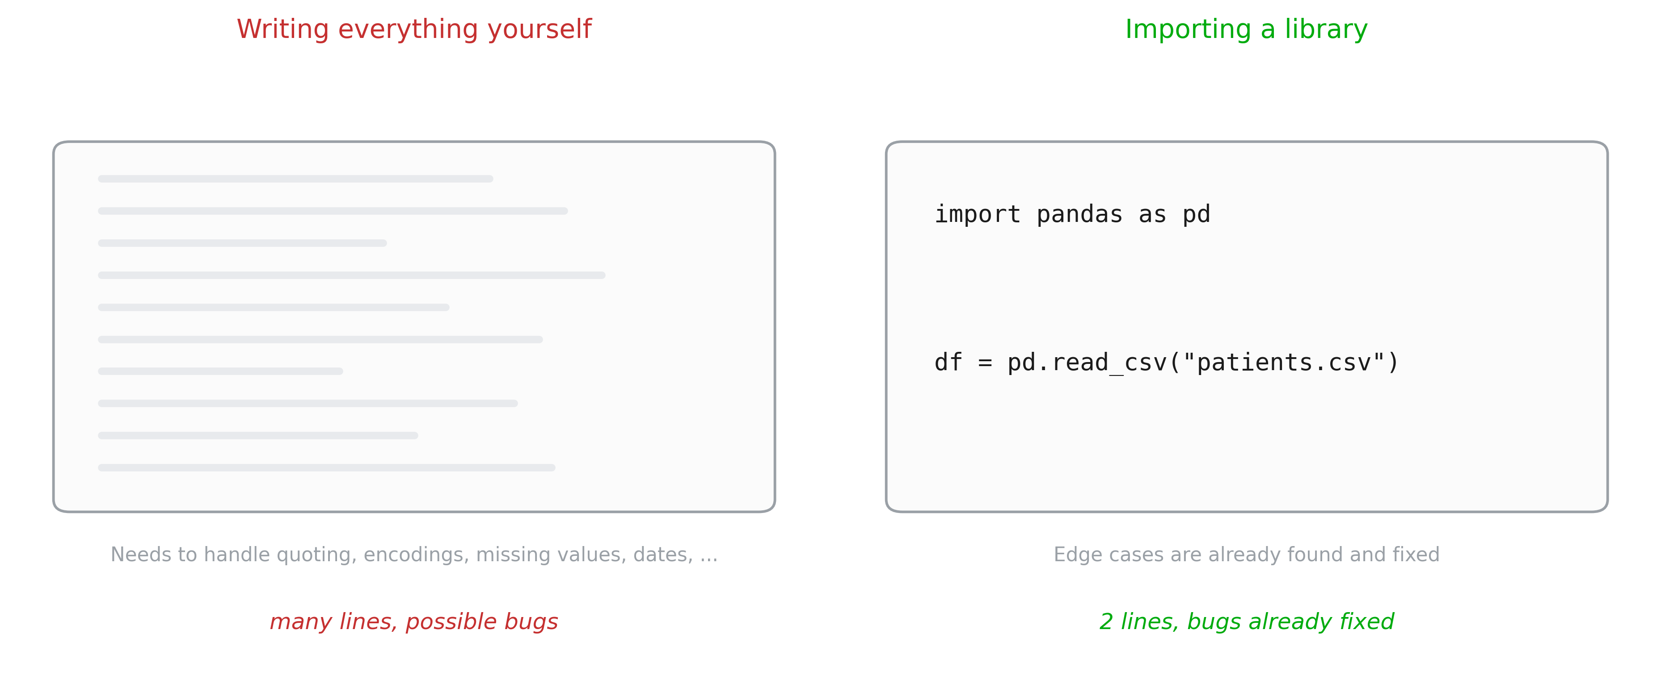
Reusing code

Slide 4
Libraries
Standard libraries
  tkinter (basic GUI)
  re (regular expressions)
  json (reading json files)
Installed libraries:
  numpy (arrays)
  matplotlib/seaborn (plots)
  pandas (data)
  scikit-learn (machine learning)
  pytorch (neurale networks)
  pydicom, nibabel (DICOM/NifTi images)
Your own files
  e.g.: a neural network architecture you want to reuse

Slide 5
2. Versions, and why environments exist

Slide 6
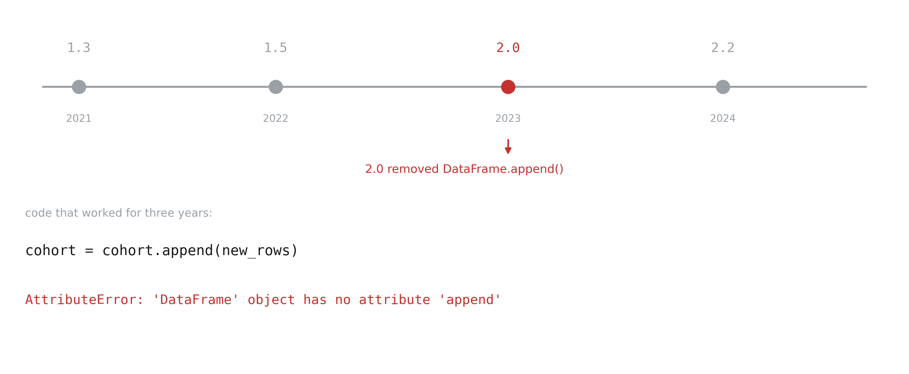
Libraries move

Slide 7
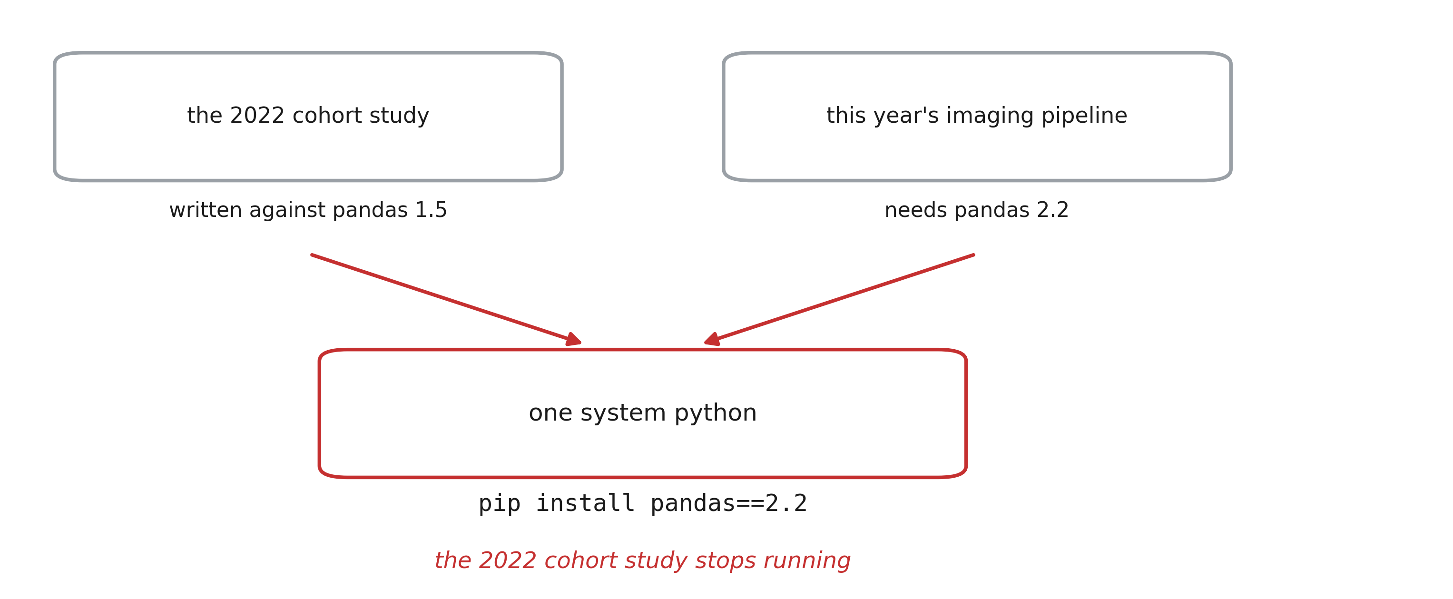
Projects versions clash

Slide 8
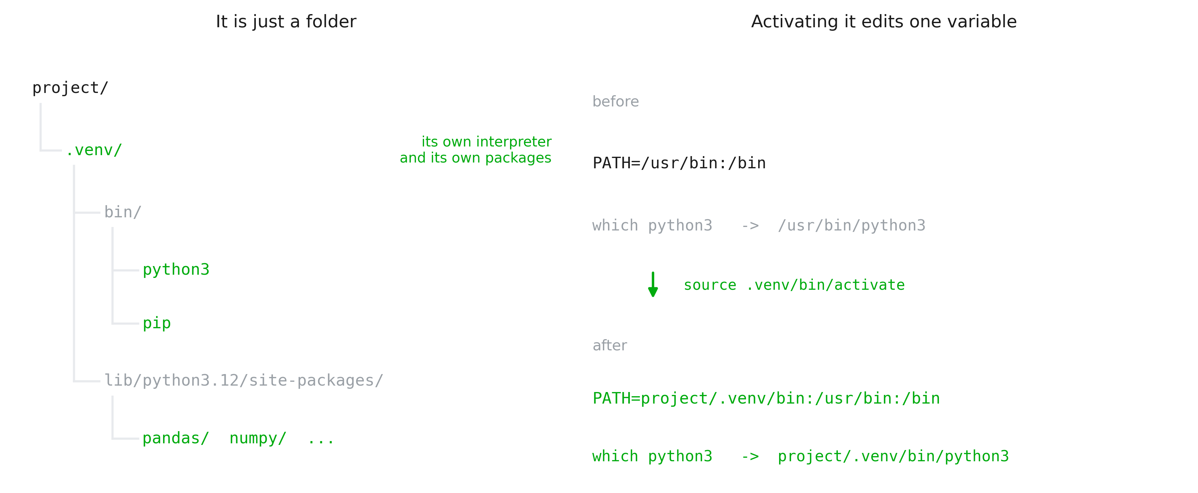
Virtual environment is a folder

Slide 9
Making a virtual environment
python3 -m venv .venv # create it
source .venv/bin/activate # Windows: .venv\Scripts\activate
which python3 # my-project/.venv/bin/python3
python3 -m pip install pandas # into .venv, not into the system
deactivate

Slide 10
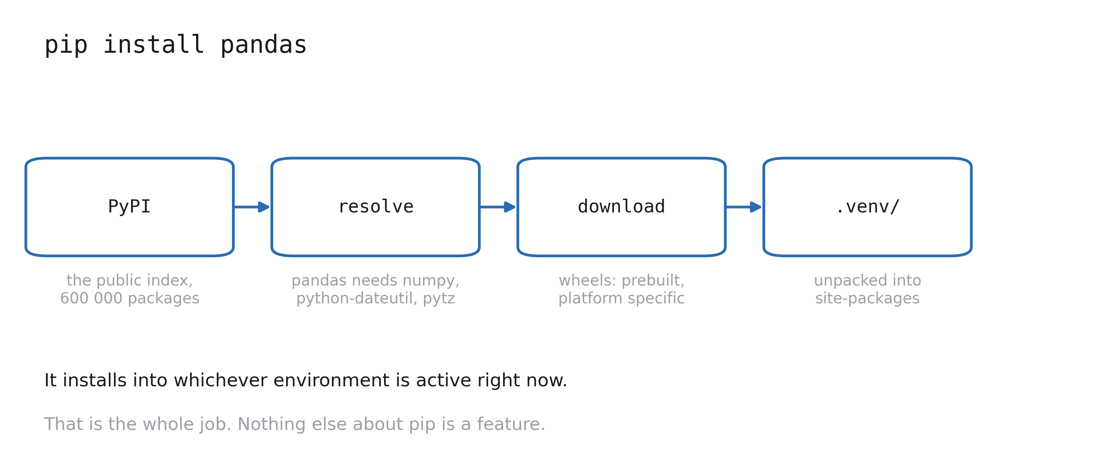
pip

Slide 11
Freezing an environment
python3 -m pip freeze > requirements.txt # pandas==2.2.3, numpy==2.1.3, ...
# on another machine, in a fresh environment:
python3 -m pip install -r requirements.txt

Slide 12
3. uv

Slide 13
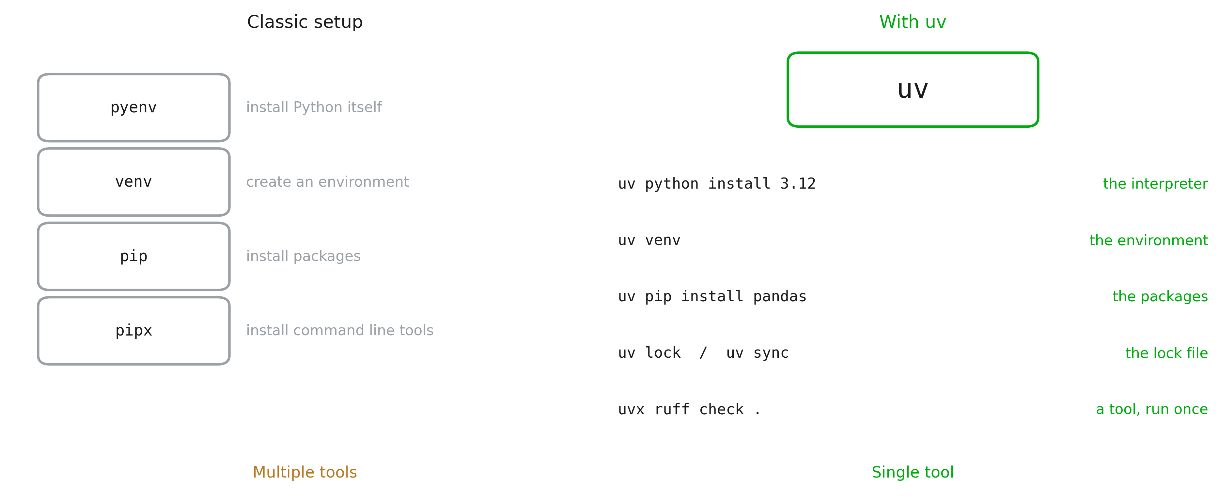
What is uv?
Notes:
uv is a single program, written in Rust by Astral (the people behind ruff), first released in 2024. It does the jobs of five separate tools with one command and one mental model. Important reassurance: the commands are the ones they already learned. uv pip install pandas does what pip install pandas does.

Slide 14
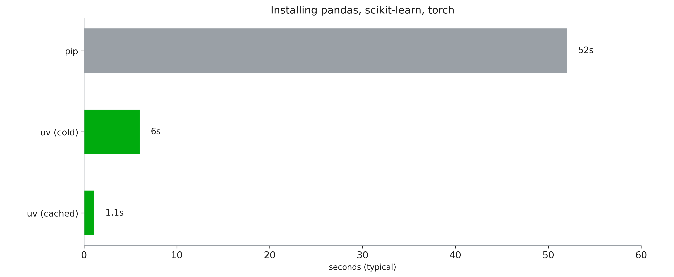
Speed

Slide 15
uv in practice
curl -LsSf https://astral.sh/uv/install.sh | sh
# no Python required
uv venv
uv pip install pandas
uv add pandas # adds library to lock file
uv sync # install dependencies in the lock file
uv run analysis.py # uses uv venv

