Slide 1
Session 4
Tables with pandas, plots with Matplotlib
Digital Health, Mastère Spécialisé · 2026
Paul Dubois

Slide 2
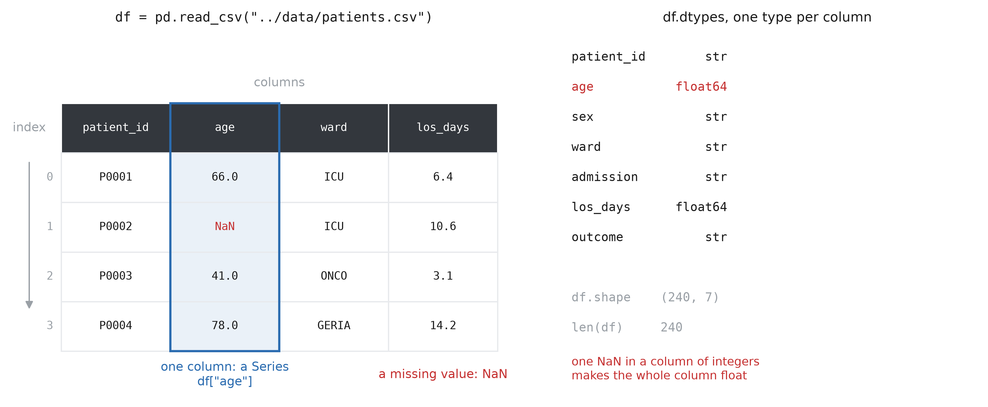
The table before the plot
Notes:
Before any figure there is a table: an export from the hospital information system, a spreadsheet from a colleague, the results of a query. pandas is the library that reads it and gives you one object, the DataFrame. Vocabulary, which every error message uses. The DataFrame is the whole table. Each column has a name and one type (df.dtypes); one column alone is a Series. Each row has a label, the index, which by default is just its position. The age column is read as float64 and not as an integer because of the missing value: NaN only exists for floats, so one empty cell makes the whole column float. That is the first surprise of every real export. df.head(), df.shape, df.info(): the three commands to run on any table you receive, before anything else.

Slide 3
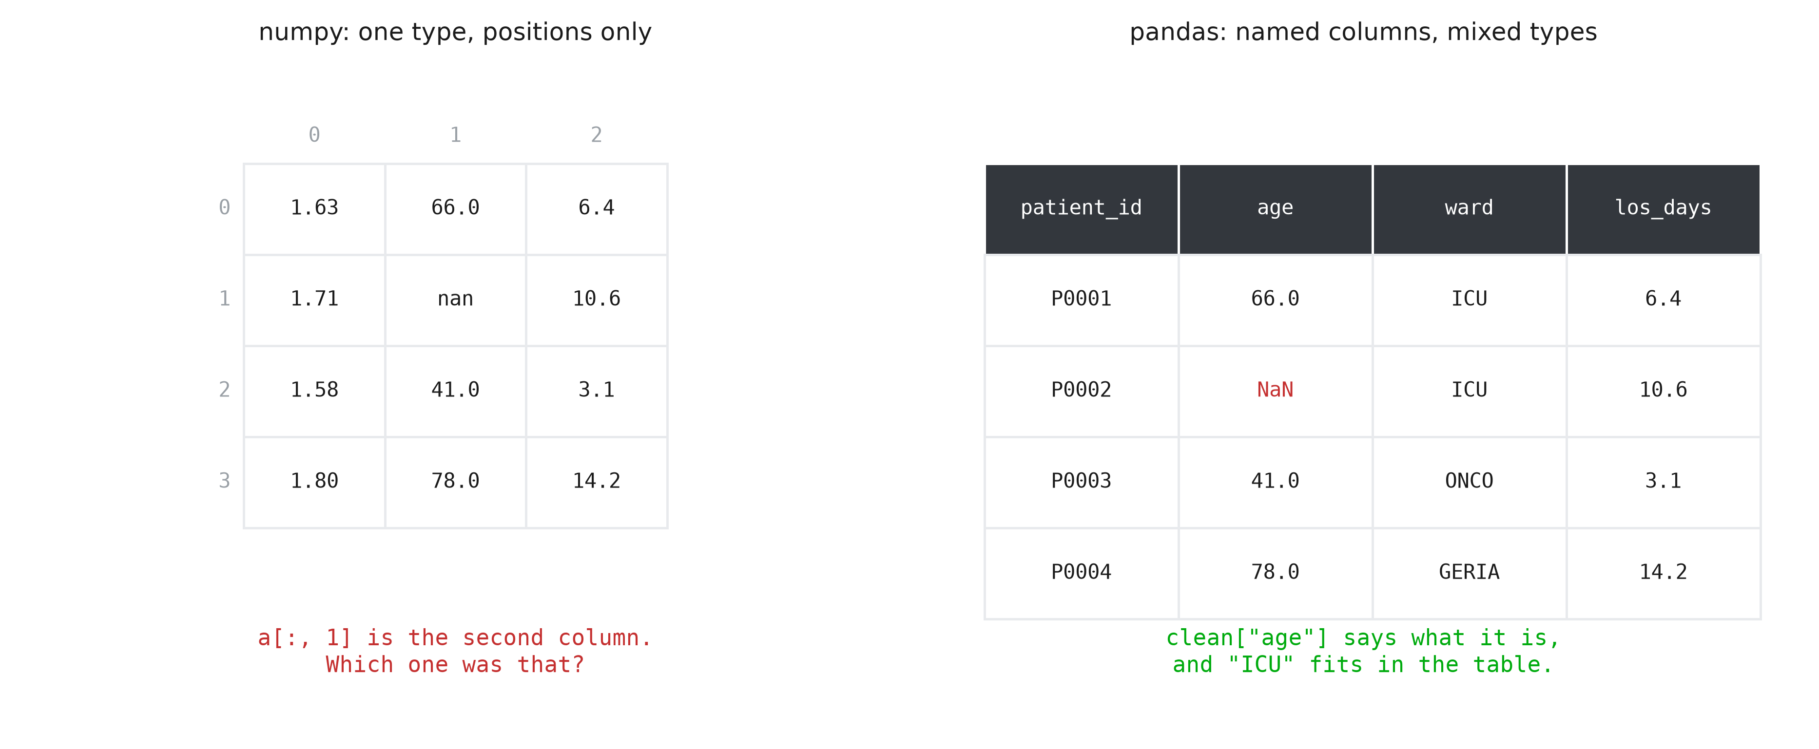
Table or array?
Notes:
A numpy array (Session 3) holds one type and positions. a[:, 1] is the second column, and nothing in the array says what the second column was: you keep that in your head, or in a comment, and one day you get it wrong. A DataFrame keeps the names and allows one type per column, so text (ward, outcome) and numbers live in the same table. clean["age"] cannot be the wrong column. The rule for this course: pandas to load, clean and select; numpy inside, for the computation; matplotlib at the end, for the figure. A column is a numpy array underneath, so ax.plot(df["age"], df["los_days"]) just works.

Slide 4
Loading a table
import pandas as pd
df = pd.read_csv("../data/patients.csv")
df.head()
df.shape # (240, 7)
df.dtypes # one type per column
df.info() # types and the number of values present
Notes:
pd.read_csv is one line for what took a csv.DictReader loop, a list of dicts and a manual conversion of every field. It also reads Excel (read_excel), JSON, SQL and others, with the same shape of call. Useful arguments when the export does not cooperate: sep=";" (the French Excel default), decimal=",", na_values=["", "NA", "NR"], parse_dates=["admission"], encoding="latin-1". df.info() is the one that tells you how many values are actually present per column, so how many are missing.

Slide 5
Missing values and types
df.isna().sum() # how many NaN per column
clean = df.dropna() # keep only the complete rows
len(df), len(clean) # 240, 232
clean["age"] = clean["age"].astype("int64")
clean["ward"] = clean["ward"].astype("category")
clean["admission"] = pd.to_datetime(clean["admission"])
Notes:
isna() gives a table of True/False, and .sum() counts the True per column: the missing value report of the export, in one line. dropna() removes every row with at least one missing value. It is the simplest choice, not always the right one: here it costs 8 patients out of 240. dropna(subset=["age"]) drops only on the column that matters, and fillna(value) replaces instead of dropping. Whatever you choose, say it in the methods section. Once the NaN are gone, astype("int64") gives back a real integer age. "category" is for a column with few distinct values (the ward, the outcome): less memory, and it says that these are groups. pd.to_datetime turns the admission text into real dates, which can be subtracted and sorted.

Slide 6
Selecting
clean["age"] # one column, a Series
clean["age"].mean() # 50.9
clean["ward"].value_counts() # how many patients per ward
summary = clean[["patient_id", "age"]] # a smaller DataFrame
type(clean["age"]) # Series
type(clean[["age"]]) # DataFrame, one column
Notes:
One name in the brackets gives a Series, which carries the usual statistics as methods: mean, median, std, min, max, describe. value_counts() is the one you will use constantly on the categorical columns: the number of patients per ward, per outcome, per sex, sorted, in one call. A list of names in the brackets gives a DataFrame with those columns, in that order. Hence the double brackets: the outer ones are the selection, the inner ones are the list. Selecting rows instead of columns is a condition: clean[clean["ward"] == "ICU"], exactly the boolean masks of Session 3, applied to a table.

Slide 7
A new column with .apply
def stay_length(days):
if days < 3:
return "short"
if days > 10:
return "long"
return "medium"
summary["stay"] = summary["los_days"].apply(stay_length)
Notes:
add summary["age_group"] = summary["age"].apply(lambda a: "minor" if a < 18 else "adult")?
.apply(f) calls f on every value of the column and returns a new column of results. The function is an ordinary Python function (Session 2), so any rule you can write, you can apply: a clinical threshold, a recoding, a parsing of a free text field. Assigning to summary["stay"] with a name that does not exist yet creates the column. For arithmetic, do not use apply: clean["weight"] / clean["height"] ** 2 works on whole columns at once, and is much faster because numpy does the loop. Keep apply for what cannot be written as a formula.

Slide 8
Saving a table
summary.to_csv("patients_summary.csv", index=False)
back = pd.read_csv("patients_summary.csv")
back.shape # (232, 6)
Notes:
to_csv writes the table back to disk, and index=False keeps the row labels out of the file. Without it you get a nameless first column of 0, 1, 2, which the next reader (often you, next month) has to clean up again. Other formats, same call: to_excel when a colleague asks for it, to_parquet for a large table that stays inside the project (smaller and faster, and it keeps the types). Never save over the raw export. The raw file stays untouched, the script rebuilds everything else: that is what makes the analysis reproducible.

Slide 9
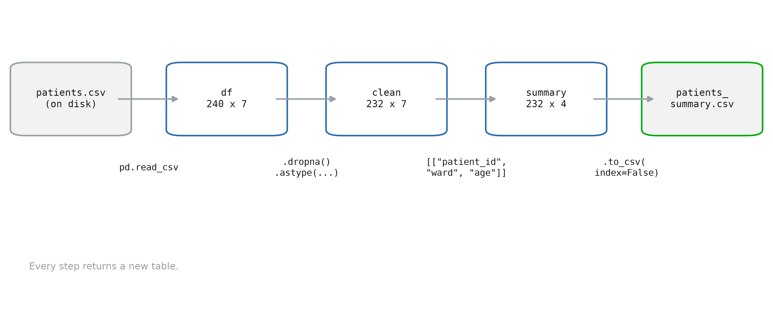
Full workflow
Notes:
This is the shape of almost every analysis script: load, clean, select, compute, save, and then plot. Every step returns a new table instead of changing the old one, so the variable names (df, clean, summary) record the state of the data at each step, and re-running a cell cannot corrupt what came before. The rest of this session is the last arrow, the figures, with matplotlib. The columns you just selected are what you are about to plot.

Slide 10
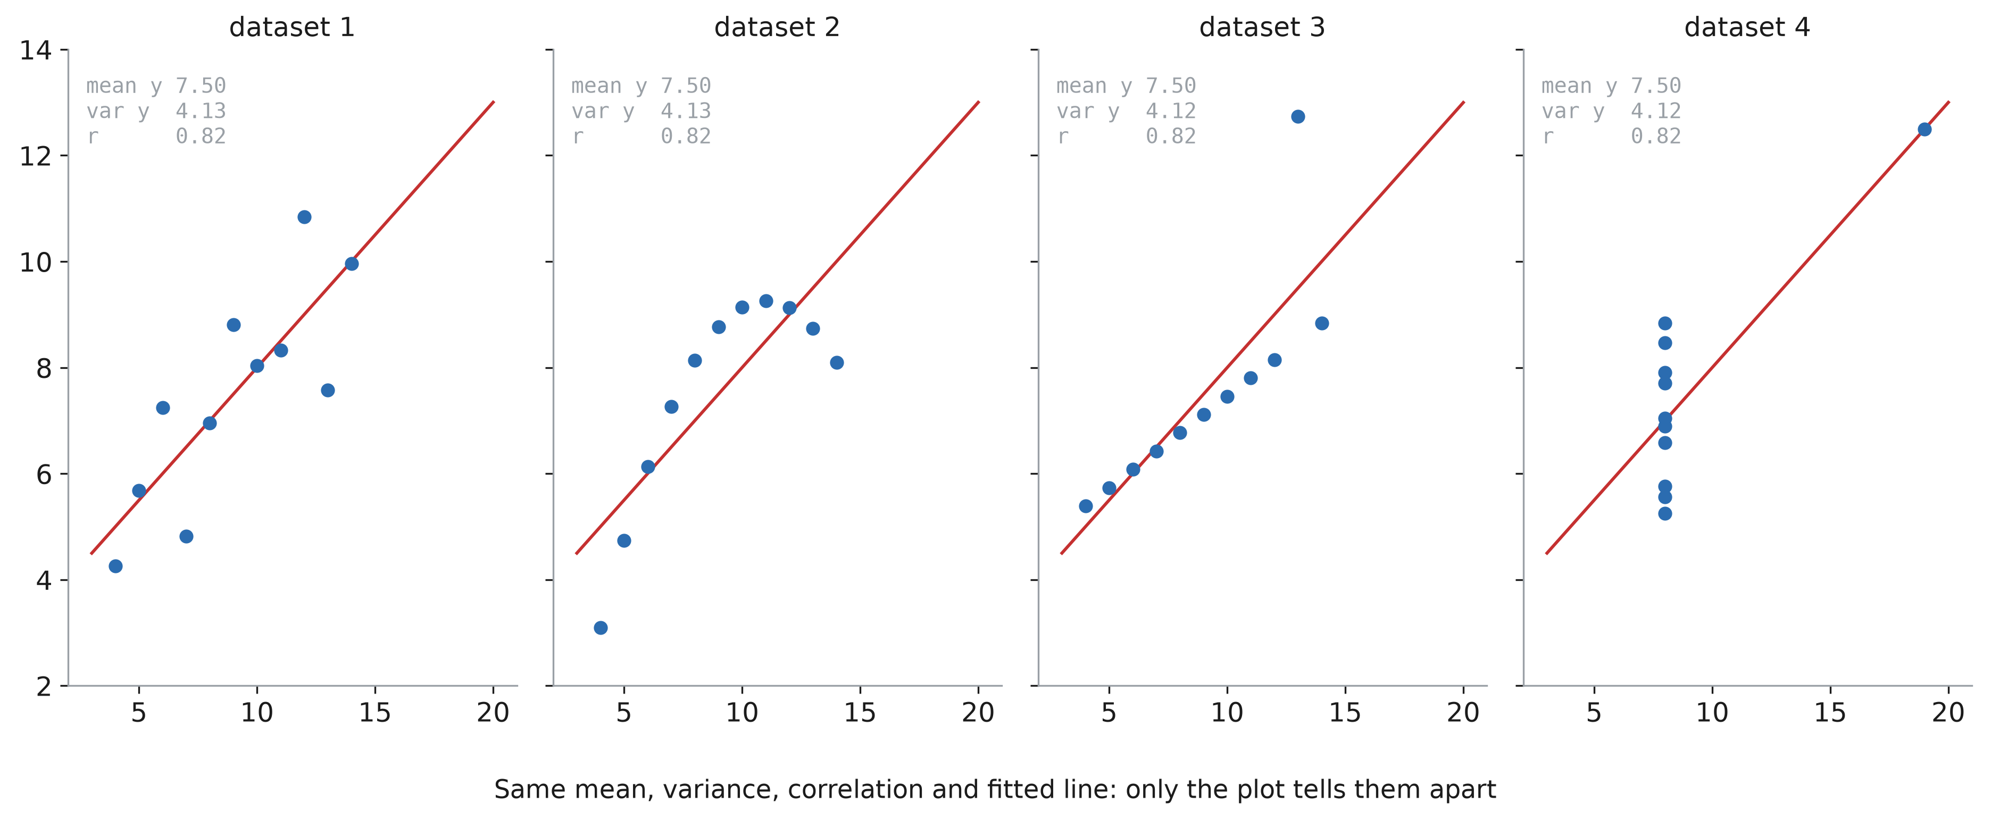
Understanding with a plot
Notes:
Anscombe’s quartet (1973). Four datasets of 11 points: same mean, same variance, same correlation, same regression line, to two decimals. A table of summary statistics says they are identical. The plots say: a noisy linear relation, a curve, a perfect line with one outlier, and no relation at all except one extreme point. The habit to build: plot the raw data before any statistic. In clinical data the plot is where you find the impossible ages, the unit changes (kg vs lb), the duplicated rows and the device that was unplugged.

Slide 11
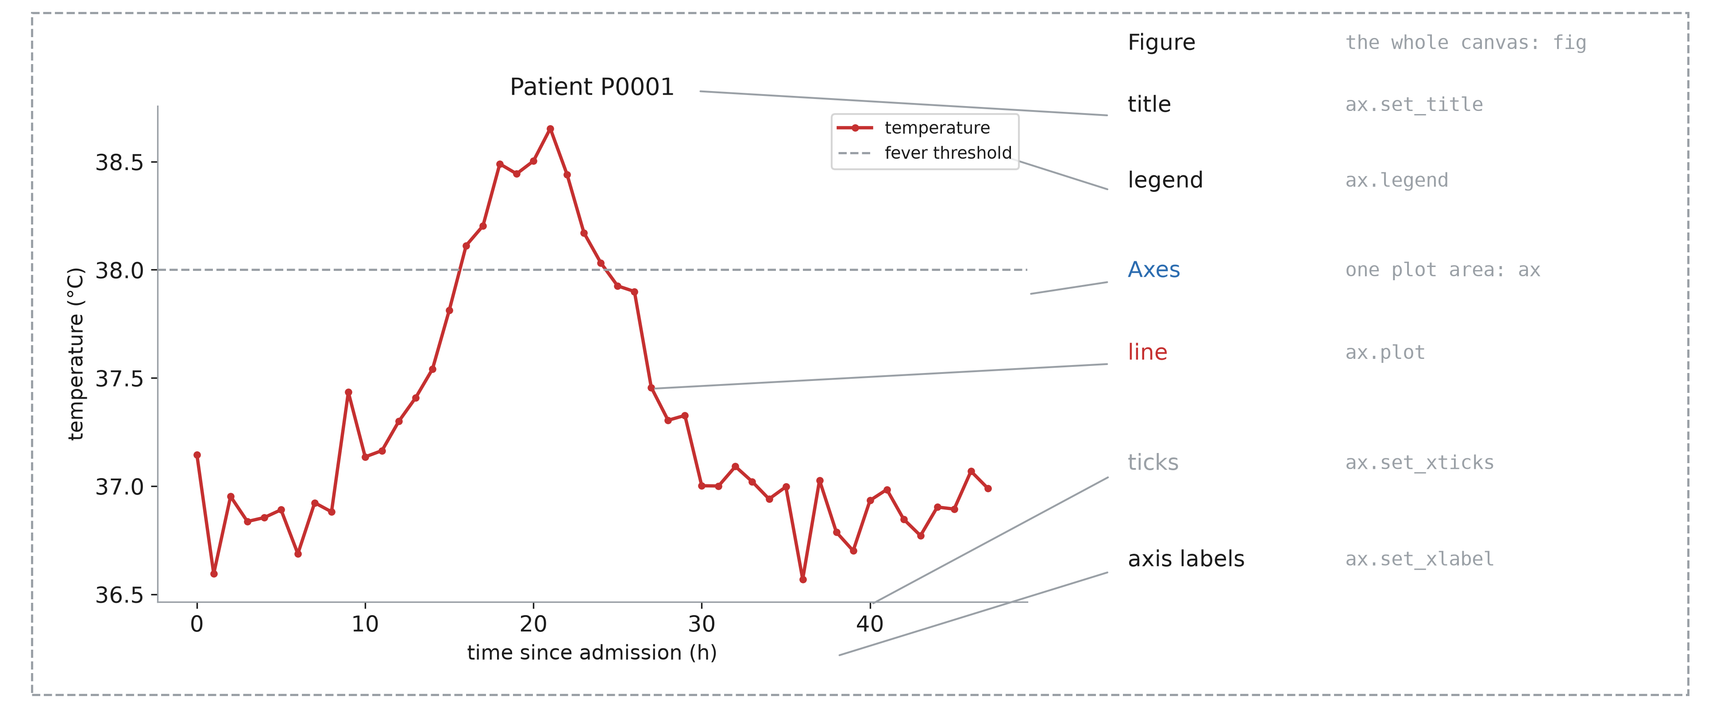
Anatomy of a figure
Notes:
Matplotlib vocabulary, which every error message and every Stack Overflow answer uses. The Figure is the canvas: the file you save. An Axes (with an e, plural Axes) is one plot area with its own coordinates: a figure can hold several. Everything else (line, title, labels, ticks, legend) belongs to one Axes, and is set by a method of that Axes. Do not confuse Axes (the plot area) with axis (the x or y ruler of an Axes).

Slide 12
First figure
import matplotlib.pyplot as plt
fig, ax = plt.subplots()
ax.plot(t, temp, label="temperature")
ax.axhline(38, ls="--", label="fever")
ax.set_xlabel("time (h)")
ax.set_ylabel("temperature (°C)")
ax.set_title("Patient P0001")
ax.legend()
fig.savefig("temp.png", dpi=200)
Notes:
The pattern of every figure in this course: create the figure and its axes, draw on the axes, label the axes, save the figure. plt.subplots() returns two things, unpacked into fig and ax (tuple unpacking, from Session 1). You will also see the short style plt.plot(...), plt.xlabel(...): it draws on “the current axes”. It is fine for a quick look, but as soon as there are two plots it becomes ambiguous. Use fig, ax everywhere and you never have to wonder. In a notebook the figure is displayed at the end of the cell; in a script, call plt.show() or just save it.

Slide 13
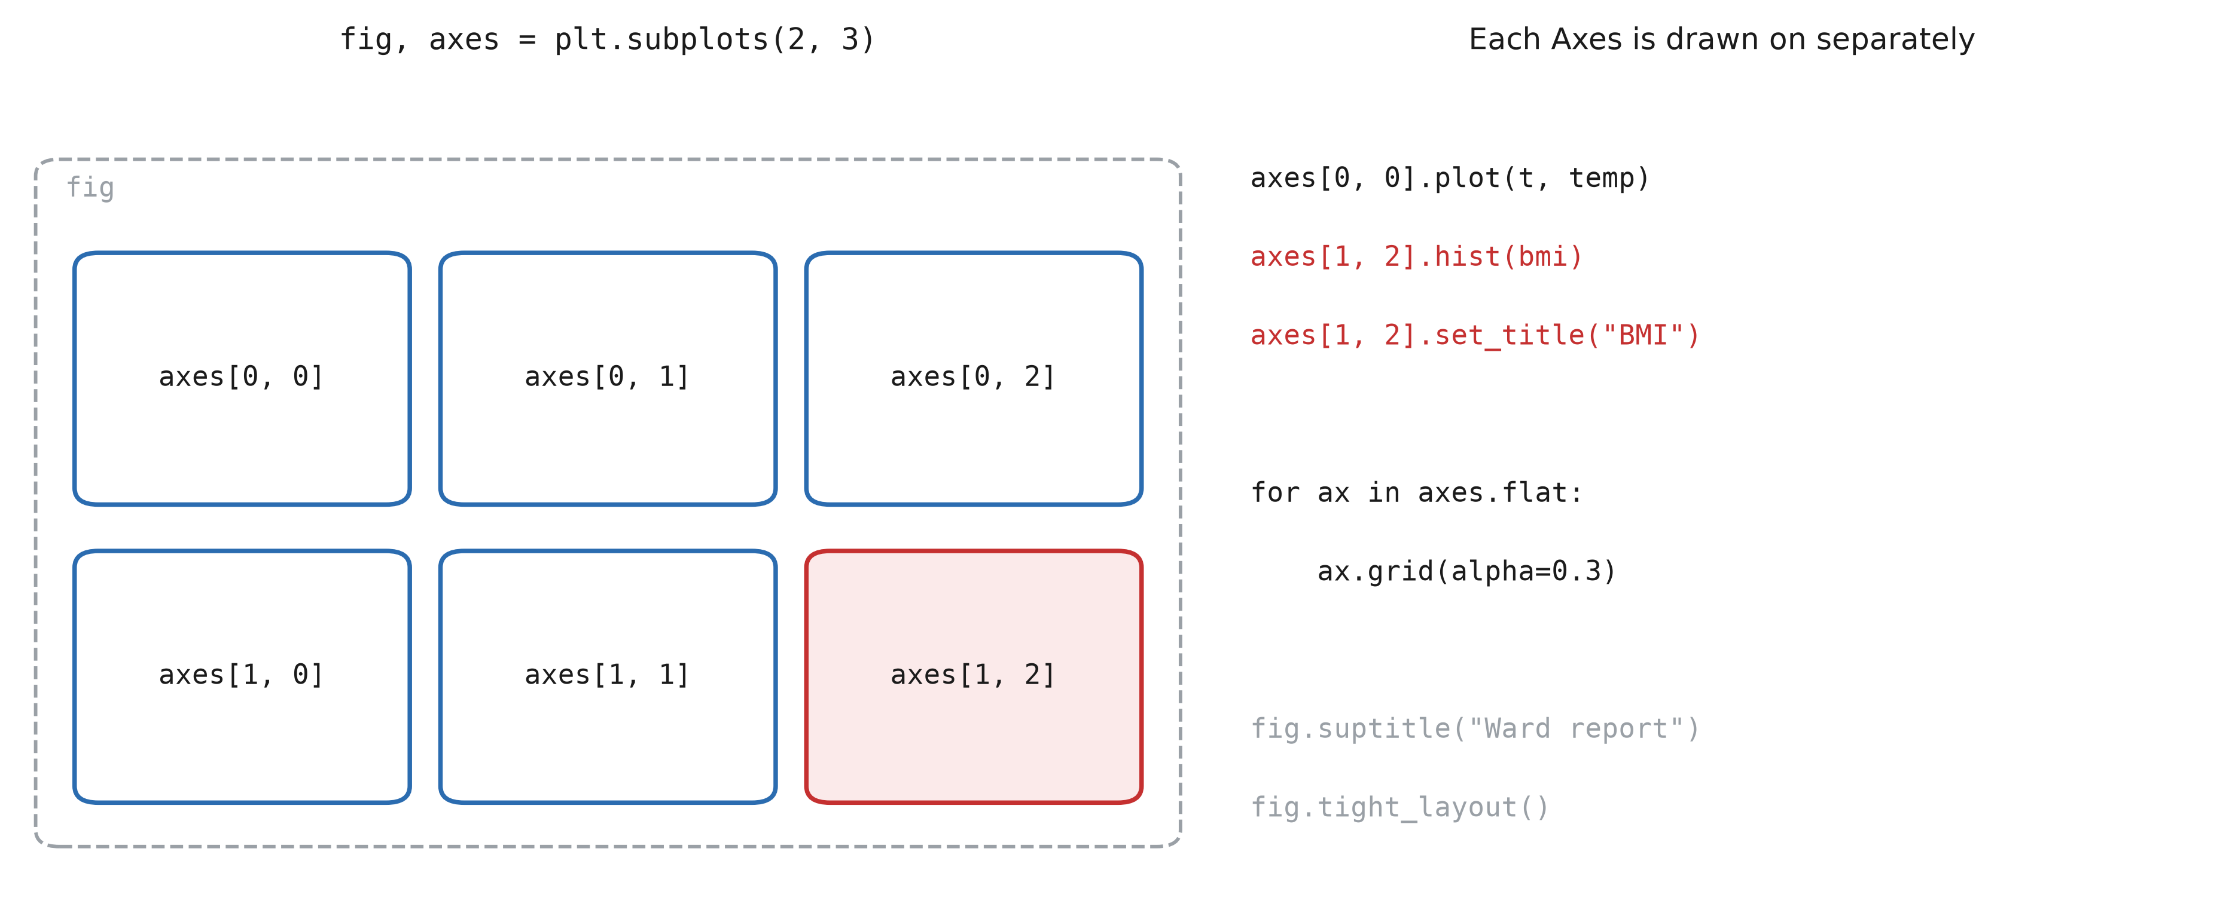
Several plots in one figure
Notes:
plt.subplots(2, 3) returns a numpy array of Axes, shape (2, 3), indexed exactly like the arrays of Session 1: axes[1, 2] is the bottom right one. With a single row or column the array is 1D: axes[0], axes[1]. axes.flat iterates over all of them, to apply the same setting everywhere. sharex=True gives all plots the same x axis (essential for vitals over time). fig.tight_layout() fixes overlapping labels: call it just before saving.

Slide 14
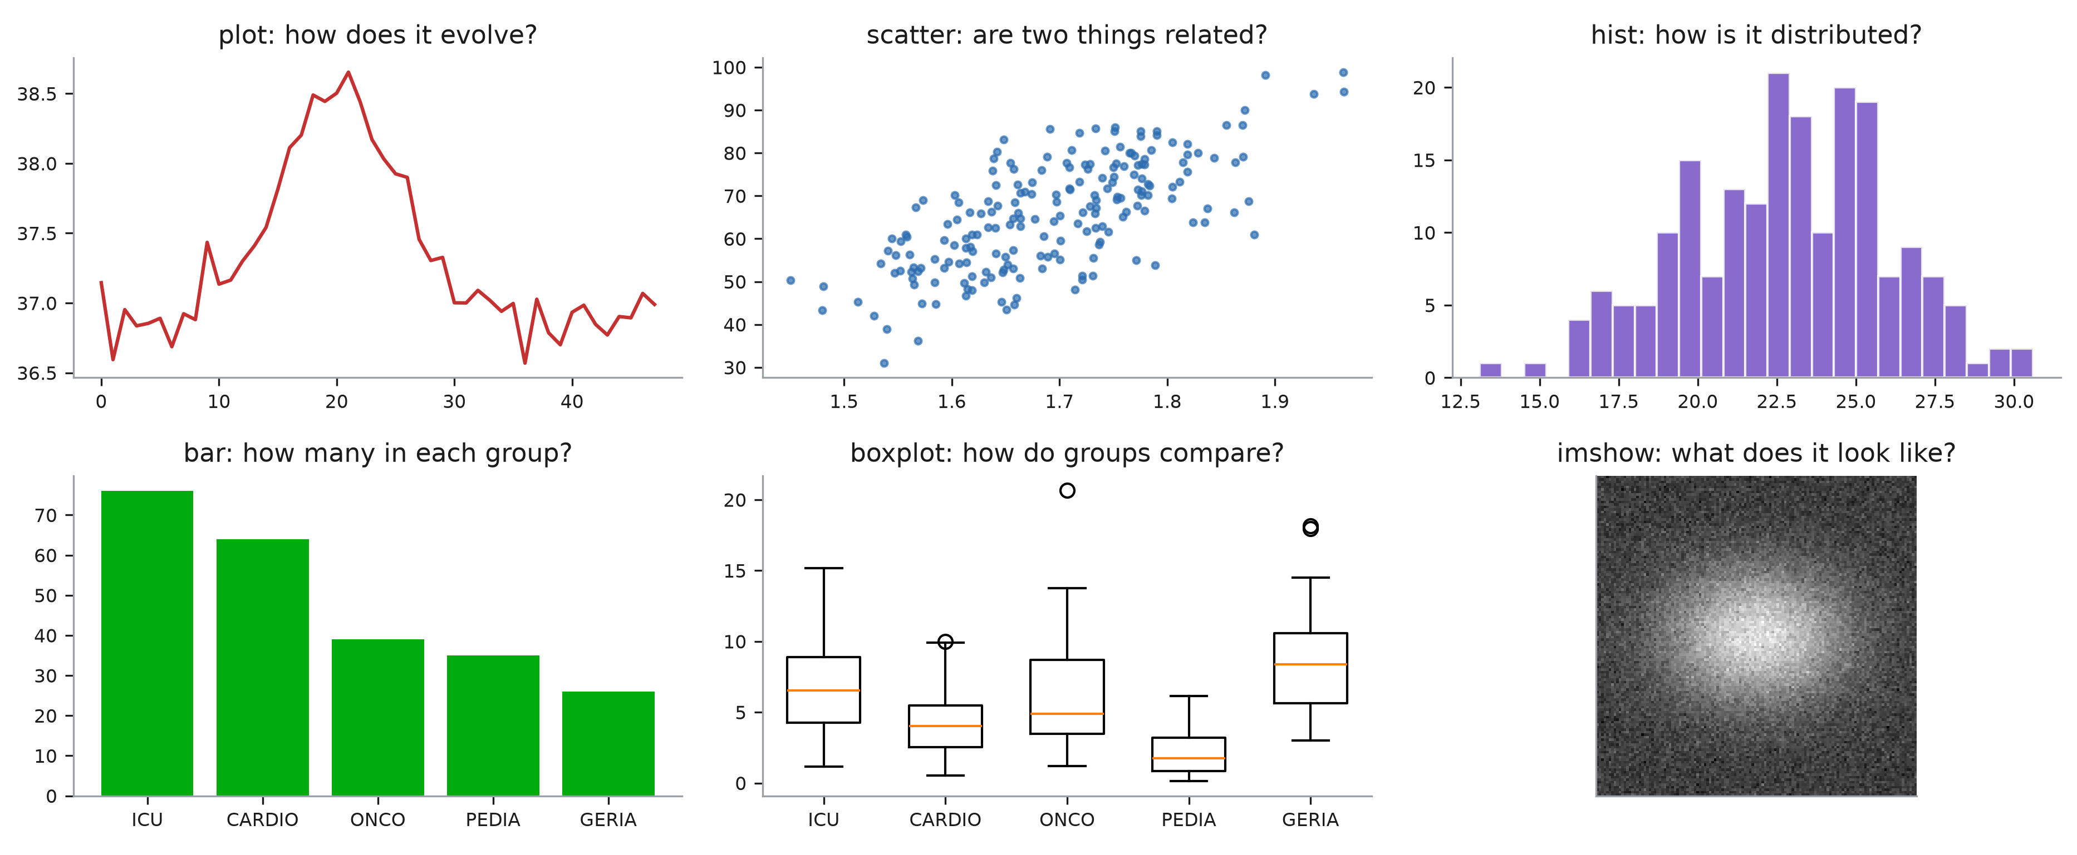
Which plot?
Notes:
Choose the plot from the question, not from the data. How does a value evolve: plot, a line, x is time. Are two measurements related: scatter, one point per patient. How is one measurement distributed: hist. How many patients in each group: bar. How does a measurement compare between groups: boxplot. What does a 2D array look like: imshow. Every one of them is a method of ax, and every one takes numpy arrays.

Slide 15
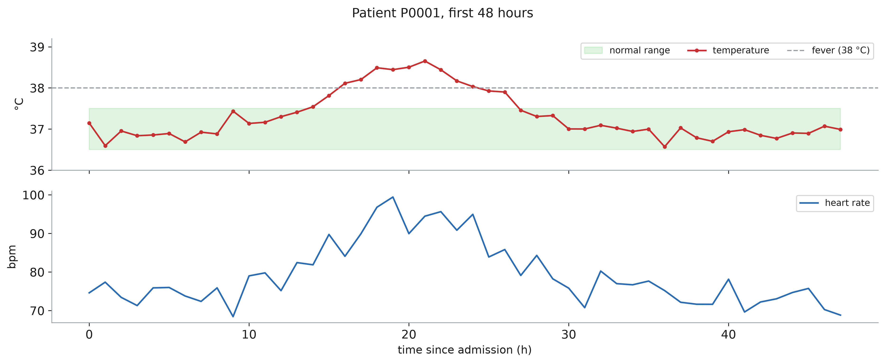
Line plots: evolution
Notes:
Lines are for ordered x values: time, dose, age. If the x values are not ordered (patients), a line between them means nothing: use a scatter. Two measurements with different units get two Axes sharing x, not one Axes with two scales mixed. marker shows where the actual measurements are: with one value per hour, the line between two points is an interpolation, not data. ax.axhline(38) and ax.fill_between(t, 36.5, 37.5, alpha=0.15) put the clinical reference (threshold, normal range) on the plot, so the reader does not have to remember it.

Slide 16
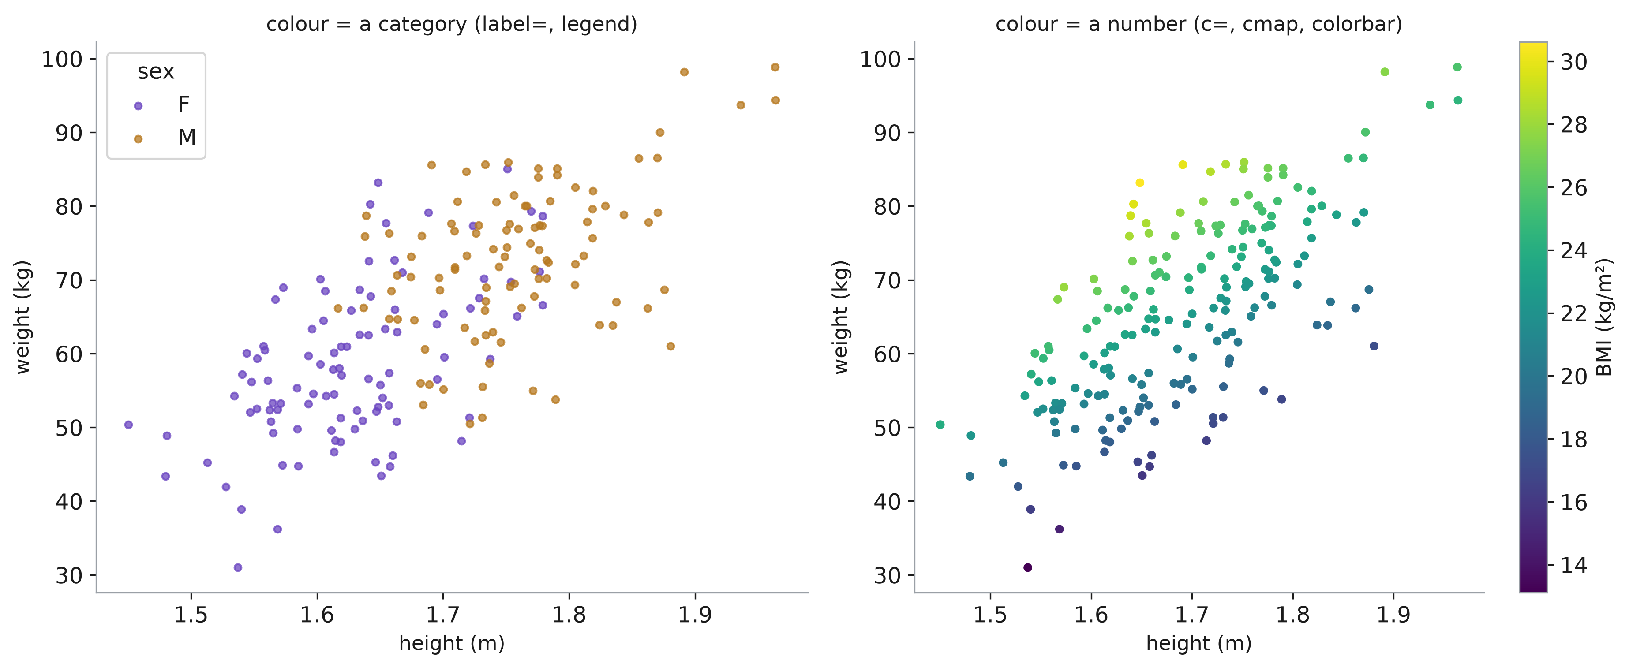
Scatter plots: relations
Notes:
One point per patient, two measurements as coordinates. A third variable can go in the colour. A category: one scatter call per group, each with a label, and ax.legend(). A number: c=values with a colour map, and fig.colorbar to read it back. With thousands of points, reduce s (size) and add alpha (transparency) so that dense regions become visible instead of a solid blob.

Slide 17
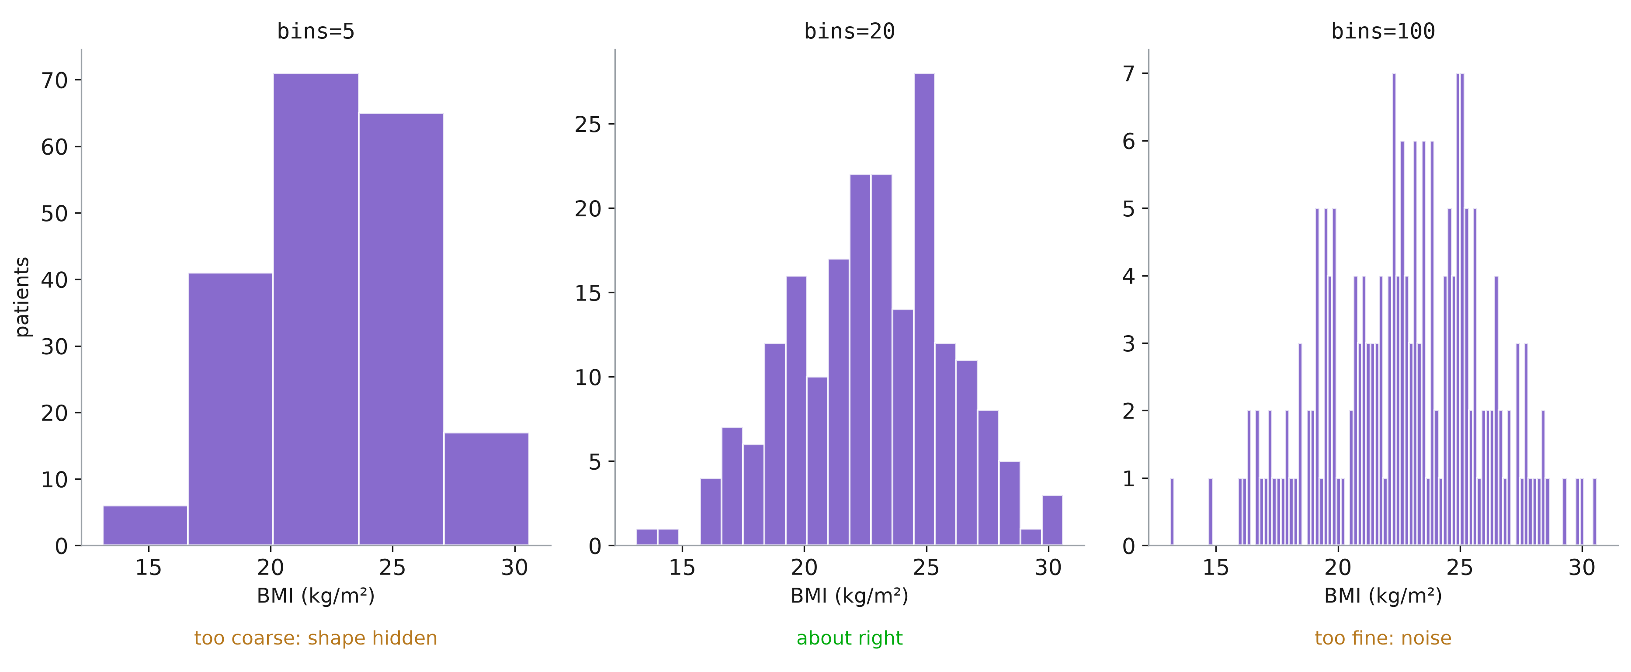
Histograms: distributions
Notes:
A histogram counts values in bins. The number of bins changes the story: too few hide the shape, too many show only noise. Try several, and say which one you kept. bins also accepts the edges themselves, e.g. bins=np.arange(10, 45, 1): one bar per BMI unit, comparable between figures. density=True divides by the total, to compare groups of different sizes.

Slide 18
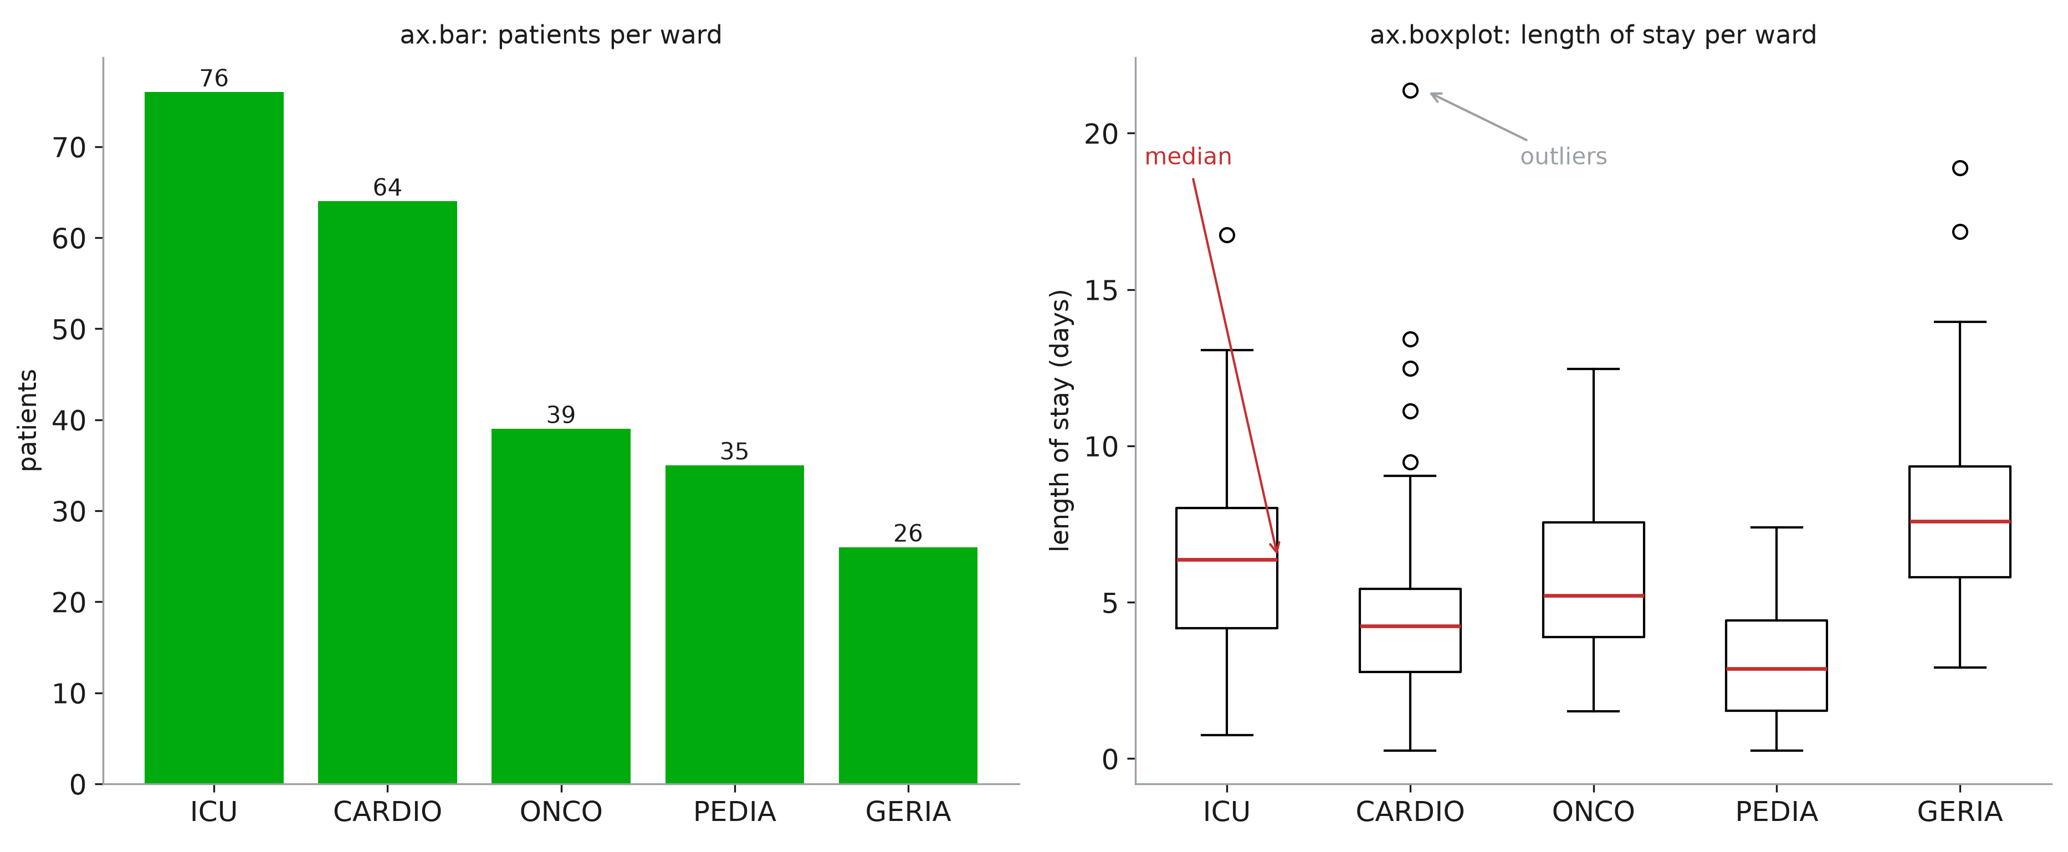
Bars and boxes: groups
Notes:
A bar is for a count or a total per group: its height is the information, so the y axis must start at 0. To compare a measurement between groups, a bar of the mean hides everything; a boxplot shows the median (line), the middle 50 % (box), the range (whiskers) and the outliers (circles). Length of stay is the classic skewed variable: most stays are short, a few are very long. The mean would be pulled up by them; the boxplot shows it at once.

Slide 19
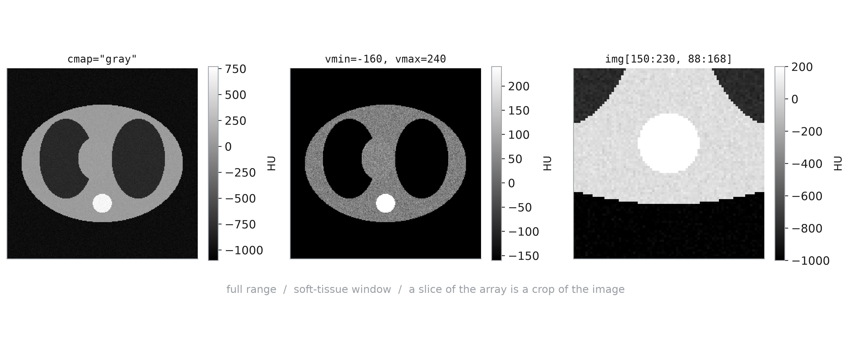
Images: 2D arrays
Notes:
imshow turns each value of a 2D array into a pixel, through a colour map. A CT slice is just a numpy array of Hounsfield units: -1000 is air, 0 water, about 40 soft tissue, several hundred for bone. vmin and vmax choose which values span the colour map: this is the “window” radiologists change all day. The same array shows lungs or soft tissue depending on the window. Slicing the array crops the image: everything from Session 1 applies to images. Always add a colorbar with the unit: without it, the grey levels mean nothing.

Slide 20
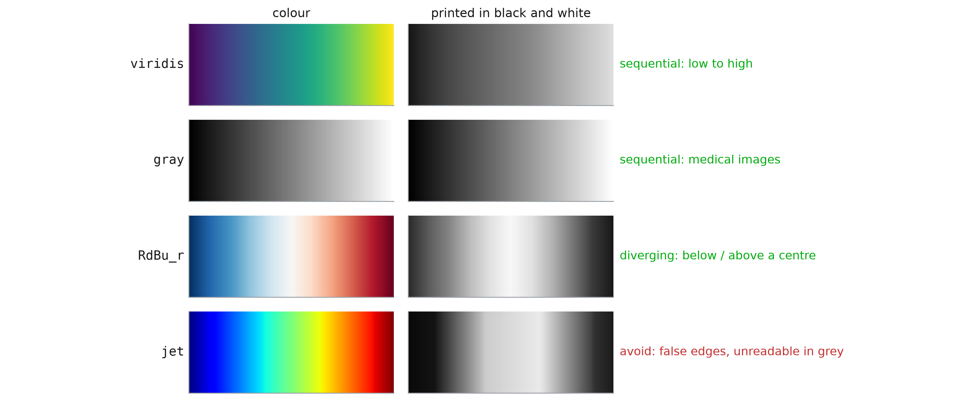
Colour maps
Notes:
A colour map encodes a number; the eye must read it as a number. Sequential maps (viridis, the default, or gray) go from dark to light: brightness increases with the value, even printed in black and white, and for colour-blind readers (about 1 man in 12). Diverging maps (RdBu) are for data with a meaningful centre: change from baseline, correlation. Set vmin=-v, vmax=v so that the centre is white. jet (rainbow) creates bands that are not in the data, and its brightness goes up and down: it is still in many medical software packages, and it should not be in your figures.

Slide 21
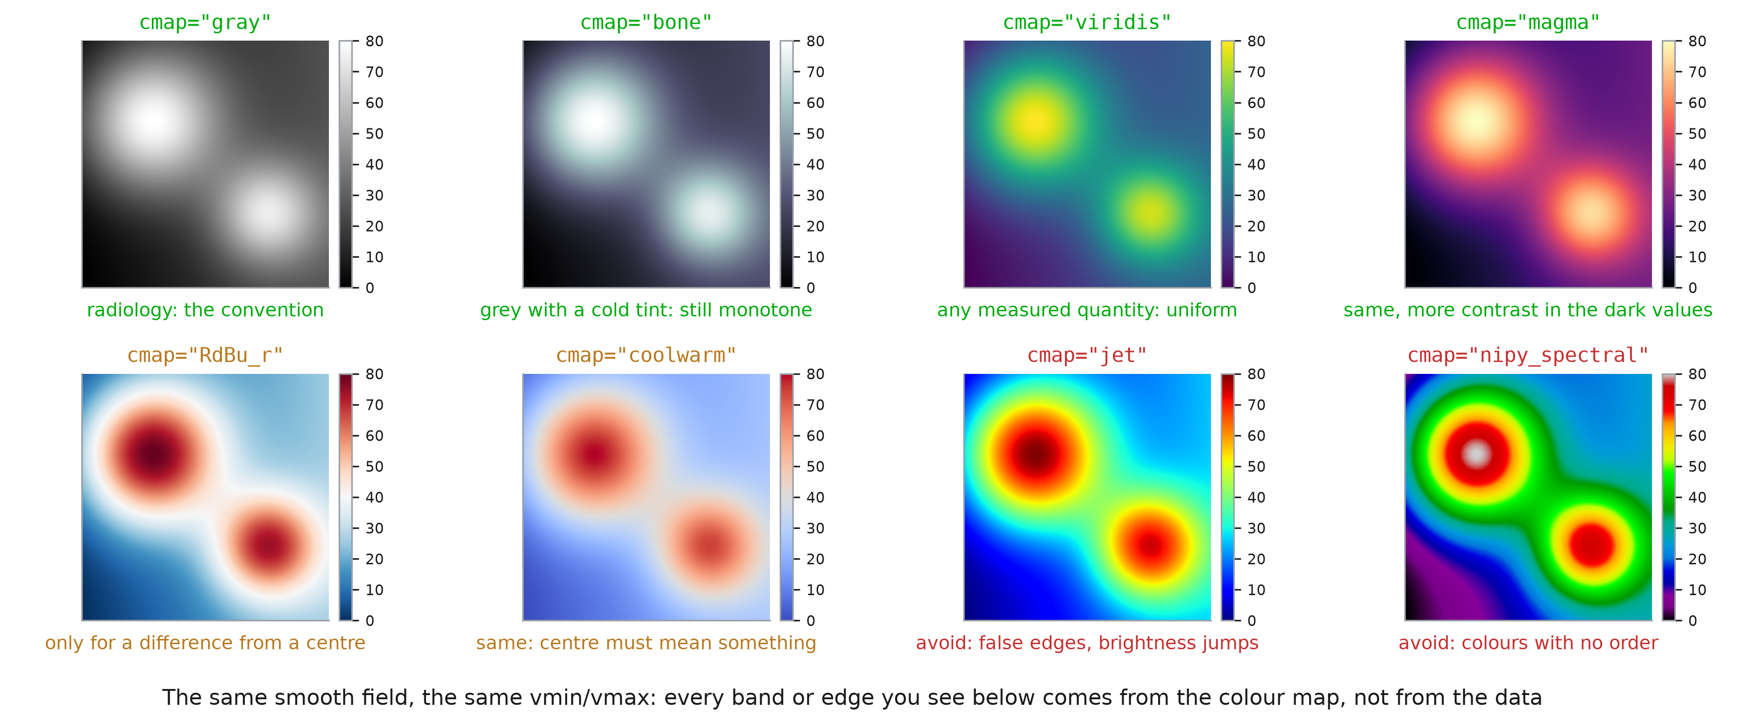
Colour maps
Notes:
One smooth field (think a perfusion map, mL/100 g/min), one window (vmin=0, vmax=80): everything that changes between these eight panels is the colour map, and so is everything the reader sees. The data has no edge anywhere; every ring and every band below was added by the colour map. gray is the convention for CT, MRI and X-ray: radiologists read grey levels, and a colourful slice looks wrong to them. bone is the same idea with a cold tint. viridis and magma are the default choices for a measured quantity (perfusion, dose, activation, a correlation matrix): brightness increases with the value, so they survive printing in black and white and colour blindness. RdBu_r and coolwarm are for a difference: post minus pre, patient minus atlas, a correlation. They need vmin=-v, vmax=v so the white is exactly 0. On raw data, where no value is special, they invent a centre that does not exist, which is what you see here. jet and nipy_spectral put bands and bright spots where the data is smooth. They are still the default in a lot of medical software; change them. Rule of thumb: one quantity going up, sequential (gray, viridis); a signed difference, diverging centred on 0; categories (segmentation labels), a qualitative map such as tab10 with imshow and no colorbar.

Slide 22
Saving
fig.tight_layout()
fig.savefig("fig1.png", dpi=300)
fig.savefig("fig1.pdf")
fig.savefig("fig1.svg")
plt.close(fig) # in loops
Notes:
The format is chosen by the extension. PNG is an image: choose a dpi high enough for the final size (300 for print). PDF and SVG are vector formats: lines and text stay sharp at any zoom, and journals ask for them. Save from code, never with a screenshot: the figure is then reproducible, and regenerating it after a data correction is one command. In a loop that makes a figure per patient, plt.close(fig) frees the memory; otherwise matplotlib keeps them all and warns after 20.

